Slide 1


Slide 2
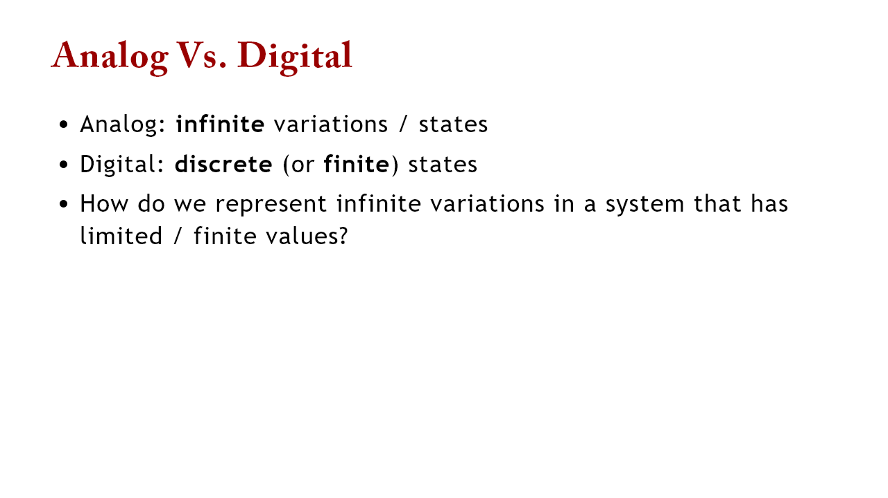

Slide 3
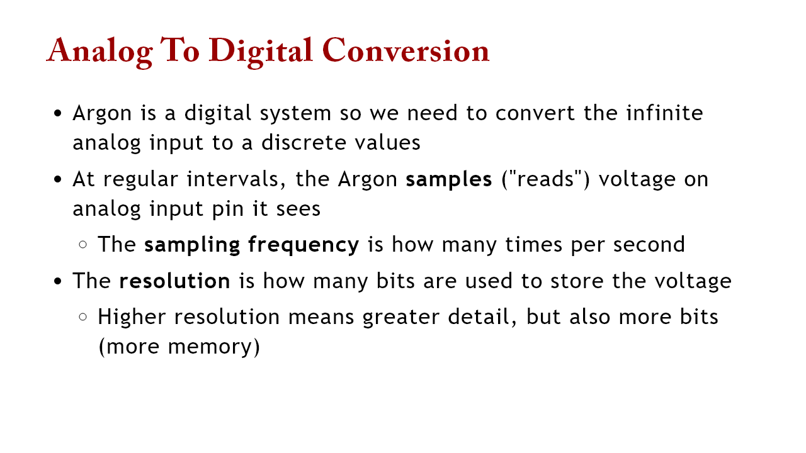

Slide 4
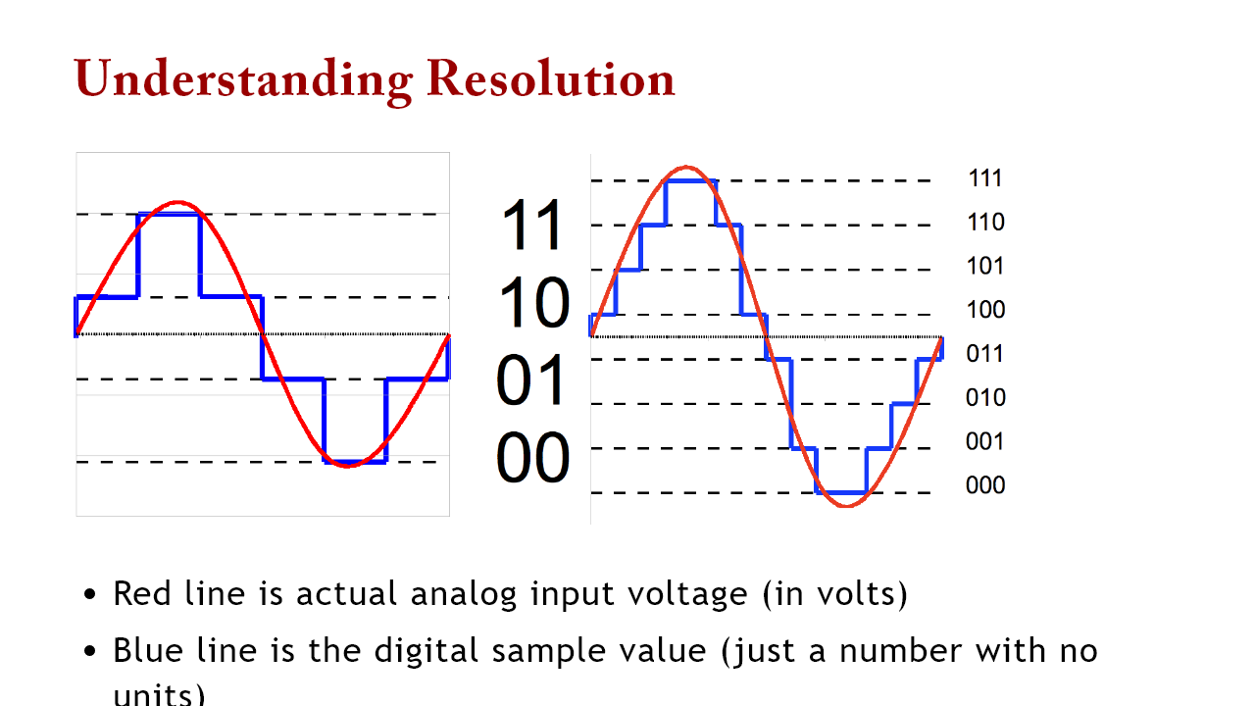
Notes:
red line is the analog input; blue line is the sampling left: 2 bit resolution; 2^2 = 4 buckets right: 3 bit resolution; 2^3 = 8 buckets

Slide 5
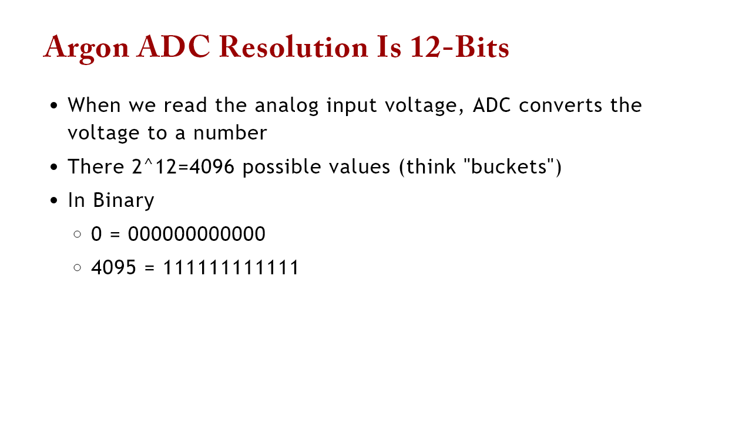

Slide 6
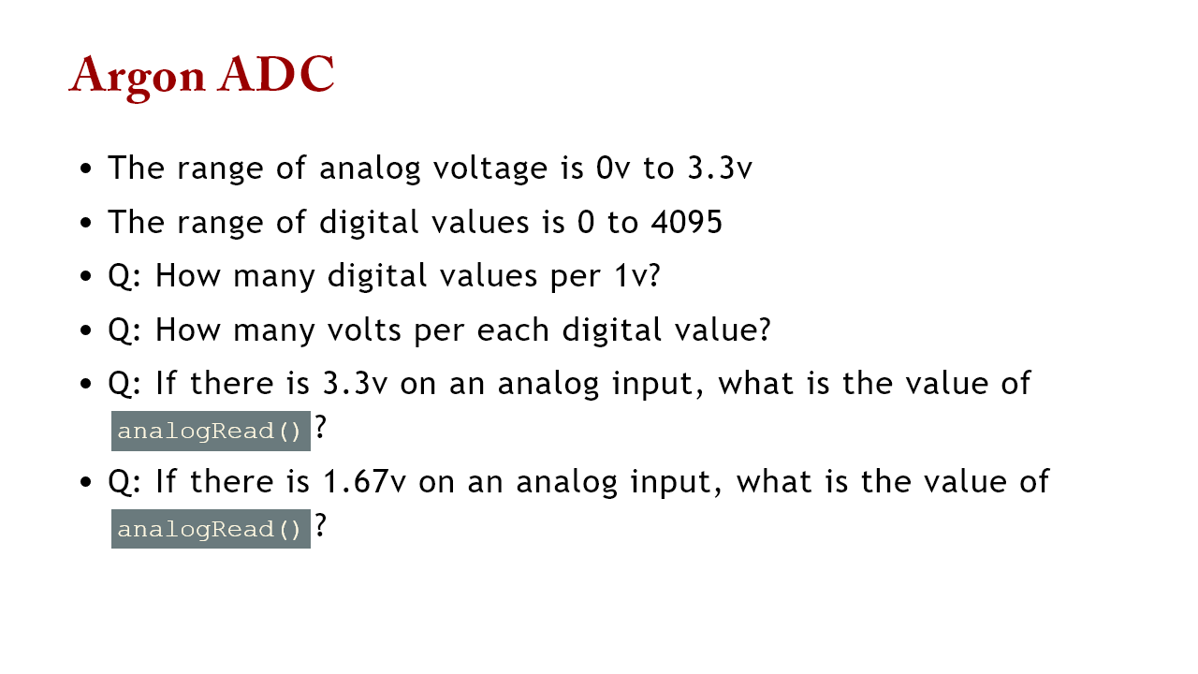
Notes:
3.3v = 4095 so 1v spans 1240 units or 1 unit = 4095/3.3 -> so 1 unit is 0.8 mV 1.67v is 2047

Slide 7
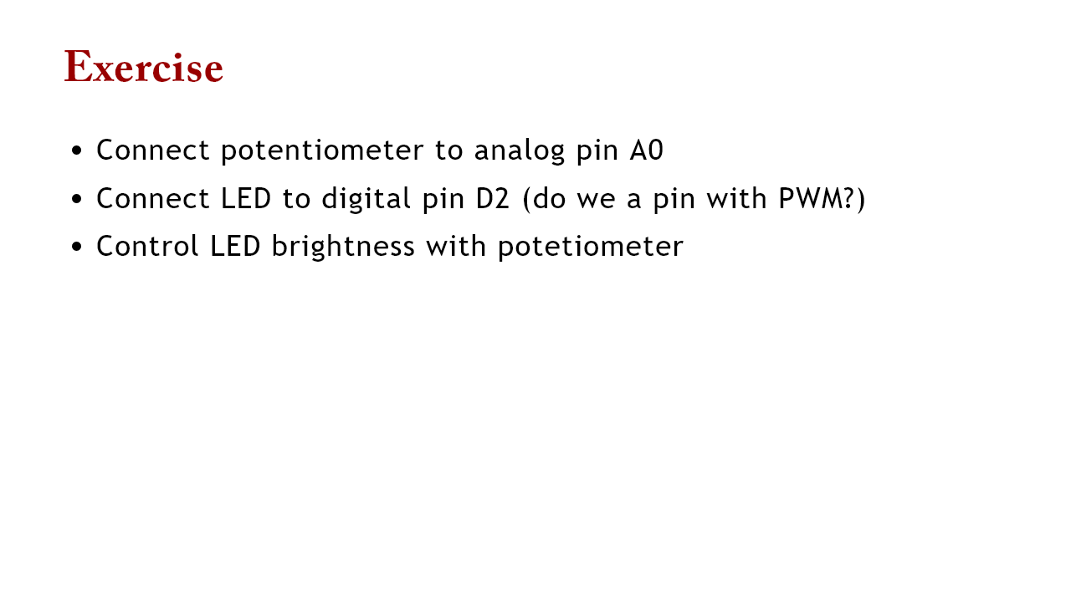

Slide 8


