Slide 1
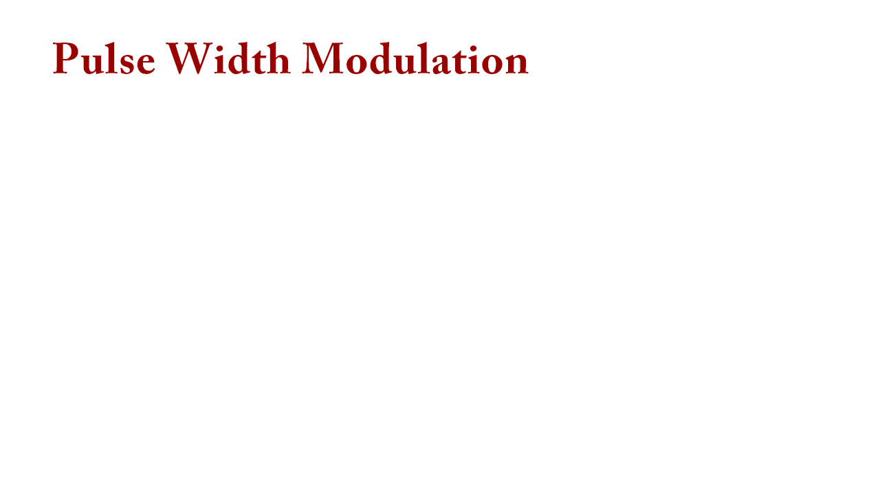

Slide 2
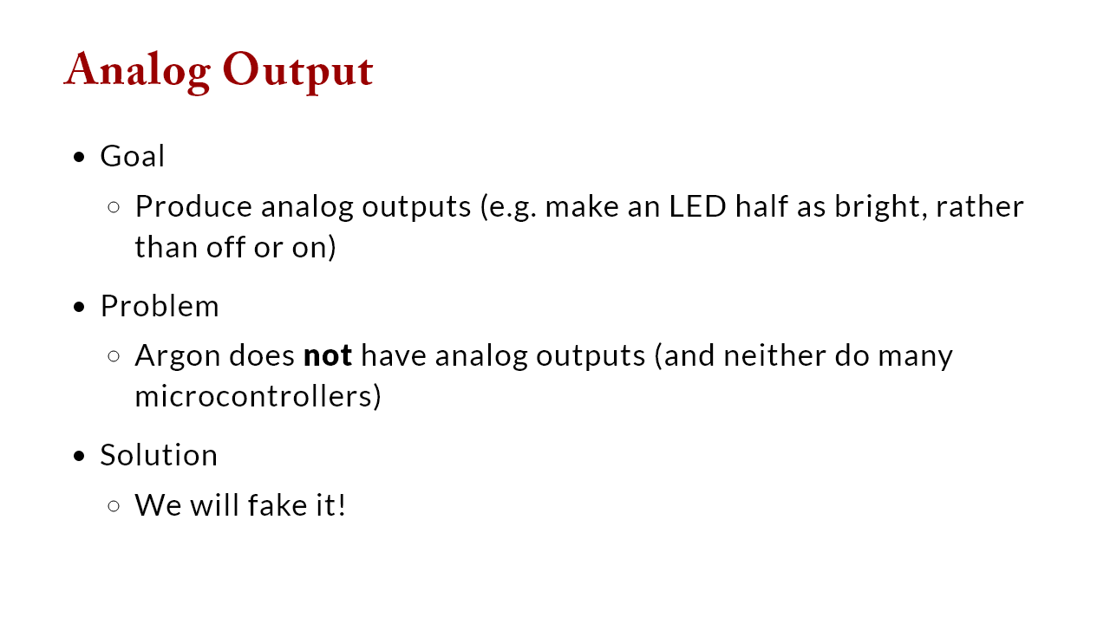

Slide 3
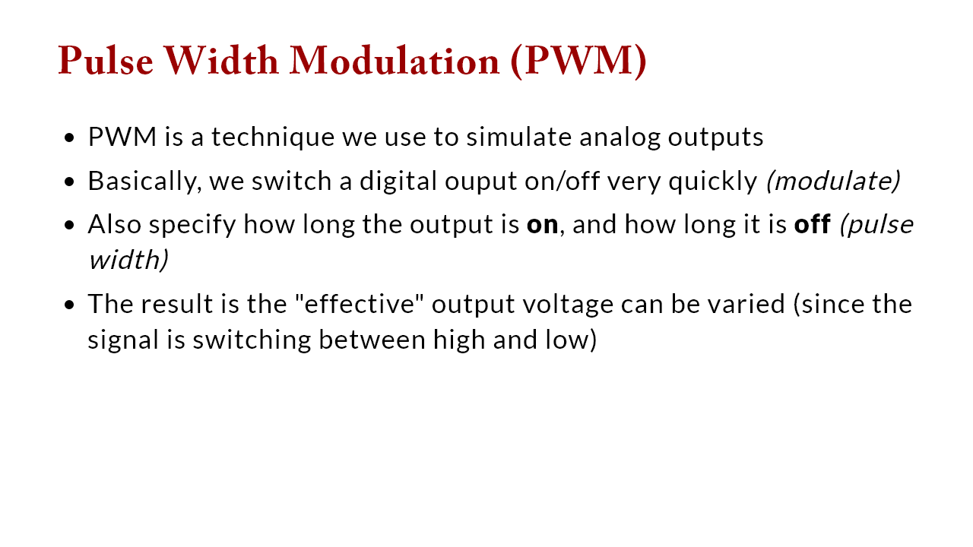

Slide 4
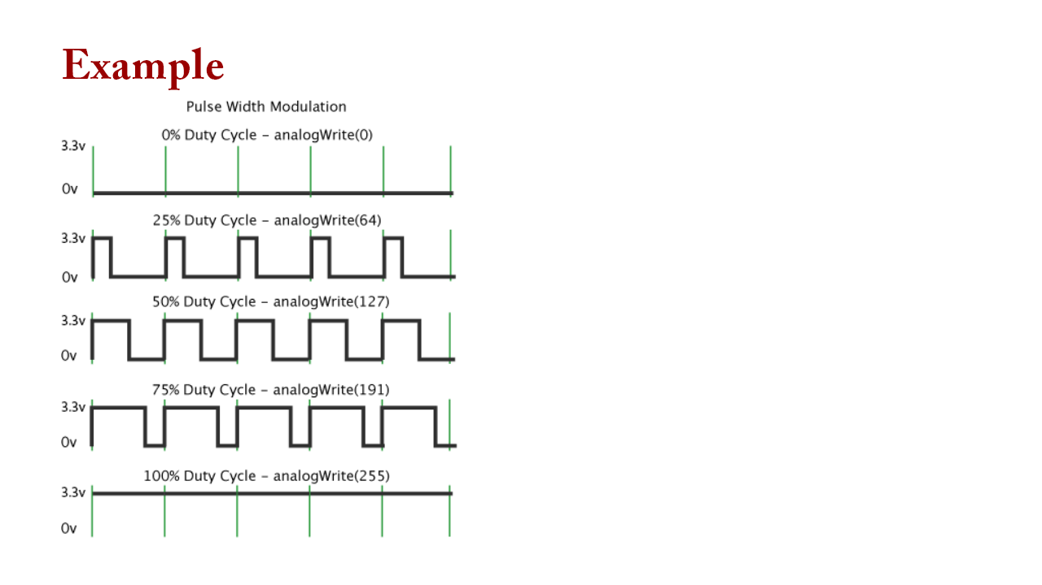
Notes:
Point out: 0v and 5v (3.3V for argon), different percentage duty cycles; ignore analogWrite for now

Slide 5
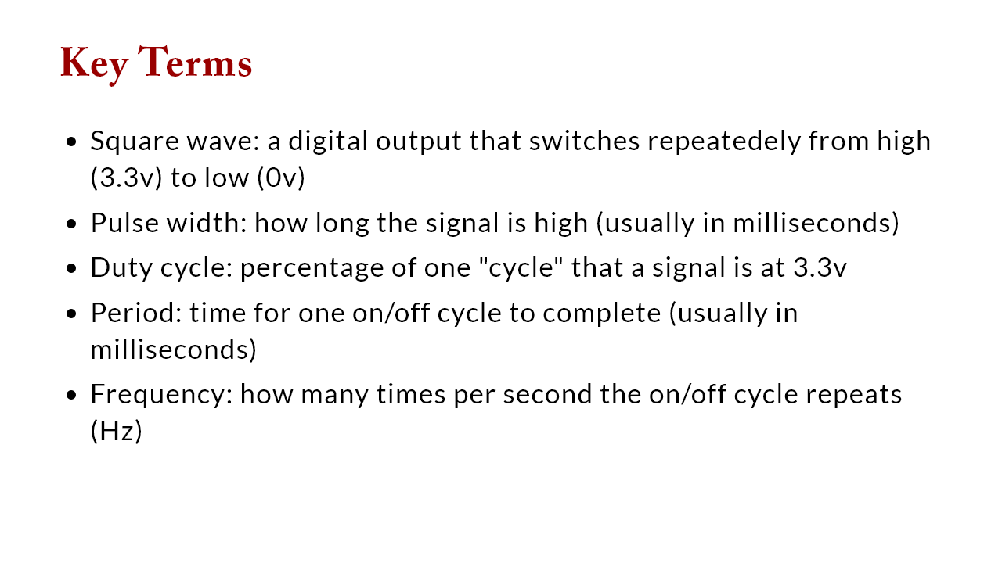

Slide 6
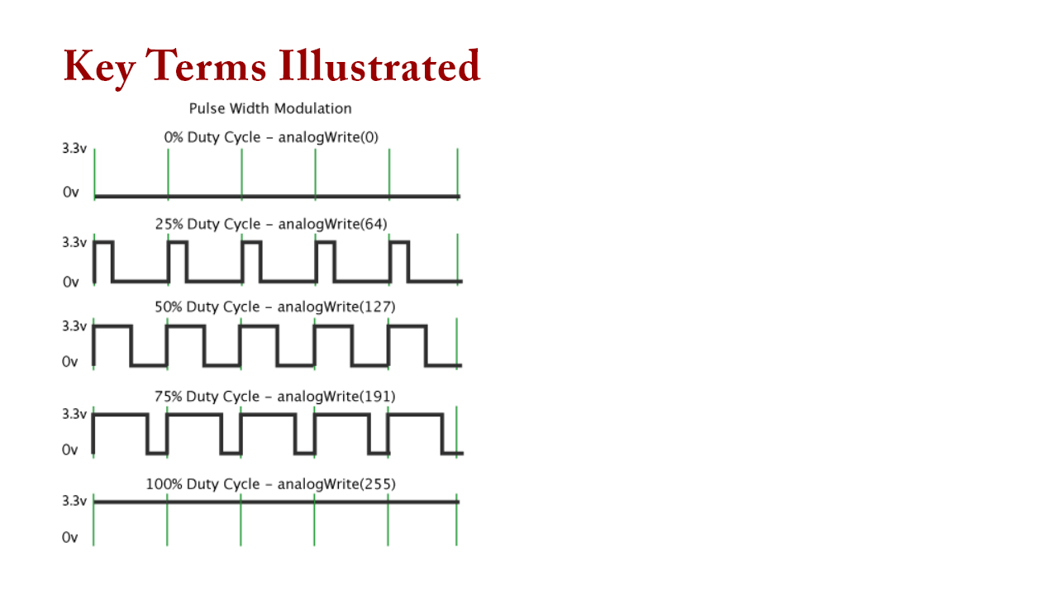
Notes:
point out * Square wave: a digital output that switches repeatedely from high (3.3v) to 0v * Pulse width: how long the signal is high (usually in milliseconds) * Duty cycle: percentage of time that a signal is at 3.3v * Period: time for one on/off cycle to complete (usually in milliseconds) * Frequency: how many times per second the on/off cycle repeats (Hz)

Slide 7
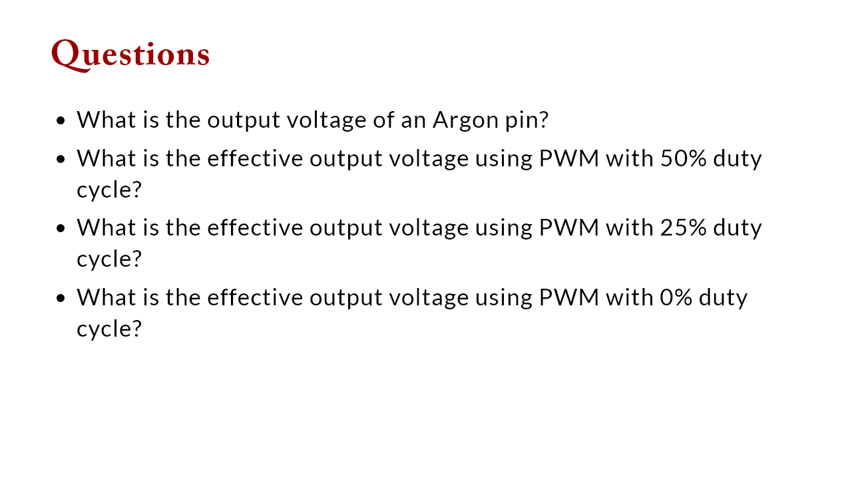

Slide 8
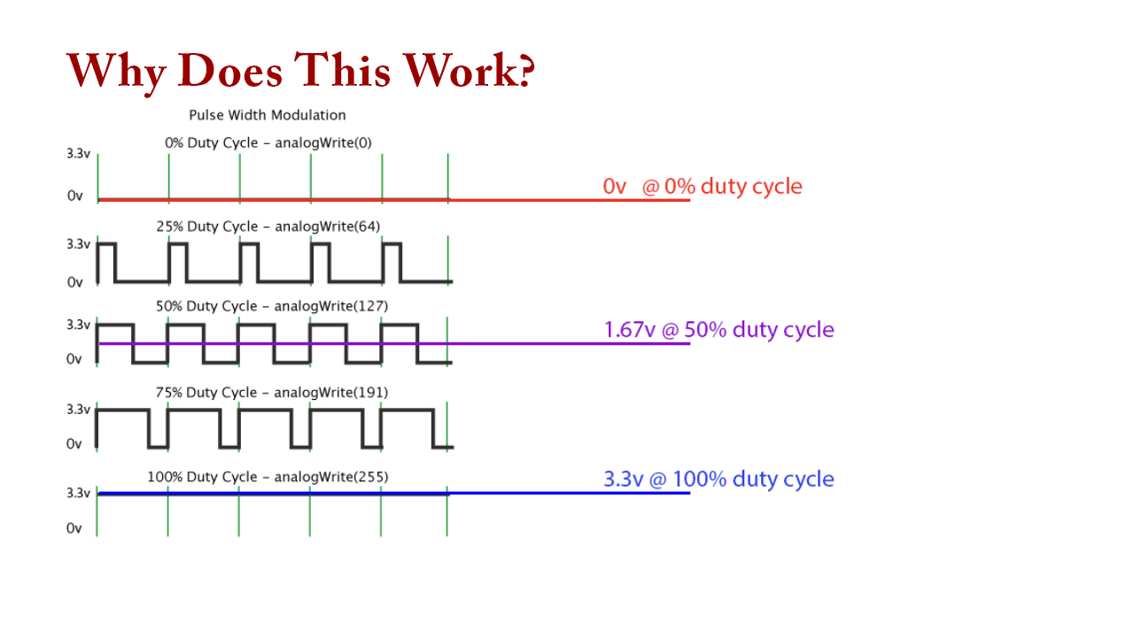
Notes:
The on/off switching happens very fast so the output device "perceives" the effect of an average (integration) of the output voltage

Slide 9
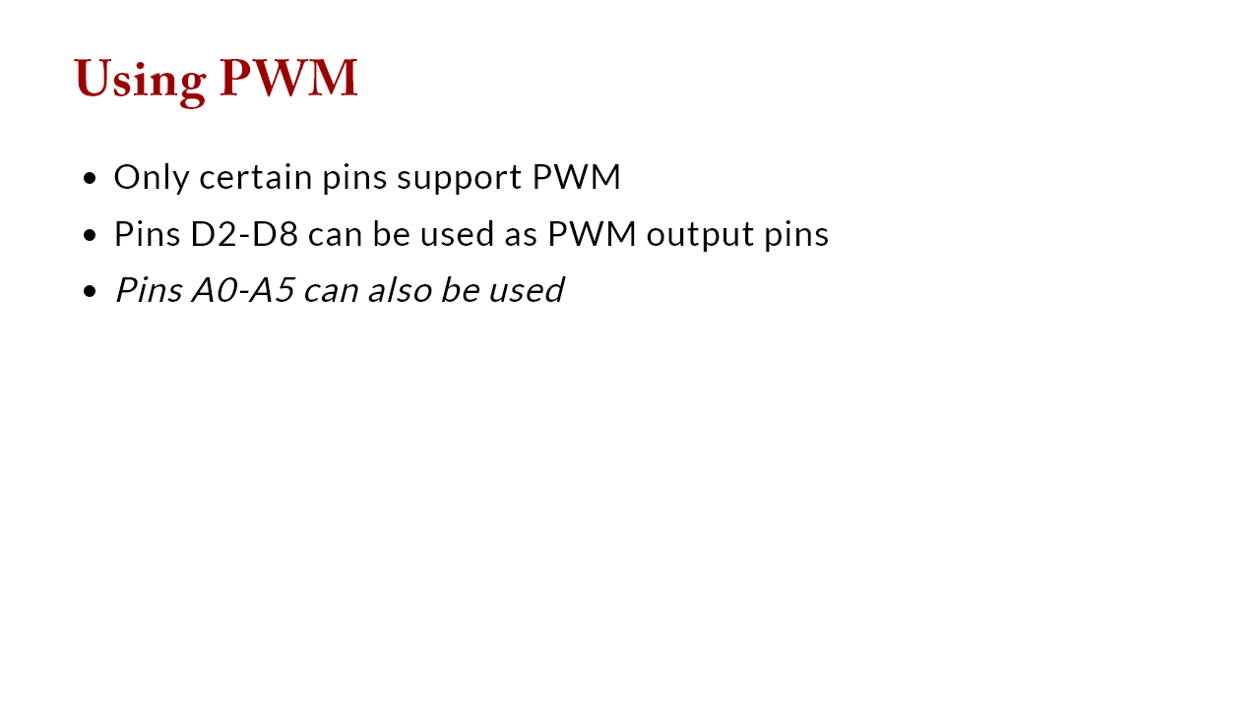

Slide 10
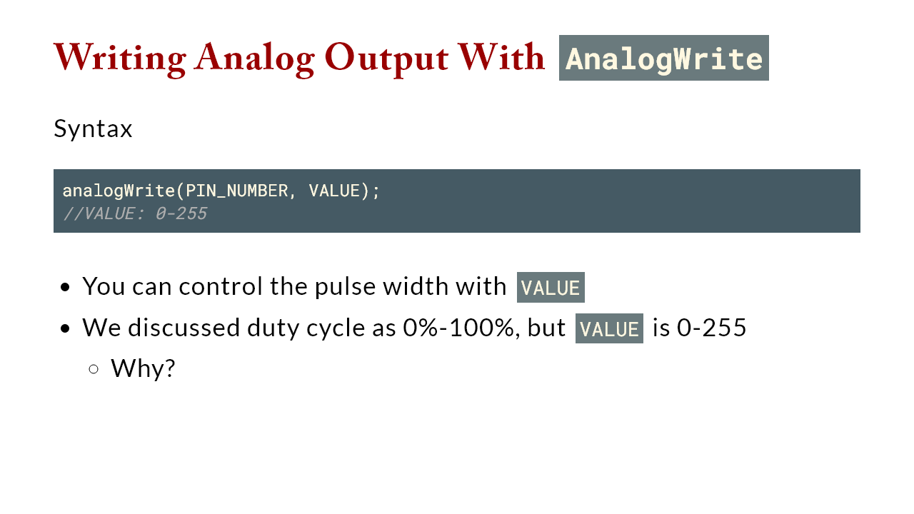
Notes:
we are using digital values to simulate analog values

Slide 11
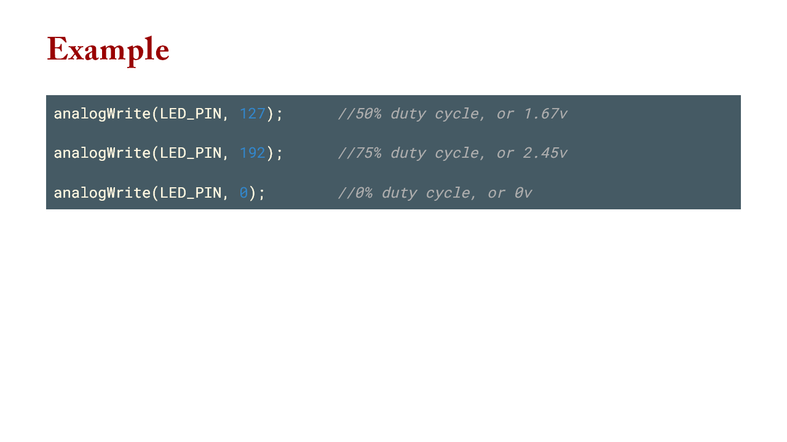

Slide 12


