Slide 1

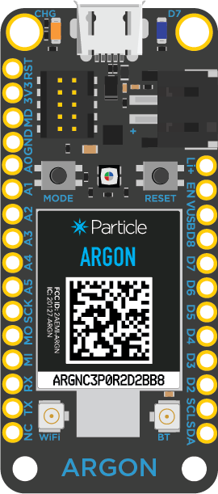
Initial State API
Argon
Particle Cloud

Slide 2
Send request via Particle.publish() to webhook
Initial State API
Argon
Particle Cloud

Slide 3
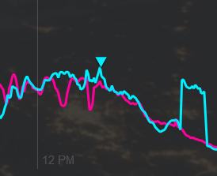
Send request via Particle.publish() to webhook
Particle webhook connects to API endpoint
Initial State API
Argon
Particle Cloud

