Slide 1


Slide 2
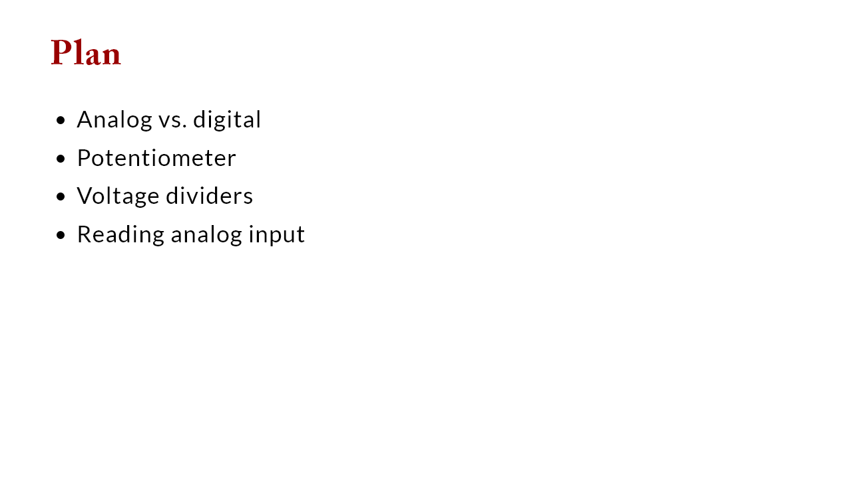

Slide 3
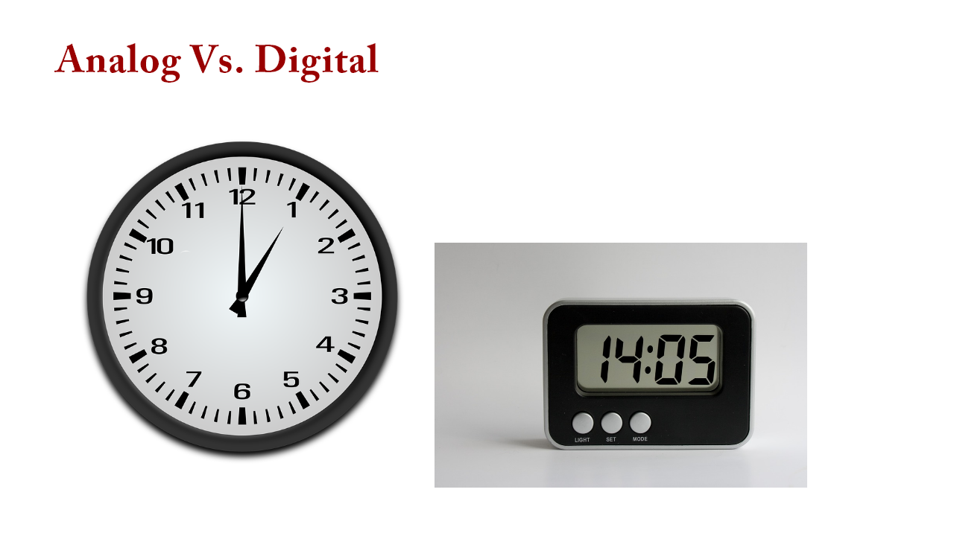

Slide 4
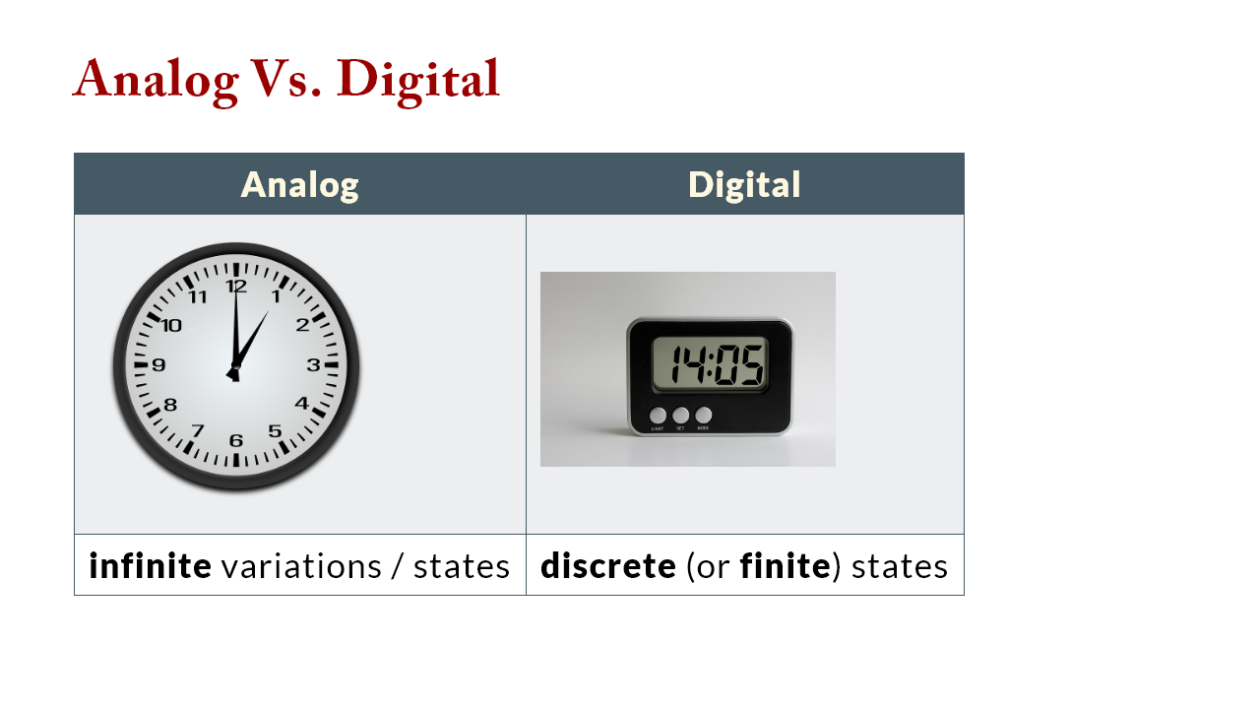

Slide 5
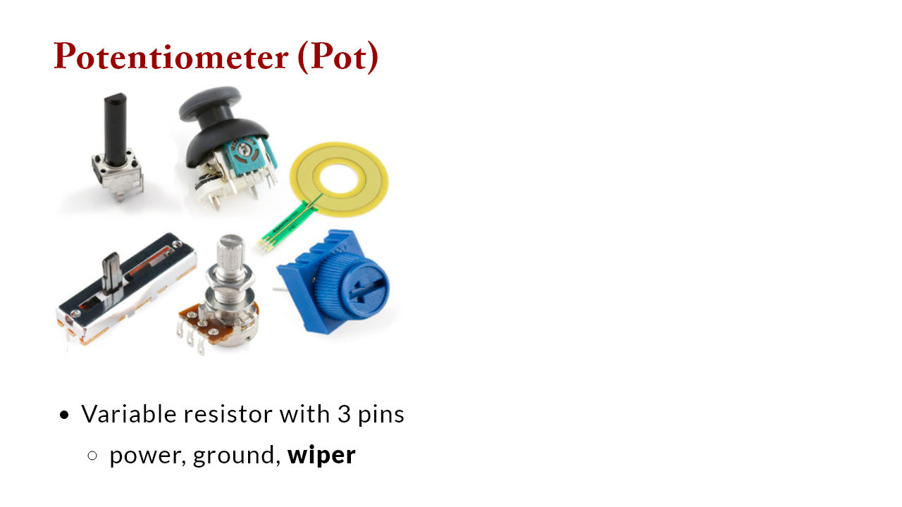

Slide 6
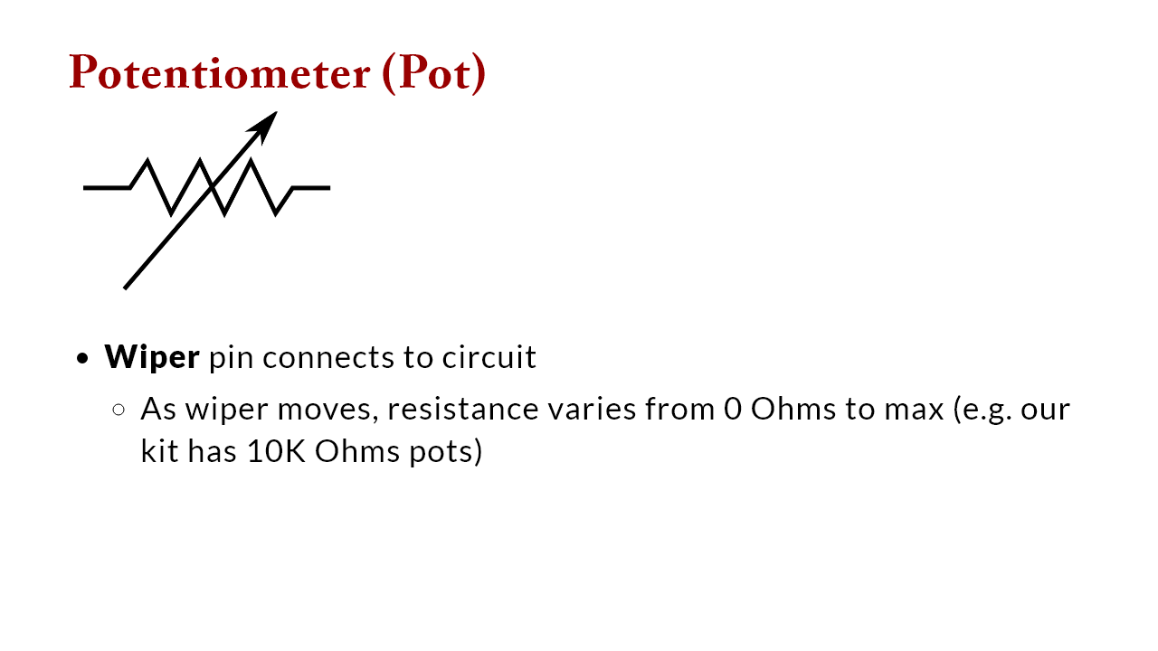

Slide 7


Slide 8
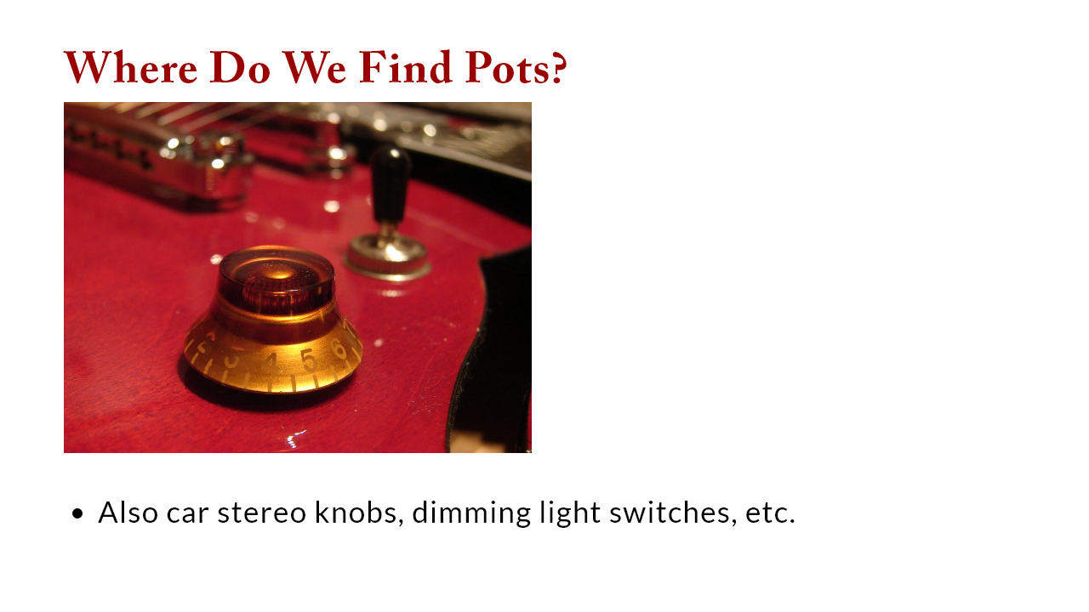

Slide 9
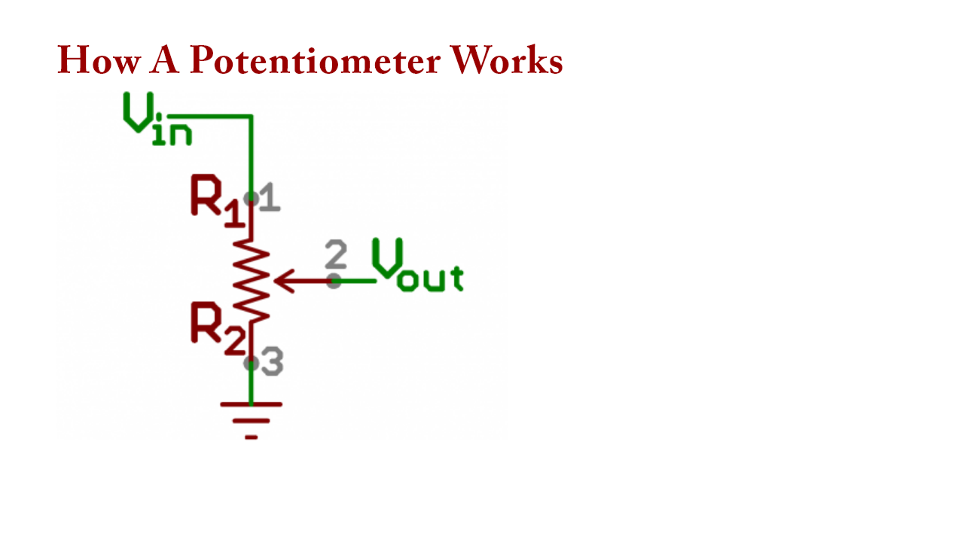

Slide 10
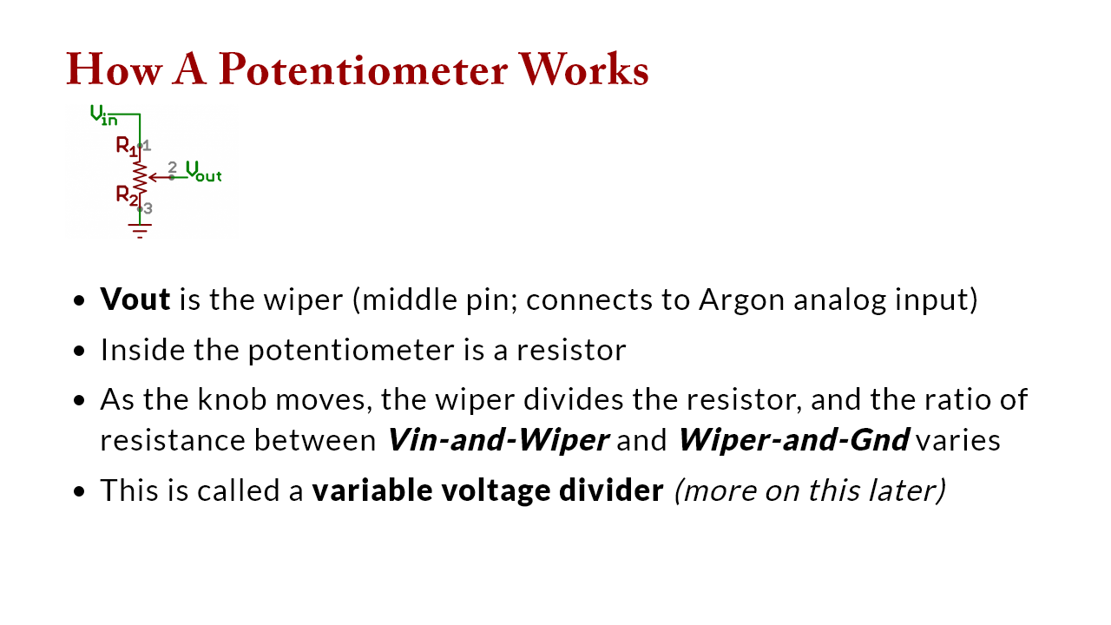

Slide 11
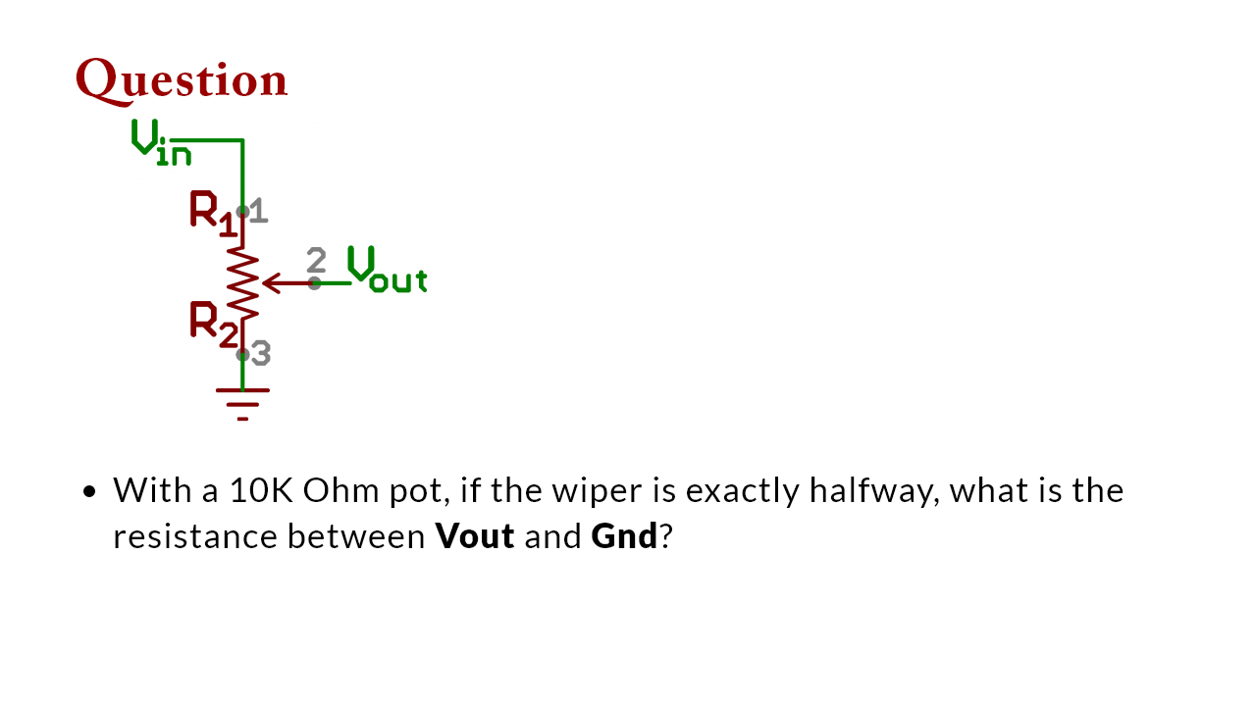
Notes:
middle: 5K Ohms; top: 10K ohms because it is the R between Vout and Gnd

Slide 12
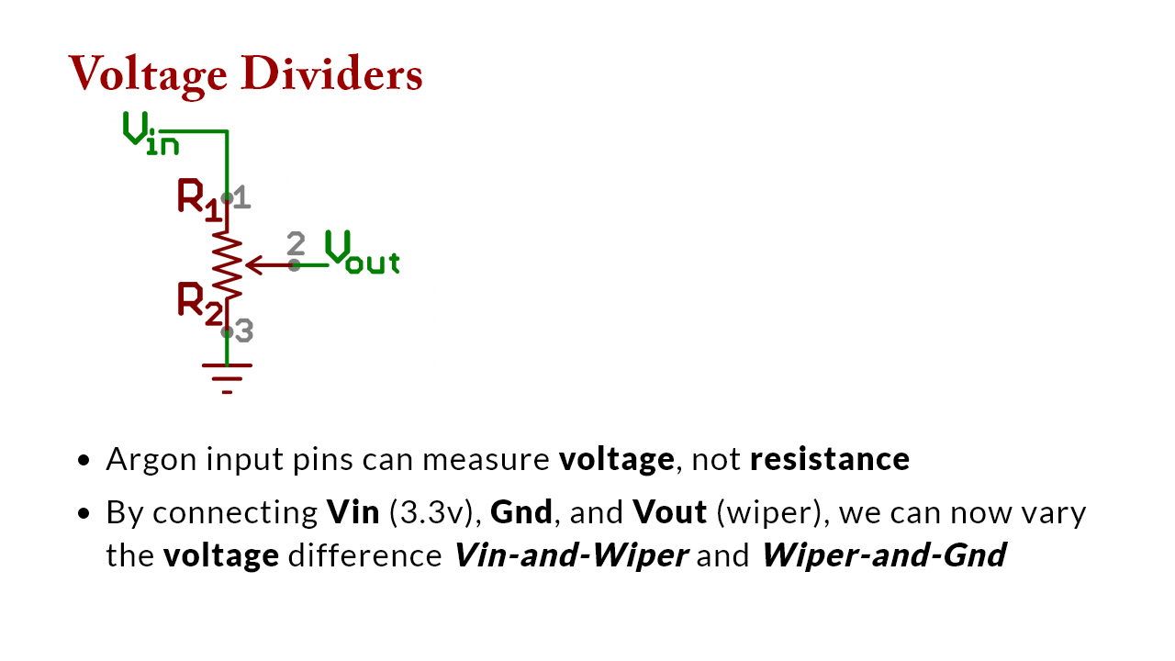

Slide 13
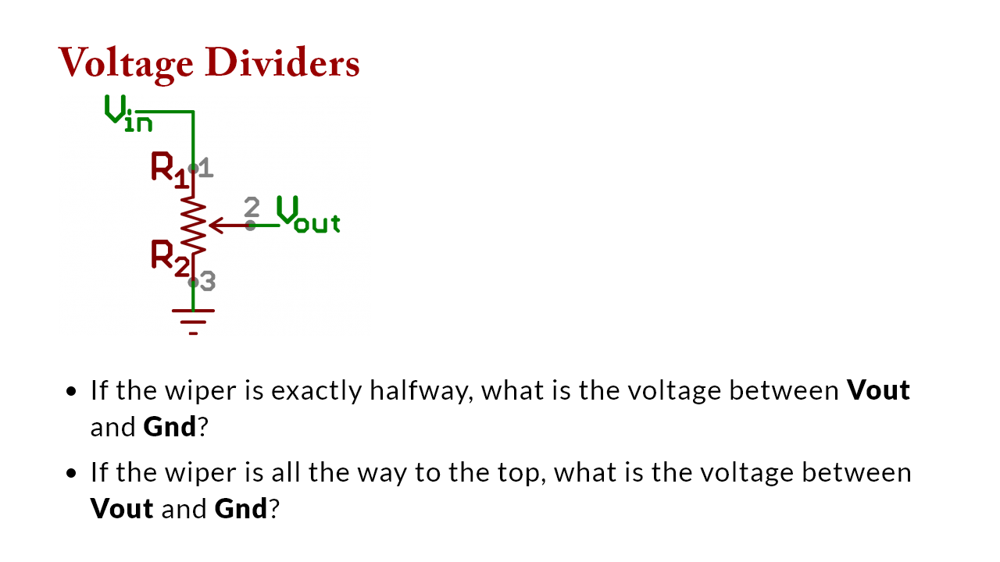
Notes:
middle: 1.67v because the wiper is "seeing" halfway through the drop of 3.3v across the entire resistor; bottom: 0v because Vout and Gnd are directly connected; top: 3.3v because vout is connected to 3.3v, which is being dropped over 10K resisor;

Slide 14
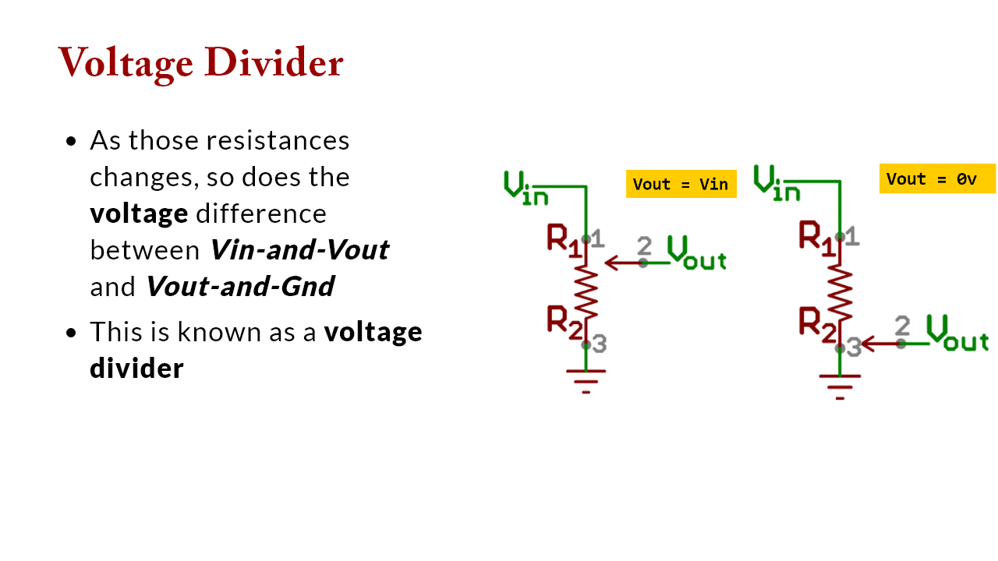
Notes:
<img src="lecture_photoresistor.assets/511ac8f5ce395f5846000000.png" alt="Schematic symbol for a potentiometer" style="width:350px" />

Slide 15
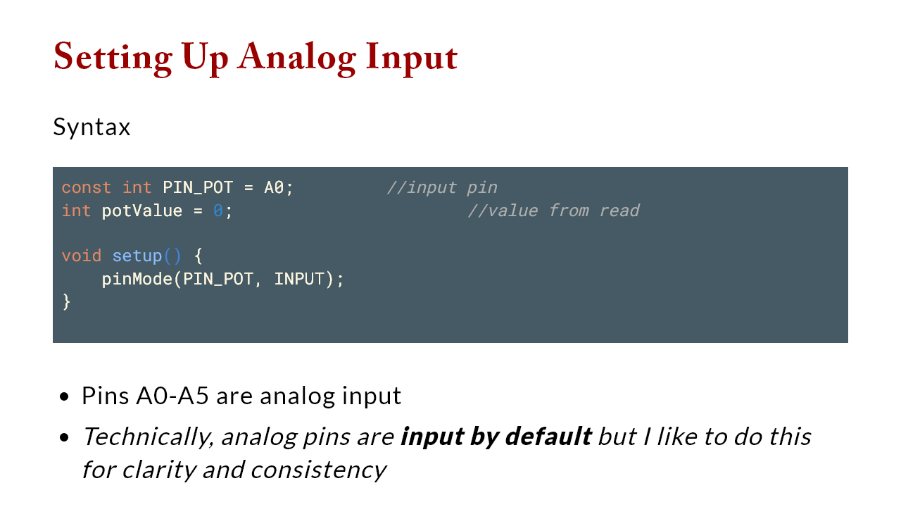

Slide 16
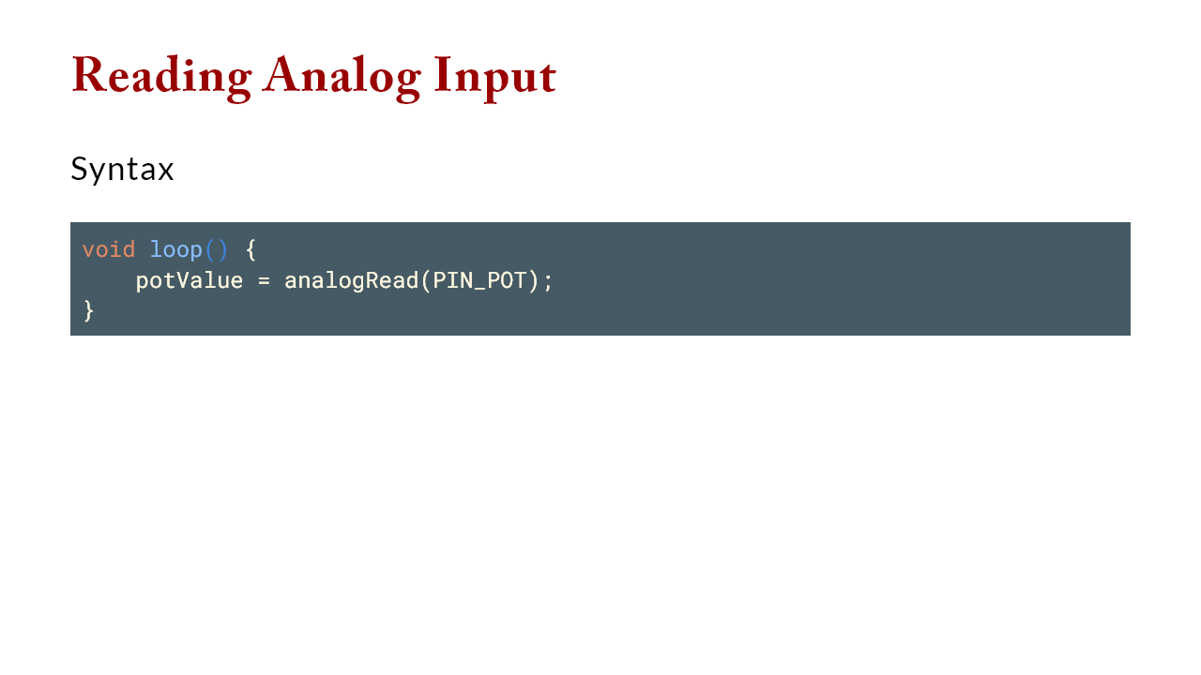

Slide 17
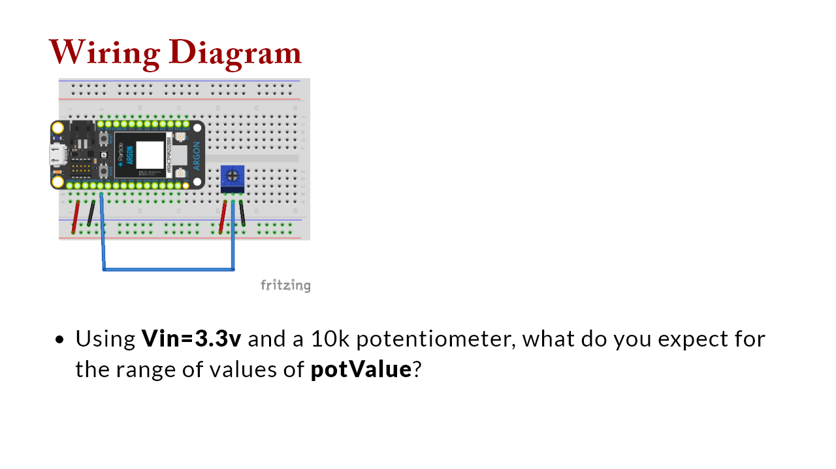
Notes:
we would expect a range of 0-3.3v, but we will see with ADC that that is not what we get

Slide 18


