Slide 1
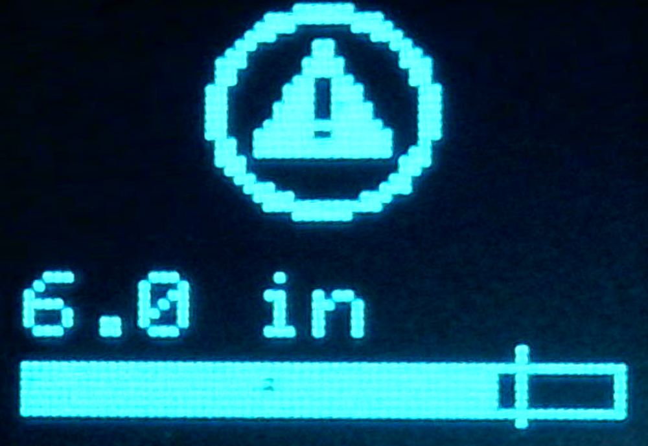
y = 0
y = 30
y = 40
4
y = 46
60
x = 1
x = 63

