Slide 1
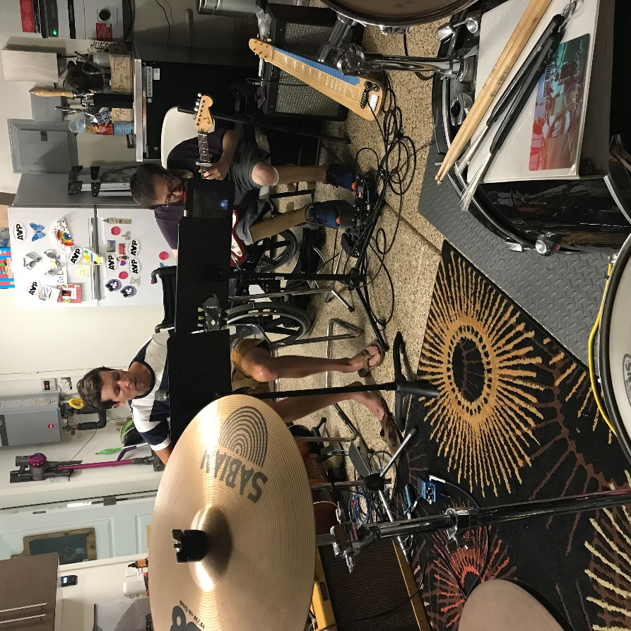
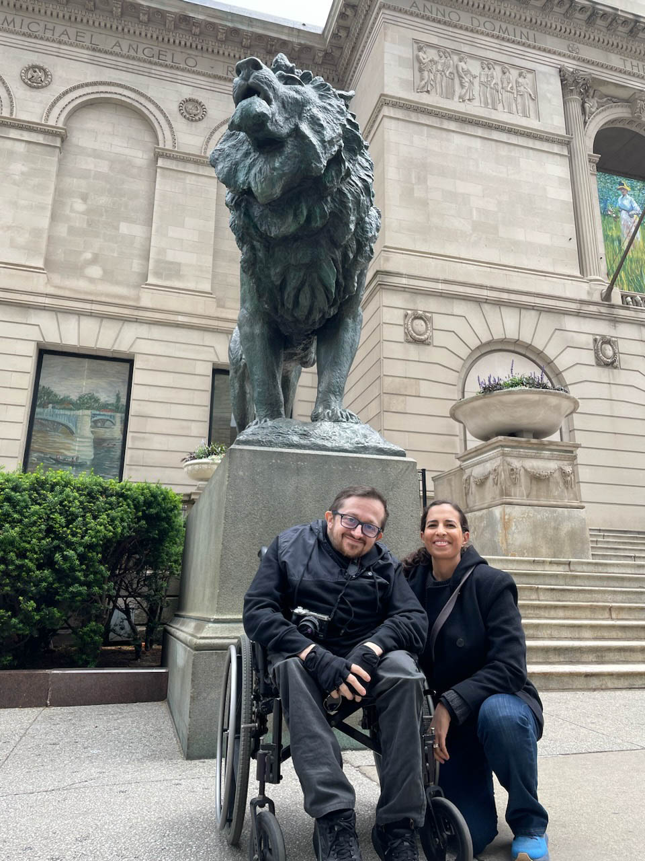
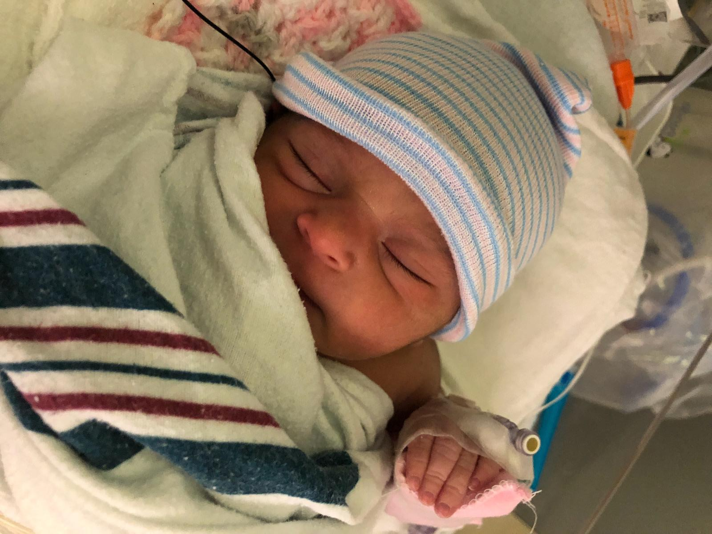
Band
Chicago with wife Jackie
New niece Magnolia

Slide 2
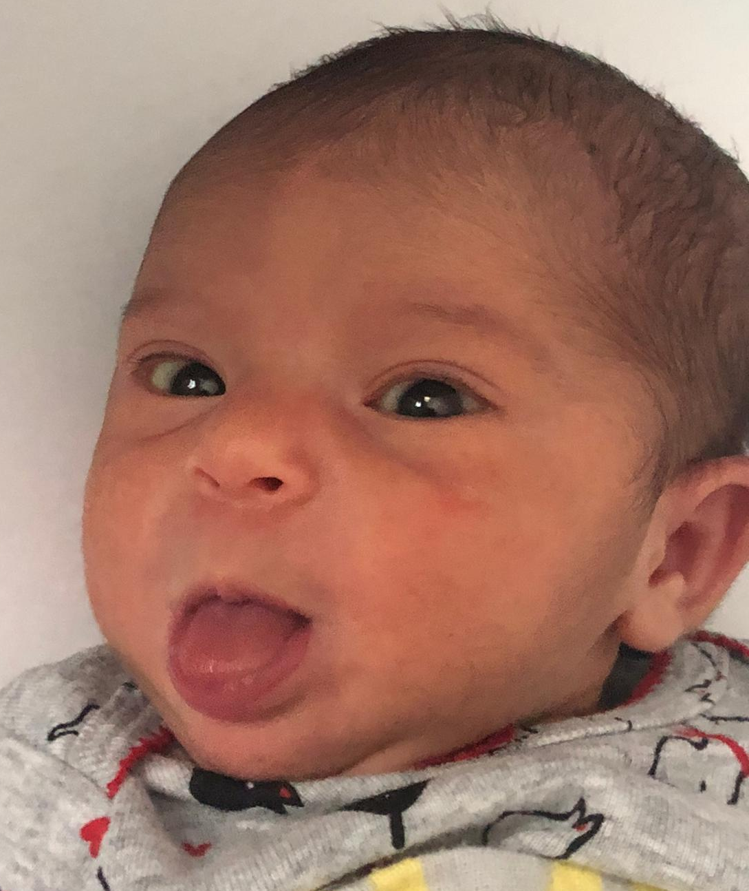

Band
Chicago with wife Jackie
New niece Magnolia
Notes:
Hide other faculty slides

Slide 3
Band
Chicago with wife Jackie
New niece Magnolia

