Slide 1
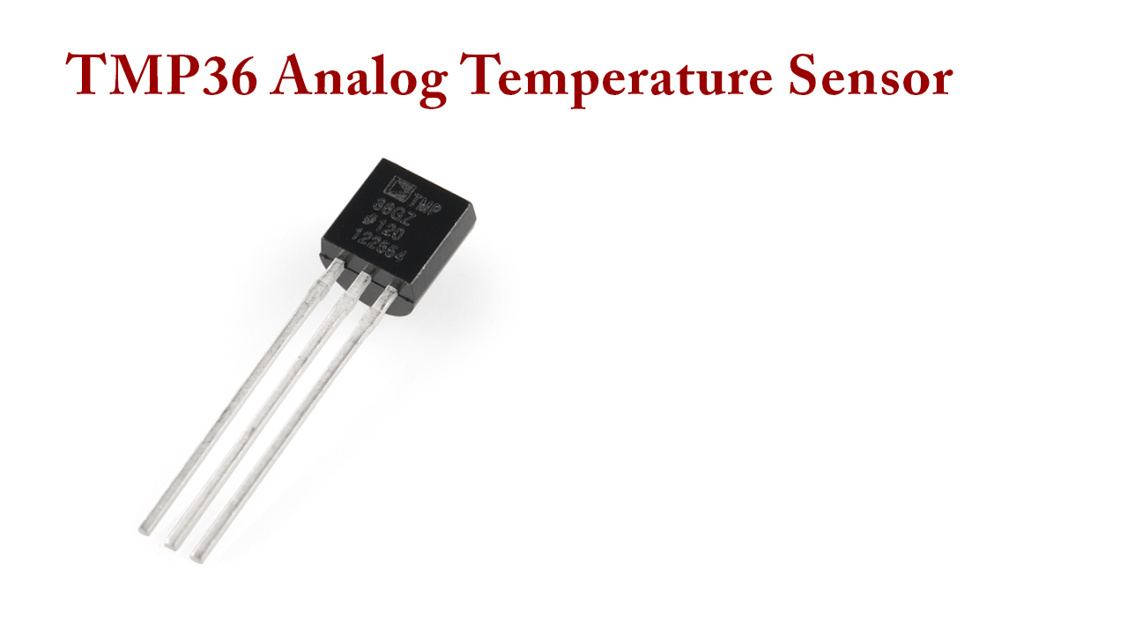

Slide 2
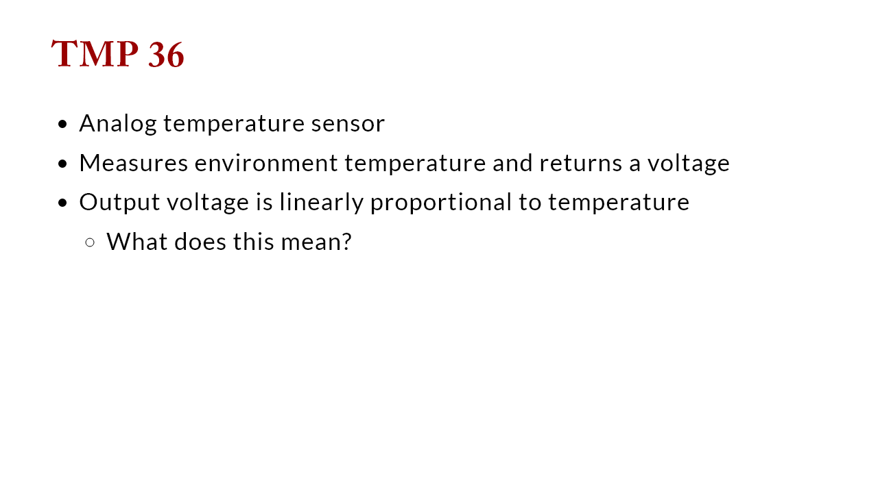

Slide 3
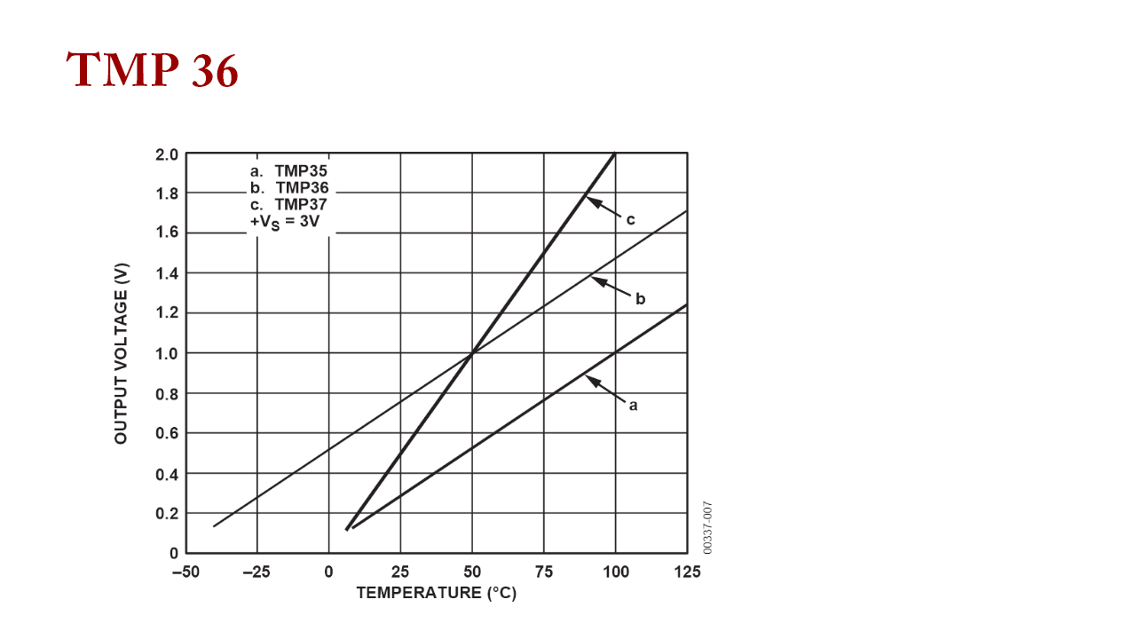

Slide 4
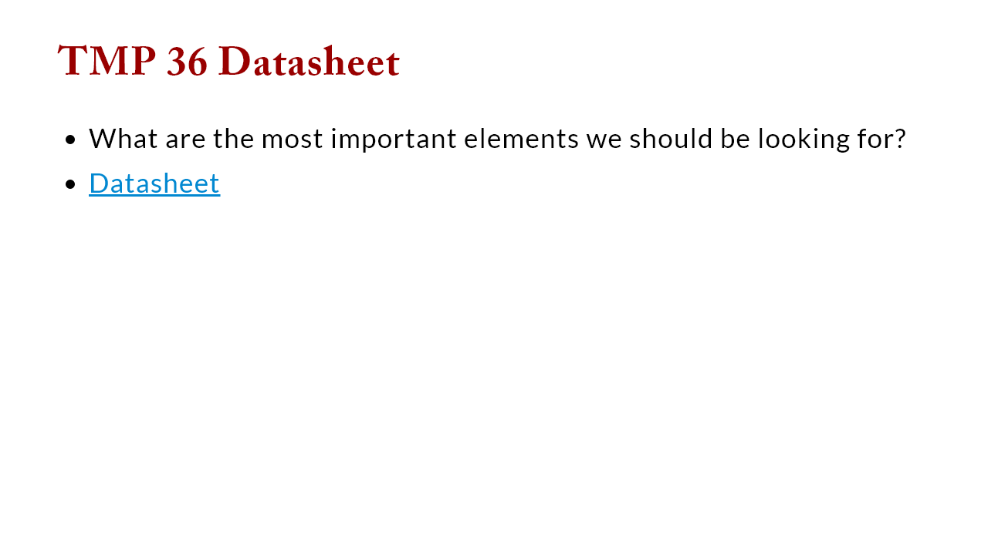
Notes:
pin outs: 1=Vin, 2=Vout, 3=ground orientation: flat part goes up measurement range: -40 C -- 125 C (-40 F -- 257 F) voltage range: 2.7 V to 5.5 scale factor: 10mV per C with a 500mv offset accuracy: +- 1 C

Slide 5
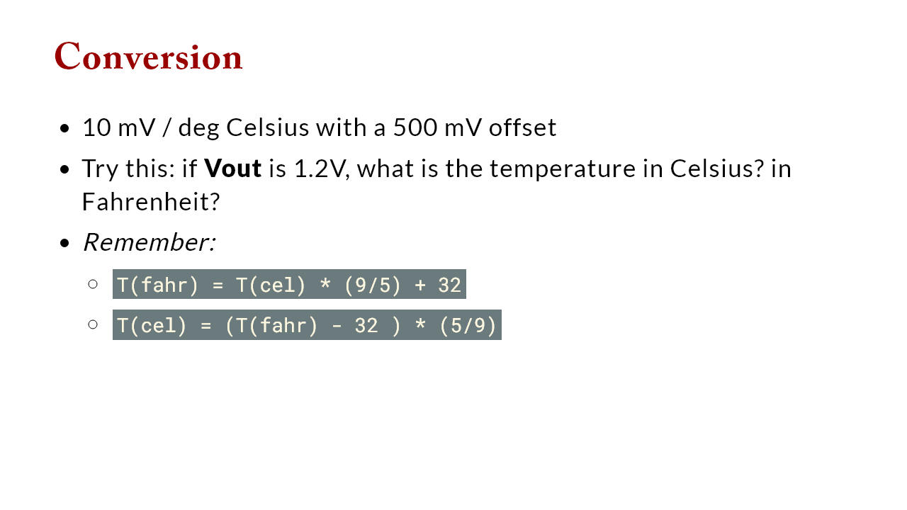
Notes:
consider offset: 1.2v - 500mv = 1.2V - 0.5V = 0.7V now handle conversion 0.7 V * degC / 10mV = 0.7V * degC / 0.01V =0.7V * degC * 100 = 70 degC Now to fahrenheit 158 degF

Slide 6
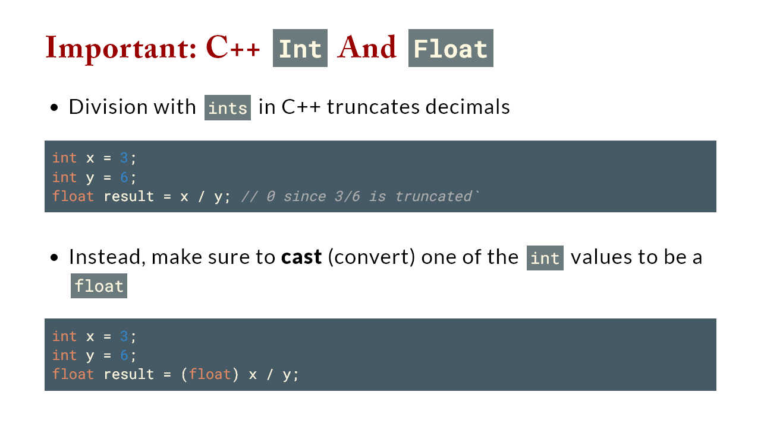

Slide 7
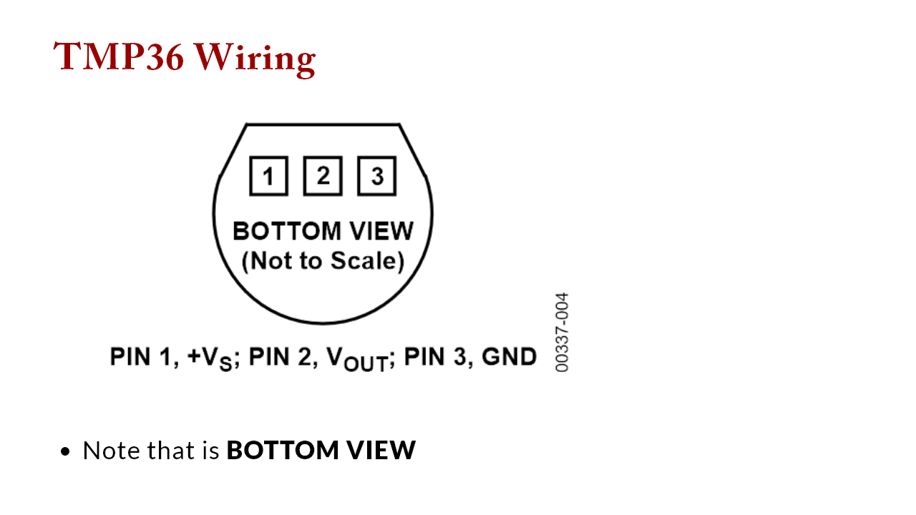

Slide 8
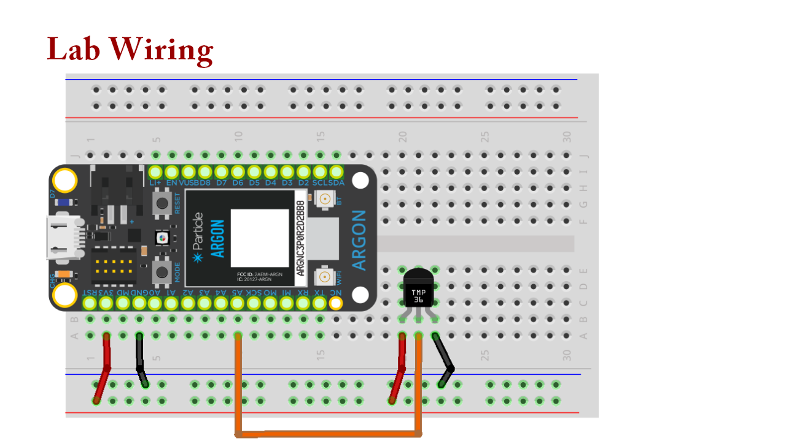

Slide 9
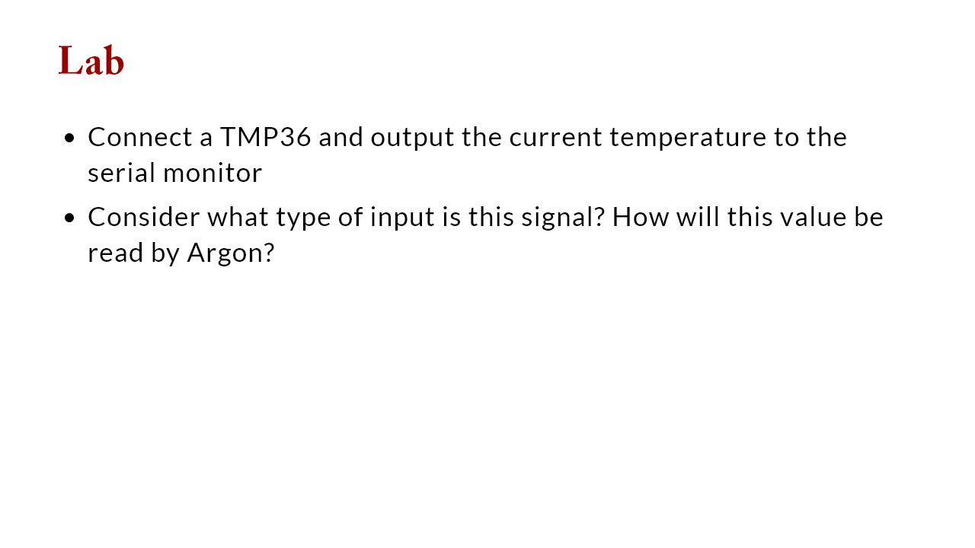
Notes:
This also tests a few C++ features Variable types: analog read value is INT, but voltage and temperature need to be DOUBLE Division: C++ division (in Cel->Fahr) needs to be between doubles Note: this picture is the BOTTOM VIEW, not top down

Slide 10
