Slide 1


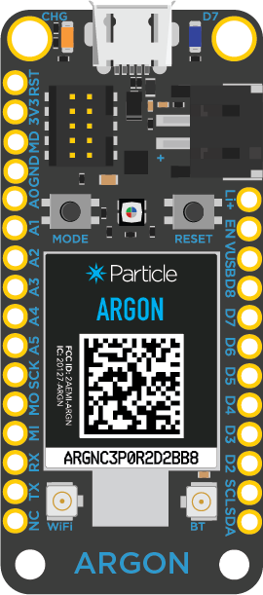


Argon
Particle Cloud
Weather API

Slide 2
Send request via Particle.publish() to webhook
Argon
Particle Cloud
Weather API

Slide 3
Send request via Particle.publish() to webhook
Particle webhook connects to API endpoint
Argon
Particle Cloud
Weather API

Slide 4
Send request via Particle.publish() to webhook
Particle webhook connects to API endpoint
API responds with request JSON-formatted data
Argon
Particle Cloud
Weather API

Slide 5
Send request via Particle.publish() to webhook
Particle webhook connects to API endpoint
API responds with request JSON-formatted data
Argon receives JSON data via Particle.subscribe()
Argon
Particle Cloud
Weather API

Slide 6
Send request via Particle.publish() to webhook
Particle webhook connects to API endpoint
API responds with request JSON-formatted data
Argon receives JSON data via Particle.subscribe()
Argon
Particle Cloud
Weather API

