Slide 1
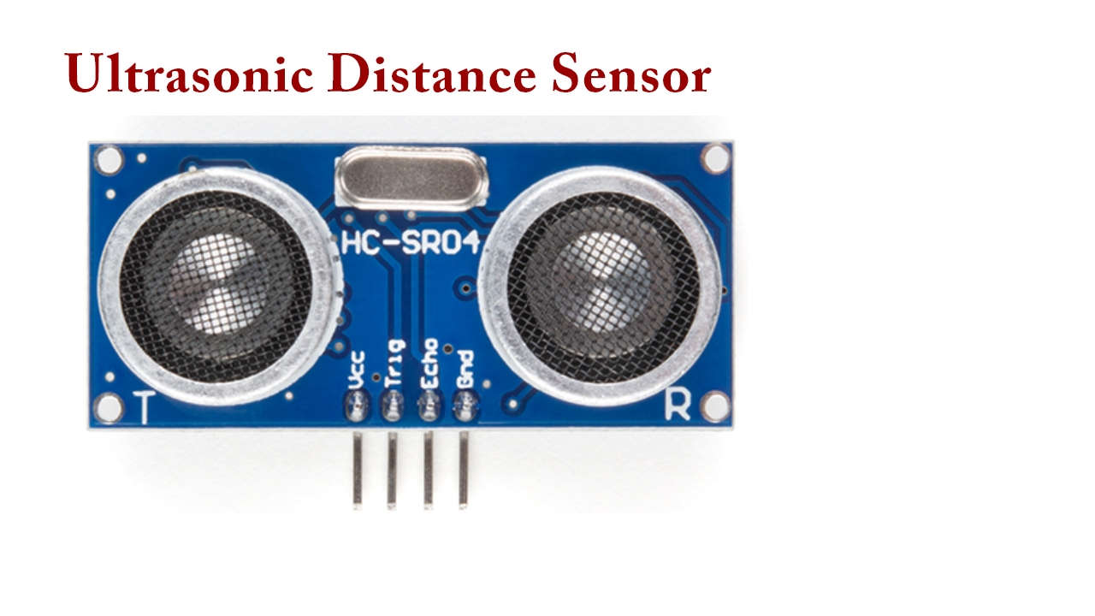

Slide 2
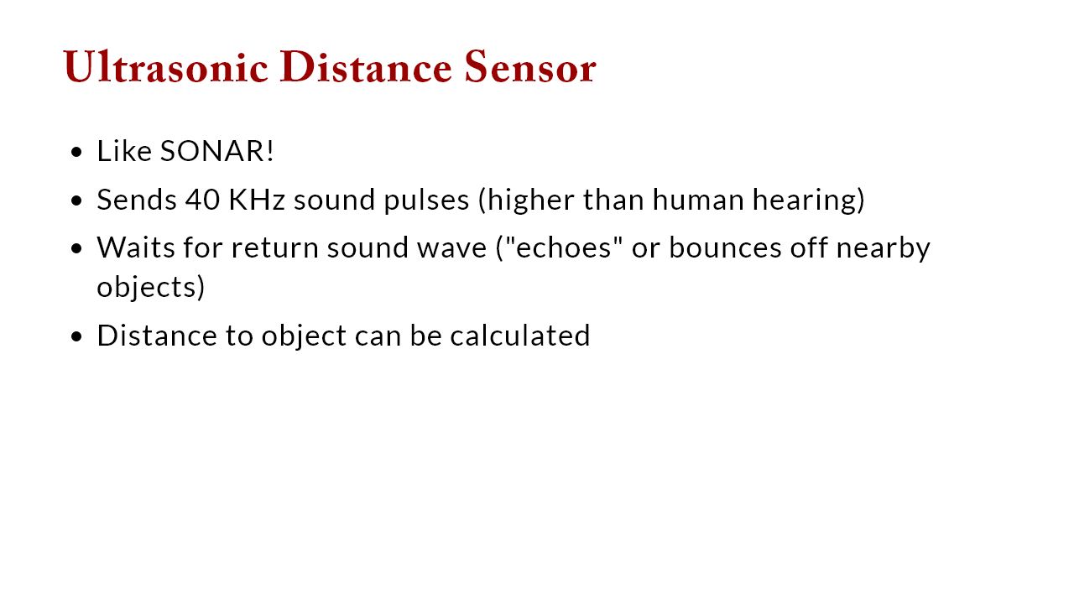

Slide 3
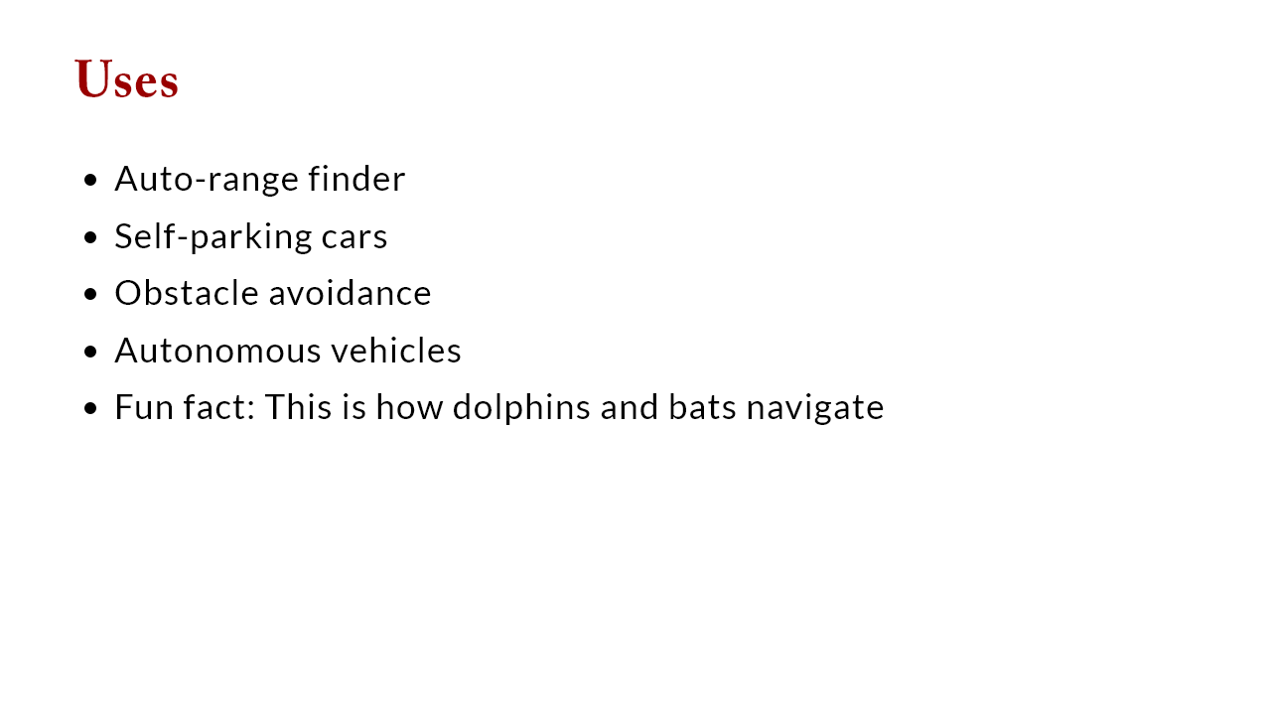

Slide 4
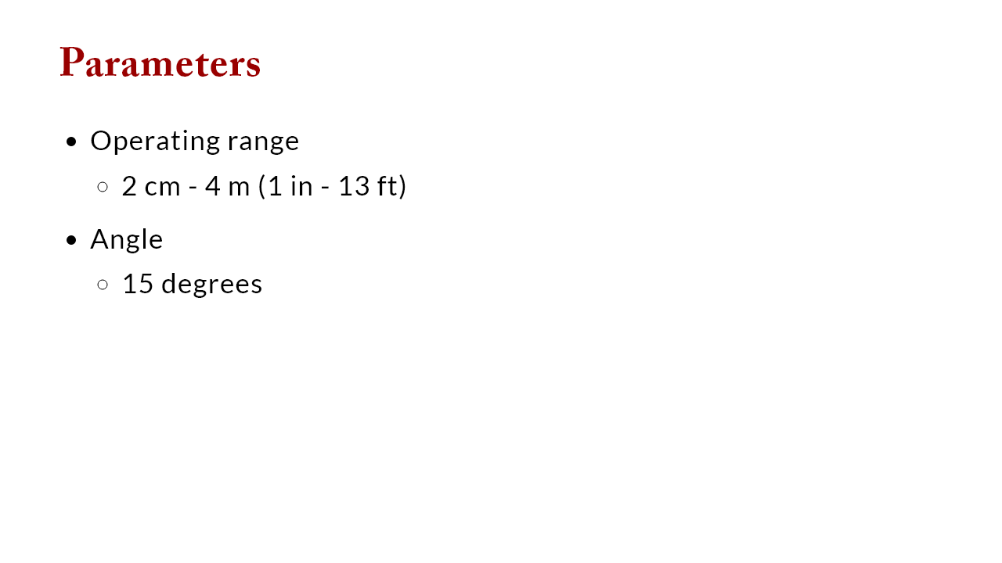

Slide 5
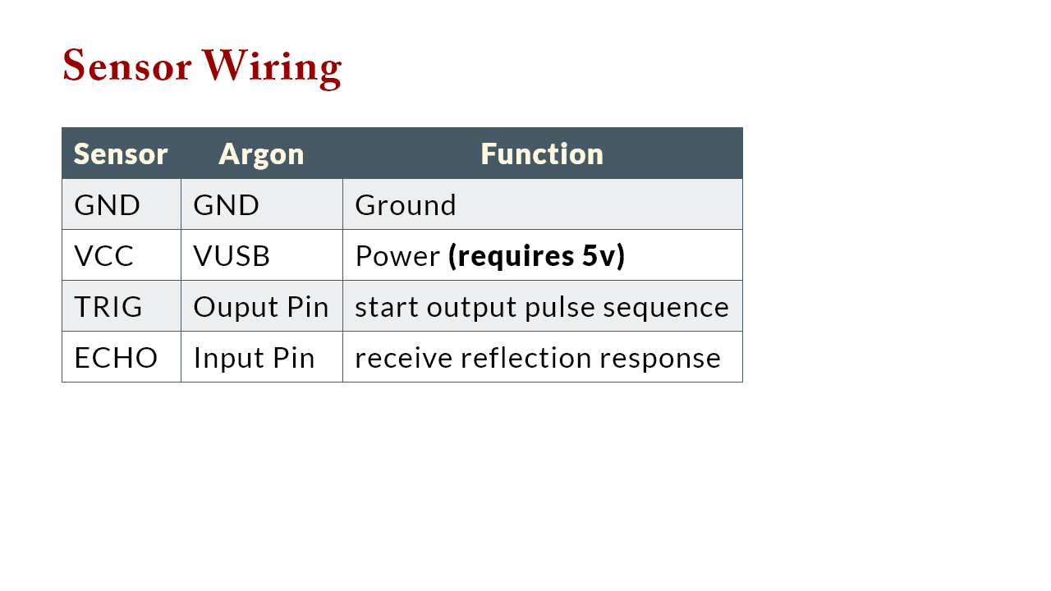

Slide 6
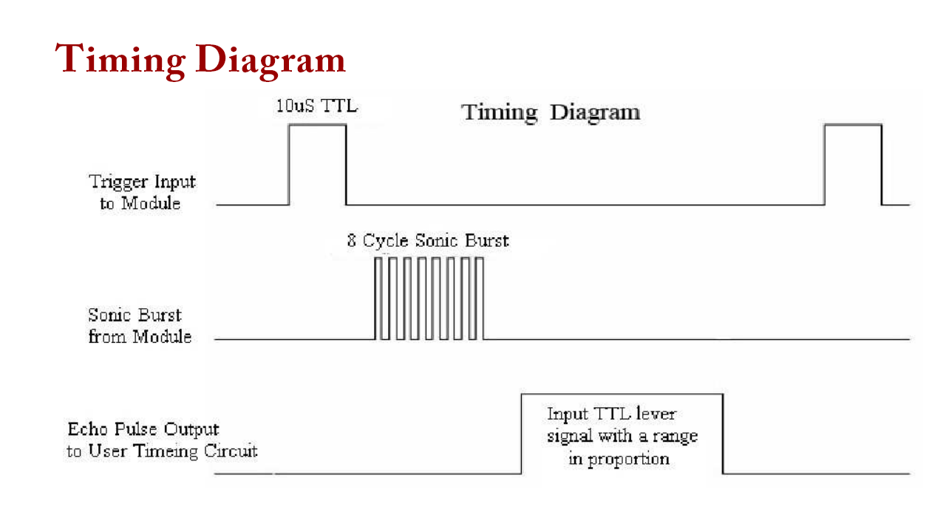

Slide 7
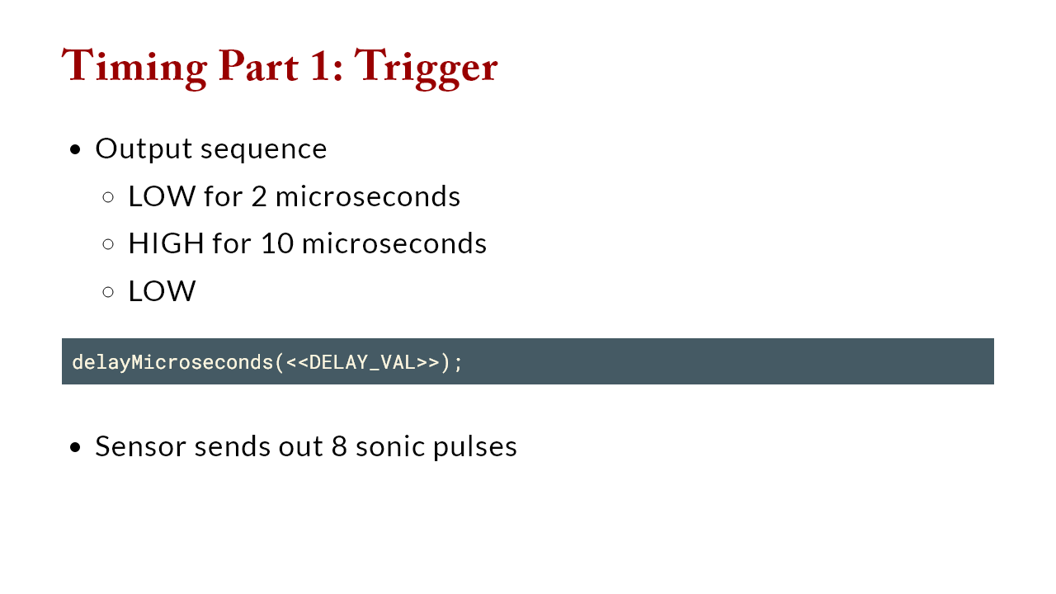

Slide 8
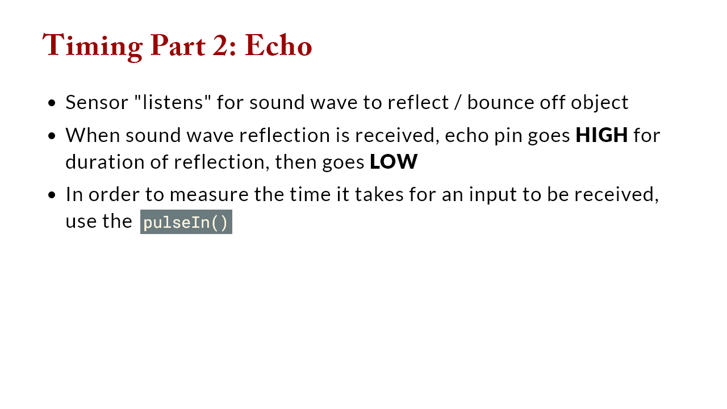

Slide 9
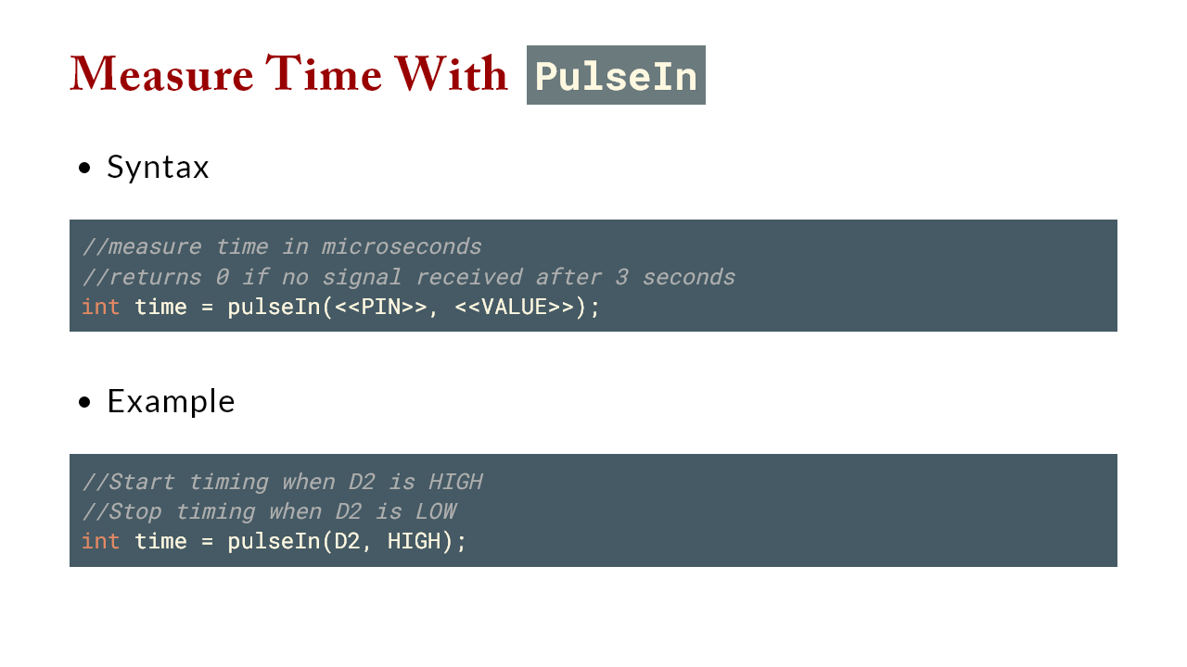

Slide 10
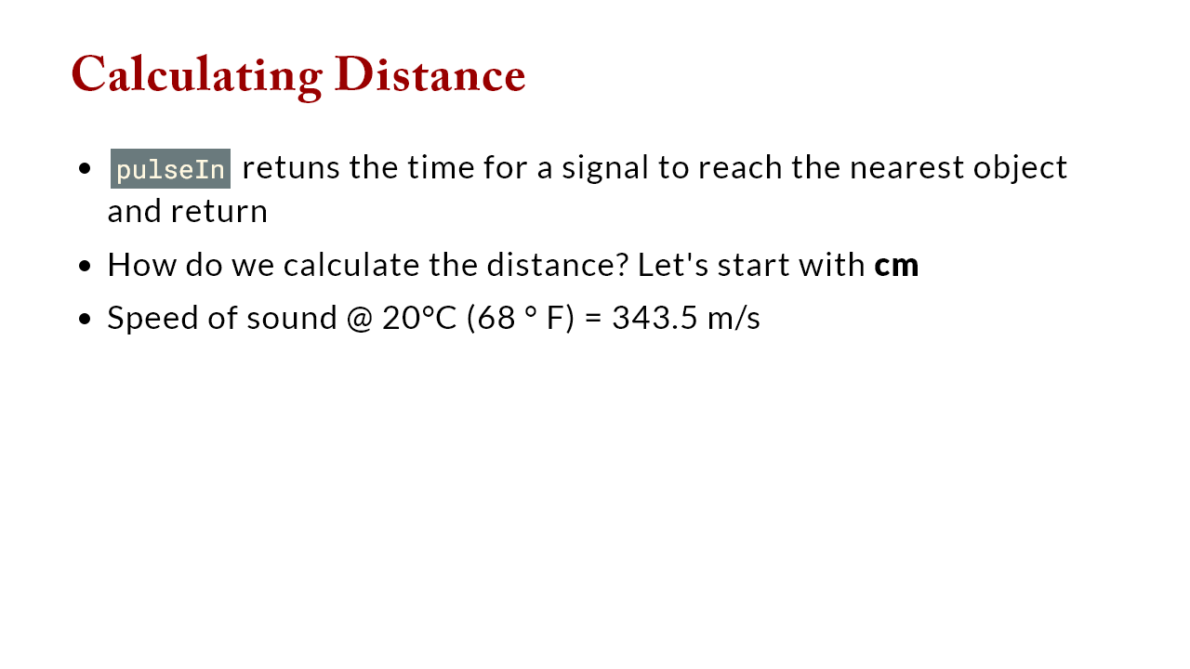
Notes:
speed = dist/time -> dist = time*speed convert speed from m/s to c/uS speed(m/s) * 100 (cm/m) * 1/10^6 (s/uS) speed = 0.03435 cm/uS dist = 0.03435 * time NOTE: dist is the round trip time so divide by 2 for distance to object CONV_FACTOR_CM_TO_IN = 0.3437

Slide 11
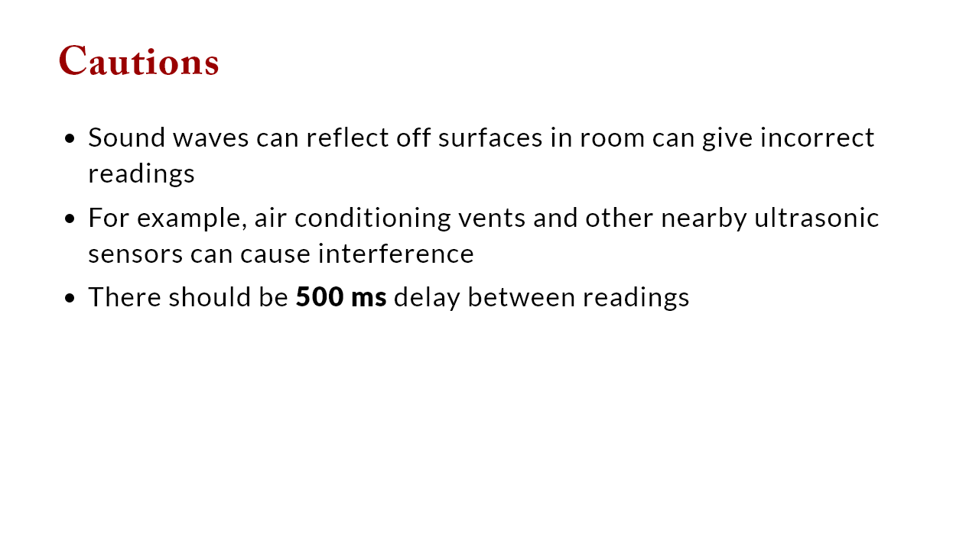

Slide 12


Slide 13
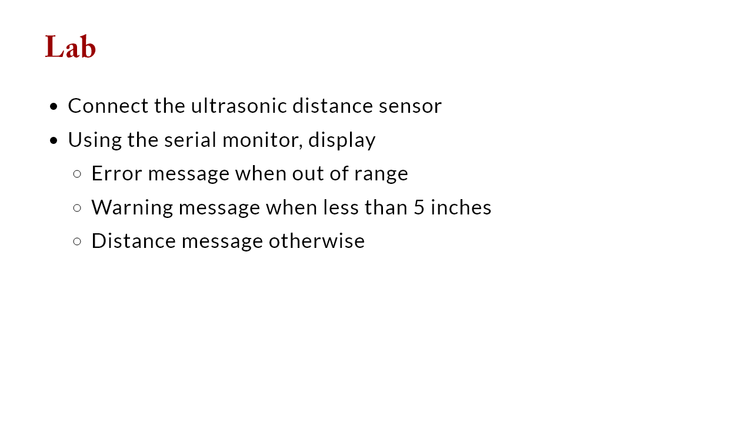

Slide 14
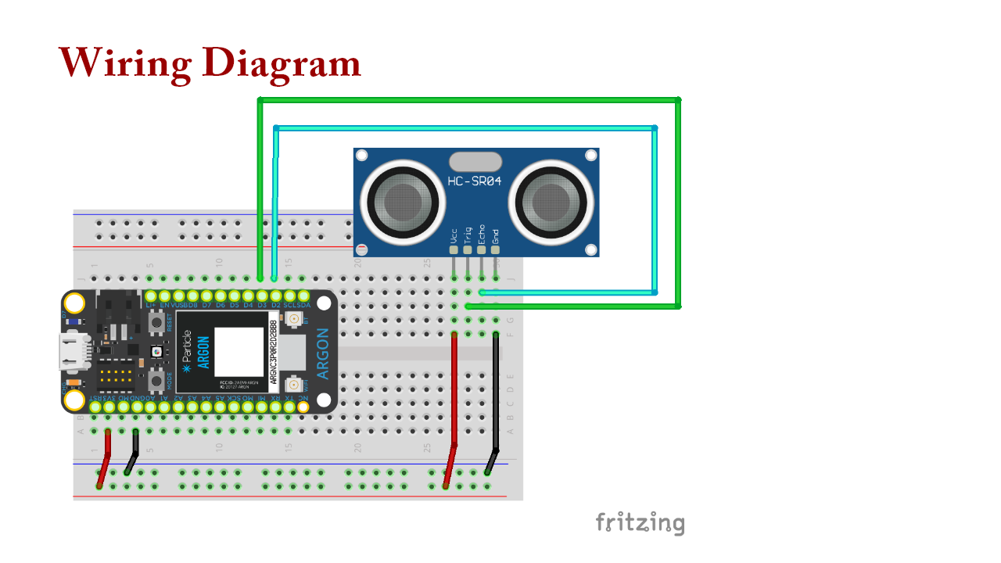

Slide 15


