Slide 1

Aircraft – Taxi-out Prediction
What is the NEED for PREDICTION..?

Slide 2
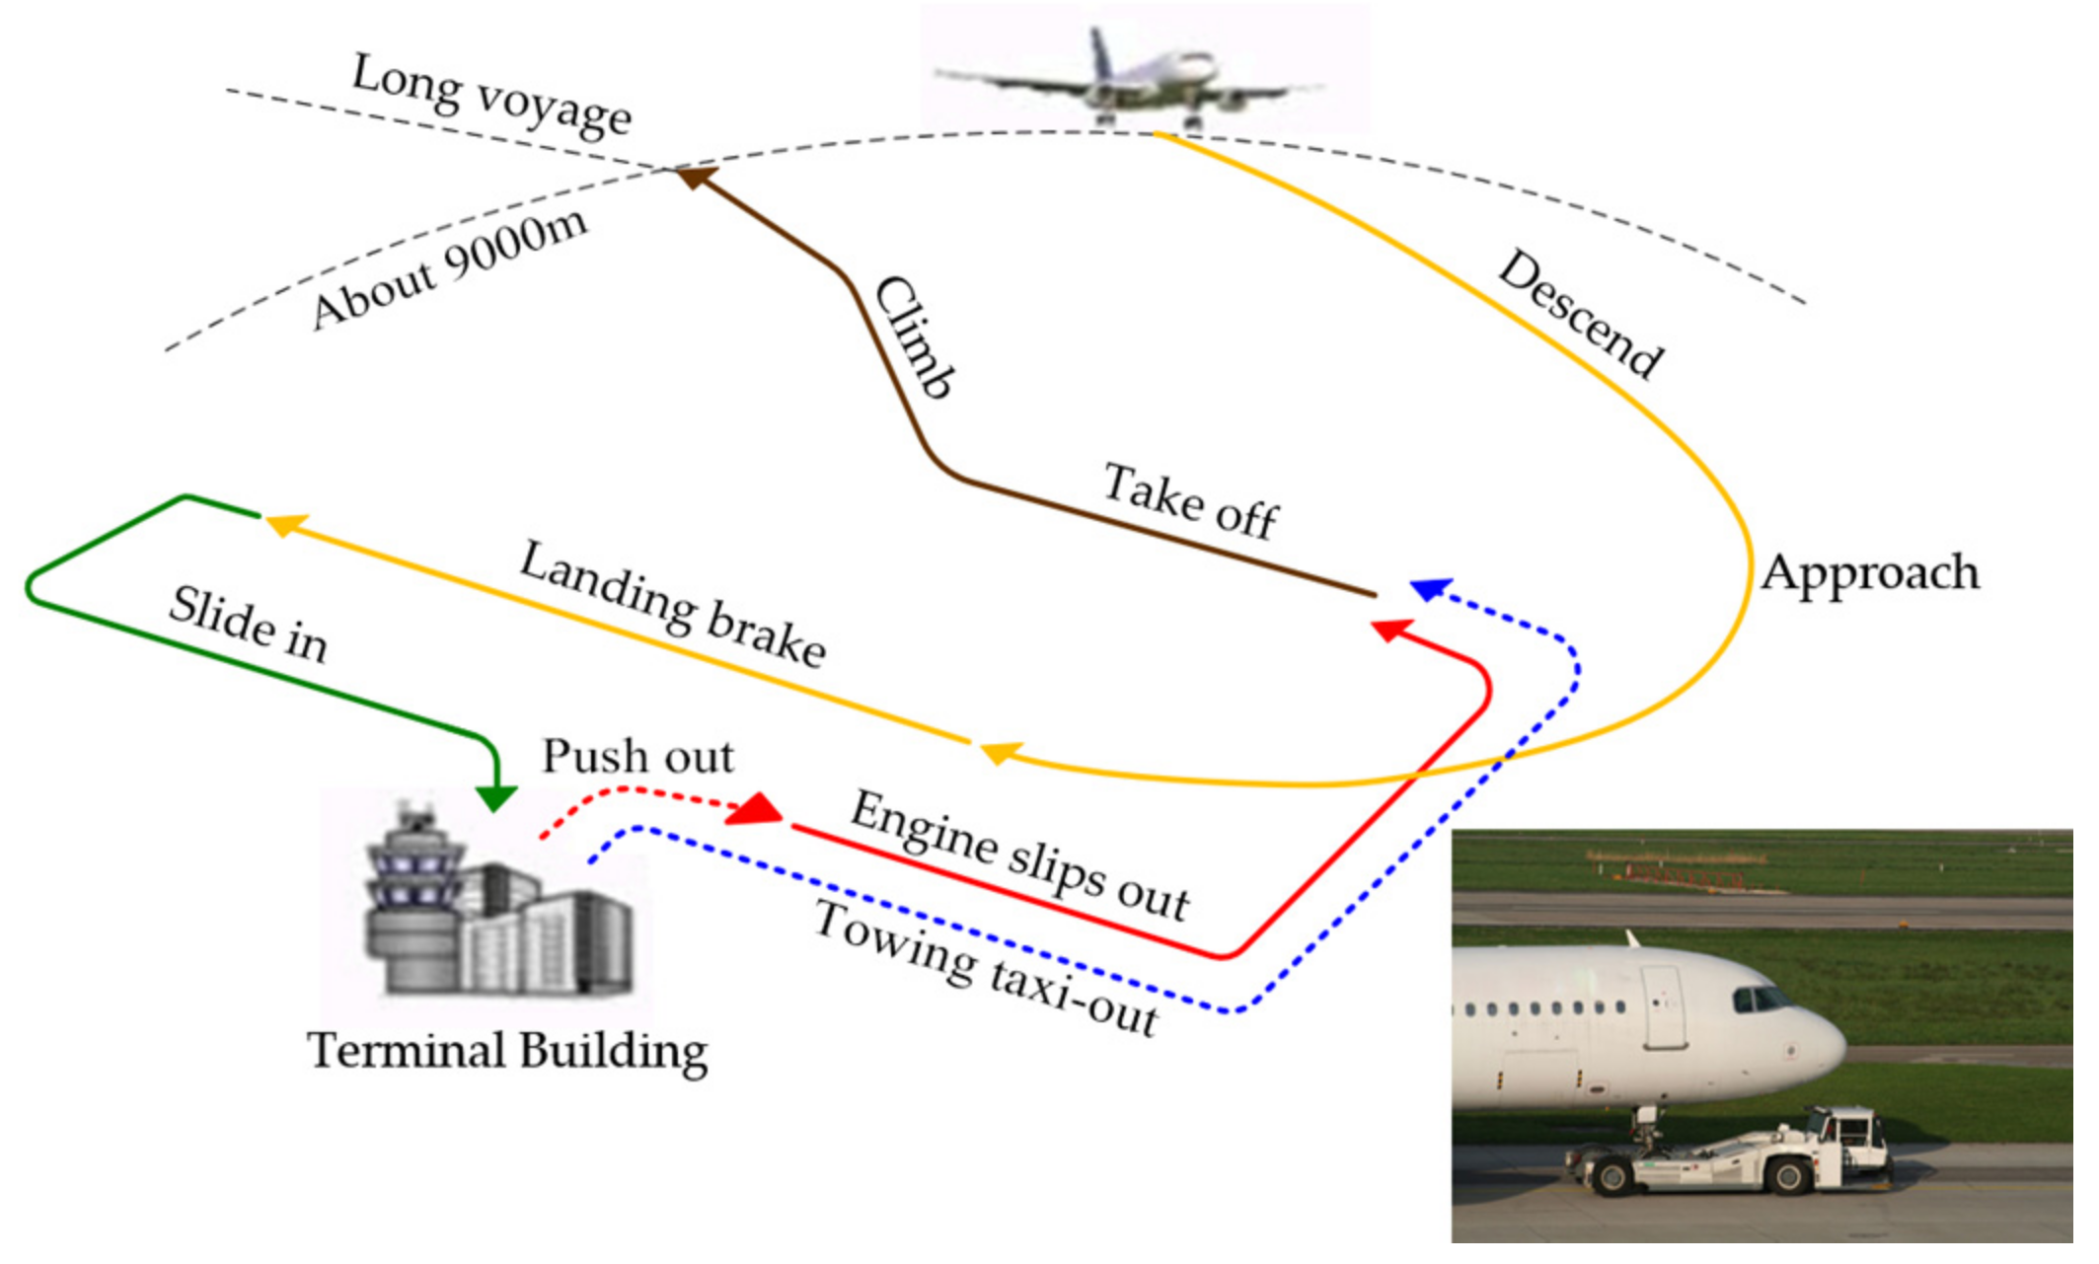
…after a long voyage
Source: Google Images

Slide 3
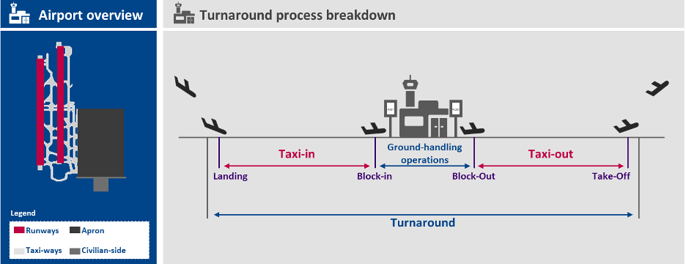
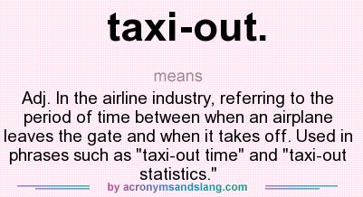
Taxi in & out Process
Source: Google Images

Slide 4
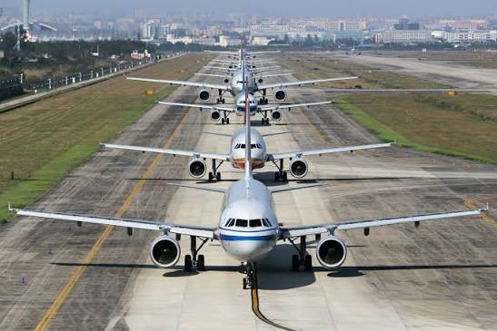
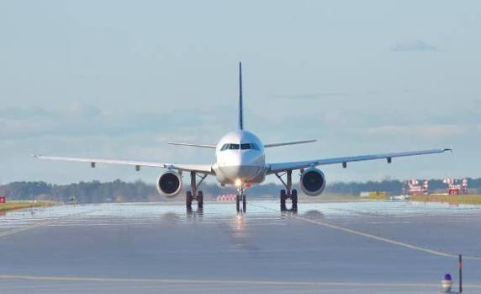


Need for Prediction
Long standing Queues
ready
to
take-off
Take off

Slide 5
Reasons for “NEED for PREDICTION”
1. Engine Life & Maintenance Costs
(Thermal Stress & Engine Degradation)
Cold Rotations and Thermal Shock: Jet engines operate at extreme internal temperatures. Erratic taxi-out results in thermal gradients across turbine blades which accelerate thermal fatigue.
3. Gate Availability and Apron Gridlock (Ground Logistics)
Inbound Gate Blockage: An aircraft delayed in taxi-out creates immediate bottleneck for incoming flights forcing arriving aircraft to hold on taxiways with engines running
Ground Support Equipment (GSE) Resource Allocation: Efficient taxi-out timelines dictate the precise release of ground power units, pushback tugs, and marshalling crews, allowing apron staff to immediately transition to next aircraft without idle labor costs.
4. Flight Crew Duty-Time (FTL) and Crew Legality Thresholds
The "Ticking Clock" of Fatigue Rules: Crew’s legal duty clock begins ticking the moment they report for duty, and continuous ground delays run directly into this window before the aircraft even leaves the ground.
The "Going Illegal" Cascade: Extended taxi-out pushes crew’s legality to "illegal" mid-queue or just prior to takeoff. This forces the aircraft to return to the gate, and often results in outright flight cancellations—costing airlines thousands in hotel accoms., passenger compensation, and rebooking fees.
2. On-Time Performance (OTP) and
Downstream Network Cascades
Ripple Effect: Airlines operate hub-and-spoke model. A 15-minute taxi-out delay on an early morning flight compounds across every subsequent segment.
Slot Adherence (CTOT / EDCT): Under air traffic control frameworks like Eurocontrol. Failing to complete the taxi-out on time results in losing the slot, forcing the aircraft to re-queue—often adding 30 to 60+ minutes of ground delay.
CTOT - Calculated Takeoff Time | EDCT - Expect Departure Clearance Time

Slide 6
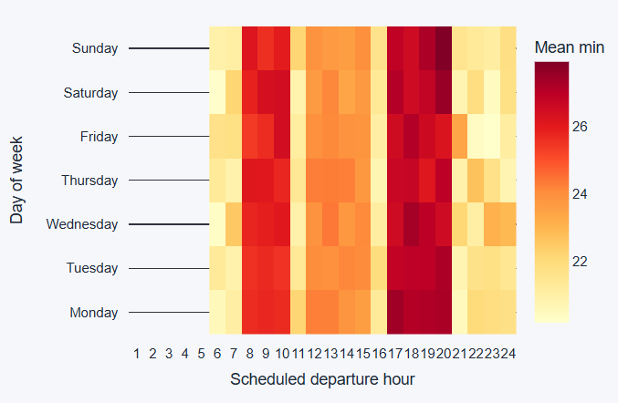
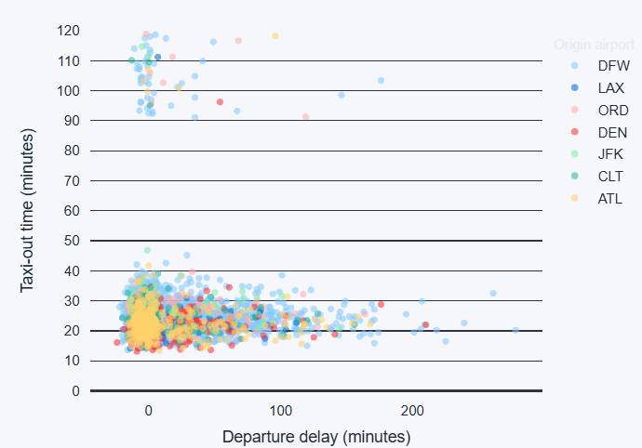
Datasource
Bureau of Transportation Statistics (BTS) Airline On-Time Performance
CTOT - Calculated Takeoff Time | EDCT - Expect Departure Clearance Time

Slide 7
Datasource
Bureau of Transportation Statistics (BTS) Airline On-Time Performance
CTOT - Calculated Takeoff Time | EDCT - Expect Departure Clearance Time

