Slide 1
Team meeting
Pierre Dangauthier
24 avril 2006

Slide 2
Out line
Machine learning
Philosophy of probability
Bayesian Learning
3 debates in machine learning
Entropy maximization difficulties
Pictures of my last holidays

Slide 3
Machine learning
Goal
  machine or agents that learn from experience,
  that performs better days after days.
Necessity of
  Memorization: summing up past relevant information
  Generalization: over fitting is a big issue
  Prediction (what decision to take in front of a new situation)
  A model of the phenomena
  A fitness function (for evaluation)
Probabilities: 2 purposes:
  Obvious: Analyze performances of learning algorithms,
    ex: how often they takes good decisions on a benchmark set
  One approach probability rules = the way the agent represents its knowledge
    ”probability as logic”
Those two applications are compatible, and both imply that probability is an important notion for machine learning.

Slide 4
Philosophy of probability
What is a probability ? Definition ?
  Kolmogorov axiomatic is (almost) uncontroversial.
What meaning, what interpretation ?
  Different philosophical schools
  Practical methods depend on interpretation
  Numerical results are different
  Open debates

Slide 5
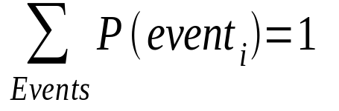
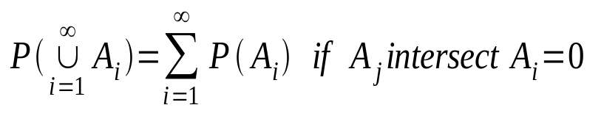
Philosophy of probability
Kolmogorov axiomatic: measure theory
P is a probability if
  P is a function from a convenient set of events
    (sigma algebra)
  to [0,1]
  Sum to one
  Countable additivity
That’s all, no interpretation implied !
  Random variables = measurable function
    From probabilized space to measurable space
    P(a<X<b) = P(X^-1 ([a,b]))
  No definition of “randomness”, just measure theory.
  Random variables are useful (also in bayesianism)

Slide 6
Philosophy of probability
Different interpretations
  Classical probabilities
    based on the principle of indifference.
  Logical probabilities
    notion of “degree of implication” in a formal language.
  Frequency interpretation
    limiting relative frequencies in an hypothetical infinite sequence of trials.
  Propensity
    quality of the physical word. It represents an intrinsic tendency to behave in a certain way.
  Subjective interpretation
    degree of belief of a suitable agent.

Slide 7
Bayesian learning
Rational belief updating
  Of a model in front of data.
Methodology
  1: Make a model, formalize prior knowledge
    Parametrical model ex: X <- N(m,s2)
    Ex: Prior knowledge S2 = 3, m <- uniform[0,5.5]
  2: collect data
  3: Compute posterior proba. of parameters.
  4: Use posterior for:
    Point estimation of parameters
    Prediction
    Model comparison
    Decide with expected loss minimization

Slide 8
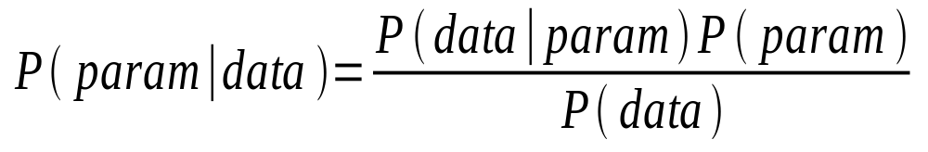
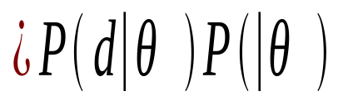

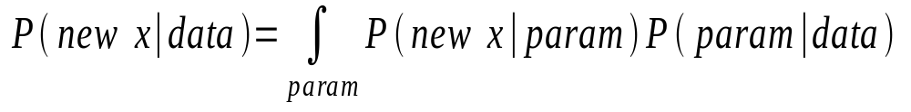
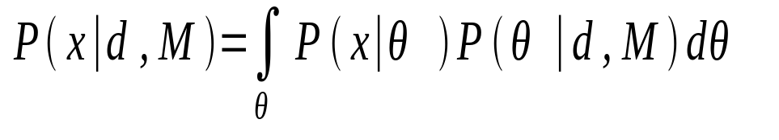
Bayesian learning
Prediction (marginalization over parameter space)

Slide 9
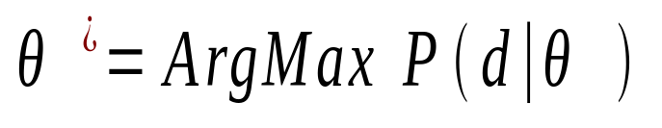
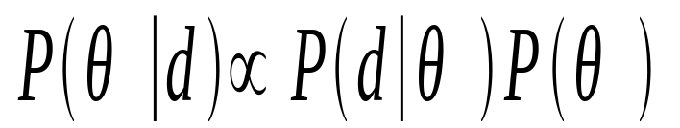
Bayesian learning: Definitions
Maximum Likelihood (ML) Learning
Maximum a Posteriori (MAP) Learning:
Bayesian Learning: We keep all

Slide 10
Bayesian learning: Priors
Informative
  Translate expert knowledge in prior
“non informative”
  Respect invariance of model (Jeffrey)
  Minimize effect of prior (Bernardo)
  Maximize “uncertainty” entropy (Jaynes)
Hierarchical priors, empirical
  Hyper parameters estimated on data
Conjugate priors
  Mathematical convenience, usable if flexible enough
  Virtual data

Slide 11
Bayesian learning: inference
Exact
  tractable integration on discrete variable
  Analytical (easy if conjugate prior)
Approximate
  Sampling (all MCMC stuff)
  Variational approaches
    Message passing (loopy belief propagation, expectation propagation, mean field) [belief propagation is exact on trees) cf Statistical physics
    Min d( real posterior, a class of candidate distrib)
  Posterior modes
    Laplace, BIC
    EM

Slide 12
Bayesian learning : Pros and cons
Pros
  Coherent, rational framework
  Uncertainty
  Pretty good philosophical foundations
  Doesn’t over fit, if good prior
  Automatic Occam razor
  Generalization of (ML, Kalman, Markov, PCA, ICA, EM, neural nets)
  Rational agent model : psychology and machine learning
Cons
  Subjectivity
  Formulating a good prior is THE issue
  Computationally demanding
  Easy to do bad Bayesian :
    No distribution over models
    Improper Posteriors
    Stupid priors ridicules, just convenient (conjugate prior)
    Only MAP
    Always uniform prior

Slide 13
3 debates in machine learning
Vapnik or Bayes?
  Vapnik (SVM): minimize future risk of error
  Bayes : Probability = knowledge
Frequencies or degree of belief?
  Orthodoxy isn’t Bayesianism with flat prior !!
Subjective or objective Bayesianism?
  Will two agents with the same information choose the same prior ?
    Objectivist: YES (but which one ? Formal rule ? “know nothing ?)
    Subjectivists: NO, matter of conventions, only “reference”, “defaults” priors

Slide 14
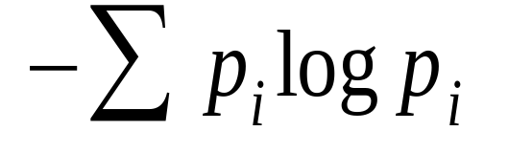
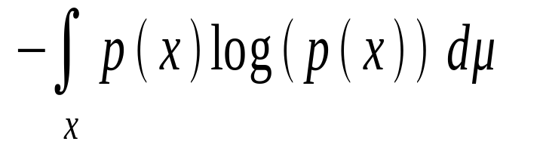
Entropy maximization difficulties
Problems of MaxEnt
  Which entropy function ?
  Sensitive to discretization
  Invariance by reparametrization
  Pb. with continuous variable
    Choice of base measure reports the problem (Jaynes: invariance)
  History: Shannon != inference
  Uncertainty not well defined ! Uniform is information !
  Conflict with Bayesian updating
    Why not ? That’s different theories !

Slide 15
Entropy maximization difficulties
Take a die X = 1,2,3,4,5,6
Prior information: E(X)=3.5
  MaxEnt -> p1=..=p6=1/6
New information: “A”= only odd numbers
  MaxEnt E(X)=3.5 and E(1A)=1
    -> p1=0.22 p2=0 p3=0.32 p4=0 p5=0.47 p6=0
  Bayesian updating
    P(X|A)=0 for 2,4,6 and 1/3 for others
Conflict ! Explanation: 2 different ways of belief updating, nothing say they must agree !

Slide 16
Pictures of my last holidays

Slide 17
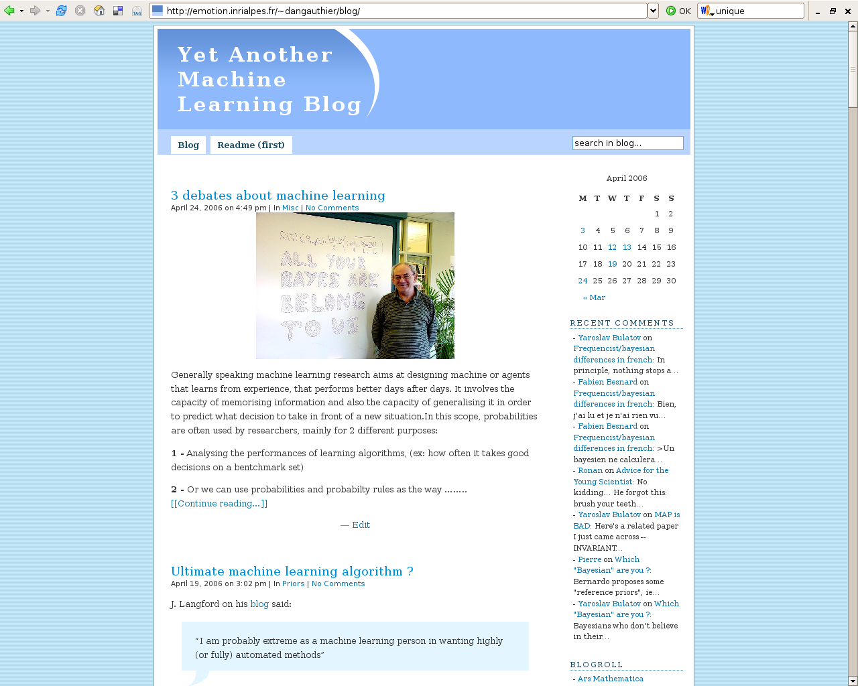
References
http://emotion.inrialpes.fr/~dangauthier/blog/
Historical
  Laplace / Jeffrey / Jaynes / Good
Modern bayesians
  MacKay / Neal / Ghahramani / Pearl / Minka
More «mathematical» bayesians
  Robert / Gelman / Bernardo
Physicists
  Baez / Jaynes / Jefferys/

Slide 18
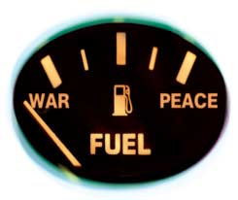
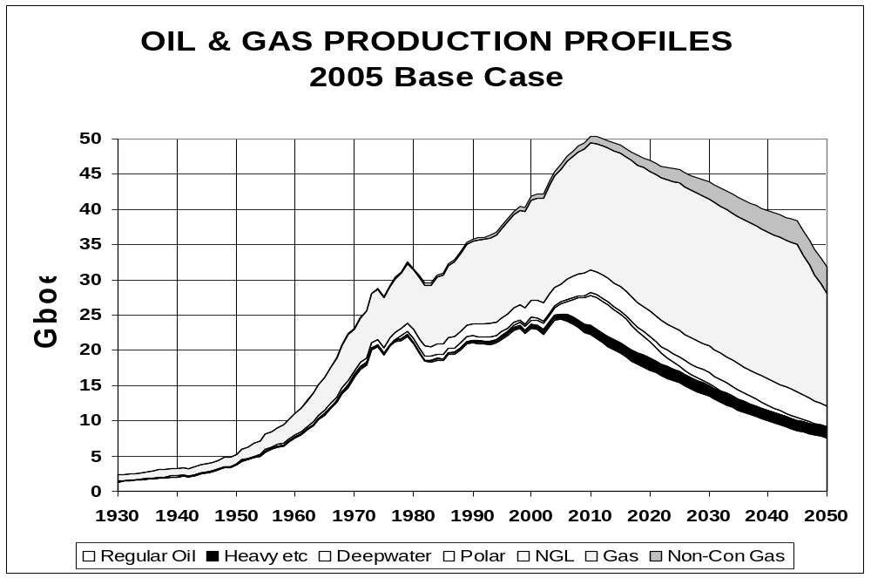
The end
« Toute personne croyant qu'une croissance exponentielle
peut durer indéfiniment dans un monde fini est soit un fou, soit un économiste. »
Kenneth Boulding

Slide 19


Slide 20
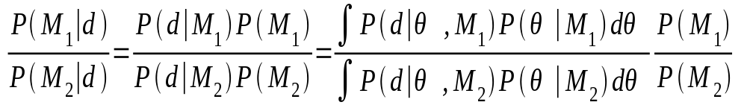
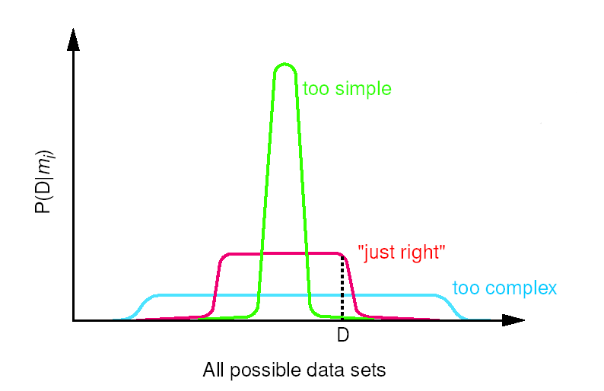
Comparaison de modèles
Choix entre deux modèles
Rasoir d’Occam automatique
Une classe de modèles trop simple ou
trop complexe donnera une faible
probabilité au jeu de données
La classe de modèles la plus probable
pour un jeu de données aura une
complexité adaptée.

Slide 21
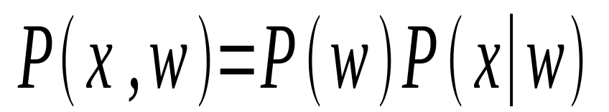
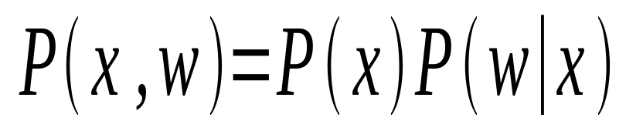
Modèle génératif / discriminatif
Une classification binaire peut s’exprimer
  Génératif - Discriminatif
w
x1
x2
x3
x1
x2
x3
w

Slide 22
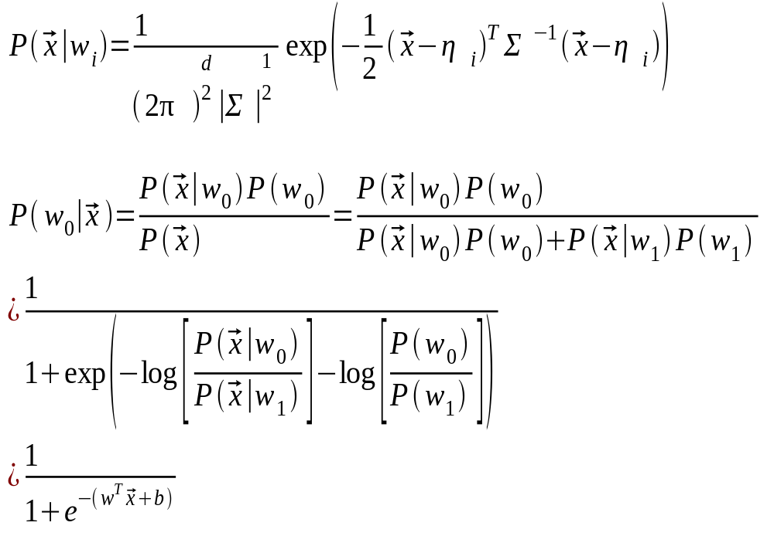
Modèle génératif

