Slide 1
Ukkonen's algorithm, step by step
Reading the diagrams
Red nodes created in this step
Orange edge shortened by a split
Building the suffix tree of abcabaa$
Blue active parent and active edge
One slide per iteration of the main loop, 13 operations in total.
Edge labels show the characters and the index range [a, b). Leaf ranges end at the shared index i.
Leaves are numbered by the start index of the suffix they spell.
ε marks an empty edge. A new leaf is empty until the index advances.

Slide 2

Start
Initial state
Start
String
a
b
c
a
b
a
a
$
0
1
2
3
4
5
6
7
current character
pending suffix
 | Before | After
Index i' | – | 0
Remainder | – | 0
Active length l | – | 0
Active point | – | (R, –, 0)
What happens
The tree is only the root R. The index, the remainder and the active length all start at 0.
Notes:
Initial state. The tree is only the root R. The index, the remainder and the active length all start at 0.

Slide 3
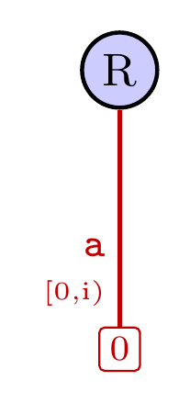
Rule 2.i
New leaf under "a" at the root
Step 1 of 13
String
a
b
c
a
b
a
a
$
0
1
2
3
4
5
6
7
current character
pending suffix
 | Before | After
Index i' | 0 | 1
Remainder | 0 | 0
Active length l | 0 | 0
Active point | (R, –, 0) | (R, –, 0)
What happens
No edge from the root starts with "a", so a new leaf is added there. Its range ends at the shared index i, so it grows automatically (Rule 1). The remainder was 0, so the index advances to 1. The active point resets to the root.
Notes:
Rule 2.i: new leaf under a at the root. No edge from the root starts with "a", so a new leaf is added there. Its range ends at the shared index i, so it grows automatically (Rule 1). The remainder was 0, so the index advances to 1. The active point resets to the root.

Slide 4
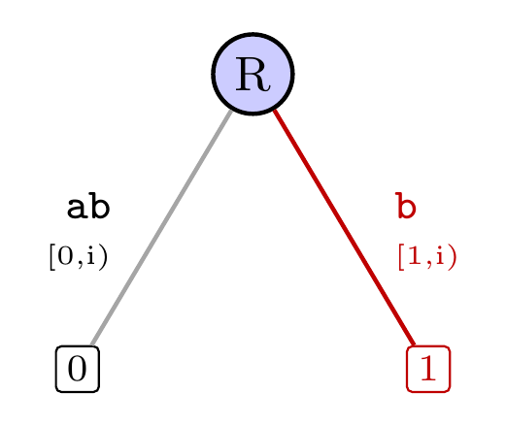
Rule 2.i
New leaf under "b" at the root
Step 2 of 13
String
a
b
c
a
b
a
a
$
0
1
2
3
4
5
6
7
current character
pending suffix
 | Before | After
Index i' | 1 | 2
Remainder | 0 | 0
Active length l | 0 | 0
Active point | (R, –, 0) | (R, –, 0)
What happens
No edge from the root starts with "b", so a new leaf is added there. Its range ends at the shared index i, so it grows automatically (Rule 1). The remainder was 0, so the index advances to 2. The active point resets to the root.
Notes:
Rule 2.i: new leaf under b at the root. No edge from the root starts with "b", so a new leaf is added there. Its range ends at the shared index i, so it grows automatically (Rule 1). The remainder was 0, so the index advances to 2. The active point resets to the root.

Slide 5
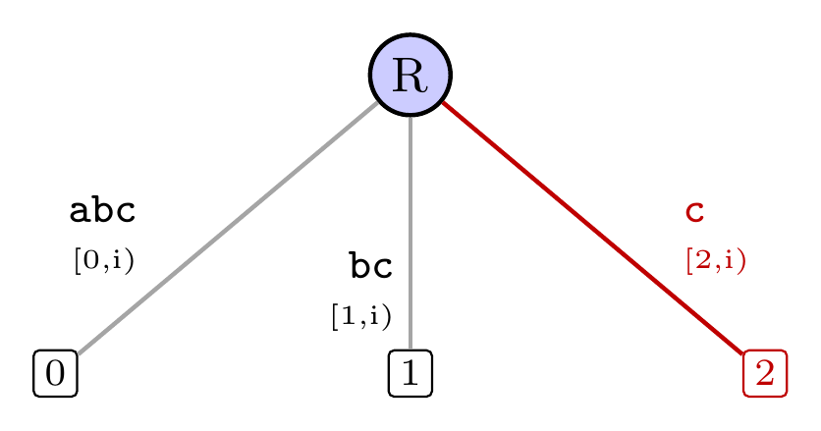
Rule 2.i
New leaf under "c" at the root
Step 3 of 13
String
a
b
c
a
b
a
a
$
0
1
2
3
4
5
6
7
current character
pending suffix
 | Before | After
Index i' | 2 | 3
Remainder | 0 | 0
Active length l | 0 | 0
Active point | (R, –, 0) | (R, –, 0)
What happens
No edge from the root starts with "c", so a new leaf is added there. Its range ends at the shared index i, so it grows automatically (Rule 1). The remainder was 0, so the index advances to 3. The active point resets to the root.
Notes:
Rule 2.i: new leaf under c at the root. No edge from the root starts with "c", so a new leaf is added there. Its range ends at the shared index i, so it grows automatically (Rule 1). The remainder was 0, so the index advances to 3. The active point resets to the root.

Slide 6
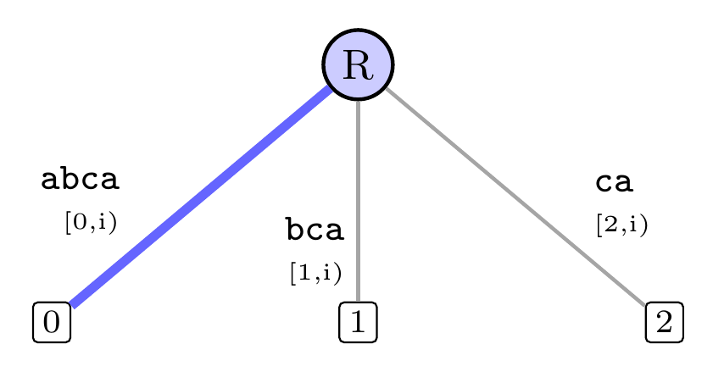
Rule 3
"a" already follows, so defer the insertion
Step 4 of 13
String
a
b
c
a
b
a
a
$
0
1
2
3
4
5
6
7
current character
pending suffix
 | Before | After
Index i' | 3 | 4
Remainder | 0 | 1
Active length l | 0 | 1
Active point | (R, –, 0) | (R, a…, 1)
What happens
"a" already follows at the active point, so this suffix is already in the tree implicitly. The insertion is deferred. The remainder and the active length each rise by one, and the index advances to 4.
Notes:
Rule 3: a already follows, so defer the insertion. "a" already follows at the active point, so this suffix is already in the tree implicitly. The insertion is deferred. The remainder and the active length each rise by one, and the index advances to 4.

Slide 7
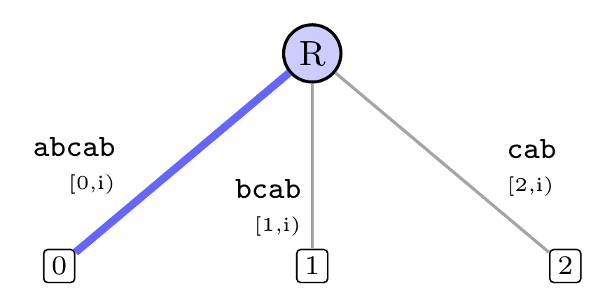
Rule 3
"b" already follows, so defer the insertion
Step 5 of 13
String
a
b
c
a
b
a
a
$
0
1
2
3
4
5
6
7
current character
pending suffix
 | Before | After
Index i' | 4 | 5
Remainder | 1 | 2
Active length l | 1 | 2
Active point | (R, a…, 1) | (R, a…, 2)
What happens
"b" already follows at the active point, so this suffix is already in the tree implicitly. The insertion is deferred. The remainder and the active length each rise by one, and the index advances to 5.
Notes:
Rule 3: b already follows, so defer the insertion. "b" already follows at the active point, so this suffix is already in the tree implicitly. The insertion is deferred. The remainder and the active length each rise by one, and the index advances to 5.

Slide 8
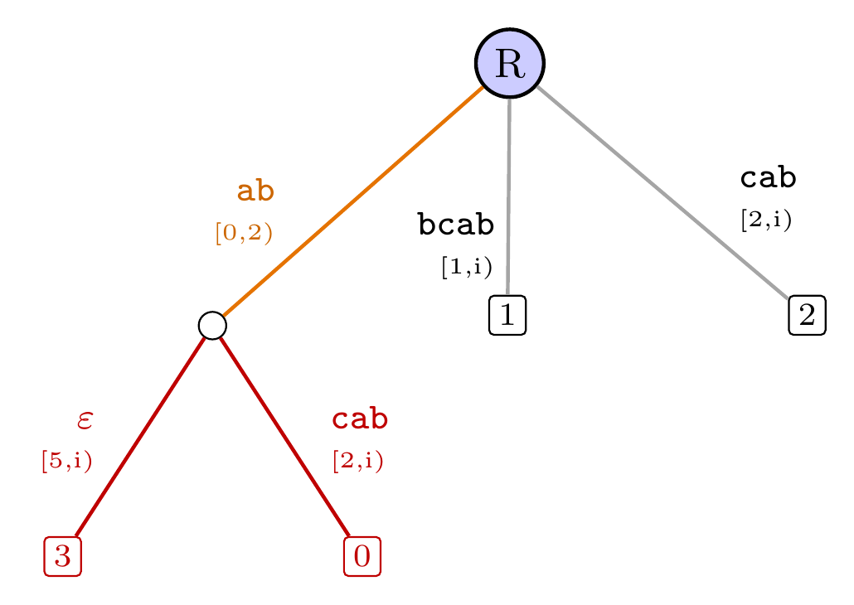
Rule 2.ii
Split leaf edge "abcab" after 2 characters, since "c" ≠ "a"
Step 6 of 13
String
a
b
c
a
b
a
a
$
0
1
2
3
4
5
6
7
current character
pending suffix
 | Before | After
Index i' | 5 | 5
Remainder | 2 | 1
Active length l | 2 | 1
Active point | (R, a…, 2) | (R, –, 1)
What happens
The edge "abcab" matches for 2 characters, then has "c" where the next character is "a". The edge is cut at that point. The lower part keeps the old end, so it is still a leaf. A new leaf is added for "a". The remainder was 2, so it drops to 1 and the index stays at 5. The new leaf is empty (ε) until the index advances. The active point resets to the root.
Notes:
Rule 2.ii: split leaf edge abcab after 2 characters, since c ≠ a. The edge "abcab" matches for 2 characters, then has "c" where the next character is "a". The edge is cut at that point. The lower part keeps the old end, so it is still a leaf. A new leaf is added for "a". The remainder was 2, so it drops to 1 and the index stays at 5. The new leaf is empty (ε) until the index advances. The active point resets to the root.

Slide 9
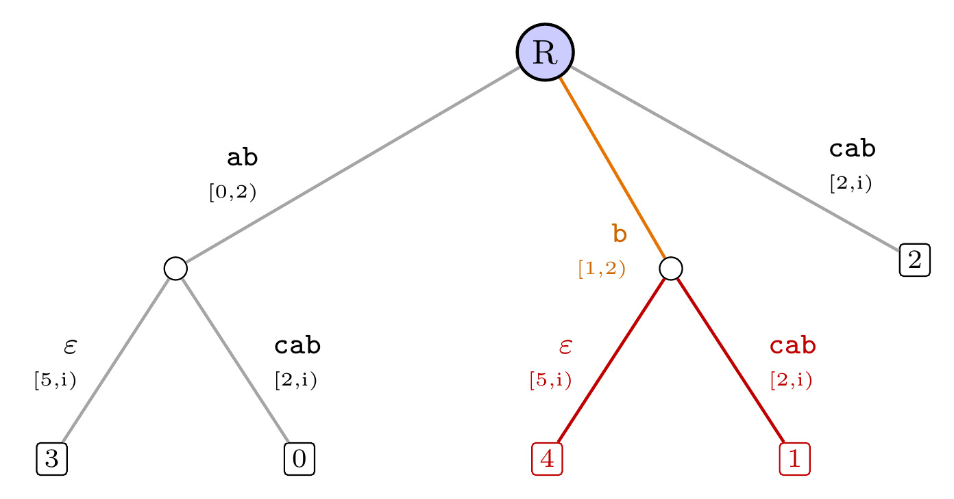
Rule 2.ii
Split leaf edge "bcab" after 1 character, since "c" ≠ "a"
Step 7 of 13
String
a
b
c
a
b
a
a
$
0
1
2
3
4
5
6
7
current character
pending suffix
 | Before | After
Index i' | 5 | 5
Remainder | 1 | 0
Active length l | 1 | 0
Active point | (R, –, 1) | (R, –, 0)
What happens
The edge "bcab" matches for 1 character, then has "c" where the next character is "a". The edge is cut at that point. The lower part keeps the old end, so it is still a leaf. A new leaf is added for "a". The remainder was 1, so it drops to 0 and the index stays at 5. The new leaf is empty (ε) until the index advances. The active point resets to the root.
Notes:
Rule 2.ii: split leaf edge bcab after 1 character, since c ≠ a. The edge "bcab" matches for 1 character, then has "c" where the next character is "a". The edge is cut at that point. The lower part keeps the old end, so it is still a leaf. A new leaf is added for "a". The remainder was 1, so it drops to 0 and the index stays at 5. The new leaf is empty (ε) until the index advances. The active point resets to the root.

Slide 10
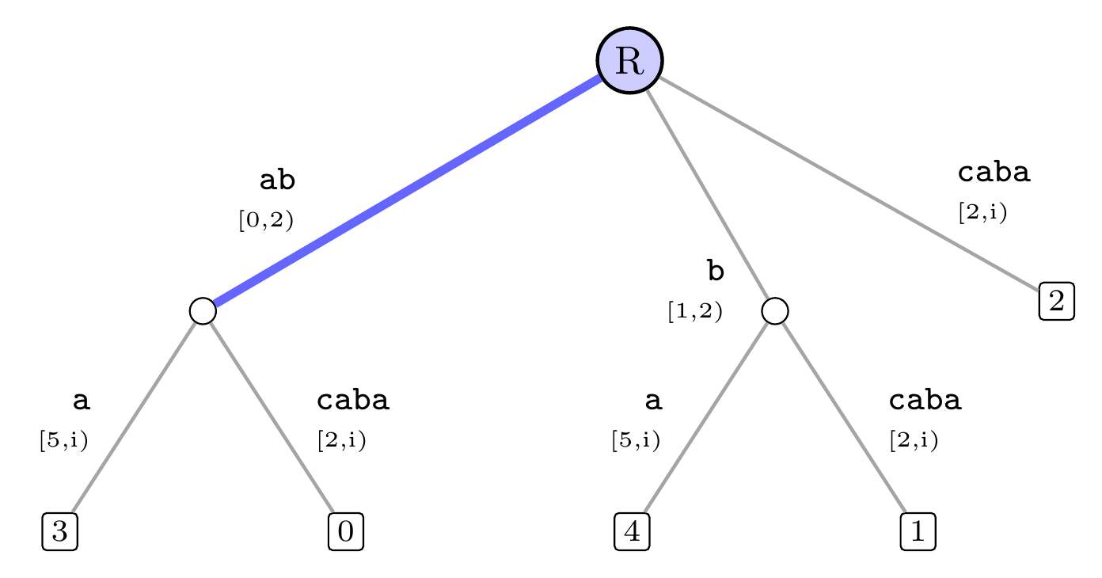
Rule 3
"a" already follows, so defer the insertion
Step 8 of 13
String
a
b
c
a
b
a
a
$
0
1
2
3
4
5
6
7
current character
pending suffix
 | Before | After
Index i' | 5 | 6
Remainder | 0 | 1
Active length l | 0 | 1
Active point | (R, –, 0) | (R, a…, 1)
What happens
"a" already follows at the active point, so this suffix is already in the tree implicitly. The insertion is deferred. The remainder and the active length each rise by one, and the index advances to 6.
Notes:
Rule 3: a already follows, so defer the insertion. "a" already follows at the active point, so this suffix is already in the tree implicitly. The insertion is deferred. The remainder and the active length each rise by one, and the index advances to 6.

Slide 11
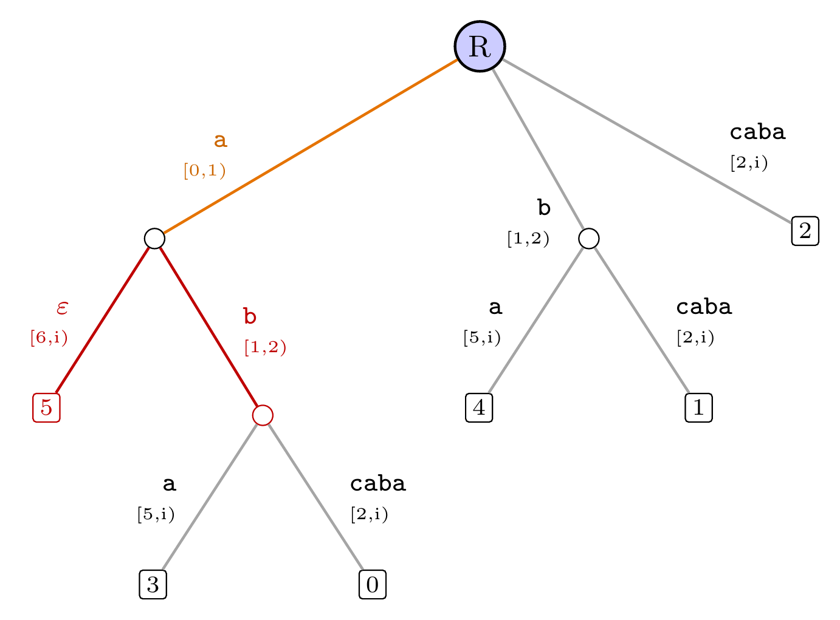
Rule 2.ii
Split internal edge "ab" after 1 character, since "b" ≠ "a"
Step 9 of 13
String
a
b
c
a
b
a
a
$
0
1
2
3
4
5
6
7
current character
pending suffix
 | Before | After
Index i' | 6 | 6
Remainder | 1 | 0
Active length l | 1 | 0
Active point | (R, a…, 1) | (R, –, 0)
What happens
The edge "ab" matches for 1 character, then has "b" where the next character is "a". The edge is cut at that point. The lower part keeps the old end and takes the old children. A new leaf is added for "a". The remainder was 1, so it drops to 0 and the index stays at 6. The new leaf is empty (ε) until the index advances. The active point resets to the root.
Notes:
Rule 2.ii: split internal edge ab after 1 character, since b ≠ a. The edge "ab" matches for 1 character, then has "b" where the next character is "a". The edge is cut at that point. The lower part keeps the old end and takes the old children. A new leaf is added for "a". The remainder was 1, so it drops to 0 and the index stays at 6. The new leaf is empty (ε) until the index advances. The active point resets to the root.

Slide 12
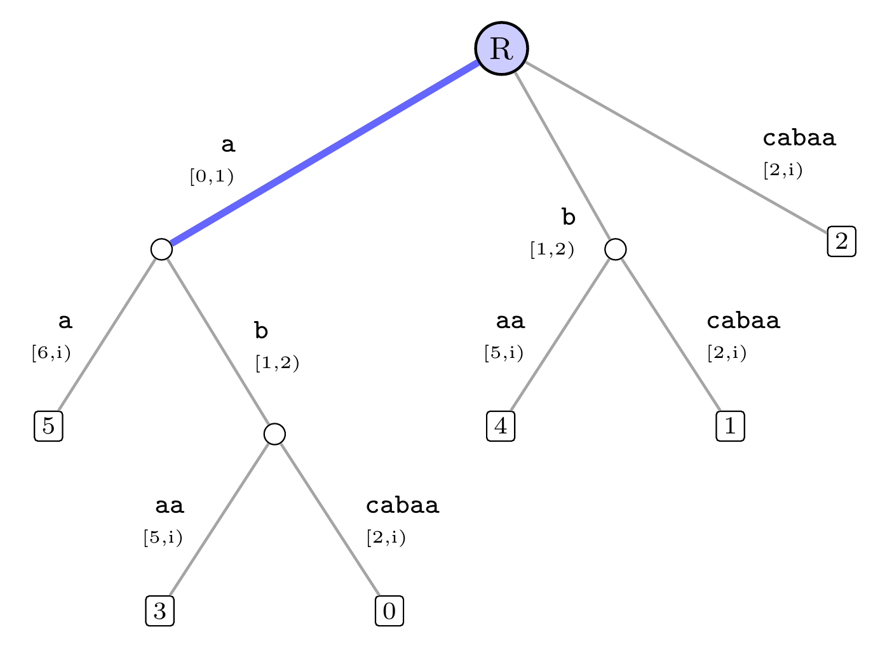
Rule 3
"a" already follows, so defer the insertion
Step 10 of 13
String
a
b
c
a
b
a
a
$
0
1
2
3
4
5
6
7
current character
pending suffix
 | Before | After
Index i' | 6 | 7
Remainder | 0 | 1
Active length l | 0 | 1
Active point | (R, –, 0) | (R, a…, 1)
What happens
"a" already follows at the active point, so this suffix is already in the tree implicitly. The insertion is deferred. The remainder and the active length each rise by one, and the index advances to 7.
Notes:
Rule 3: a already follows, so defer the insertion. "a" already follows at the active point, so this suffix is already in the tree implicitly. The insertion is deferred. The remainder and the active length each rise by one, and the index advances to 7.

Slide 13
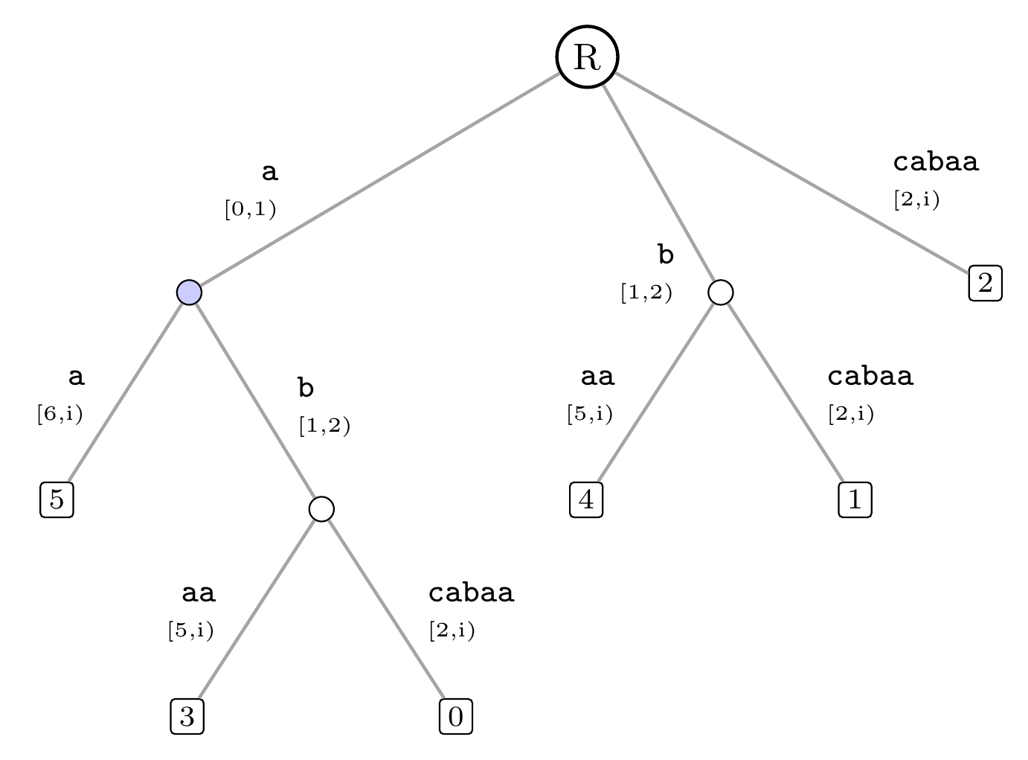
Walk down
Edge "a" is not longer than l, so move below it
Step 11 of 13
String
a
b
c
a
b
a
a
$
0
1
2
3
4
5
6
7
current character
pending suffix
 | Before | After
Index i' | 7 | 7
Remainder | 1 | 1
Active length l | 1 | 0
Active point | (R, a…, 1) | (a, –, 0)
What happens
The active length l = 1 reaches the end of edge "a", so the active parent moves below it. The active length drops by the edge's length. Nothing is added to the tree.
Notes:
Walk down: edge a is not longer than l, so move below it. The active length l = 1 reaches the end of edge "a", so the active parent moves below it. The active length drops by the edge's length. Nothing is added to the tree.

Slide 14
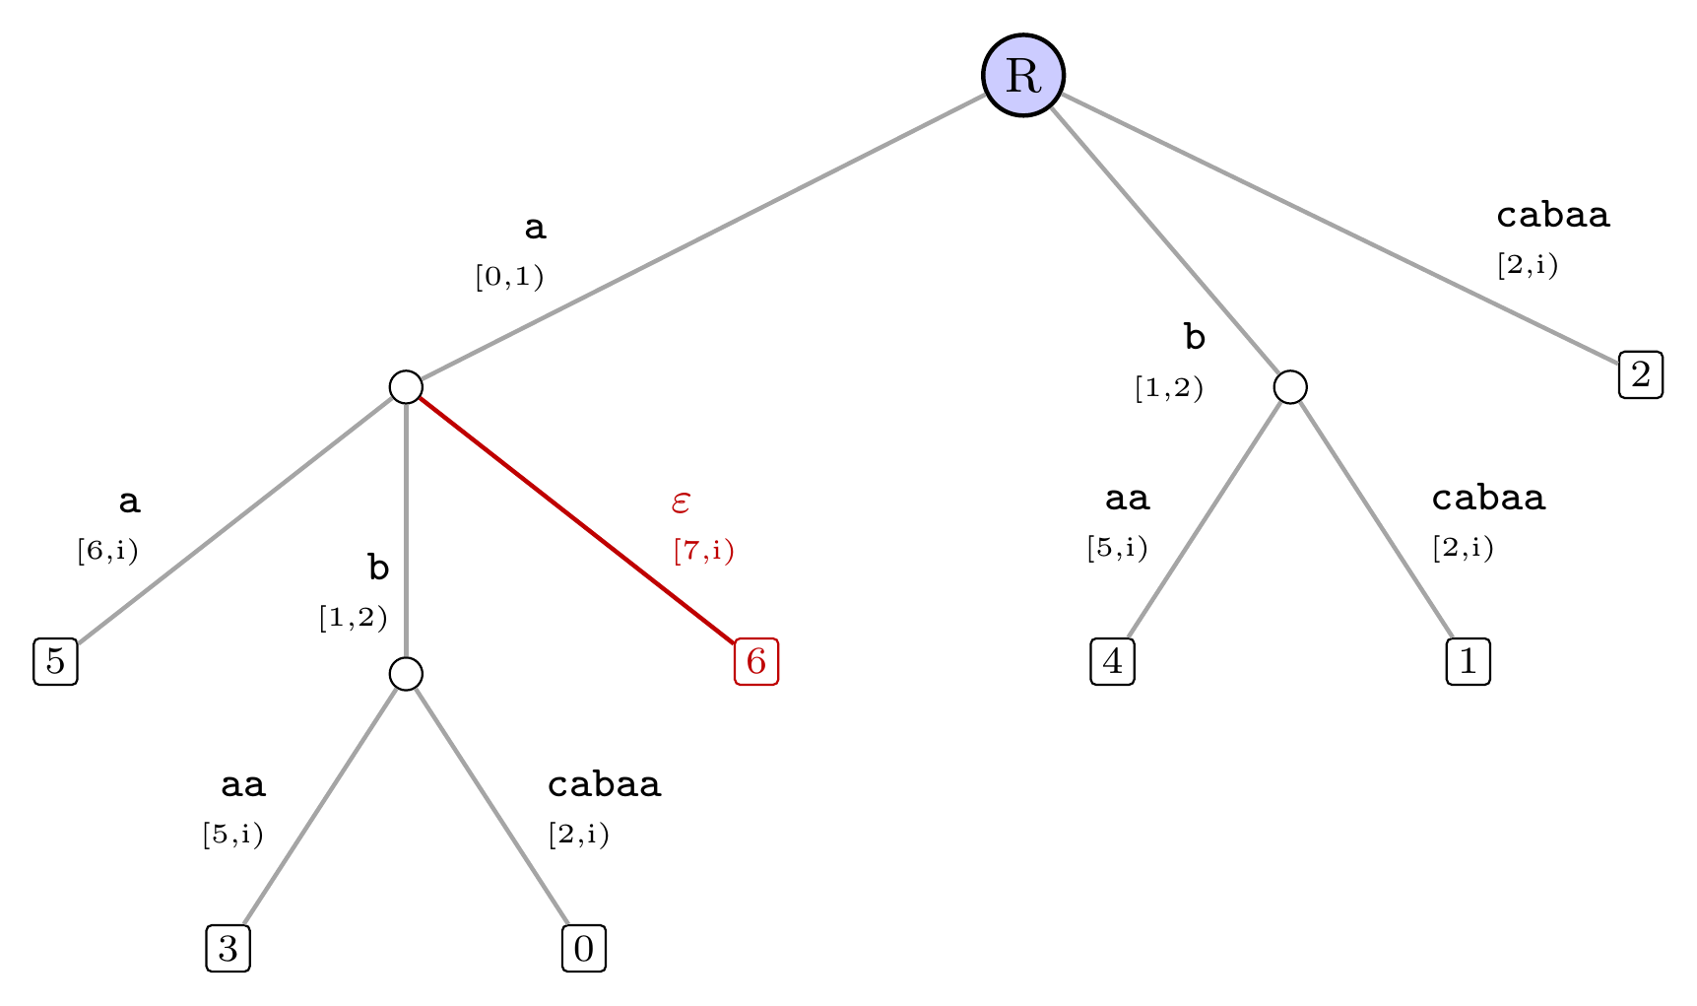
Rule 2.i
New leaf under "$" at an internal node
Step 12 of 13
String
a
b
c
a
b
a
a
$
0
1
2
3
4
5
6
7
current character
pending suffix
 | Before | After
Index i' | 7 | 7
Remainder | 1 | 0
Active length l | 0 | 0
Active point | (a, –, 0) | (R, –, 0)
What happens
No edge from the node for "a" starts with "$", so a new leaf is added there. Its range ends at the shared index i, so it grows automatically (Rule 1). The remainder was 1, so it drops to 0 and the index stays at 7. The new leaf is empty (ε) until the index advances. The active point resets to the root.
Notes:
Rule 2.i: new leaf under $ at an internal node. No edge from the node for "a" starts with "$", so a new leaf is added there. Its range ends at the shared index i, so it grows automatically (Rule 1). The remainder was 1, so it drops to 0 and the index stays at 7. The new leaf is empty (ε) until the index advances. The active point resets to the root.

Slide 15
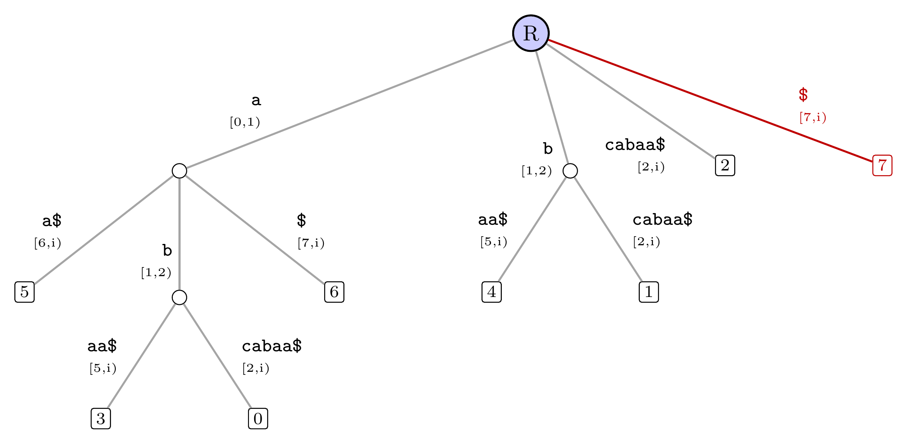
Rule 2.i
New leaf under "$" at the root
Step 13 of 13
String
a
b
c
a
b
a
a
$
0
1
2
3
4
5
6
7
current character
pending suffix
 | Before | After
Index i' | 7 | 8
Remainder | 0 | 0
Active length l | 0 | 0
Active point | (R, –, 0) | (R, –, 0)
What happens
No edge from the root starts with "$", so a new leaf is added there. Its range ends at the shared index i, so it grows automatically (Rule 1). The remainder was 0, so the index advances to 8. The active point resets to the root. Every suffix of abcabaa$ now ends at its own leaf.
Notes:
Rule 2.i: new leaf under $ at the root. No edge from the root starts with "$", so a new leaf is added there. Its range ends at the shared index i, so it grows automatically (Rule 1). The remainder was 0, so the index advances to 8. The active point resets to the root. Every suffix of abcabaa$ now ends at its own leaf.

