Slide 1




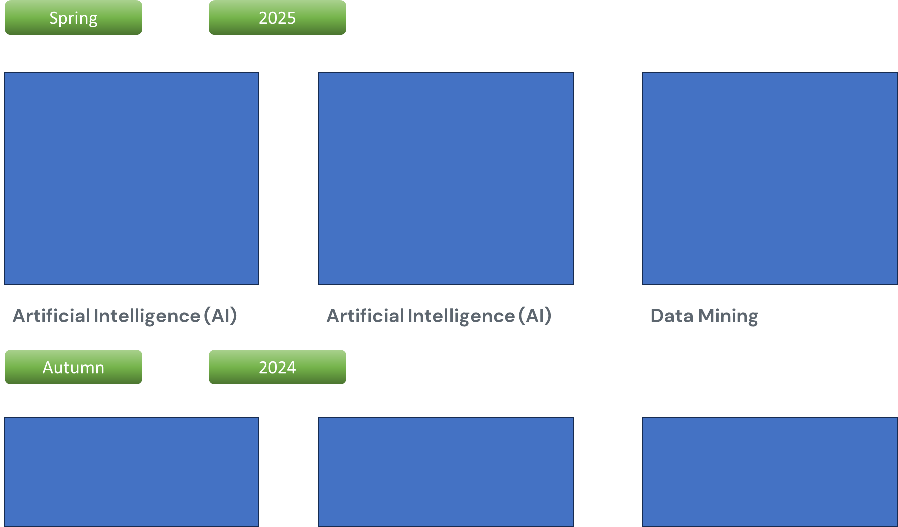
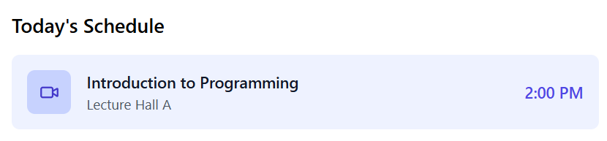
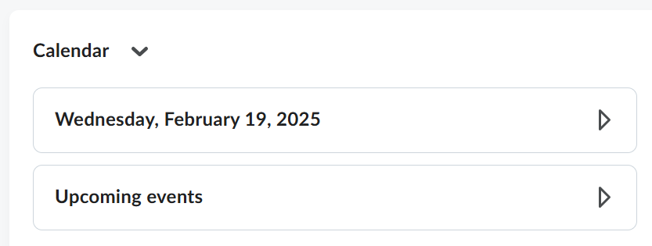
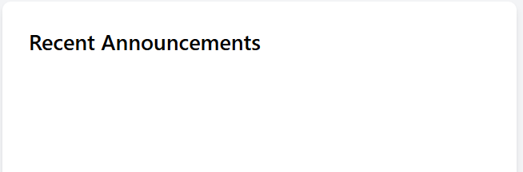
KIIT eXtension School
Welcome to KiiTX LMS!!

Slide 2
KIIT eXtension School
Profile
Switch Profile
Account Setting
Log out
Welcome to KiiTX LMS!!

Slide 3
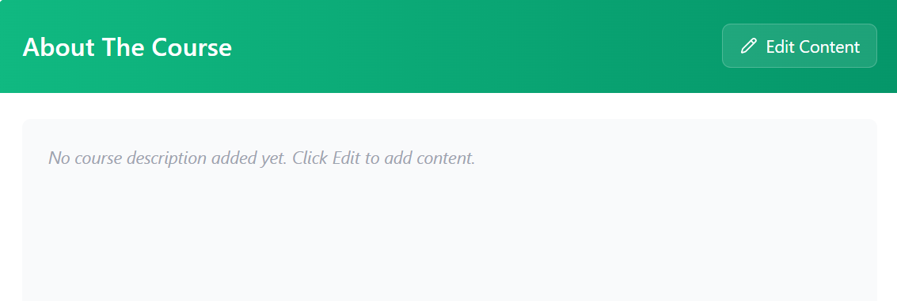

Take Class
Course
Course Brief
Syllabus
Weekly Plan
Class Schedule
Student Detail
Attendance
Mark Attendance
Heat Map
Status Sheet
Credit Points Distribution
Recorded Lecture
Lecture
Tutorial
Practical
Project
Total
e-Content
Assignment
Class Test
Learning Outcome
Grade Sheet
LO1:
+ Add Learning Outcome

Slide 4
Take Class
Module 1:
Module title
Course
Course Brief
Topic 1
Syllabus
Topic 2
Weekly Plan
Class Schedule
Topic 3
Student Detail
Add more Topic
Attendance
Mark Attendance
Heat Map
Status Sheet
Add more Module
Recorded Lecture
e-Content
Question Bank
Assignment
Class Test
Grade Sheet
Here "Week Plan" refers to a plan that covers the entire week, starting from Monday and ending on Sunday
Cancel
Save

Slide 5
Take Class
Weekly Delivery Plan
Course
Course Brief
Syllabus
Weather apps
Digital assistants
Software that analyzes data to optimize a given business function
Week 1:
Weekly Plan
Class Schedule
Student Detail
Attendance
Weather apps
Digital assistants
Software that analyzes data to optimize a given business function
Week 2:
Mark Attendance
Heat Map
Status Sheet
Recorded Lecture
Weather apps
Digital assistants
Software that analyzes data to optimize a given business function
e-Content
Week 3:
Assignment
Class Test
Grade Sheet
Add more week
Here "Week Plan" refers to a plan that covers the entire week, starting from Monday and ending on Sunday
Cancel
Save

Slide 6
Take Class
Course Schedule
Course
Course Brief
Syllabus
Class starts from | Date
Class ends on | Date
Mid-Semester Exam Date | Date
End Semester Exam Date | Date
Class Day and Timing:
Weekly Plan
Class Schedule
Student Detail
Attendance
Mark Attendance
Heat Map
Status Sheet
Day | Time
Monday | 6 pm to 7.30 pm
Wednesday | 6 pm to 7.30 pm
Recorded Lecture
e-Content
+ Add more Days and Time
Question Bank
Assignment
Assignment 1 | Date
Assignment 2 | Date
Quiz Test 1 | Date
Assignment 3 | Date
Activity 1 | Date
Class Test
Grade Sheet

Slide 7
Artificial Intelligence (AI)
Take Class
Sl. No. | Roll No. | Name | Mobile | Email | Program | Current Semester | Associated Company
Course
Student Detail
Attendance
Recorded Lecture
E-Content
Question Bank
Assignment
Class Test
Grade Sheet

Slide 8
Take Class
Course
Course Brief
Date: 24/2/2025 Time: 6 pm
Syllabus
*Tap and Change the Status of the attendance
Weekly Plan
Sl. No | Roll No. | Name | Program | Status
1
2
3
4
5
Class Schedule
Student Detail
Absent
Attendance
Absent
Mark Attendance
Heat Map
Status Sheet
Absent
Absent
Recorded Lecture
Present
e-Content
Question Bank
Assignment
Class Test
Grade Sheet

Slide 9
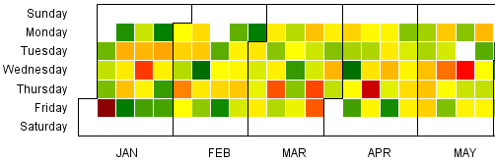
Take Class
Course
Course Brief
Syllabus
Weekly Plan
Class Schedule
Student Detail
Attendance
Mark Attendance
Heat Map
Status Sheet
Recorded Lecture
e-Content
Question Bank
Assignment
Class Test
Grade Sheet

Slide 10
Take Class
Course
Course Brief
Date: 24/2/2025 Time: 6 pm
Syllabus
Weekly Plan
*Tap and Change the Status of the attendance within 7 days of last class
Class Schedule
Sl. No. | Roll No. | Present %age | 21Feb | 24 Feb | Date | Date | Date | Date | Date
1 |  | 100
2 |  | 100
3 |  | 100
4 |  | 0
5 |  | 100
6 |  | 100
7 |  | 100
8 |  | 100
9 |  | 100
Student Detail
Attendance
Mark Attendance
Heat Map
Status Sheet
Recorded Lecture
e-Content
Question Bank
Assignment
Class Test
Grade Sheet

Slide 11




Take Class
Course
Course Brief
Lecture 1
Lecture 2
Lecture 3
Syllabus
Weekly Plan
Class Schedule
Student Detail
Title of the Lecture
Title of the Lecture
Title of the Lecture
Attendance
Date: Time:
Duration:
Date: Time:
Duration:
Date: Time:
Duration:
Mark Attendance
Heat Map
Status Sheet
Recorded Lecture
Lecture 4
Lecture 5
Lecture 6
e-Content
Question Bank
Assignment
Class Test
Grade Sheet
Title of the Lecture
Add Title of the Lecture
Add Title of the Lecture
Date: Time:
Duration:
Date: Time:
Duration:
Date: Time:
Duration:
Note: Uncut Lecture recordings will be automatically listed by Sunday Midnight if not reviewed by Sunday midnight

Slide 12

Lecture 1: Date 18/2/24
Cancel
Save

Slide 13
Take Class
Course
Course Brief
Lecture 1
Lecture 2
Lecture 3
Syllabus
Weekly Plan
Lecture 1:
Class Schedule
Student Detail
Add Title of the Lecture
Title of the Lecture
Title of the Lecture
Title of the Lecture
Attendance
Date: Time:
Duration:
Date: Time:
Duration:
Date: Time:
Duration:
Add topics covered in the Lecture
Mark Attendance
Heat Map
Status Sheet
Recorded Lecture
Lecture 4
Lecture 5
Lecture 6
e-Content
Question Bank
Back
Assignment
Class Test
Title of the Lecture
Add Title of the Lecture
Add Title of the Lecture
Grade Sheet
Date: Time:
Duration:
Date: Time:
Duration:
Date: Time:
Duration:
Note: Uncut Lecture recordings will be automatically listed by Sunday Midnight if not reviewed by Sunday midnight

Slide 14



Lecture 1
Lecture 2
Lecture 3
Lecture 4
Title of Lecture
Title of Lecture
Title of Lecture
Title of Lecture

Slide 15


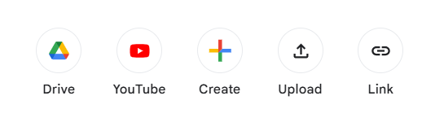


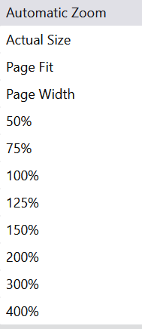






Search Topic, description
Module 1: Module Title
Module 2: Module Title
Topic 1
Topic 2
Topic 3
Module 3: Module Title
Module 4: Module Title
Module 5: Module Title
Module 6: Module Title

Slide 16

Search Topic, description
Module 1: Module Title
Module 2: Module Title
Topic 1
Topic 2
Topic 3
Module:
1
Topic:
Module 3: Module Title
Note: Upload Notes in word, pdf or ppt format
Module 4: Module Title
Module 5: Module Title
Module 6: Module Title

Slide 17
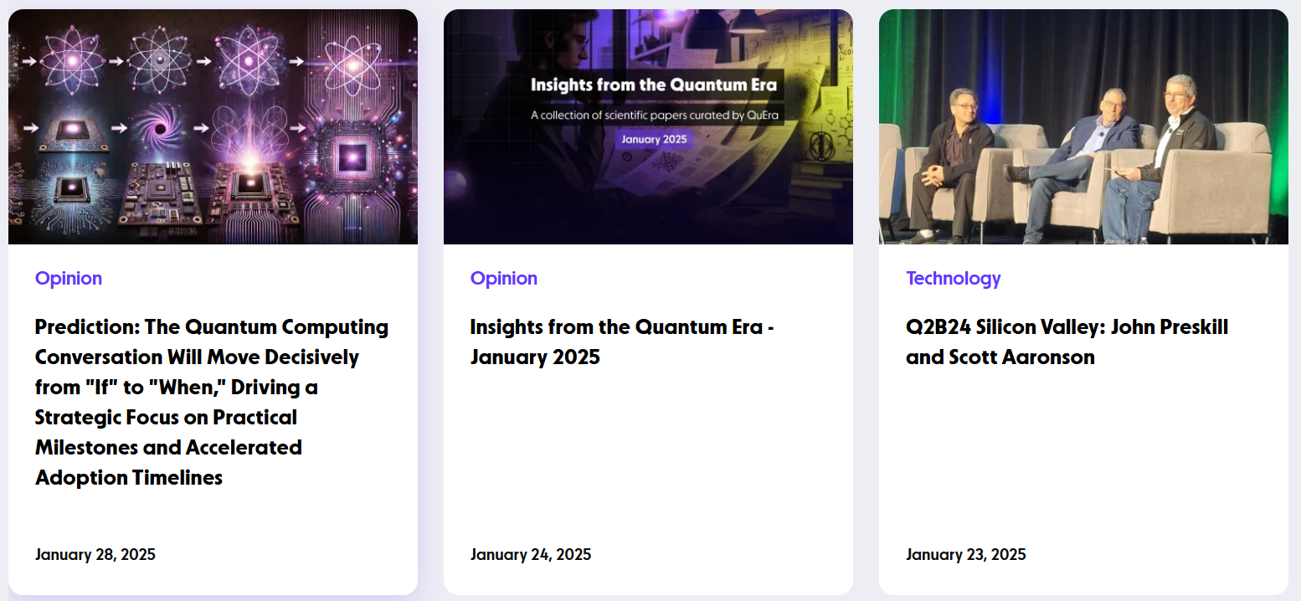
Search Topic, description
+
Add more Reference links
Module 1: Module Title
Module 2: Module Title
Topic 1
Topic 2
Topic 3
Module 3: Module Title
Module 4: Module Title
Module 5: Module Title
Module 6: Module Title

Slide 18
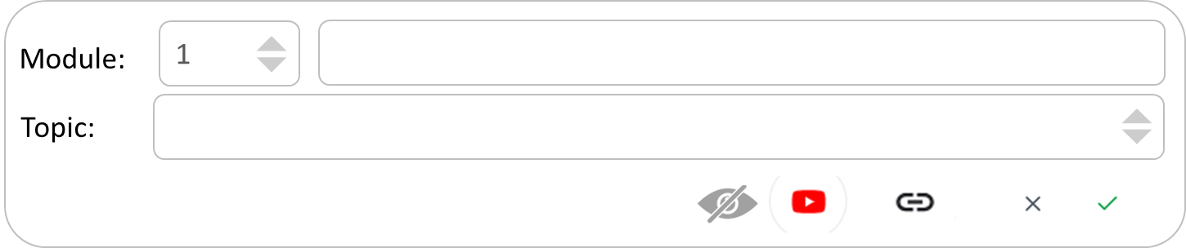
Search Topic, description
+
Add more Reference links
Module 1: Module Title
Module 2: Module Title
Topic 1
Topic 2
Topic 3
Module 3: Module Title
Module 4: Module Title
Module 5: Module Title
Module 6: Module Title

Slide 19

Search Topic, description
+
Add more Questions
Short Type Questions
Long Type Questions
Very Long Type Questions
Multiple Choice Questions
Short type Questions
Module 1: Module Title
Sl. No. | Question | LO
1
2
3
Module 2: Module Title
Topic 1
Topic 2
Topic 3
Topic 4
Topic 5
Long type Questions
Sl. No. | Question | LO
1
2
3
Module 3: Module Title
Module 4: Module Title
Module 5: Module Title
Very Long type Questions
Sl. No. | Question | LO
1
2
3
Module 6: Module Title

Slide 20
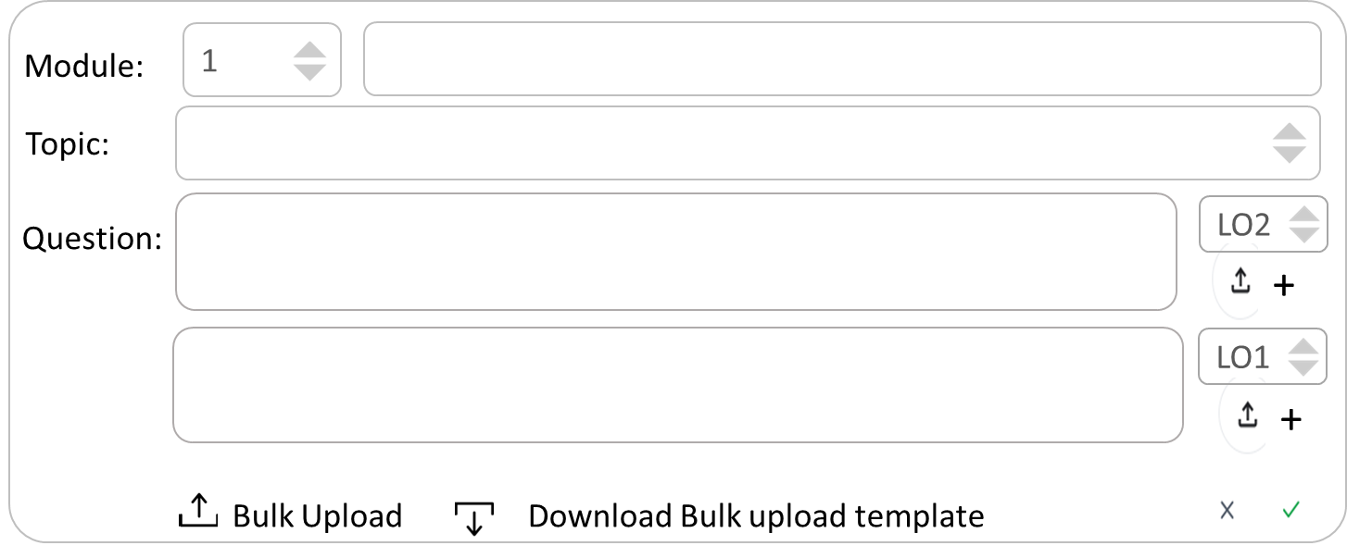
Search Topic, description
+
Add more Questions
Short Type Questions
Long Type Questions
Very Long Type Questions
Multiple Choice Questions
Short type Questions
Module 1: Module Title
Sl. No. | Question | LO
1
2
3
Module 2: Module Title
Topic 1
Topic 2
Topic 3
Topic 4
Topic 5
Long type Questions
Sl. No. | Question | LO
1
2
3
Module 3: Module Title
Module 4: Module Title
Module 5: Module Title
Very Long type Questions
Sl. No. | Question | LO
1
2
3
Module 6: Module Title

Slide 21
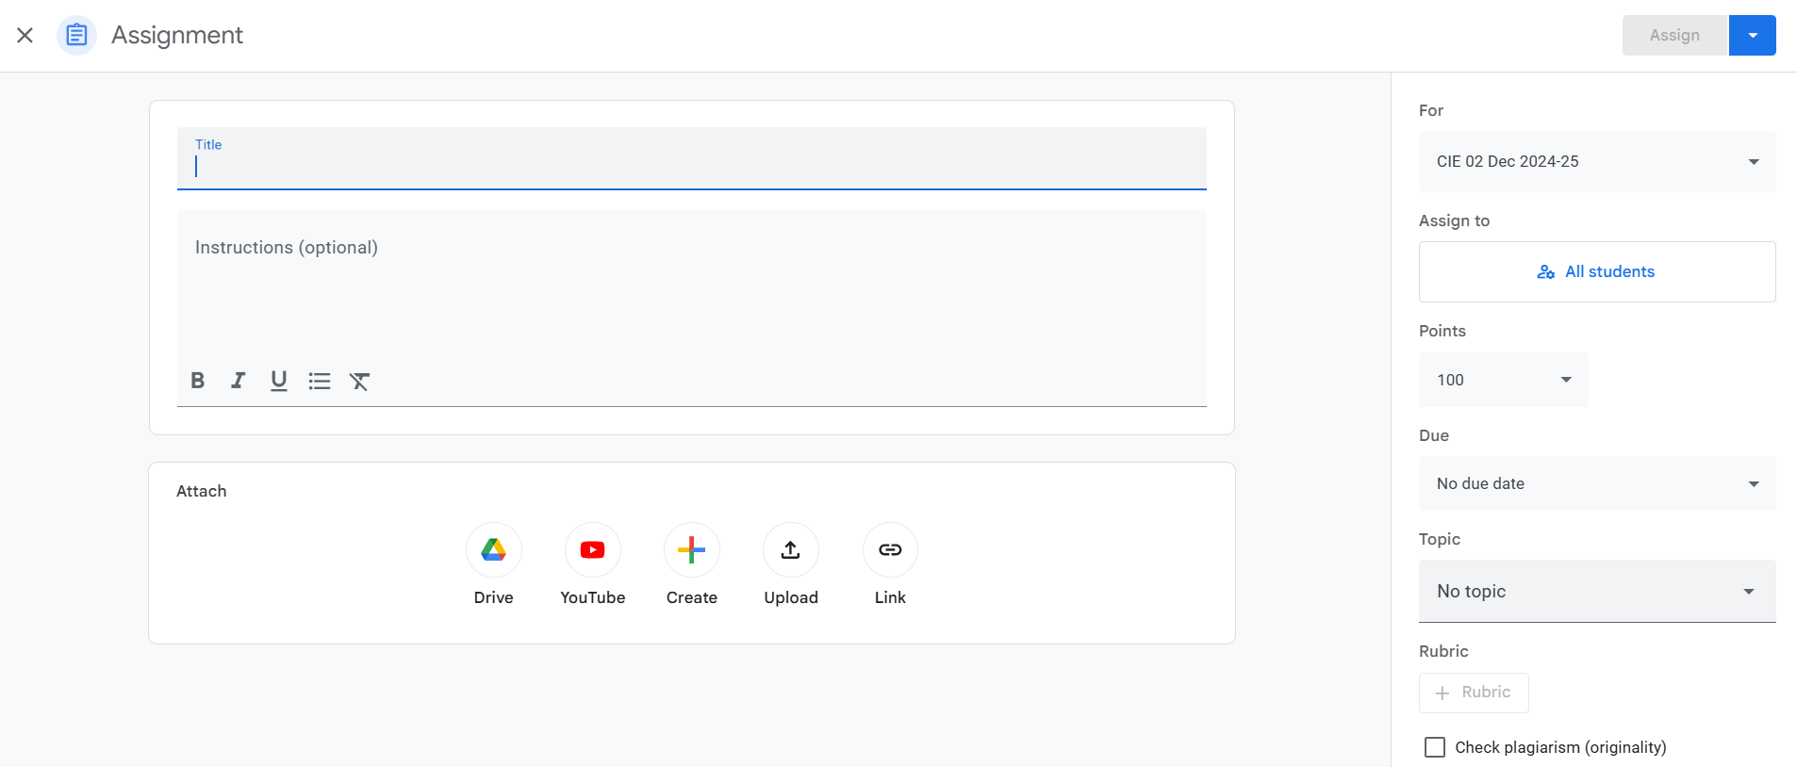
Take Class
Course
Long/ Short type Questions
Course Brief
Syllabus
Weekly Plan
Class Schedule
Student Detail
Attendance
Mark Attendance
Heat Map
Status Sheet
Recorded Lecture
e-Content
Question Bank
Assignment
Class Test
Grade Sheet

Slide 22
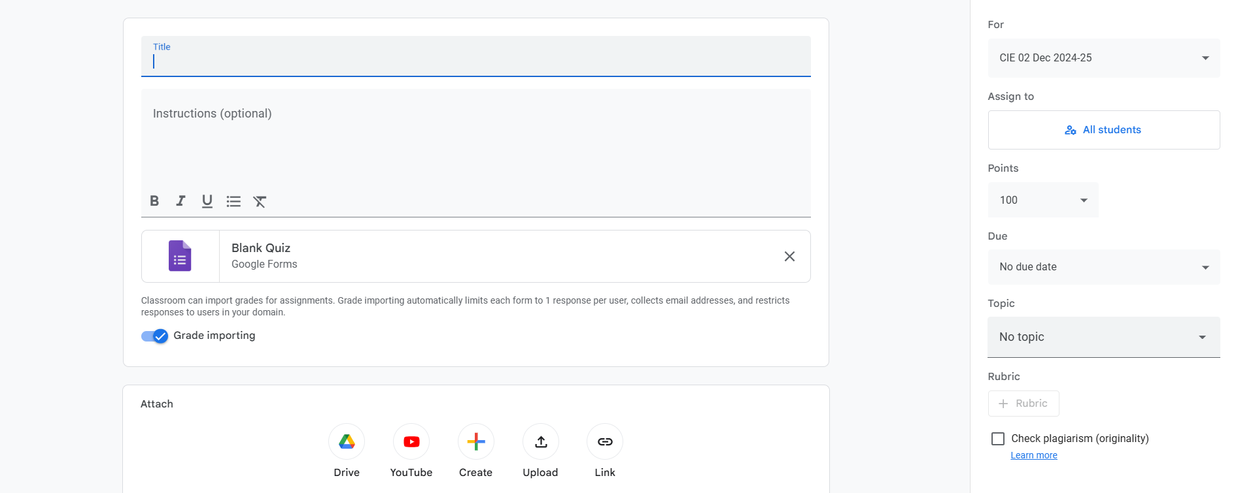
Take Class
Course
Course Brief
Multiple Choice Questions
Syllabus
Weekly Plan
Class Schedule
Student Detail
Attendance
Mark Attendance
Heat Map
Status Sheet
Recorded Lecture
e-Content
Question Bank
Assignment
Class Test
Grade Sheet

Slide 23
Admin
Dean
ICT Support Head
Associate Dean
ICT Manager
Program Coordinator
ICT Campus Supervisor
Mentor
Teacher
Student
Teaching Assistant

