Slide 1




BDM Project - Viva Report
Optimizing Inventory and Operations for Sustainable Growth in a Family-Run Grocery Business
Name : Sumit
Roll No : 22f2000848
Email : 22f2000848@ds.study.iitm.ac.in

Slide 2


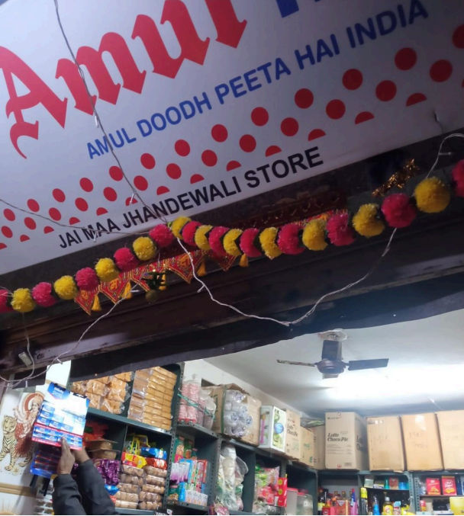
Organization Background
Business Name
Jai Maa Jhandewali Store, VP Block, Pitampura, Delhi
Structure
Family-run B2C store operating 9 AM – 9 PM
Established
~2 years ago, initial investment ₹7 Lakh
Revenue Recovery
Broke even in 1.5 years, now profitable
Key Products
Dairy (Milk, Butter), FMCG (Bread, Chips, Soft Drinks), Groceries (Rice, Pulses, etc.)

Slide 3



Problem Statement
Inventory Management Issues
Limited Business Growth
Space Constraints
Fluctuating demand (e.g., Milk: 4–108 units/day)
Overstocking perishable items leads to wastage
Manual processes, no automation, time constraints of owner
Limited storage (some stock kept at home)
Poor SKU placement efficiency

Slide 4

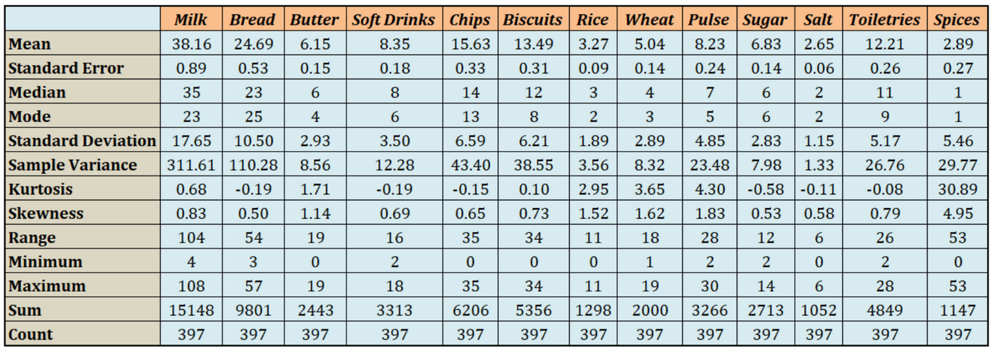
Data Collection & Metadata
Data Type : Primary – 13-month sales from handwritten bills
Source : Owner logs & interviews
Duration : Jan 2024 to Jan 2025
Data Size : 398 daily entries × 13 SKUs = ~5,174 records
Variables Collected :
Date, SKU, Quantity Sold
SKU Category (Dairy, FMCG, Groceries)
Dataset Link

Slide 5
Methodology
Trend Analysis | Sales Forecasting | ABC Analysis | Correlation Analysis
Visualized monthly sales; revealed seasonal spikes (e.g., Milk in March/Dec) Decomposed time series using moving averages | Applied Linear Regression to Milk (R² ≈ 0.78, RMSE = low) Used lag features, month, category, weekday | Ranked SKUs by cumulative sales contribution Categorized into A (top 70%), B (next 20%), C (bottom 10%) | Pearson method used Heatmap shows SKU relationships (cross-sell potential)

Slide 6
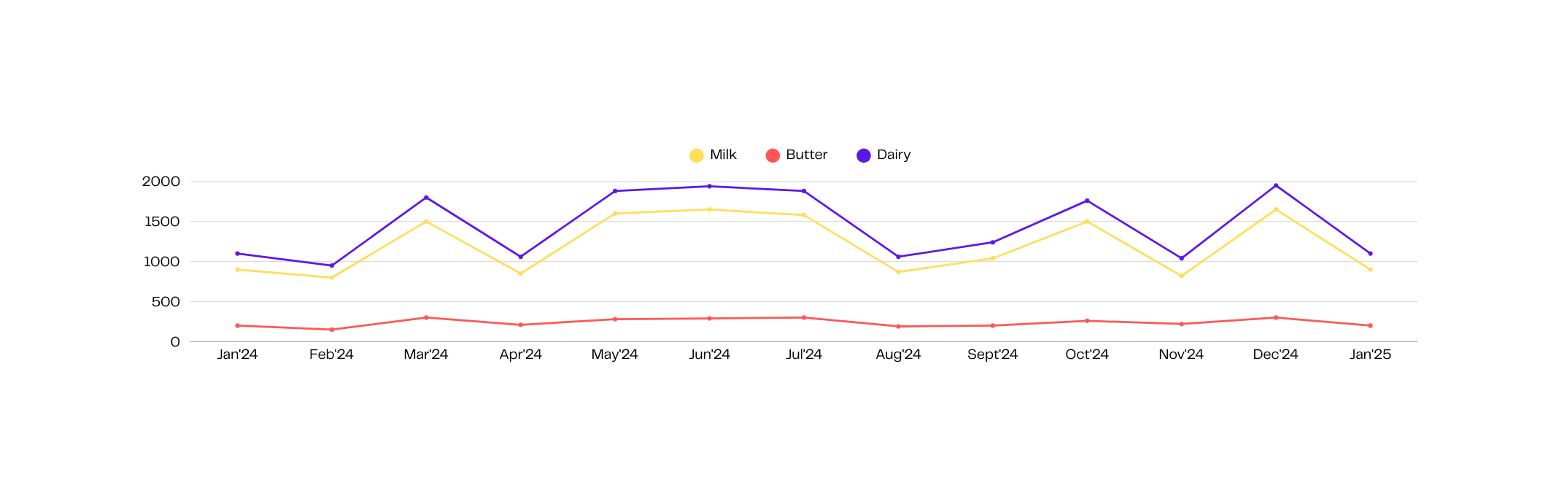
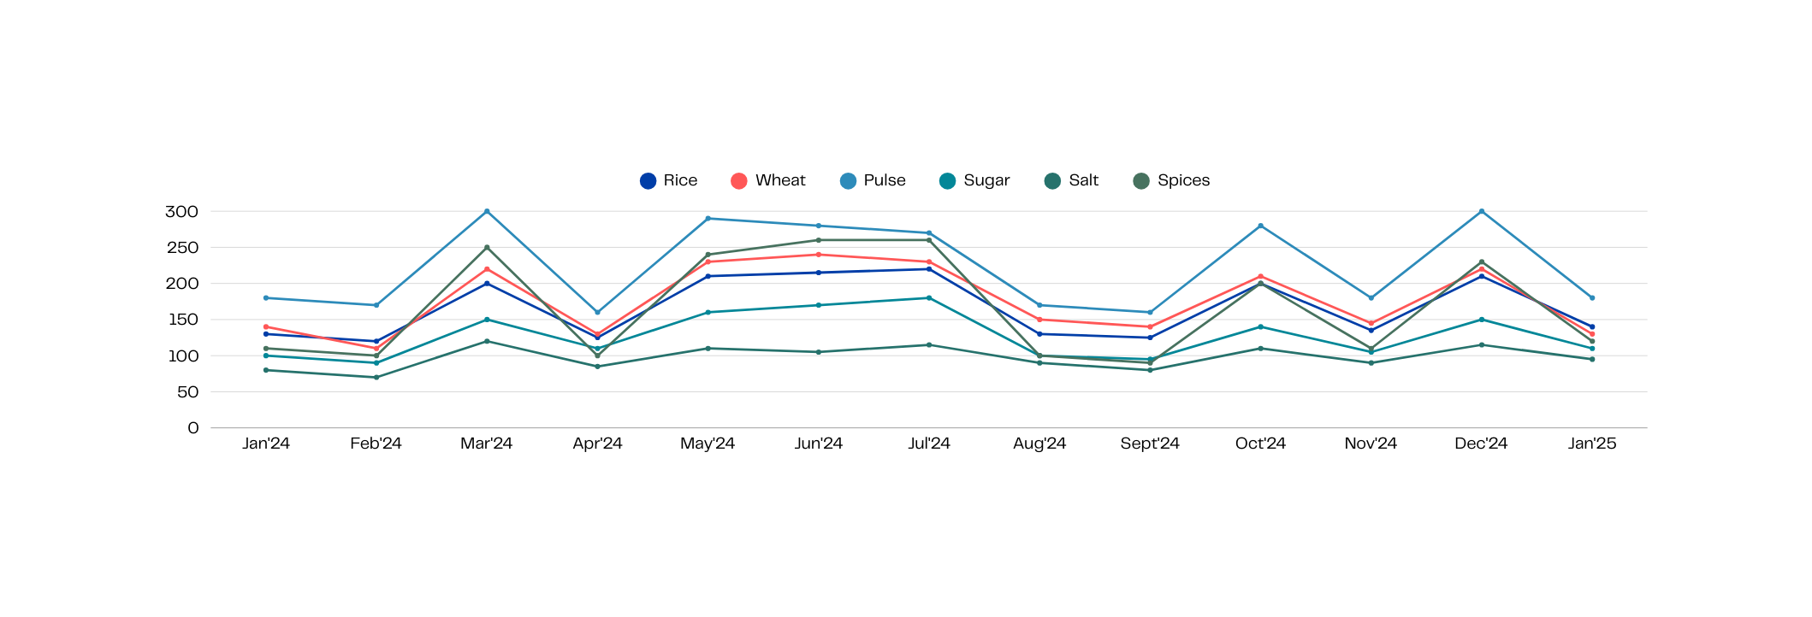
Sales Trends & Category Insights
Dairy Products Sales (Units)
Groceries Sales (Units)

Slide 7
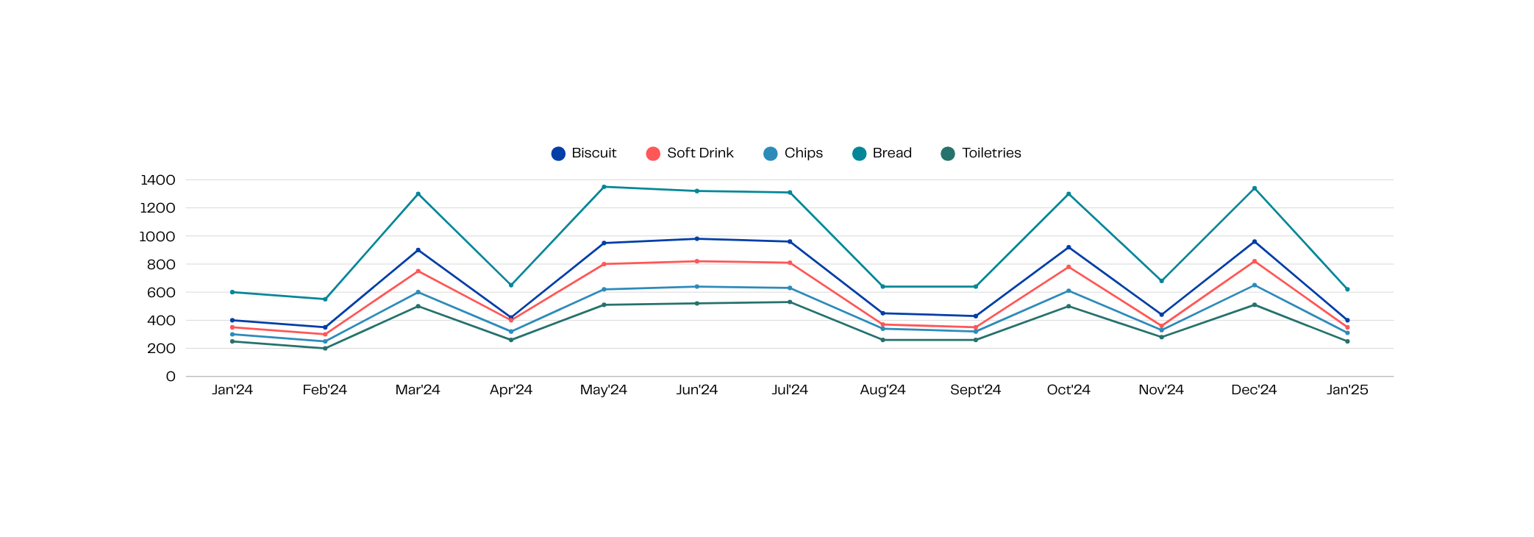
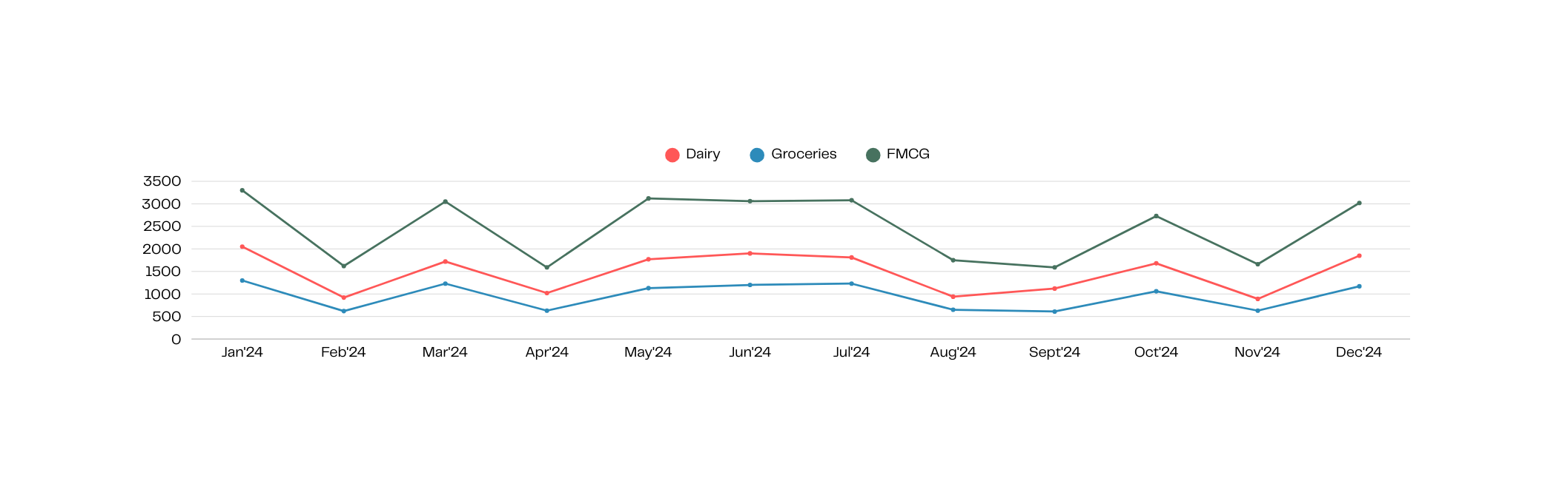
Sales Trends & Category Insights
FMCG Sales (Units)
Total Sales (Category)

Slide 8
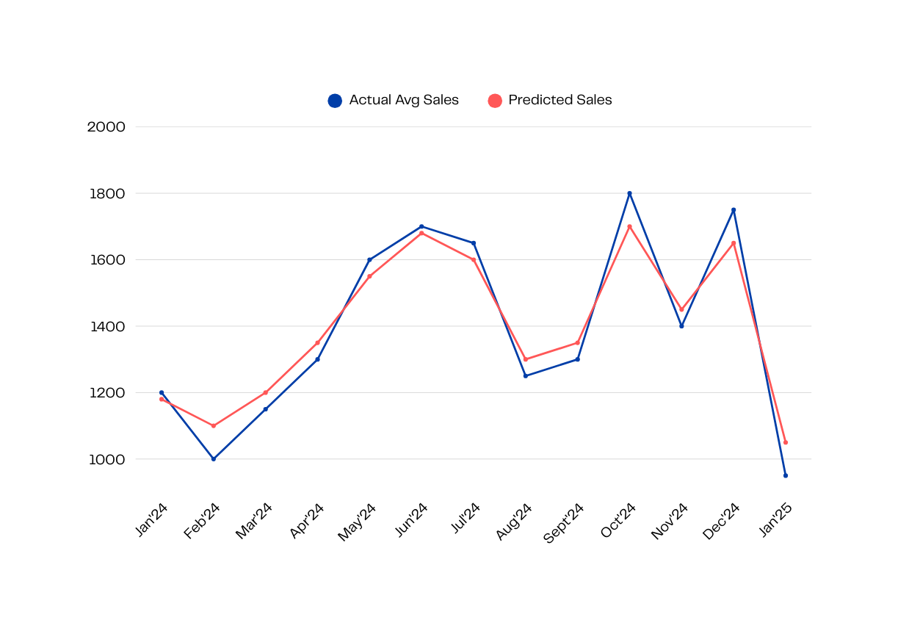
Trend & Forecasting Insights
Milk Sales : Peaks in March, June, October, December
FMCG (Bread) : Mirrors milk’s seasonality
Groceries (Pulses) : Consistent sales year-round
Forecast (Milk) :
Predicted upcoming 3-months sales using ML
Enabled proactive ordering of perishables

Slide 9
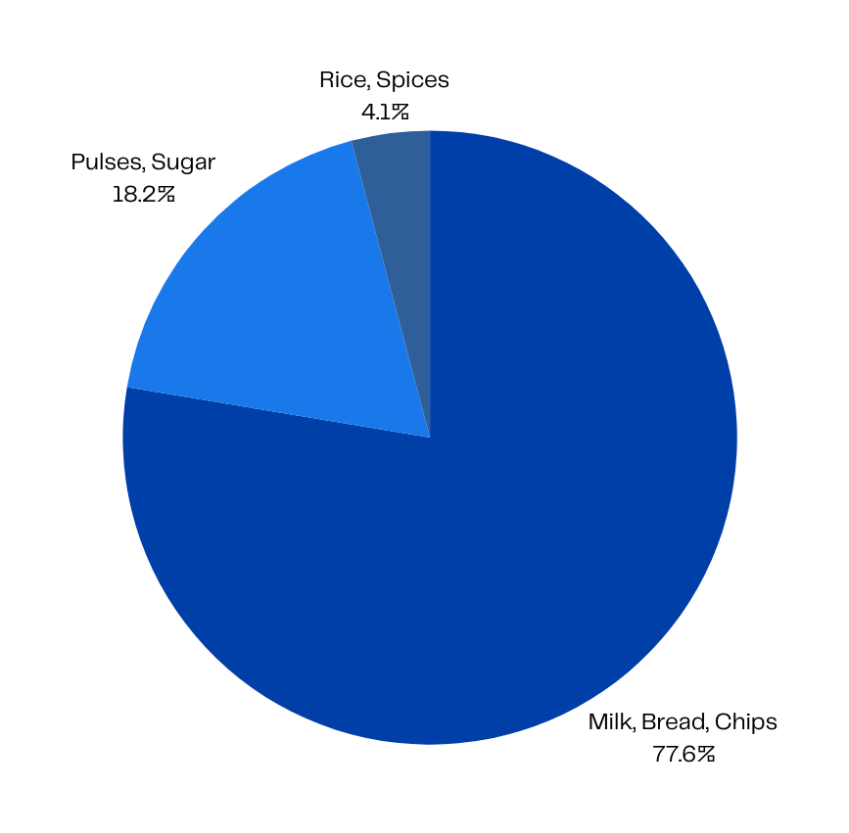
ABC & SKU Analysis
Category A (High Priority)
Milk (15,148 units, 25.85% of total sales)
Bread (9,801 units, 16.77%)
Chips, Biscuits, Soft Drinks
Category B (Mid Priority)
Pulses (3,266), Sugar (2,713), Butter
Category C (Low Priority)
Rice (1,298), Salt, Spices

Slide 10
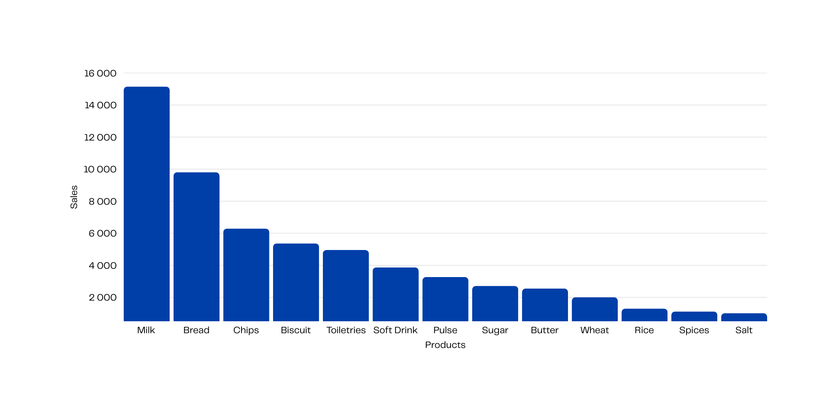
Total Sales (Product Based)

Slide 11
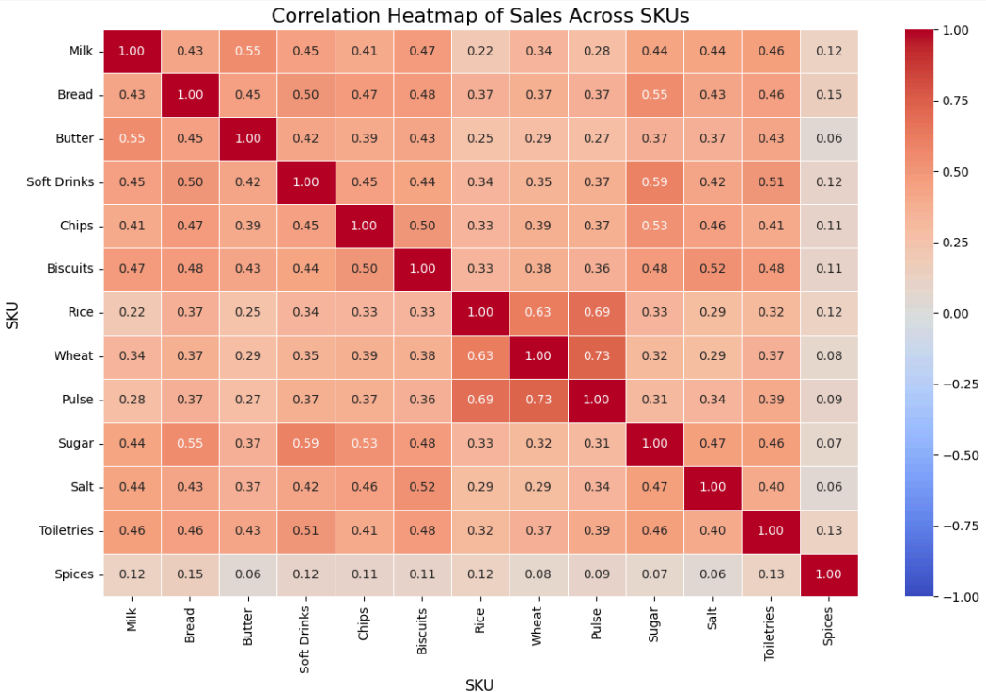
Correlation Insight
Top Correlated Pairs :
Pulse & Wheat: 0.729
Pulse & Rice: 0.691
Bread & Sugar: 0.550
Milk & Spices: 0.119 (no dependency)
Chips & Biscuits: 0.499 → Bundle Suggestion

Slide 12
Recommendations
Inventory Optimization | Space Utilization | Process Automation | Business Growth
Use ML model for JIT stocking (esp. Milk, Bread) Prioritize A-category SKUs in procurement | Redesign layout – front-load fast movers Clear out or discount slow-moving SKUs (Category C) | Excel Tracker / Inventory App Reduce manual tracking & errors | Home delivery (low-cost local WhatsApp-based) Festival combos for high correlation pairs Temporary help during Oct–Dec

Slide 13

Impact of the Project
Inventory Issues
Linear Regression improved stock forecasting for perishables like Milk
ABC analysis helped prioritize top SKUs and reduce overstocking of slow movers (e.g., Spices, Salt)
Space Constraints
Recommended rearranging shelves to highlight high-revenue A-category items (Milk, Bread, Chips)
Suggested removing or discounting low-performing SKUs to free up space
Limited Growth
Proposed simple automation (Excel tools) and WhatsApp-based home delivery
Solutions are low-cost, easy to adopt, and suitable for a family-run setup

Slide 14
Quantifiable Benefits Observed (Based on Model Simulations)
Stockout Risk Reduced
Inventory Holding Cost Estimation
30% drop in forecast error for Milk using ML
Potential reduction by 15–20% for Dairy and FMCG
Sales Boost via Bundling
Shelf Efficiency Improvement Potential
Identified high-correlation product pairs for combo offers (e.g., Bread + Milk, Chips + Soft Drinks)
Upto 25% by reallocating Category A SKUs to high-visibility spots

Slide 15
Impact of the Project
Implement Inventory Tracker | Introduce Home Delivery via WhatsApp | ML-Based Forecasting Monthly | Start Trial Promotions | Explore Future Tech Add-ons
Track daily sales, stock left, reorder thresholds Auto-highlight fast/slow-moving items Simple to use and aligns with current shop workflows | Take daily orders via message Free local delivery for orders >₹200 Promotes customer retention and convenience | Use updated sales data to retrain the linear model Expand prediction to other SKUs (e.g., Bread, Biscuits) | Use bundle insights (Milk + Bread, Chips + Biscuits) Offer combo discounts during high-demand months (Oct–Dec) | POS billing software for faster checkout QR-code-based order form or online menu via Google Forms Low-cost website or listing on Google Business

