Slide 1
Orlando Gasification Project Demonstration of a 285 MW Coal-Based Transport Gasifier Managing Your Energy Portfolio in a Greener World The Institute for Professional and Executive Development, Inc. January 18, 2007 Timothy Pinkston Denise Stalls Frederick F. Haddad, Jr.

Slide 2
Orlando Utilities Commission
Quasi governmental agency established by the Florida Legislature in 1923
Provide electric and water services to 190,000 customers in City of Orlando, Orange, and Osceola County, Florida
Long term record of reliable supply and environmental stewardship

Slide 3
OUC Financial Position
$ 2.7 Billion in assets
$ 746 Million gross revenue
$ 62 Million net income
AA rated credit standing

Slide 4
Competitive Strategy
Neutralize customers to the commodity cost of electricity
Conservatively plan for physical supply
Build in flexibility to maintain market neutrality
Generate net income

Slide 5
Planning for Physical Supply
In compliance with PSC requirements
Retail load growth and firm obligations
Reserve requirements of 15%
Report 10 year plan to the PSC annually
Develop base case to determine lowest cost to retail customers

Slide 6
Additional Planning Criteria
Resource type: Base, intermediate, peaking
Technology utilized: PC, CFB, CC,CT
Primary fuel source: Coal, natural gas, oil, synthetic
Uncertainty: Load growth, commodity fuels, cost of wholesale power, regulatory
Environmental Performance

Slide 7
Planning for Physical Supply History of Additions
McIntosh 3 1982
St. Lucie 2 1983
Stanton Energy Center 1 1987
IR CT A&B 1989
IR CT C&D 1992
Stanton Energy Center 2 1996
Stanton Energy Center CCA 2003

Slide 8
Generation Asset Optimization
Develop competitive alternatives to base case
Perform wholesale market optimization
to identify positive scenarios
Perform retail market optimization to determine the best scenario

Slide 9
Power Supply Portfolio Year 2006 by Fuel Type

Slide 10
Alternatives to Base Case Summary of Results
Combined cycle option has more economic potential than simple cycle base case
Combined cycle with coal gasification has more economic potential than combined cycle option on natural gas alone
Risk mitigation is a key issue
Notes:
Risk Mitigation
Fixed capital cost for our ownership share of the gasifier
Southern has availability guarantee on performance
Standard technology for the combined cycle
Natural gas as backup

Slide 11
Orlando Gasification Project Overview
$235 million co-funded by DOE under the Clean Coal Power Initiative
Southern Company/OUC joint partnership
Located at the Stanton Energy Center in Orlando, Florida

Slide 12
Stanton Energy Center Overview
Ultimate certification of 2000 MW’s of coal or natural gas generation.
Approximately 3280 acres of which 1100 acres is allocated for development of power generation and support facilities.
Zero discharge facility with no impact to surface or groundwater
Two 468 mw pulverized coal and one 633 mw gas combined cycle units

Slide 13
Stanton Energy Center Environmental Systems
Coal Units
Electrostatic Precipitators
Wet Flue Gas Desulfurization
Selective Catalytic Reduction
Combined Cycle Unit
Dry low NOx burners with SCR
Balance of Plant
Model for Regional Water Reuse

Slide 14
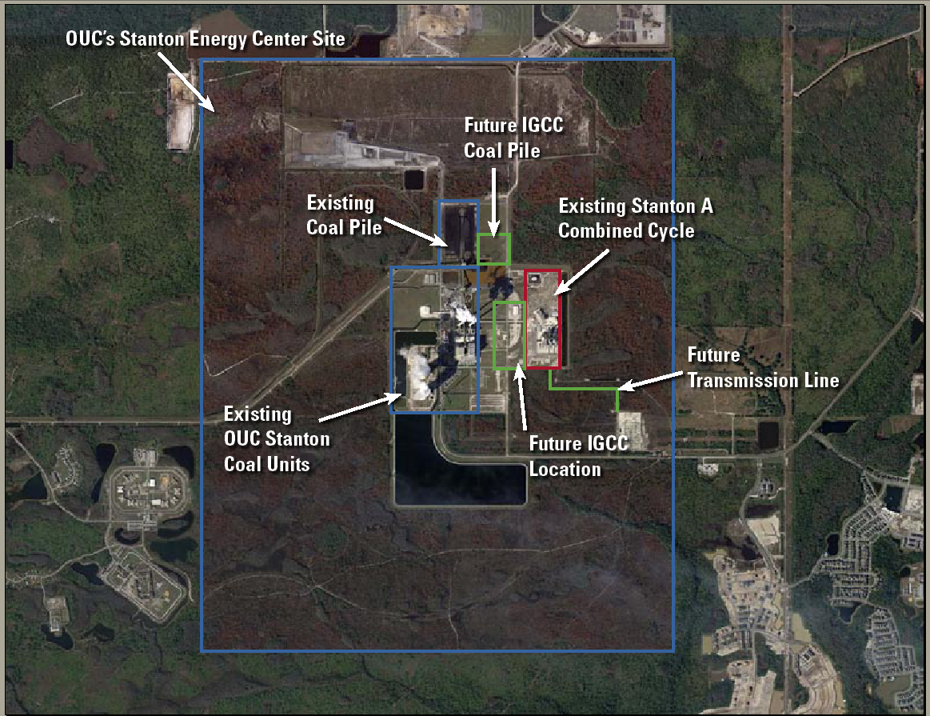

Slide 15
Competitive Alternatives Project Risk Mitigation
Fixed investment in Gasifier project
Fuel switching capability
Established Generation Technology
DOE Funding participation

Slide 16
Power Supply Portfolio Year 2010 by Fuel Type

Slide 17
Orlando Gasification Project Details
285 MW IGCC comprised of two distinct projects:
1x1 combined cycle (Owned 100% by OUC)
Jointly owned gasifier island (Owned: 65% Southern/35% OUC)
Located at OUC’s Stanton Energy Center
PRB coal
Electricity from the facility will serve OUC’s retail customers
Southern Company responsible for operation of the IGCC with a blended OUC and Southern Company staff
KBR responsible for Gasification Island EPC
June 1, 2010 COD for the IGCC

Slide 18
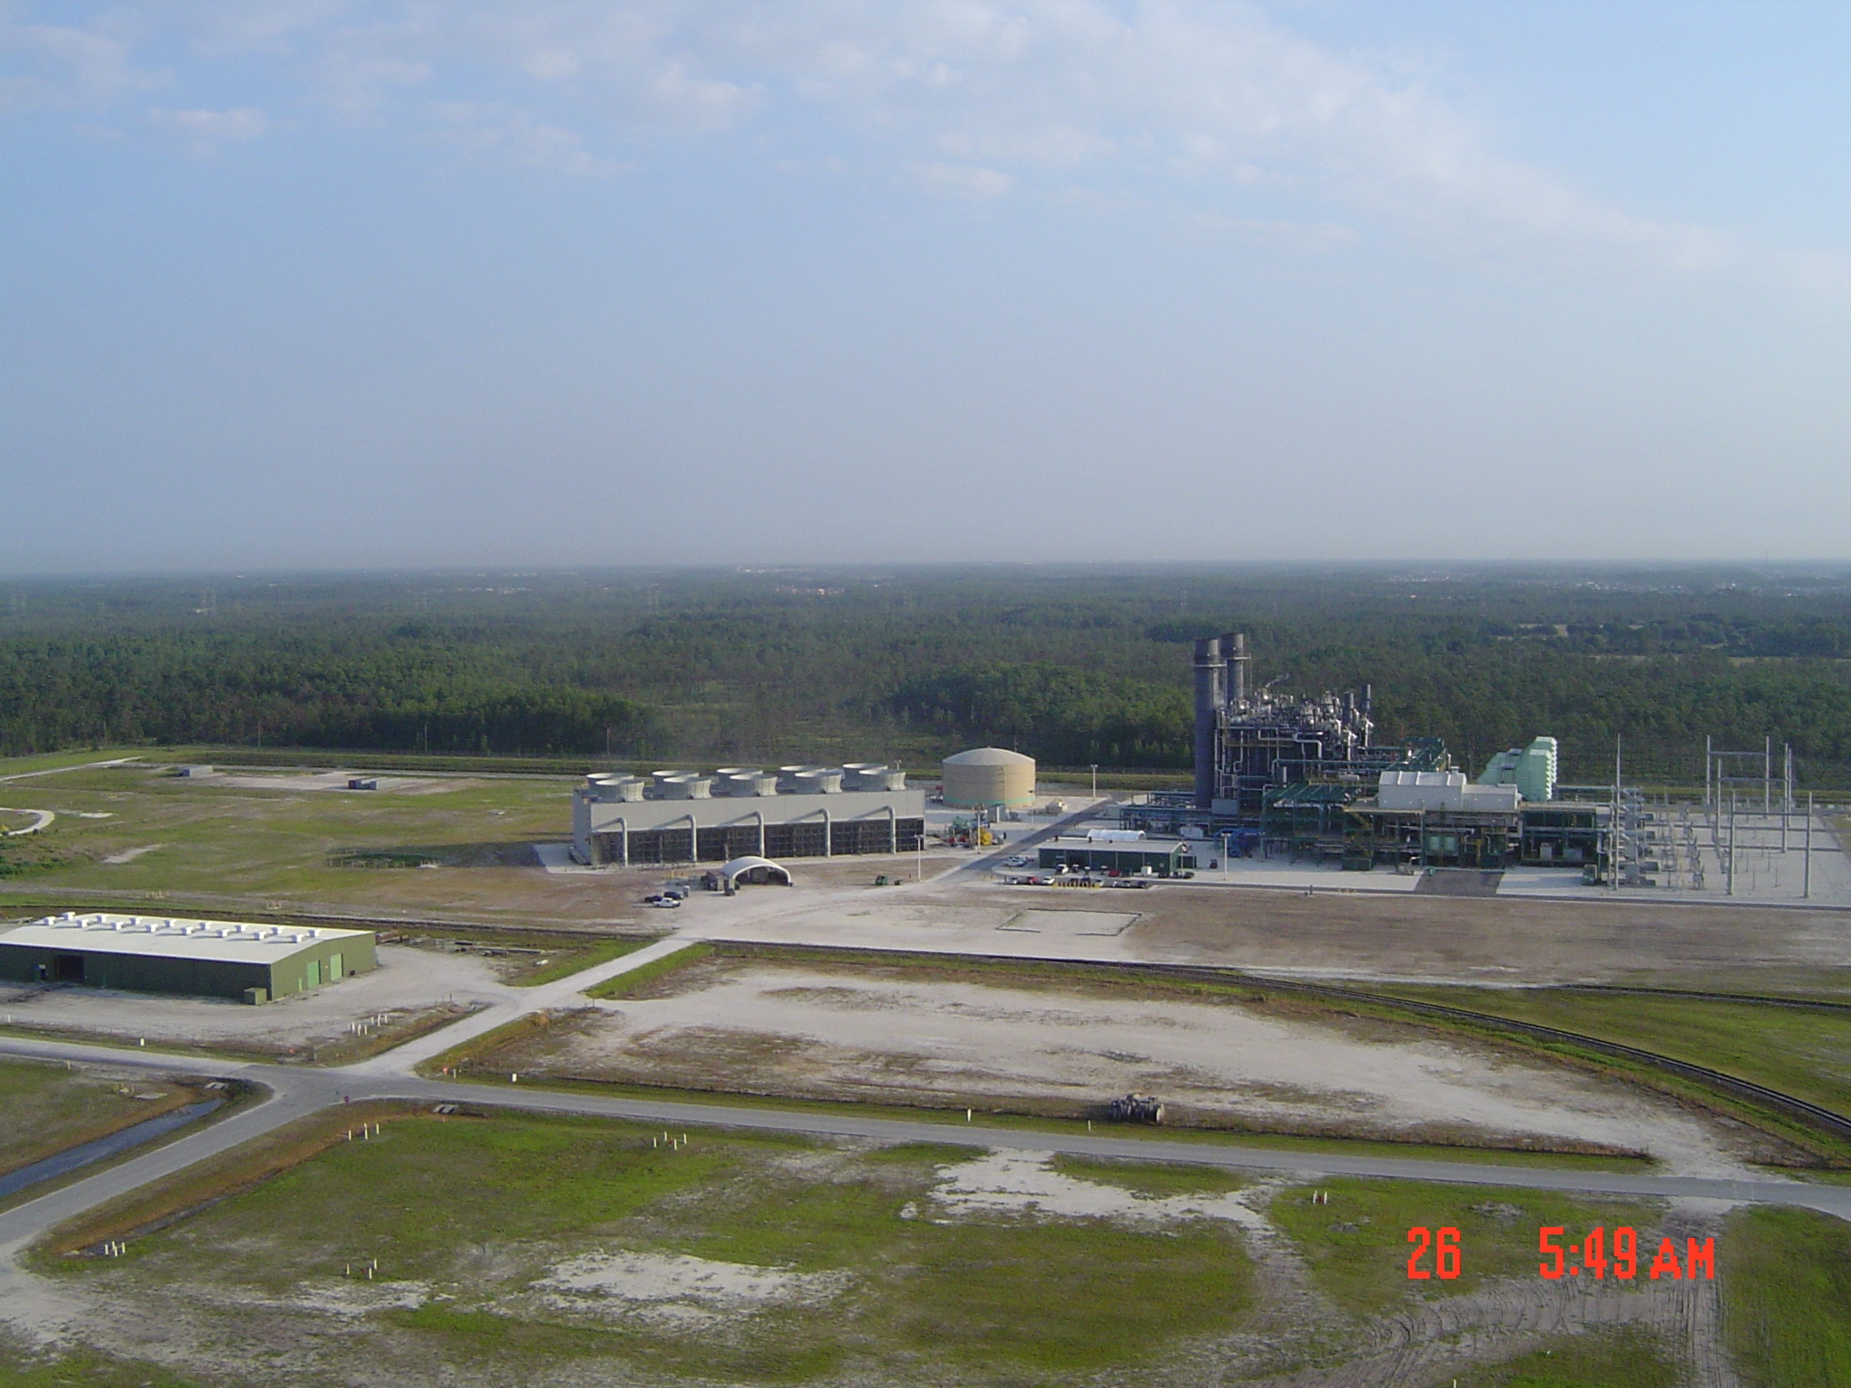
Stanton Energy Center

Slide 19
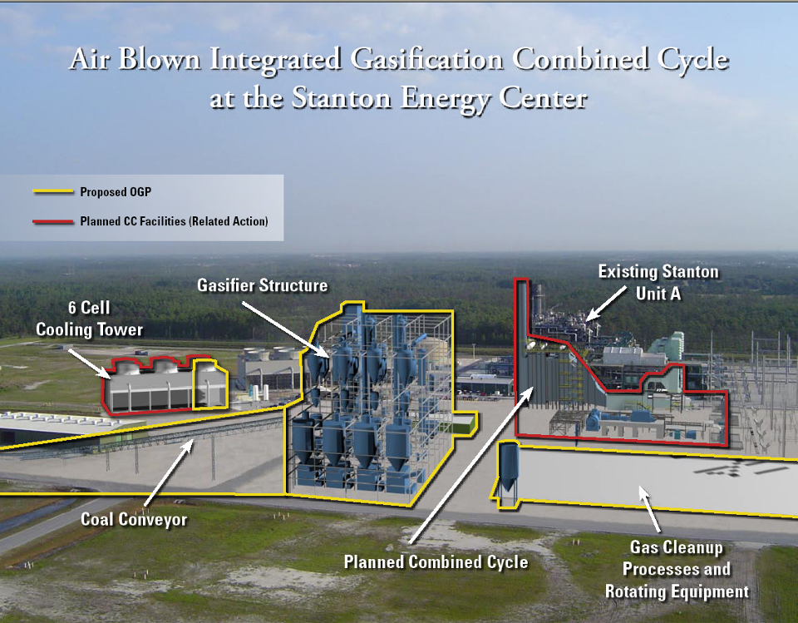

Slide 20
Project Status
All contracts with the Major Participants are in place
DOE/Southern Company Cooperative Agreement
Subcontract with KBR for Gasifier Island
Commercialization Agreement between Southern Company and KBR
GE contract for CT supply and syngas testing
All contracts between OUC and Southern Company
Including ownership, capacity purchase and O&M

Slide 21
Project Status
Activities for 2006 included NEPA, SCA, Need for Power and Front End Engineering and Design (FEED).
OUC's Need for Power Application was approved by the Florida Public Service Commission on 5/24/06.
The Supplemental SCA was submitted to the Florida Department of Environmental Protection (FDEP) on 2/17/06. The Site Certification was approved by the Florida Department of Environmental Protection on 12/8/2006.
NEPA completion is expected in February 2007.
FEED is progressing and will be completed 1st Qtr 2007
Detailed design and equipment procurement will begin in April of 2007

Slide 22
Orlando Project Timeline
Pre-Award
NEPA +Engineering
Phase 1
Project Definition
Phase 2
Design & Phase 3 Construction
Phase 4
Demonstration
OUC &
Southern
Phase 1 Commitment
Contract Negotiation
CCPI
Contract Negotiation
Enviro
NEPA
Permitting
Gasifier Island
Eng & Const
Preliminary
Detailed
Construction
Start-Up
Ops
Gasifier Demonstration
Gasifier Post-Demo Operation
Combined Cycle
Preliminary
Detailed Design
Construction
Start-Up
CC Commercial
05
06
07
08
09
10
11
15

Slide 23
Summary Flow Diagram
VENT GAS
SOUR
AMMONIA
ANHYDROUS
WATER
RECOVERY
AMMONIA
TREATMENT
COAL PILE
G-ASH
SYNGAS
COAL
HIGH
HIGH
LOW
SULFUR
MILLING &
PRESSURE
TRANSPORT
SYNGAS
TEMPERATURE
PARTICULATE
TEMPERATURE
MERCURY
REMOVAL AND
DRYING
COAL
GASIFIER
SYNGAS
COLLECTION
SYNGAS
REMOVAL
RECOVERY
FEEDING
COOLING
COOLING
G-ASH
HP BFW
Gasifier
Island
SYNGAS
SYNGAS
SULFUR
RECYCLE
PROCESS
AIR
AIR
EXTRACTION AIR
COMPRESSOR
HP STEAM
SYNGAS
TO STACK
SCR
Heat Recovery Steam Generator
GAS
TURBINE
CONDENSATE
HP, SUPERHEATED
POWER
STEAM
Combined
Cycle
CONDENSER
STEAM
POWER
TURBINE

Slide 24
Transport Gasifier
Disengager
Syngas to Cooling & PCD
Cyclone
Riser
Mixing
Loopseal
Zone
Simple Design:
No burners
Limited internal parts
Developed specifically for power generation
Ability to operate air-blown
Low operating temperature
Performs well on high ash/high moisture coal
Compatible with renewable fuels
Coal
Limestone
J-leg
Loopseal
O₂/ Air
Startup
Standpipe
Burner
O₂/Air
Steam

Slide 25
Orlando Gasification Project In Summary
Utilizes proven generation technology to meet retail load
Provides additional fuel diversity in the asset base
Consistent with OUC’s commitment to advanced environmental technologies
Provides positive economic potential in both wholesale and retail markets
Provides another opportunity to enhance our joint partner relationship

