Slide 1
Competitive Strategy
Neutralize customers to the commodity cost of electricity
Conservatively plan for physical supply
Build in flexibility to maintain market neutrality
Generate net income

Slide 2
Planning for Physical Supply
In compliance with PSC requirements
Retail load growth and firm obligations
Reserve requirements of 15%
Report 10 year plan to the PSC annually
Develop base case to determine lowest cost to retail customers

Slide 3
Additional Planning Criteria
Resource type: Base, intermediate, peaking
Technology utilized: PC, CFB, CC,CT
Primary fuel source: Coal, natural gas, oil, synthetic
Uncertainty: Load growth, commodity fuels, cost of wholesale power, regulatory
Environmental Performance

Slide 4
Planning for Physical Supply History of Additions
McIntosh 3 1982
St. Lucie 2 1983
Stanton Energy Center 1 1987
IR CT A&B 1989
IR CT C&D 1992
Stanton Energy Center 2 1996
Stanton Energy Center CCA 2003

Slide 5
Generation Asset Optimization
Develop competitive alternatives to base case
Perform wholesale market optimization
to identify positive scenarios
Perform retail market optimization to determine the best scenario

Slide 6
Competitive Alternatives Project Risk Mitigation
Fixed investment in Gasifier project
Fuel switching capability
Established Generation Technology
DOE Funding participation

Slide 7
Power Supply Portfolio Year 2010 by Fuel Type

Slide 8
Orlando Gasification Project Details
285 MW IGCC comprised of two distinct projects:
1x1 combined cycle (Owned 100% by OUC)
Jointly owned gasifier island (Owned: 65% Southern/35% OUC)
Located at OUC’s Stanton Energy Center
PRB coal
Electricity from the facility will serve OUC’s retail customers
Southern Company responsible for operation of the IGCC with a blended OUC and Southern Company staff
KBR responsible for Gasification Island EPC
June 1, 2010 COD for the IGCC

Slide 9
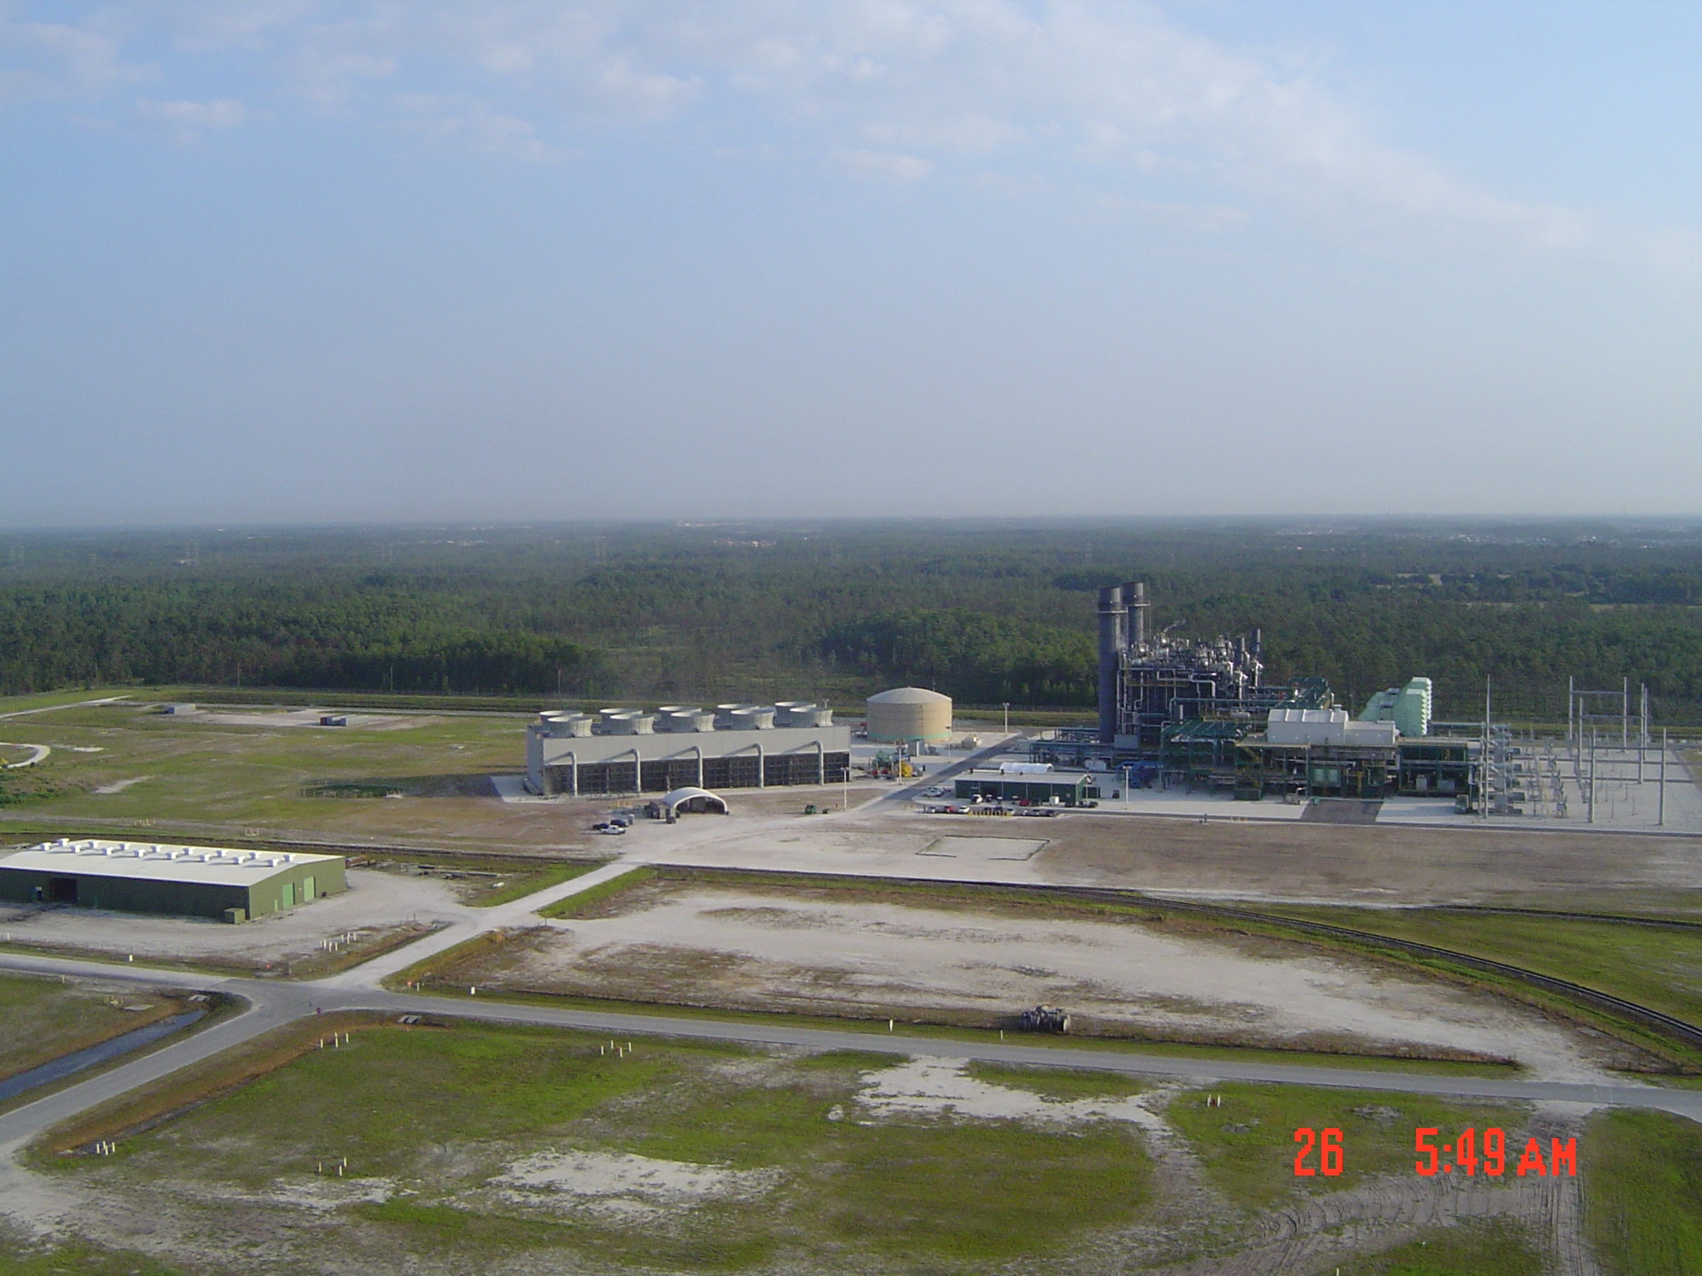
Stanton Energy Center

