Slide 1

Knows What It Knows:
A Framework for Self-Aware Learning
Lihong Li Michael L. Littman Thomas J. Walsh
Rutgers Laboratory for Real-Life Reinforcement Learning (RL³)
Presented at ICML 2008
Helsinki, Finland
July 2008

Slide 2

A KWIK Overview
KWIK = Knows What It Knows
Learning framework when
  Learner chooses samples
    Selective sampling: “only see a label if you buy it”
    Bandit: “only see the payoff if you choose the arm”
    Reinforcement learning: “only see transitions and rewards of states if you visit them”
  Learner must be aware of its prediction error
    To efficiently balance exploration and exploitation
A unifying framework for PAC-MDP in RL
Notes:
This slides gives a high level preview of this whole talk. By doing this, I’ll also relate KWIK to active learning and bandit problems. I’m not sure if it’s necessary to discuss active learning more later (except in “conclusion/future work” section).

Slide 3
Outline
An example
Definition
Basic KWIK learners
Combining KWIK learners
(Applications to reinforcement learning)
Conclusions

Slide 4
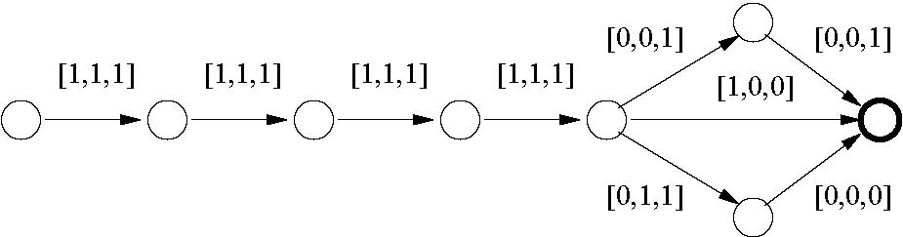

An Example
1
1
3
3
3
3
1
2
0
Standard least-squares linear regression: ŵ = [1,1,1]
Fails to find the minimum-cost path!
Deterministic minimum-cost path finding
Episodic task
Edge cost = x ¢ w* where w*=[1,2,0]
Learner knows x of each edge, but not w*
Question: How to find the minimum-cost path?
Notes:
This example motivates why KWIK is desirable.

Slide 5
An Example: KWIK View
0
0
?
?
3
3
3
3
1
2
0
Reason about uncertainty in edge cost predictions
Encourage agent to explore the unknown
Able to find the minimum-cost path!
Deterministic minimum-cost path finding
Episodic task
Edge cost = x ¢ w* where w*=[1,2,0]
Learner knows x of each edge, but not w*
Question: How to find the minimum-cost path?

Slide 6
Outline
An example
Definition
Basic KWIK learners
Combining KWIK learners
(Applications to reinforcement learning)
Conclusions

Slide 7
Formal Definition: Notation
KWIK: a supervised-learning model
  Input set: X
  Output set: Y
  Observation set: Z
  Hypothesis class: H µ (X → Y)
  Target function: h* 2 H
    “Realizable assumption”
  Special symbol: ? (“I don’t know”)
Edge’s cost vector x (<³)
Edge cost (<)
{Cost = x ¢ w | w 2 <³}
Cost = x ¢ w*
Notes:
This slides gives notation of KWIK. I’ll also relate these symbols to the earlier shortest path example.

Slide 8

Formal Definition: Protocol
Learning succeeds if
Given: ε, δ, H
W/prob. 1- δ, all predictions are correct
  |ŷ - h*(x)| ≤ ε
Total #? is small
  at most poly(1/²,1/δ,dim(H))
Env: Pick h* 2 H
secretly & adversarially
Env: Pick x adversarially
Learner
“I know”
“ŷ”
Observe y=h*(x) [deterministic]
or measurement z [stochastic
where E[z]=h*(x)]
“I don’t know”
“?”

Slide 9
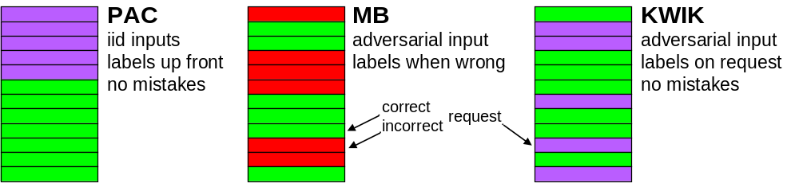
Related Frameworks
(if one-way functions exist)
(Blum, 94)
PAC: Probably Approximately Correct (Valiant, 84)
MB: Mistake Bound (Littlestone, 87)
Notes:
This compares the three frameworks. Michael: did you mention you have a nicer looking picture for this? Could you please send it around? I’ll re-do the pictures then.

Slide 10
KWIK-Learnable Classes
Basic cases
  Deterministic vs. stochastic
  Finite vs. infinite
Combining learners
  To create more powerful learners
  Application: data-efficient RL
    Finite MDPs
    Linear MDPs
    Factored MDPs
    …
Notes:
This transitions the talk from definition to examples and applications of KWIK in the following two sections.

Slide 11
Outline
An example
Definition
Basic KWIK learners
Combining KWIK learners
(Applications to reinforcement learning)
Conclusions

Slide 12

Deterministic / Finite Case
(X or H is finite, h* is deterministic)
Thought Experiment:
You own a bar frequented by n patrons…
  One is an instigator. When he shows up, there is a fight, unless
  Another patron, the peacemaker, is also there.
  We want to predict, for a subset of patrons, {fight or no-fight}
Alg. 1: Memorization
Memorize outcome for each
subgroup of patrons
Predict ? if unseen before
#? ≤ |X|
Bar-fight: #? · 2^{n}
Alg. 2: Enumeration
Enumerate all consistent
(instigator, peacemaker) pairs
Say ? when they disagree
#? ≤ |H| -1
Bar-fight: #? · n(n-1)
Notes:
This is an interesting example covering the two most straightforward algorithms.

Slide 13

Stochastic and Finite Case:
Coin-Learning
Problem:
  Predict Pr(head) 2 [0,1] for a coin
  But, observations are noisy: head or tail
Algorithm
  Predict ? the first O(1/ε² log(1/δ)) times
  Use empirical estimate afterwards
  Correctness follows from Hoeffding’s bound
  #? = O(1/ε² log(1/δ))
Building block for other stochastic cases
Notes:
Simplest stochastic case. Building block for later algorithms.

Slide 14
More KWIK Examples
Distance to an unknown point in <^{d}
  Key: maintain a “version space” for this point
Multivariate Gaussian distributions (Brunskill, Leffler, Li, Littman, & Roy, 08)
  Key: reduction to coin-learning
Noisy linear functions (Strehl & Littman, 08)
  Key: reduction to coin-learning via SVD
Notes:
This slide briefly goes through three less trivial cases. It is to convince the audience KWIK is not restricted to the simplest cases.

Slide 15
Outline
An example
Definition
Basic KWIK learners
Combining KWIK learners
(Applications to reinforcement learning)
Conclusions

Slide 16

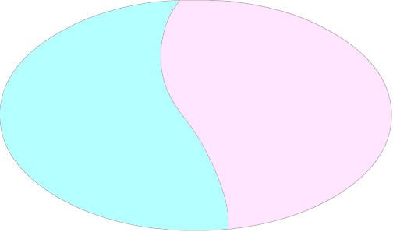
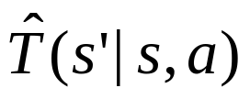
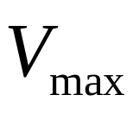
MDP and Model-based RL
Markov decision process: h S, A, T, R, i
  T is unknown
  T(s’|s,a) = Pr(reaching s’ if taking a in s)
Observation: “T can be KWIK-learned”
) “An efficient, Rmax-ish algorithm exists”
(Brafman & Tenenhotlz, 02)
“Optimism in the face of uncertainty”:
Either: explore “unknown” region
Or: exploit “known” region
Known
region
S
Unknown
region

Slide 17




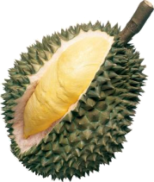


Finite MDP Learning by Input-Partition
Problem:
  Given: KWIK learners A_{i} for H_{i} µ (X_{i} → Y)
    X_{i} are disjoint
  Goal: to KWIK-learn H µ (_{i} X_{i} → Y)
Algorithm:
  Consult A_{i} for x 2 X_{i}
  #? · ∑_{i} #?_{i} (mod log factors)
Learning a finite MDP
  Learning T(s’|s,a) is coin-learning
  A total of |S|² |A| instances
  Key insight shared by many prior algorithms
  (Kearns & Singh, 02; Brafman & Tenneholtz, 02)
?
$5
?
$5
Environment

Slide 18


Cross-Product Algorithm
Problem:
  Given: KWIK learners A_{i} for H_{i} µ (X_{i} → Y_{i})
  Goal: to KWIK-learn H µ (Π_{i} X_{i} → Π_{i} Y_{i})
Algorithm:
  Consult A_{i} with x_{i} for x=(x₁,…,x_{n})
  #? · ∑_{i} #?_{i} (mod log factors)
$100
?
$5
$5
($5,$100,$20)
?
Environment
$20
$20

Slide 19
Unifying PAC-MDP Analysis
KWIK-learnable MDPs
  Finite MDPs
    Coin-learning with input-partition
    Kearns & Singh (02); Brafman & Tennenholtz (02);
    Kakade (03); Strehl, Li, & Littman (06)
  Linear MDPs
    Singular value decomposition with coin-learning
    Strehl & Littman (08)
  Typed MDPs
    Reduction to coin-learning with input-partition
    Leffler, Littman, & Edmunds (07)
    Brunskill, Leffler, Li, Littman, & Roy (08)
  Factored MDPs with known structure
    Coin-learning with input-partition and cross-product
    Kearns & Koller (99)
    What if structure is unknown...

Slide 20
Union Algorithm
Problem:
  Given: KWIK learners for H_{i} µ (X → Y)
  Goal: to KWIK-learn H₁ [ H₂ [ … [ H_{k}
Algorithm (higher-level enumeration)
  Enumerate consistent learners
  Predict ? when they disagree
Can generalize to stochastic case
c + x
2 + x
2
|x|
?
2
3
?
?
3
c * x
2 * x
Environment
X = 0
X = 2
X = 1
?
0
Y = 4
Y = 2

Slide 21
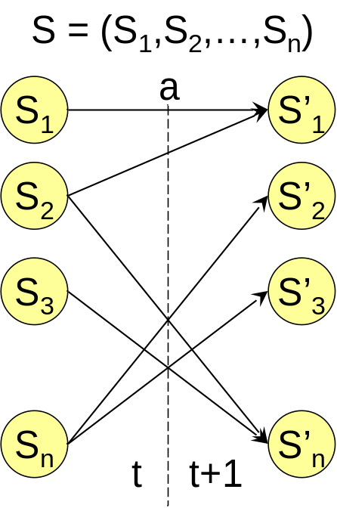
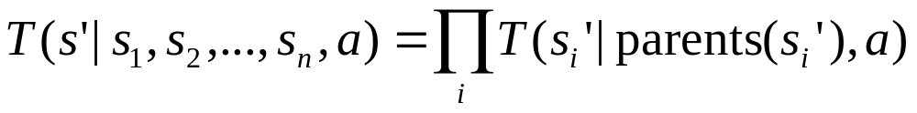
Factored MDPs
DBN representation (Dean & Kanazawa 89)
  Assuming #parents is bounded by a constant
Problems
How to discover parents of each s_{i}’?
How to combine learners L(s_{i}’) and L(s_{j}’)?
How to estimate Pr(s_{i}’ | parents(s_{i}’),a)?

Slide 22
Efficient RL with DBN Structure Learning
Significantly improve on state of the art (Strehl, Diuk, & Littman, 07)
Learning a factored MDP
From (Kearns & Koller, 99):
“This paper leaves many interesting problems unaddressed. Of these, the most intriguing one is to allow the algorithm to learn the model structure as well as the parameters. The recent body of work on learning Bayesian networks from data [Heckerman, 1995] lays much of the foundation, but the integration of these ideas with the problems of exploration/exploitation is far
from trivial.”
Noisy-Union
Discovery of parents of s_{i}’
Cross-Product
CPTs for T(s_{i}’ | parent(s_{i}’), a)
Input-Partition
Entries in CPT
Coin-Learning

Slide 23
Outline
An example
Definition
Basic KWIK learners
Combining KWIK learners
(Applications to reinforcement learning)
Conclusions

Slide 24
Open Problems
 | Deterministic | Stochastic
Coin-Learning | 1 | O(1/²² log 1/δ)
Linear Functions | d | Õ(d³ / ²⁴) (Strehl & Littman, 08)
Union | ∑_{i} B_{i}(²,δ)+k-1 | ∑_{i}B_{i}(²/4,δ/(k+1))+O(k/²² log k/δ)
Is there a systematic way of extending an KWIK algorithm
for a deterministic observations to noisy ones?
(More open challenges in the paper.)

Slide 25

Conclusions
Conclusions
What we now know we know
We defined KWIK
  A framework for self-aware learning
  Inspired by prior RL algorithms
  Potential applications to other learning problems
  (active learning, anomaly detection, etc.)
We showed a few KWIK examples
  Deterministic vs. stochastic
  Finite vs. infinite
We combined basic KWIK learners
  to construct more powerful KWIK learners
  to understand and improve on existing RL algorithms
Thank You!

Slide 27
Is This Bayesian Learning?
No
KWIK requires no priors
KWIK does not update posteriors
But Bayesian techniques might be used to lower the sample complexity of KWIK

Slide 28
Is This Selective Sampling?
No
Selective sampling allows imprecise predictions
  KWIK does not
Open question
  Is there a systematic way to “boost” a selective-sampling algorithm to a KWIK one?

Slide 29
What about
Computational Complexity?
We have focused on sample complexity in KWIK
All KWIK algorithms we found are polynomial-time

Slide 30
More Open Problems
Systematic conversion of KWIK algorithms from deterministic problems to stochastic problems
KWIK in unrealizable (h* ∉ Η) situations
Characterization of dim(H) in KWIK
Use of prior knowledge in KWIK
Use of KWIK in model-free RL
Relation between KWIK and existing active-learning algorithms

