Slide 1
Turtle [tur-tool]
A test-case profiler, classifier, and cataloger
Notes:
Walk-through behind the scene on how the tool works.
Word Origin
Old English turtla, from Latin turtur, of imitative origin; related to GermanTurteltaube

Slide 2
Features
Lookup test-cases based on keyword/function name.
Test-case profile summary report
Page checksums
Location
Elapse time
Code path/route (function invocation map)
Test-case performance history (graph report)
Unit test automation (detect test-case breakage)
Notes:
- Be able to detect breakage

Slide 3
System Components
Scripts
Log Parser
DB
PDLsapp
Front-End
User Interface
Notes:
PDLsapp (–finstrument-functions compile flag)
Scripts (turtle.sh and etrace.pl)
Log parser (DB importer)
Front-end UI (web-system)
nm is used to examine binary files (including libraries, compiled object modules, shared-object files, and standalone executables) and to display the contents of those files, or meta information stored in them, specifically the symbol table.
finstrument-functions:
https://gcc.gnu.org/onlinedocs/gcc-4.3.4/gcc/Code-Gen-Options.html

Slide 4
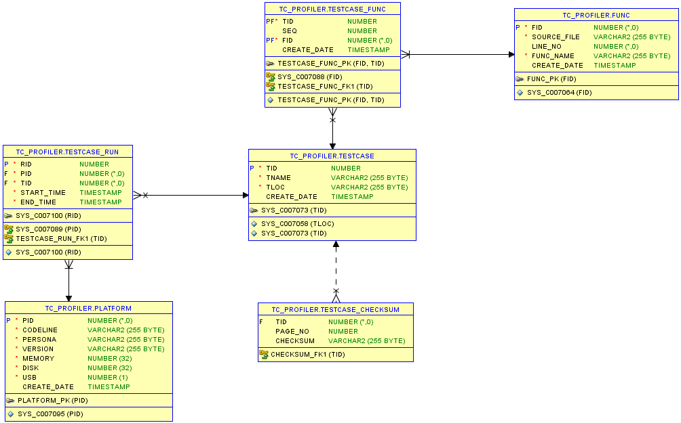
DB schema

