Slide 1

Turtle [tor-tool] Emulators Tool
A test-case profiler, classifier, and cataloger
Notes:
Word Origin
Old English turtla, from Latin turtur, of imitative origin; related to GermanTurteltaube
Main function is to accurately lookup test-cases filtered by a given keyword.
Saves us time, resources, and ultimately money!
Influence by the fact that FTL tests takes up to 1 week and its not guaranteed that all test-case are covered.
Walk-through behind the scene on how the tool works.
Keyword
Category
Feature
Tag
File Type
Source code function name
Sample values:
PDF annotation
JP2K
PS Type 42 font
HD photo
pdfObjFontDefineFont_T42
jpxdecode
gef_wmphoto_read
pdfObjAnnotsDoApStream

Slide 2
Motivator
Code breakages
Difficulty in finding the right test cases to use for unit testing.
Inefficient unit testing (“shoot in the dark and hope we hit the target”)
Notes:
Background history
One thing a firmware developer must do after he alter/fix part of firmware code is to make sure that his modifications
would not affect or break anything and that is to do thorough testing. (just first line of defense)
Testing plays a major and very important role in our industry/product.
Lexmark have invested and put a lot amount of effort and resources just to ensure nothing is broken, we have:
1. build level unit test.
2. sentry automation testing,
3. FTL,
4. PPQA
We have platoons of Test Engineers equipped with special skills "keen eyes" usually and they are deployed to detect and find issues 24/7.
Aside from all of these in-placed, developer needs to do manual testing.
As our testcases are so vast we tend to pick only a few relevant to our changes and this is where the bottleneck lies.
Where to find and which testcases to use?
"Where" is usually answered by asking the issue tester in-charge.
"Which" is put as a responsibility of the developer to find appropriate testcases in relation to the piece of code that has been changed.
Currently testcases are categorized into types like PDF, XPS, PS, PCL, etc..
Each type is furthermore broken down to version and features. for example pdfv1.7, annotation, images, or fonts.
Even with these categorization each section still contains a few hundreds or even thousands testcases.
Finding the right testcase manually is very tedius and time consuming!
About a year ago we made changes on the firmware PDF embedded type 42 font handling and requested FTL to do regression tests.
Got feedback that it will last from few days up to a week.
As we don't have PDFfont_type42 category yet they needed to run all test suites related to PDF fonts.
Of all the PDF font related testcases it maybe that 10% of it is font type 42 and if only there's a way to get those testcases
accurately and only run those then we could have save time, effort, resources, and money.
I made few attempts to address this process bottleneck problem.
First I made a script to scan all testcases containing certain keywords it worked but not in all testcases as some are not in plain-text and
it needed to be run everytime.
A better approach is for the information to be persistent and readily available by just a mouse click.
#to have a database full with classified testcases, there could be many application/benefit that we can get out of it.

Slide 3
Connecting…
end
start
XPS
PDF
PS
PDF v1.7
Notes:
Connecting the dots!
Second, was while I was working with profiler tools like valgrind, etc.. it makes me wonder...
how can it provide the program function usage and performance statistic reports? there must be a way to monitor all function calls taken...
i figured that if i can get the same information out of pdlsapp then i can create a function call map or code route/path taken of each run.
having this in mind, it came to me that i can use that information to catalog/classify testcases accurately.
armed with this knowledge i set out to the world(internet) and did research after all if valgrind can do it so can I!
After lots of mouse clicks I finally found the solution.
-finstrument functions gcc compiler flag let us to monitor all the function invoke in a program.
- Q/A
- Demo time!
as you may already know a function in a program does a specific task that only will be taken if certain condition is met.

Slide 4
Features
Lookup test-cases filtered by a given “keyword”.
Test-case profile summary report
Page checksum
Location
Elapse time
Code route (function invocation map)
Test-case performance history (graph report)
Tests to fail on perf degradation
Unit test automation (detect test-case breakage)
Export search results (CSV formatted?)
Tag/keyword management (EV# and US#)
Notes:
Main function is to accurately lookup test-cases filtered by a given keyword.
Saves us time, resources, and ultimately money!
Influence by the fact that FTL tests takes up to 1 week and its not guaranteed that all test-case are covered.
Walk-through behind the scene on how the tool works.
Keyword
Category
Feature
Tag
File Type
Source code function name
Sample values:
PDF annotation
JP2K
PS Type 42 font
HD photo
pdfObjFontDefineFont_T42
jpxdecode
gef_wmphoto_read
pdfObjAnnotsDoApStream

Slide 5
System Components
Scripts
Log Parser
DB
PDLsapp
Sentry automation tests
Front-End
User Interface
Notes:
PDLsapp (–finstrument-functions compile flag)
Scripts (turtle.sh and etrace.pl)
Log parser (DB importer)
Front-end UI (web-system)
nm is used to examine binary files (including libraries, compiled object modules, shared-object files, and standalone executables) and to display the contents of those files, or meta information stored in them, specifically the symbol table.
finstrument-functions:
https://gcc.gnu.org/onlinedocs/gcc-4.3.4/gcc/Code-Gen-Options.html

Slide 6
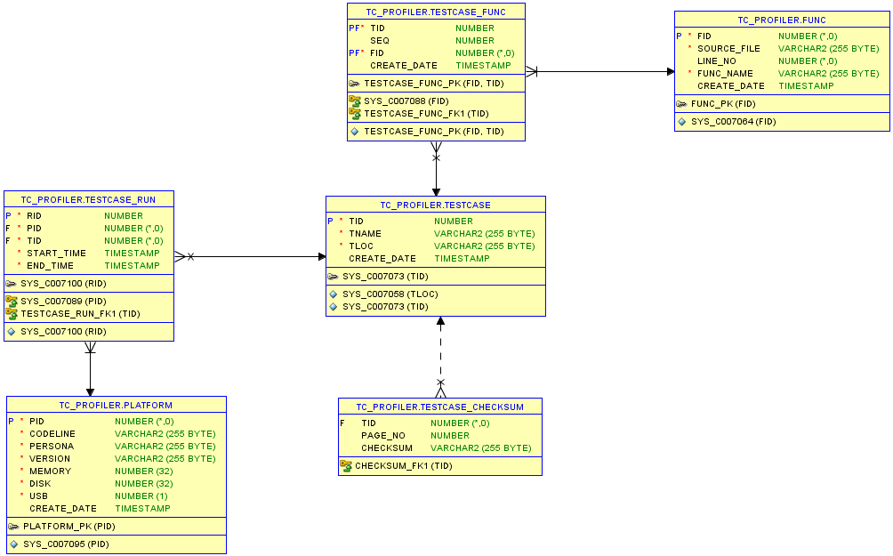
DB schema

Slide 7
- End -
Q/A

