Slide 1
Turtle Maintenance
workflows

Slide 2
Maintenance types
Testcase (files)
Function mappings
Checksums

Slide 3



UPDATES: Testcase
Marks corresponding record as dirty to be updated or deleted on next jenkins turtle job run.
On new, renamed, moved, or deleted files
Database
Folder watch dog

Slide 4
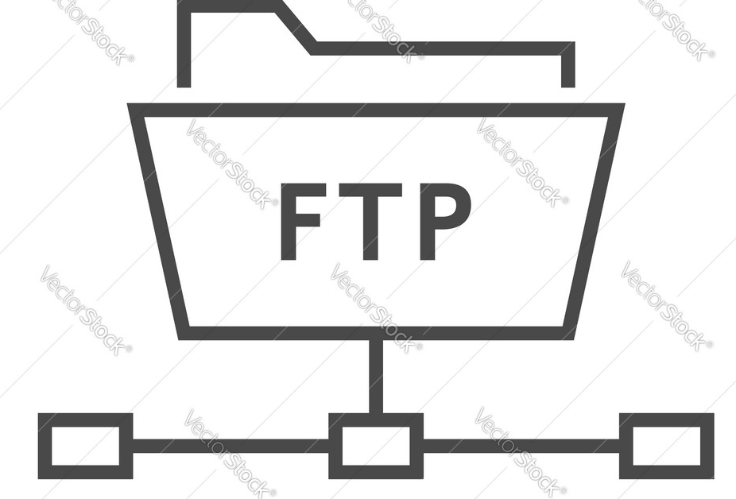
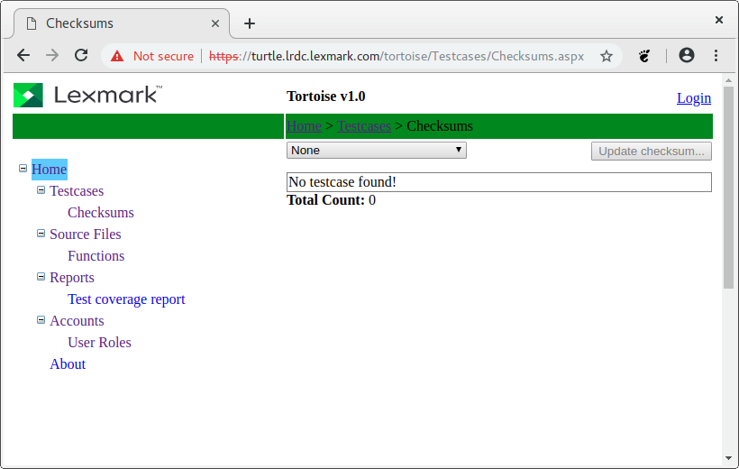
UPDATES: Function mappings
Call pdls application using valgrind instrumentation to generate a formated log file with following informations:
testcase full path
Functions visited
Valgrind/Callgrind for call tree analysis/post processing tool/script

Slide 5
UPDATES: Checksums
Update master checksums via FTP or uploading the new checksums via turtle web interface.
On pdls devshell, call turtle-test script with modified function name as parameter will fetch all testcases affected and do tests. On test fail case, it would generate a log file containing the new corrected checksums.
pdls/tests/turtle-tests.sh

