Slide 1
Potential for Parallel Computation
Module 2

Slide 2
Potential for Parallelism
Much trivially parallel computing
  Independent data, accounts
  Nothing to study
Interest is in problems in which parallelism is not obvious or communication & coordination is necessary

Slide 3
Main Topics
Prefix Algorithms
Speedup and Efficiency
Amdahl's Law

Slide 4
Examples of Parallel Programming Design
• Sequential/Parallel Add
• Sum Prefix Algorithm
• Parameters of Parallel Algorithms
• Generalized Prefix Algorithm
• Divide and Conquer
• Upper/Lower Algorithm
• Size and Depth of Upper/Lower Algorithm
• Odd/Even Algorithm
• Size and Depth of Odd/Even Algorithm
• A Parallel Prefix Algorithm with Small Size and Depth
• Size and Depth Analysis

Slide 5
Addition of sequence of numbers
Consider that we need to add n-numbers
V[1] + V[2] + …+ V[n]
Sequentially: O(n)
  Actually need n-1 additions

Slide 6
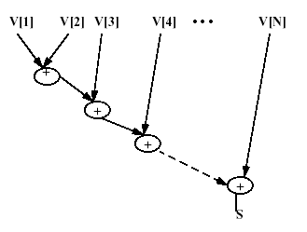
A Simple Algorithm : Adding numbers:
Assume a vector of numbers in V[1:N]
Sequential add: S:= V[1];
for i := 2 step 1 until N
S := S + V[i];
Data dependence graph for sequential summation
Total Work = 7

Slide 7
Same Problem - addition
Suppose we have several processors
For Example:
  P=4
  N=8
How can we compute in parallel?

Slide 8
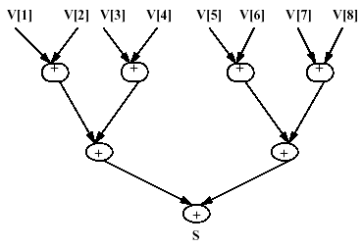
Data Dependence Graph for Parallel Summation
P0 P1 P2 P3
T4 = 3
Complexity:
O(N/P + log P)
Total Work = 7

Slide 9
Consider summation with P=2
V1 + V2 + V3 + V4 V5 + V6 + V7 + V8
+
T2 = 4
O(N/P) + log P
Complexity is same but time is different
sum
Total Work = 7

Slide 10
Prefix Sum Problem
Given a vector of numbers, for each entry, compute the sum of the entry and all its predecessors
Application: numbering pages in a book
V1, V1+V2, V1+V2+V3,…, V1+…+Vn
For j := 2 to N by 1
V [ j ] = V [ j -1 ] + V [ j ]

Slide 11
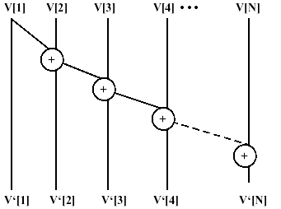
A Slightly More Complicated Algorithm
Prefix Sum : For i := 2 step 1 until N
V[i] := V[i-1] + V[i];
Dependence Graph for Sequential Prefix
O(N)
Work = N-1
Each term is the sum of all numbers in V[1:i], i ≤ N

Slide 12
Parallel Prefix Sum
-- How can we parallelize??
Not so easily
May cost more

Slide 13
PARAMETERS OF PARALLEL ALGORITHMS
SIZE: Number of operations
DEPTH: Number of operations in the longest chain from any input to any output.
EXAMPLES
Sequential sum of N inputs:
SIZE = N - 1
DEPTH = N - 1
Parallel sum of N inputs (pair wise summation):
SIZE = N - 1
DEPTH = Log N
Sequential Sum Prefix of N inputs:
SIZE = N - 1
DEPTH = N - 1

Slide 14
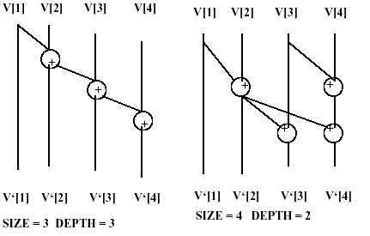
A simply stated problem having several different algorithms is the Generalized Prefix Problem:
Given an associative operator +, and N variables V1, V2, ..., VN, form the N results:
V1, V1+V2, V1+V2+V3, ..., V1+V2+V3+...+VN .
There are several different algorithms to solve this problem, each with different characteristics.

Slide 15
Divide and Conquer
A general technique for constructing non-trivial parallel algorithms is the divide and conquer technique.
The idea is to split a problem into 2 smaller problems whose solution can be simply combined to solve the larger problem.
The splitting is continued recursively until problems are so small that they are easy to solve.
In this case we split the prefix problem on V1, V2, ..., VN into 2 problems:
Prefix on V1, V2, ..., V⎡N/2⎤ , and
Prefix on V⎡N/2⎤+1 , V⎡N/2⎤+2, ..., VN
That is, we split inputs to the prefix computation into a lower half and an upper half, and solve the problem separately on each half.

Slide 16
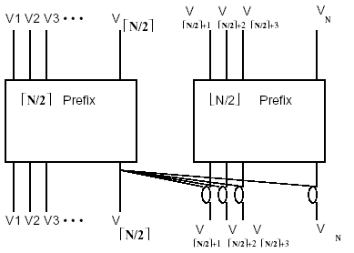
The Upper/Lower Construction
Solution to the 2 half problems are combined by the construction below:
Suppose:
P = 2
P = N
What are
T2 and Tn?
Recall that the ceiling of X, ⎡X⎤ is the least integer ≥ X and the floor of X, ⎣X⎦, is the greatest integer ≤ X.

Slide 17
Time Units for P = 2
Upper/lower “boxes” = N/2 – 1
Upper sum to lower = N/4
Total = N/2 – 1 + N/4 = ¾ N -1 = O(N)
Work = 2( ¾ N – 1) = 1.5 N -2
Result:
  Linear Speedup
  Slightly less time
  More work

Slide 18
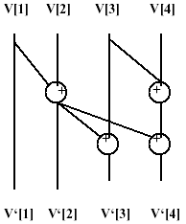
Recursively applying the Upper/Lower construction will eventually result in prefix computations on no more than 2 inputs, which is trivial.
For example: For 4 inputs we obtain:
N = 4
P = 2
Size = 4
Depth = 2
PC’s fully utilized

Slide 19
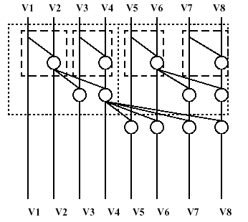
A larger example of the parallel prefix resulting from recursive Upper/Lower construction Pul(8):
N = 8
P = N/2 = 4
Size = 12
Depth = 3
PC’s fully utilized?

Slide 20
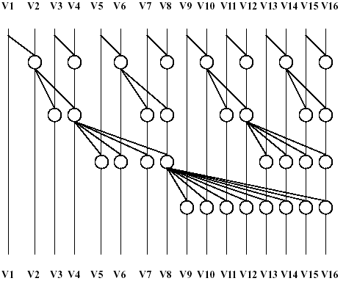
Finally Pul(16)
N = 16
P = 8
Size = 32
Depth = 4
PC’s fully utilized?

Slide 21
Analysis
Having developed a way to produce a prefix algorithm which allows parallel operations, we should now characterize it in terms of its size and depth.
The depth of the algorithm is trivial to analyze.
The construction must be repeated ⎡log N ⎤ times to reduce everything to one input.
For each application of the construction, the path from the rightmost input to the rightmost output passes through one more operation.
Therefore, Depth = ⎡log2 N ⎤

Slide 22
Review of Analysis (Time & Work)
Prefix Sum Problem – Upper/Lower
N (P = N/2) | Sequential Steps | Parallel Steps | Parallel Time
4 | 3 | 4 | 2
8 | 7 | 12 | 3
16 | 15 | 32 | 4
32 | 31 | 80 | 5
N | N -1 | N/2 Log N | Log N
See text for Proof – p. 28

Slide 23
Overview of Parallel Prefix Sum
If we have unlimited processors (arithmetic units) available then the minimum depth algorithm finishes soonest.
The Upper/Lower construction gives an algorithm with minimum depth.
If number of processors are limited then we have to keep the size small
Consider: ODD/EVEN Algorithm

Slide 24
Divide & Conquer
An alternative division of the problem
Consider dividing the array into 2 sets, those with even indices and those with odd indices

Slide 25
Odd-Even Algorithm
1. Divide the inputs into sets with odd and even index values.
2. Combine each odd with next higher even
3. Do the parallel prefix on the reduced set of evens
4. Combine each even with next higher odd at output.
Recursive application of odd/even construction – Step 3 - continues until a prefix of 2 inputs is reached. Poe(N)

Slide 26
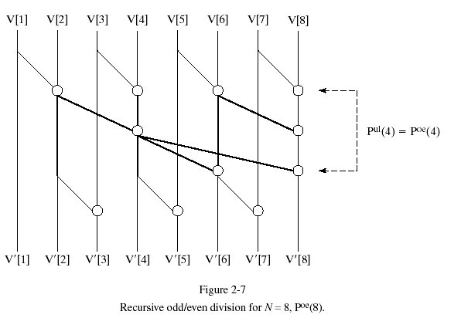
Odd-Even Prefix Sum
Prefix Sum Evens Only

Slide 27
Prefix of Even Locations
A: 2 4 6 8
S1 2 4 6 8
S2 2 4 6 8
S3 2 4 6 8

Slide 28
Once Evens are Complete
Each even adds to next odd
A: 1 2 3 4 5 6 7 8
S1: 1 2 3 4 5 6 7 8
Prefix Sums are Complete

Slide 29
Depth Analysis of Odd-Even
If we don’t divide S2 again, we get
S1: Odd + next Even: 1
S2: Prefix on evens: Log (N/2)
S3: Even + next Odd: 1
Total depth: 2 + Log (N/2)
If sub-problem S2 is divided, also, then
Depth = 2 + (2 + log (N/4))

Slide 30
Analysis O-E (continued)
If sub-problem S2 is divided, also, then
Depth = 2 + (2 + log (N/4))
If N = 2^{K} , D = 2 Log N – 2, for K >= 2
Size = Work = 2N – Log N - 2

Slide 31
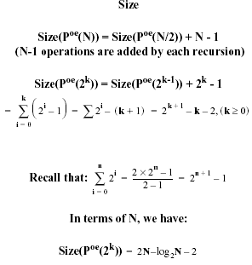
Size and Depth
The size and depth analysis of Odd/Even algorithm is simple for N a power of 2.

Slide 32
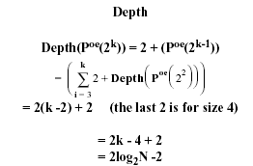
**Thus size of Odd/Even algorithm is less than the size of Upper/Lower but its depth is greater (~ twice)

Slide 33
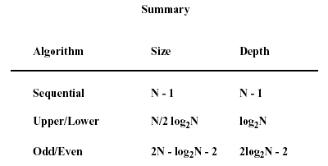

Slide 34
Summary
Sequential algorithm is very deep, Odd/Even is about twice as deep as Upper/Lower but both are much shallower than the sequential case.
Size of sequential algorithm is smallest
Size of Upper/Lower grows faster with N than the size of Odd/Even.
The size of Odd/Even is less than twice the size of sequential algorithm.
It is possible to find a parallel prefix algorithm with minimum depth which also has a size proportional to N instead of N log N.

Slide 35
A Parallel Algorithm with Small Depth & Size
Reference:
Ladner, R. E. and Fisher, M. J., “Parallel Prefix Computation, “JACM, vol. 27, no. 4, pp. 831-838, Oct. 1980.
By combining the 2 methods (Upper/Lower and Odd/Even), we can define a set of prefix algorithms P_{j}(N).
For j ≥ 1, P_{j}(N) is defined by Odd/Even construction using P_{j-1}(⎡N/2⎤).
(We shall omit the details and consider the results)

Slide 36
Comparison: Parallel Prefix Algorithms
Algorithm N = 2^{K} | Depth | Size
Upper/Lower | K | K * N/2
Odd/Even | 2K - 1 | 2N - K - 2
Ladner/Fischer | K | 4N - 4.96 N^{0.69} + 1

