Slide 1
Assignment1-Task2
Group-A3

Slide 2
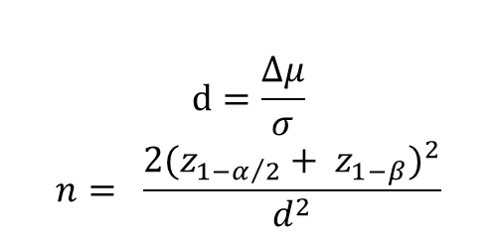
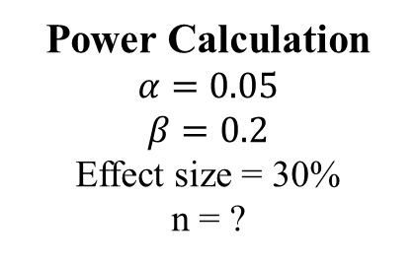
Power Calculation
MECAS Pharma has developed a promising molecule, named MECAS-123. Preclinical animal experiments have shown that MECAS-123 lowers the levels of NfL. This could potentially act to limit AD disease progression. MECAS-123 also has a favourable safety profile.
A parallel study will be carried out in matched AD patients. NfL and P-tau181 will be measured at three months following the experimental treatment and control treatment.
Based on the NfL data in AD patients in Task 1 - Perform power calculations, and give a suggestion on the number of study participants, given that we would like to detect a 30% reduction in the geometric mean of NfL.
Power Calculation
$$α=0.05$$
$$β=0.2$$
Effect size = 30%
n = ?
$$d=\frac{∆μ}{σ}$$
$$n= \frac{2{(z_{1−α/2}+ z_{1−β})}^{2}}{d^{2}}$$
 | True | True
True | TP | FP
True | FN | TN

Slide 3
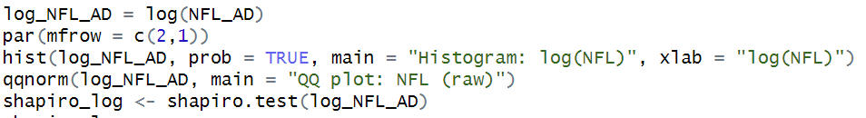
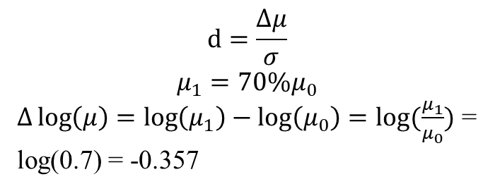
Q1
Based on the NfL data in AD patients in Task 1 - Perform power calculations, and give a suggestion on the number of study participants, given that we would like to detect a 30% reduction in the geometric mean of NfL.
Power Calculation
$$d=\frac{∆μ}{σ}$$
$$μ_{1}=70\%μ_{0}$$
$∆\log\left(μ\right)=\log\left(μ_{1}\right)−\log\left(μ_{0}\right)=log⁡(\frac{μ_{1}}{μ_{0}})$ = log(0.7) = -0.357

Slide 4
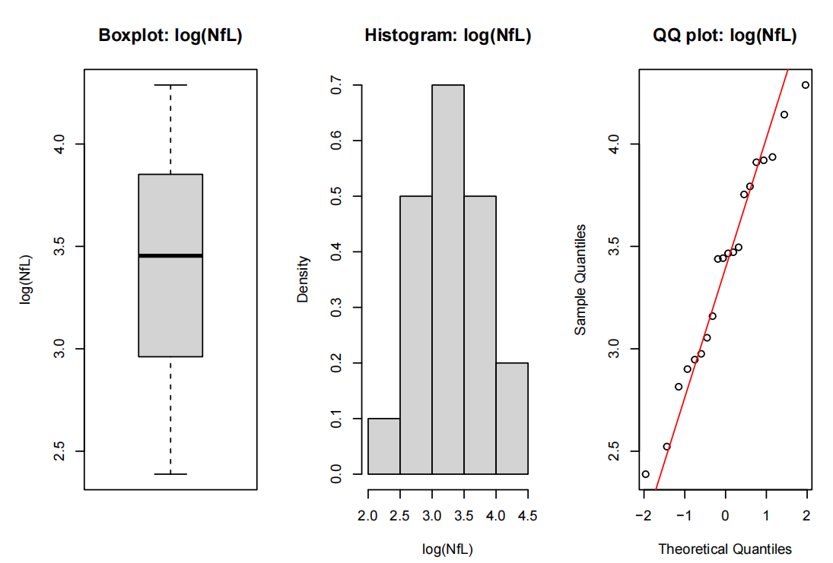
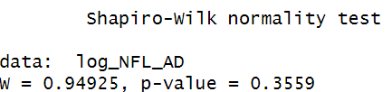
Q1
Based on the NfL data in AD patients in Task 1 - Perform power calculations, and give a suggestion on the number of study participants, given that we would like to detect a 30% reduction in the geometric mean of NfL.
Boxplot: symmetric distribution
Histogram: approximate normal distribution
QQ plot: roughly 45-degree line.
Log-normal distributed

Slide 5
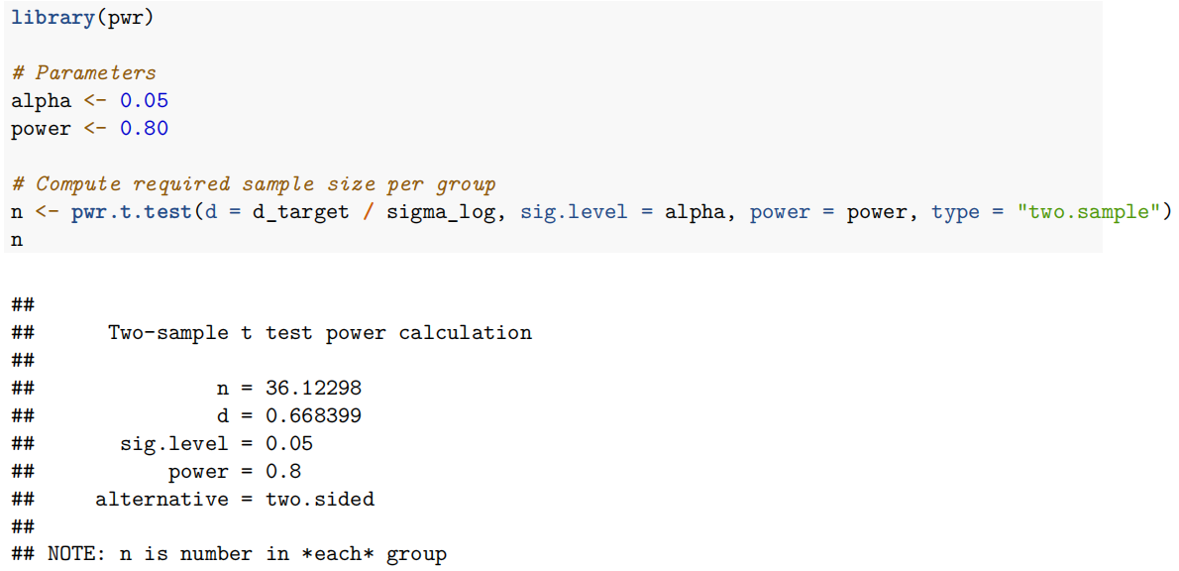
Q1
Based on the NfL data in AD patients in Task 1 - Perform power calculations, and give a suggestion on the number of study participants, given that we would like to detect a 30% reduction in the geometric mean of NfL.
Sample size: 37 individuals for each group

Slide 6
Q2
Develop a statistical data analysis plan.
Objective：
treatment (MECAS-123) vs control
Endpoint:
NFL after 3 month
Method:
Step 1: Assess Normality of Raw NFL Data & Log NFL Data;
Step 2: Hypothesis test using t-test on Log NFL Data.
Reason:
30% reduction in the geometric mean
efficient use of the data
translates into a percentage reduction

Slide 7
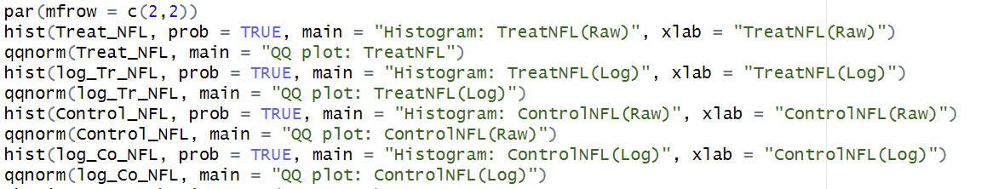
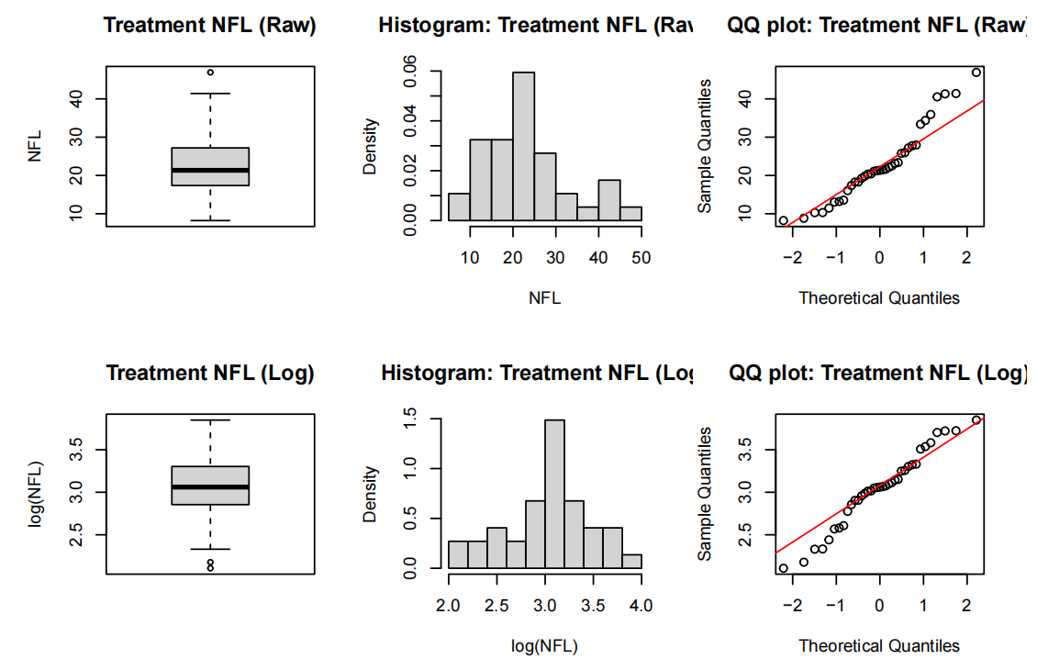
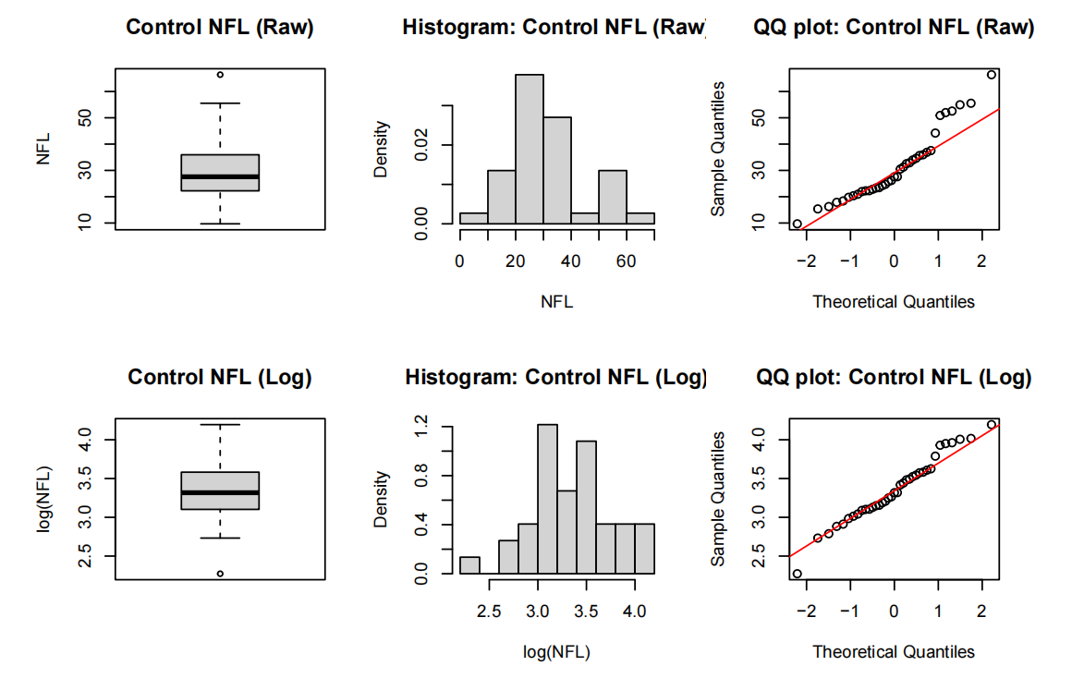
Q3&4
3. Retrieve the clinical data at your suggested sample size (N = study participants per study arm) using the CM2018 R package.
4. Carry out the statistical analysis based on your plan. What conclusions can be drawn?
Log NFL data shows a more normalized distribution in both groups

Slide 8
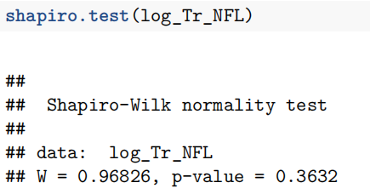
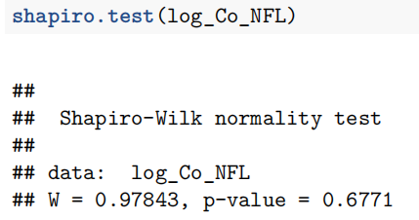
Q3$4
3. Retrieve the clinical data at your suggested sample size (N = study participants per study arm) using the CM2018 R package.
4. Carry out the statistical analysis based on your plan. What conclusions can be drawn?
Indicates that the Log NFL Data in both the Treatment group and the Control group is normally distributed

Slide 9
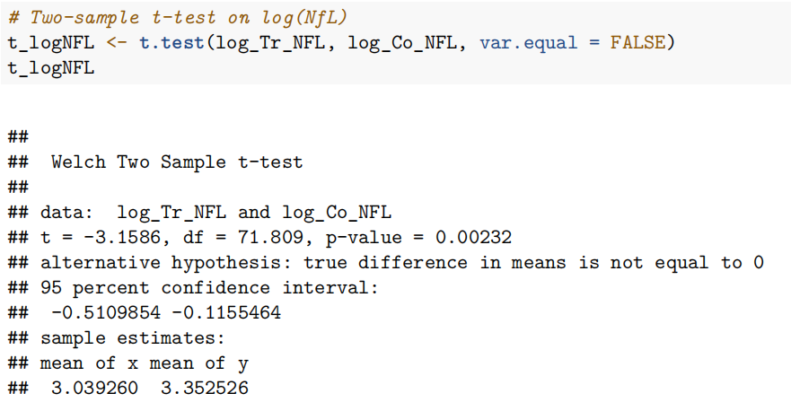
Q3$4
3. Retrieve the clinical data at your suggested sample size (N = study participants per study arm) using the CM2018 R package.
4. Carry out the statistical analysis based on your plan. What conclusions can be drawn?
Indicates that log(NFL) decrease significantly after MECAS-123 treatment.

Slide 10
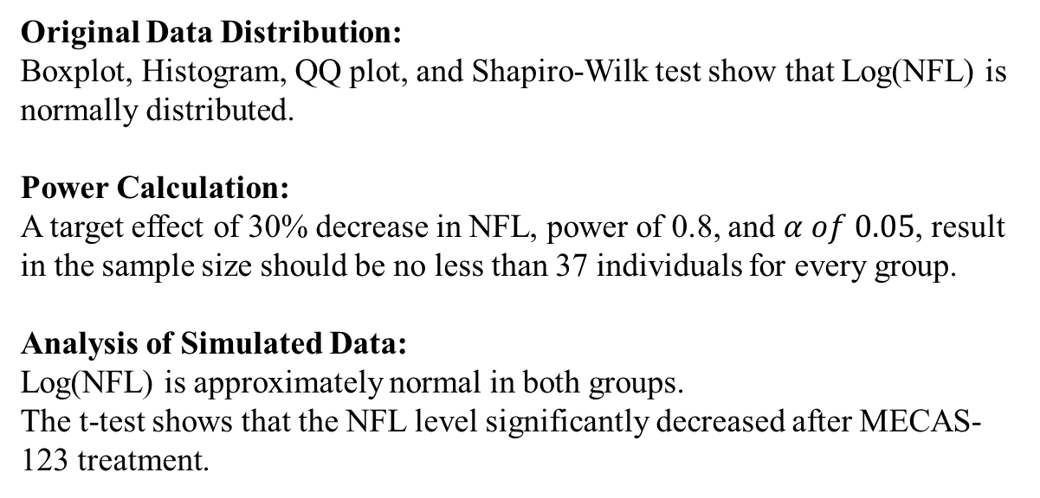
Conclusion
Original Data Distribution:
Boxplot, Histogram, QQ plot, and Shapiro-Wilk test show that Log(NFL) is normally distributed.
Power Calculation:
A target effect of 30% decrease in NFL, power of 0.8, and $α of 0.05$, result in the sample size should be no less than 37 individuals for every group.
Analysis of Simulated Data:
Log(NFL) is approximately normal in both groups.
The t-test shows that the NFL level significantly decreased after MECAS-123 treatment.

