Slide 1
Task 4
Group-A3

Slide 2
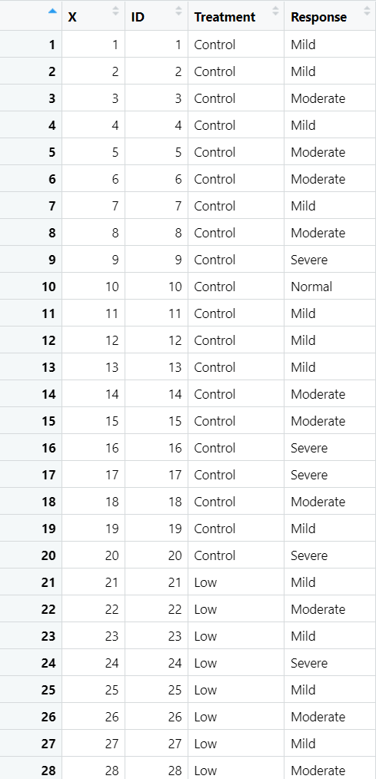
Q1 Visualize the questionnaire data across the four study arms
Data4A

Slide 3
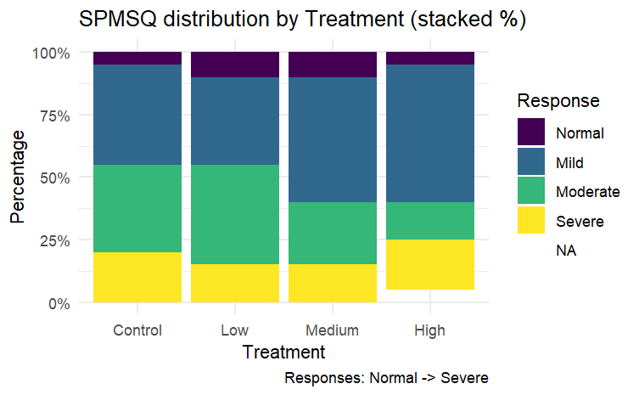
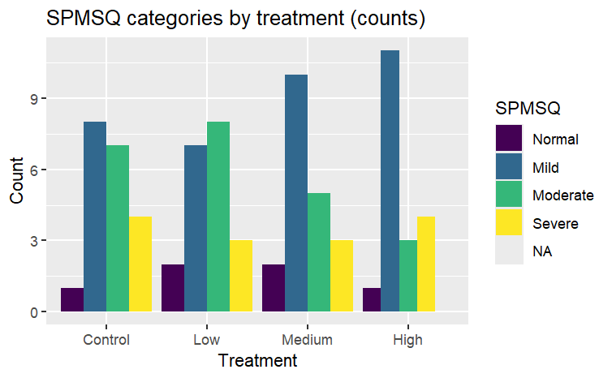
Q1 Visualize the questionnaire data across the four study arms
Stacked Percentage Bar Chart
Grouped Bar Plot
A missing value appears in the High-dose group
High-dose arm has a larger proportion of Mild impairment
Control and Low arm show relatively more Moderate responses

Slide 4
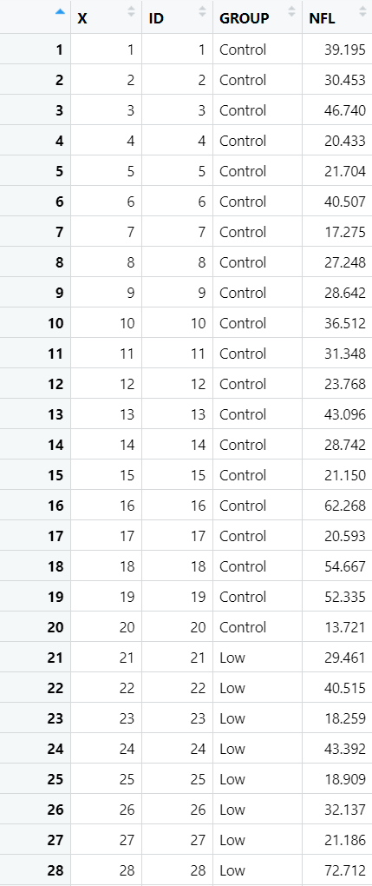
Q2 Visualizations of SPMSQ given the biomarker in Task 3
Data4A
Data3

Slide 5
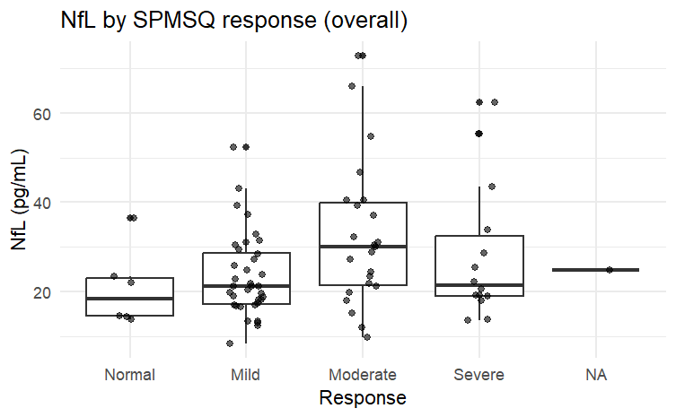
Q2 Visualizations of SPMSQ given the biomarker in Task 3
Merge the SPMSQ data (Data4A) with the NfL values (Data3) by participant ID
Plot boxplot over all treatments using NfL raw data

Slide 6
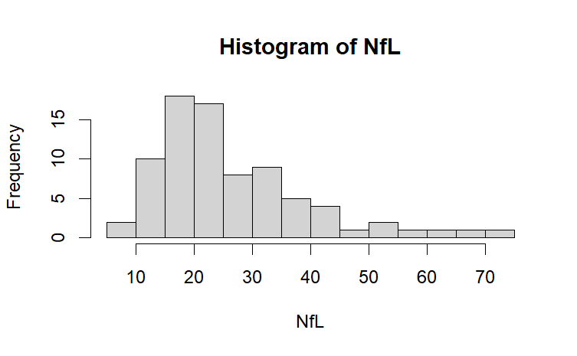
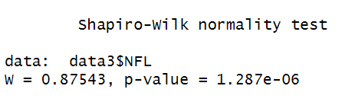
Q2 Visualizations of SPMSQ given the biomarker in Task 3
Test the normality of NfL
NfL is right-skewed distributed
p-value of shapiro-wilk normality test < 0.05
log transformation

Slide 7
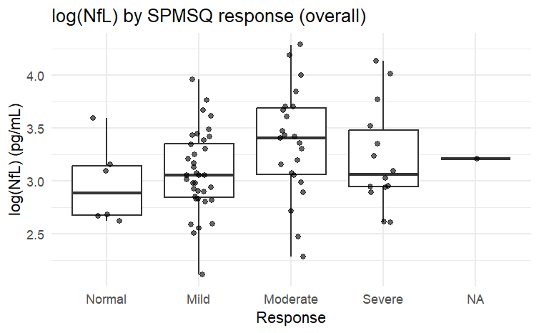
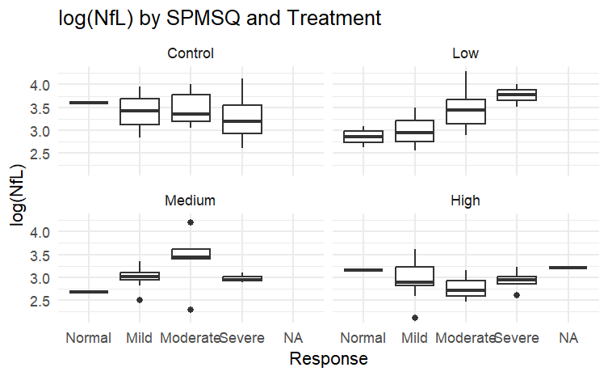
Q2 Visualizations of SPMSQ given the biomarker in Task 3
Box plot of log(NFL)
increased NfL may be associated with worse cognitive status
quantify this association

Slide 8
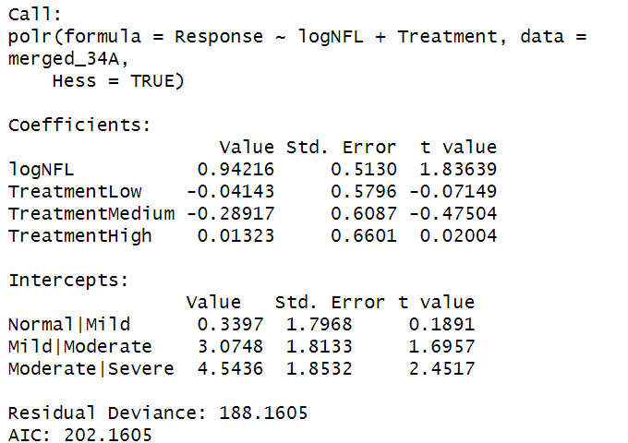
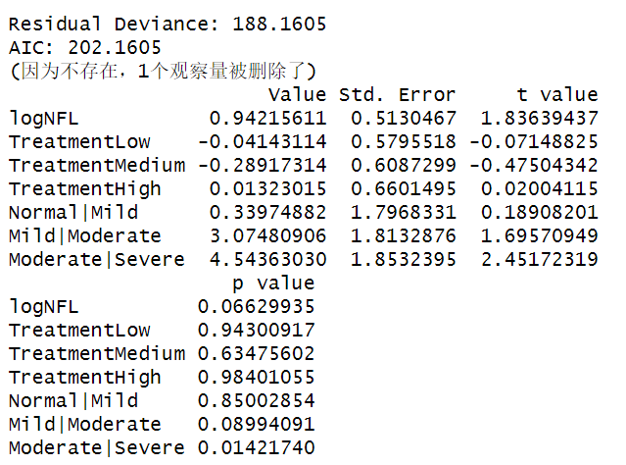
Q2 Visualizations of SPMSQ given the biomarker in Task 3
Logistic Regression Model (proportional-odds model)
odds ratios (OR) = exp(0.942)≈ 2.57
for each unit increase in log(NfL) the odds of being in a more severe SPMSQ category increases by approximately 2.57 times
p-value = 0.066 > 0.05
the evidence is only suggestive and not statistically significant

Slide 9
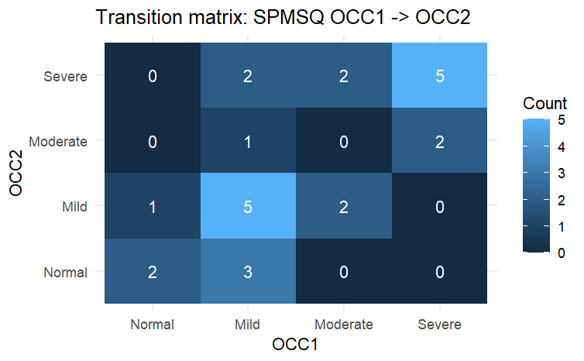
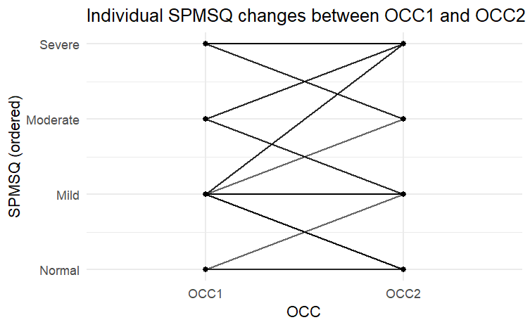
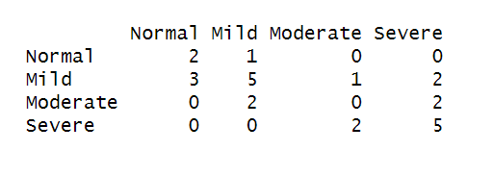
Q3 Visualise the SPMSQ for the same individuals at two occasions
Transition matrix & Heatmap & Individual connection diagram
48% stayed the same
28% improved
24% worsened
shows individual directions and magnitudes

Slide 10
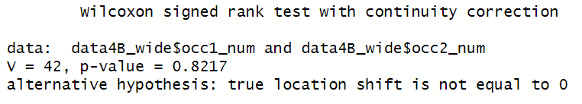
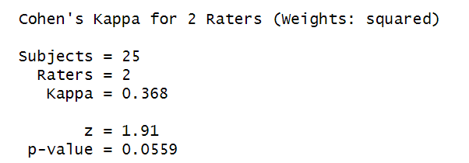
Q3 Visualise the SPMSQ for the same individuals at two occasions
Kappa
Wilcoxon signed-rank test
0-0.2 | slight agreement
0.2-0.4 | fair agreement
0.4-0.6 | moderate agreement
0.6-0.8 | substantial agreement
0.8-1.0 | almost perfect agreement
p-value was 0.8217 > 0.05
indicating no significant overall change in SPMSQ between the two occasions
Kappa = 0.368, indicating fair agreement
p-value = 0.0559, SPMSQ scores are moderately stable but not perfectly consistent across occasions

Slide 11
Summary
Methods:
Visualise SPMSQ distributions:
stacked percentage and grouped bar plots
log-transformed NfL and plotted it by SPMSQ categories
Quantify the association: ordinal logistic model (polr)
Within-subject changes: transition matrix, weighted kappa and Wilcoxon tests .
Key Findings:
Higher log(NfL) tended to associate with more severe SPMSQ categories (OR ≈2.57, borderline p), but not statistically significant.
SPMSQ showed fair agreement and no systematic group-level change across two occasions.

