Slide 1

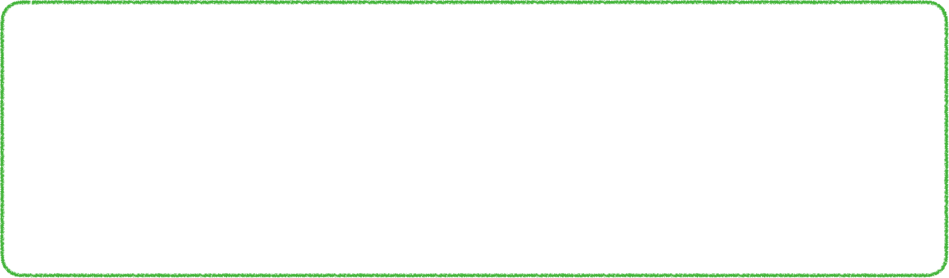
history
encode(prune, generate pair conflict)
SAT solver
SAT /
UNSAT
Pick
backtrack level
Resolve
partial assignment
conflict clause
assignment
T-Analyze
find cycle
T-Propagate
no cycle
“Unit-edge Propagate”
new assignment
theory solver

Slide 2
history
encoding (pruning, generating pair conflicts)
SAT solver
backtrack level
partial assignment
SAT /
UNSAT
Pick
Resolve
conflict clause
assignment
T-Analyze
find cycle
T-Propagate
Unit-edge Propagate
no cycle
new assignment
theory solver

Slide 3
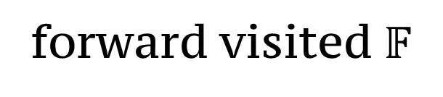
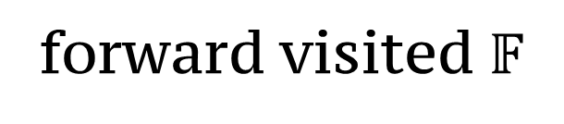

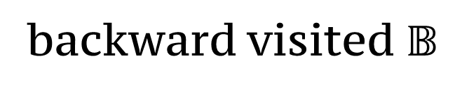
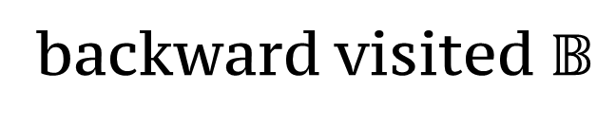
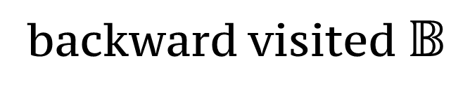







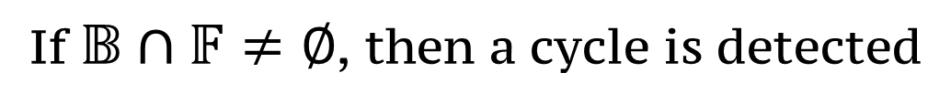
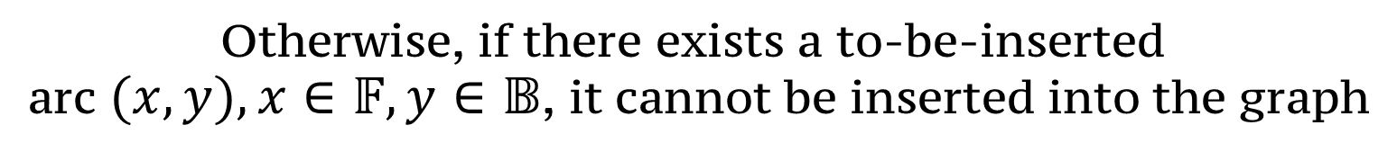
$$y$$
$$x$$
$$u$$
$$v$$
$$u$$
$$v$$
$$u$$
$$v$$
forward visited $𝔽$
backward visited $𝔹$
backward visited $𝔹$
backward visited $𝔹$
forward visited $𝔽$
Step #1, search backward
Step #2, search forward
Otherwise, if there exists a to-be-inserted
arc $(x,y),x∈𝔽,y∈𝔹$, it cannot be inserted into the graph
If $𝔹∩𝔽≠∅$, then a cycle is detected

Slide 4
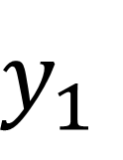
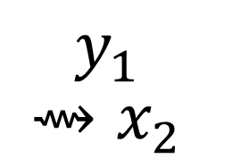
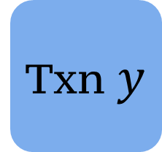
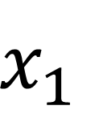

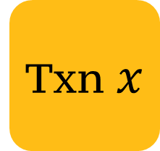
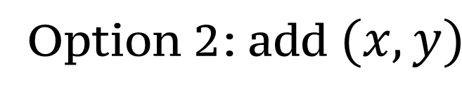

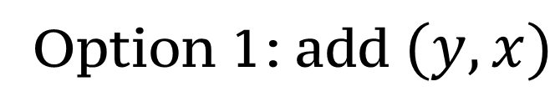
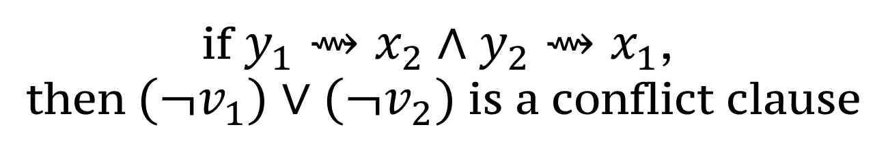
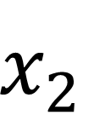

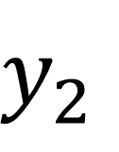

$$x_{2}$$
$$v_{2}:(x_{2},y_{2})$$
$$y_{1}⇝x_{2}$$
$$y⇝x$$
Option 2: add $(x,y)$
$$y_{2}$$
$$y_{1}$$
$$y_{1}$$
$$y_{1}$$
$$y_{1}$$
$$y_{1}$$
Txn $x$
Txn $y$
$$y_{1}$$
Option 1: add $(y,x)$
$$y_{2}⇝x_{1}$$
$$v_{1}:(x_{1},y_{1})$$
$$x_{1}$$
$$x_{1}$$
$$x_{1}$$
$$x_{1}$$
$$x_{1}$$
$$x_{1}$$
if $y_{1}⇝x_{2}∧y_{2}⇝x_{1}$,
then $(¬v_{1})∨(¬v_{2})$ is a conflict clause

Slide 5
 | z3 | monosat | a-minisat | cobra(w/o GPU)
tpcc | 10253 +（18618 + 439756）ms | 9981 + (29859 + 2385) ms | 10392 + (29629 + 1957) ms | 6723 ms
twitter | 64 s (285 + 705 + 63918 ms) | 513 ms (290 + 178 + 45 ms) | 684 ms (325 + 224 + 135 ms) | 7.06 h (25406373 ms)
rubis | 101 s (966 + 1210 + 99057 ms) | 2954 ms (967 + 1637 + 350 ms) | 3569 ms (1036 + 2022 + 511 ms) | 9.89 h (35609568 ms)

Slide 6
baseline | cycle detection algo | conflict generation algo | unit-edge propagation | pair conflict generation
z3 user propagator* | partial toposort | smallest | ✔️(partial)
monosat | PK toposort (285 + 705 + 63918 ms) | smallest (290 + 178 + 45 ms)
acyclic minisat* | ICD | first | ✔️ | ✔️
cobra (w/o GPU) | same as monosat
we have implemented *

Slide 7
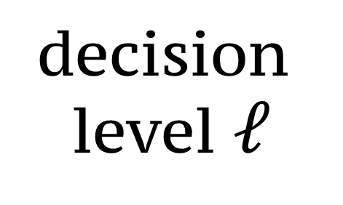
Decision trail
…
Decided by
picking
unit propagation
unit-edge propagation
decision
level $ℓ$
backtrack to some decision level
start a new decision level

