Slide 1



IsoVista: Black-box Checking Database Isolation Guarantees
Long Gu, Si Liu, Tiancheng Xing, Hengfeng Wei*, Yuxing Chen, David Basin

Slide 2





DBMSs have isolation bugs
https://jepsen.io/analyses/postgresql-12.3
https://jira.mariadb.org/browse/MDEV-27927

Slide 3
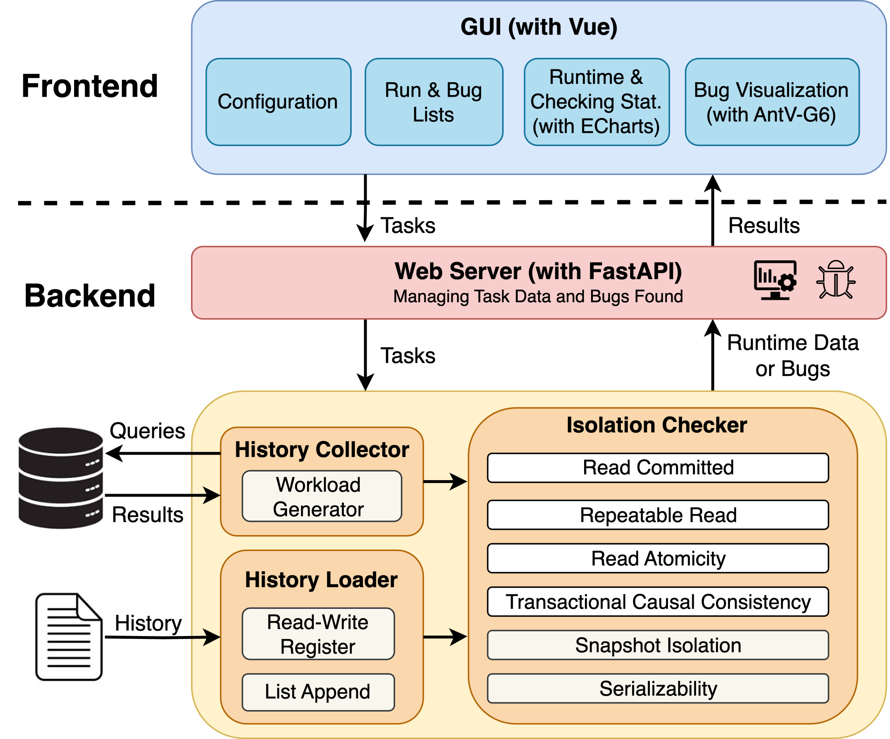
IsoVista
Key Features:
Support for Multiple Isolation Levels
Sound and Complete Checking
Efficient Checking
Informative Bug Visualization
Benchmarking and Performance Profiling
The architecture of IsoVista

