Slide 1





Online Timestamp-based Transactional Isolation Checking of Database Systems
Hexu Li, Hengfeng Wei, Hongrong Ouyang, Yuxing Chen, Na Yang, Ruohao Zhang, Anqun Pan
May 23, 2025
ICDE 2025, Hong Kong

Slide 2








Background
Transaction is an important mechanism in databases
Serializability (SER) and Snapshot Isolation (SI) are widely used isolation levels
Implementing transaction correctly is hard
SER/SI checking problem is fundamental to database testing

Slide 3
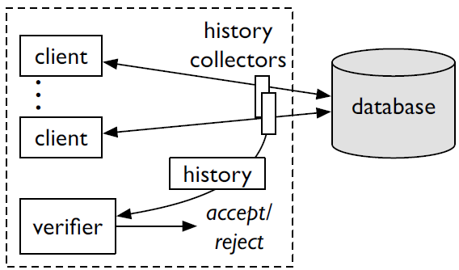
Existing checkers
Black-box checkers [Cobra:OSDI2020, Elle:VLDB2020, PolySI:VLDB2023, Viper:EuroSys2023]
cannot handle large-scale histories due to NP-hardness
White-box checkers [VerifyingMongoDB:arXiv2022, Emme:EuroSys2024]
enable polynomial-time checking
are not efficient enough because of graph building and cycle detection
The only online checker, Cobra
supports SER, not including SI
requires to inject “fence transactions” into client workloads

Slide 4
Our work
We tackle to problem of online SER/SI checking
We design an efficient and incremental timestamp-based offline checker
We further extend it to online settings, developing an online checker
Our checkers support both SER and SI
Experiments show our offline checker can handle a million transactions in seconds, and our online checker can keep a throughput of 12K TPS
We focus on SI checking, since SER is easy to understand

Slide 5
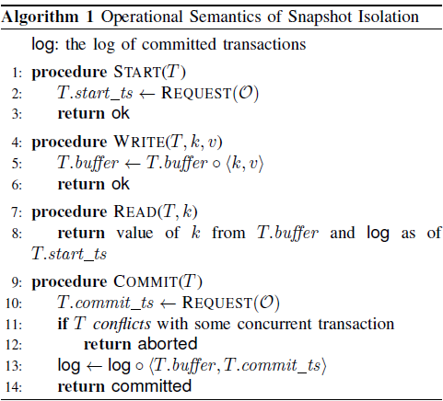




Preliminaries: operational semantics of SI [CritiqueANSI:SIGMOD1995]
Start: the txn request for a start timestamp
Write: the txn writes to its buffer
Read: the txn reads from its buffer first
Read: if not found, then the txn reads from persistent log
$$T_{1}$$
W(x, 1) W(y, 2) R(x, 1)
$$T_{0}$$
$$T_{2}$$
W(x, 0) W(y, 0)
R(x, 0)
Commit: the txn request for a commit timestamp
Commit: the txn checks if there is a conflict
Commit: if no, then its buffer will be written to the log
$$T_{3}$$
R(y, 2)

Slide 6
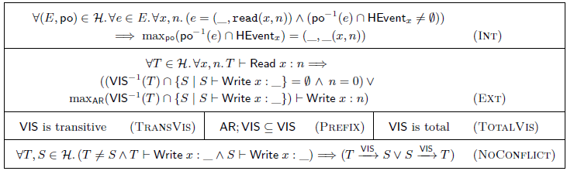
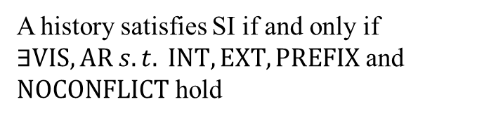
Preliminaries: axiomatic semantics of SI [Framework:CONCUR2015]
A history satisfies SI if and only if $∃VIS, AR s.t. INT, EXT, PREFIX$ and $NOCONFLICT$ hold
$$T_{1}$$
W(x, 1) W(y, 2) R(x, 1)
VIS
AR
AR
$$T_{0}$$
$$T_{2}$$
AR (arbitration, a strict total order): the total commit order of all the txns
VIS
VIS
W(x, 0) W(y, 0)
R(x, 0)
VIS
AR
VIS (visibility, a strict partial order): if a txn can see the effects of another txn
$$T_{3}$$
R(y, 2)

Slide 7
Preliminaries: axiomatic semantics of SI [Framework:CONCUR2015]
INT (internal consistency axiom): an internal read on a key returns the same value as the last read/write on that key
A history satisfies SI if and only if $∃VIS, AR s.t. INT, EXT, PREFIX$ and $NOCONFLICT$ hold
$$T_{1}$$
W(x, 1) W(y, 2) R(x, 1)
VIS
AR
AR
$$T_{0}$$
$$T_{2}$$
AR (arbitration, a strict total order): the total commit order of all the txns
VIS
VIS
W(x, 0) W(y, 0)
R(x, 0)
VIS
AR
VIS (visibility, a strict partial order): if a txn can see the effects of another txn
$$T_{3}$$
R(y, 2)

Slide 8
Preliminaries: axiomatic semantics of SI [Framework:CONCUR2015]
EXT (external consistency axiom): an external read in a txn on a key returns the final value written by the last committed txn among those it can see
A history satisfies SI if and only if $∃VIS, AR s.t. INT, EXT, PREFIX$ and $NOCONFLICT$ hold
$$T_{1}$$
W(x, 1) W(y, 2) R(x, 1)
VIS
AR
AR
$$T_{0}$$
$$T_{2}$$
AR (arbitration, a strict total order): the total commit order of all the txns
VIS
VIS
W(x, 0) W(y, 0)
R(x, 0)
VIS
AR
VIS (visibility, a strict partial order): if a txn can see the effects of another txn
$$T_{3}$$
R(y, 2)

Slide 9
Preliminaries: axiomatic semantics of SI [Framework:CONCUR2015]
PREFIX: if a txn can see another txn T, the txn should also see the txns committed before T
A history satisfies SI if and only if $∃VIS, AR s.t. INT, EXT, PREFIX$ and $NOCONFLICT$ hold
$$T_{1}$$
W(x, 1) W(y, 2) R(x, 1)
VIS
AR
AR
$$T_{0}$$
$$T_{2}$$
AR (arbitration, a strict total order): the total commit order of all the txns
VIS
VIS
W(x, 0) W(y, 0)
R(x, 0)
VIS
AR
VIS (visibility, a strict partial order): if a txn can see the effects of another txn
$$T_{3}$$
R(y, 2)

Slide 10


Preliminaries: axiomatic semantics of SI [Framework:CONCUR2015]
NOCONFLICT: concurrent txns are not allowed to write on the same key (in other words, txns that write on the same key cannot be concurrent)
A history satisfies SI if and only if $∃VIS, AR s.t. INT, EXT, PREFIX$ and $NOCONFLICT$ hold
$$T_{1}$$
W(x, 1) W(y, 2) R(x, 1)
VIS
AR
AR
$$T_{0}$$
$$T_{2}$$
AR (arbitration, a strict total order): the total commit order of all the txns
VIS
VIS
W(x, 0) W(y, 0)
R(x, 0)
VIS
AR
VIS (visibility, a strict partial order): if a txn can see the effects of another txn
$$T_{3}$$
R(y, 2)

Slide 11
Our insight: use timestamps to determine VIS and AR
The actual execution order should be consistent with their commit timestamps
Each txn should obverse the effects of all the txns that have committed before it starts
Many databases follow this rule to take a txn’s snapshot
$$T_{1}$$
W(x, 1) W(y, 2) R(x, 1)
VIS
AR
AR
$$T_{0}$$
$$T_{2}$$
VIS
VIS
W(x, 0) W(y, 0)
R(x, 0)
VIS
AR
$$T_{3}$$
R(y, 2)

Slide 12



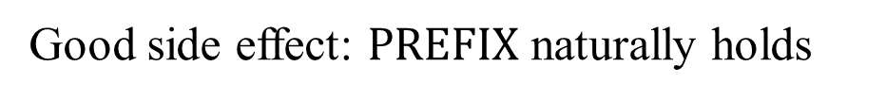
Our insight: use timestamps to determine VIS and AR
Good side effect: $PREFIX$ naturally holds
$$PREFIX:AR;VIS⊆VIS$$
$$T_{a}$$
AR
$$T_{b}$$
VIS
$$T_{c}$$
VIS
$$T_{a}.commit_ts<T_{b}.commit_ts≤T_{c}.start_ts⇒T_{a}.commit_ts≤T_{c}.start_ts$$

Slide 13





Offline checking: simulate txn execution one by one
Problem: given a whole history, how to check whether it satisfies SI?
x==1?
{x: 2, y: 1}
frontier
④
$$T_{5}$$
⑦
R(x, 1) W(y, 1)
To check EXT,
Use `frontier` to map each key to the last committed value
{x: 1}
①
$$T_{1}$$
②
W(x, 1)
{x: 2}
y==1?
{x: 2, y: 2}
INT, EXT
NOCONFLICT
⑧
⑩
③
$$T_{2}$$
⑤
$$T_{4}$$
W(x, 2)
R(y, 1)
INT, EXT
NOCONFLICT
x==2?
INT, EXT
NOCONFLICT
⑥
$$T_{3}$$
⑨
R(x, 2) W(y, 2)
INT, EXT
NOCONFLICT
INT, EXT
NOCONFLICT
{x: 2, y: 2}

Slide 14
Offline checking: simulate txn execution one by one
Problem: given a whole history, how to check whether it satisfies SI?
{x: {T2}, y: {T5}}
{x: {}, y: {T3}}
ongoing
④
$$T_{5}$$
⑦
R(x, 1) W(y, 1)
To check NOCONFLICT,
Use `ongoing` to map each key to the set of txns that are writing to that key
{x: {T1}}
{x: {}}
①
$$T_{1}$$
②
W(x, 1)
{x: {}, y: {T3}}
{x: {}, y: {}}
INT, EXT
NOCONFLICT
⑧
⑩
③
$$T_{2}$$
⑤
$$T_{4}$$
W(x, 2)
R(y, 1)
INT, EXT
NOCONFLICT
⑥
INT, EXT
NOCONFLICT
{x: {T2}}
{x: {}, y: {T2}}
$$T_{3}$$
⑨
R(x, 2) W(y, 2)
INT, EXT
NOCONFLICT
INT, EXT
NOCONFLICT
{x: {}, y: {T5, T3}}
{x: {}, y: {}}

Slide 15
Online checking: three main challenges
Problem: given an ever-growing history, how to check whether it satisfies SI?
Solutions:
We use a timeout mechanism to rectify and finalize EXT results
Some data structures are extended to support re-checking
GC is periodically executed to remove useless txns and data structures
EXT cannot be asserted upon the txn being collected
If the incoming txn has smaller timestamps, re-checking is needed
Garbage collection (GC) is required to avoid unlimited memory usage

Slide 16
Online checking (Step 1): check INT and EXT as offline
Problem: given an ever-growing history, how to check whether it satisfies SI?
x==1?
{x: 2, y: 1}
frontier_ts
④
$$T_{5}$$
⑦
R(x, 1) W(y, 1)
To check EXT,
`frontier` is extended to `frontier_ts`, versioned by timestamps
{x: 1}
①
$$T_{1}$$
②
W(x, 1)
{x: 2}
y!=1
{x: 2, y: 2}
③
$$T_{2}$$
⑤
⑧
$$T_{4}$$
⑩
W(x, 2)
R(y, 1)
⑥
$$T_{3}$$
⑨
R(x, 2) W(y, 2)
{x: 2, y: 2}

Slide 17
Online checking (Step 2): check NOCONFLICT
Problem: given an ever-growing history, how to check whether it satisfies SI?
{x: 2, y: 1}
frontier_ts
④
$$T_{5}$$
⑦
R(x, 1) W(y, 1)
Both T5 and T3 write on key y
Report a NOCONFLICT violation
{x: 1}
①
$$T_{1}$$
②
W(x, 1)
{x: 2}
y!=1
{x: 2, y: 2}
③
$$T_{2}$$
⑤
⑧
$$T_{4}$$
⑩
W(x, 2)
R(y, 1)
⑥
$$T_{3}$$
⑨
R(x, 2) W(y, 2)
{x: 2, y: 2}

Slide 18
Online checking (Step 3): re-check EXT
Problem: given an ever-growing history, how to check whether it satisfies SI?
{x: 2, y: 1}
frontier_ts
④
$$T_{5}$$
⑦
R(x, 1) W(y, 1)
the EXT violation is eliminated
{x: 1}
①
$$T_{1}$$
②
W(x, 1)
{x: 2}
y==1?
{x: 2, y: 2}
③
$$T_{2}$$
⑤
⑧
$$T_{4}$$
⑩
W(x, 2)
R(y, 1)
⑥
$$T_{3}$$
⑨
R(x, 2) W(y, 2)
{x: 2, y: 2}
terminate re-checking early

Slide 19
Online checking: garbage collection (GC)
Problem: given an ever-growing history, how to check whether it satisfies SI?
{x: 2, y: 1}
frontier_ts
④
$$T_{5}$$
⑦
R(x, 1) W(y, 1)
Given a timestamp ts:
Remove frontier[ts’] such that ts’ <= ts
Remove the txns whose commit_ts <= ts
{x: 1}
①
$$T_{1}$$
②
W(x, 1)
{x: 2}
{x: 2, y: 2}
③
$$T_{2}$$
⑤
⑧
$$T_{4}$$
⑩
W(x, 2)
R(y, 1)
⑥
$$T_{3}$$
⑨
R(x, 2) W(y, 2)
{x: 2, y: 2}

Slide 20
Evaluation: research questions
For our offline checker, Chronos
How efficient is it?
How do the individual stages contribute to its performance?
For our online checker, Aion
What is its throughput?
What is the overhead of online checking?

Slide 21
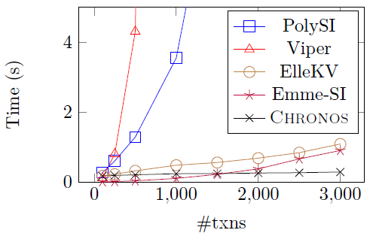
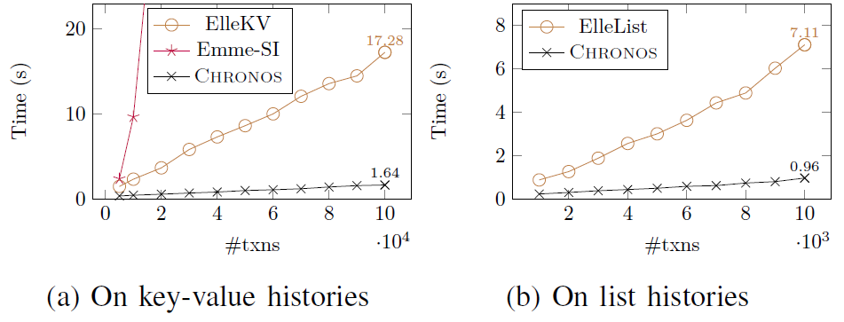
Evaluation: efficiency of Chronos
Chronos is 7-11x faster than Elle, and greatly outperforms other checkers

Slide 22
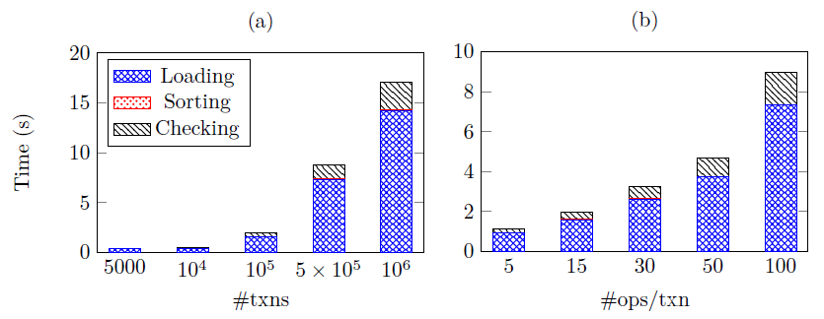
Evaluation: decomposition of Chronos
The bottleneck of offline checker is in loading files, rather than checking

Slide 23
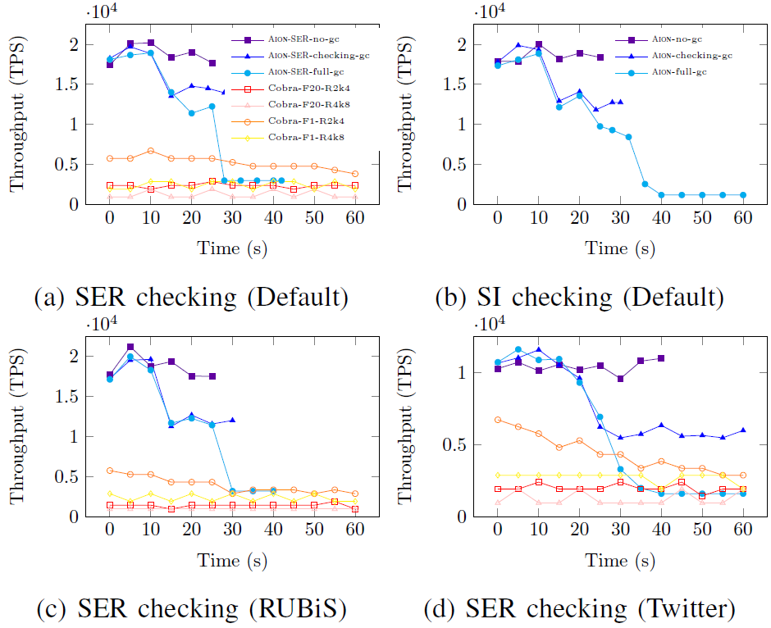
Evaluation: throughput of Aion
Chronos has a higher throughput than Cobra, and can keep a throughput of 12K TPS

Slide 24
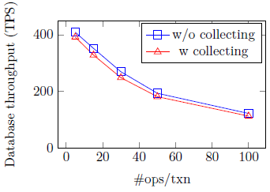
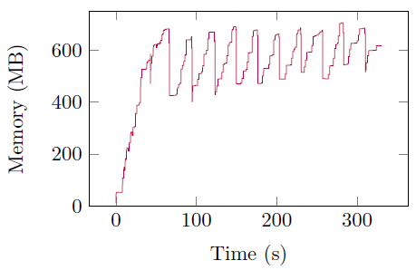
Evaluation: overhead of online checking
Collecting txns leads to a 5% drop in database TPS,
and the memory usage of Aion is controlled within a certain range

Slide 25
Summary
We design an efficient and incremental timestamp-based offline checker
We extend it to support online settings, introducing our online checker
Both of them achieve high performance
Both SI and SER are supported
Future work
support more data types and complex SQL queries, such as predicate reads
handle more databases like PostgreSQL which replies on visibility rules to take snapshots

