Slide 1
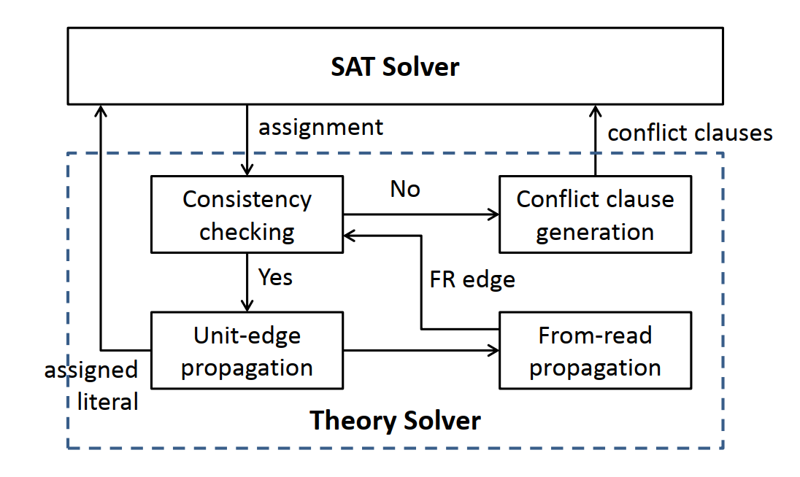
贺老师的流程图

Slide 2
SAT Solver
assignment of WW
conflict clauses
no
Consistency checking
(Cycle detection)
Conflict clause generation
yes
FR edge
Unit-edge propagation
(add one WW edge;
Set another direction false)
From-read propagation
(add RW edges caused
by the WW edge)
assigned
literal
我们的蛮力算法流程图

Slide 3
SAT Solver
assignment of WW
conflict clauses
no
Consistency checking
(Cycle detection)
Conflict clause generation
1.Incremental cycle detection
yes
FR edge
Unit-edge propagation
(add one WW edge;
Set another direction false)
From-read propagation
(add RW edges caused
by the WW edge)
assigned
literal
2.Heuristic assignment
优化方案

