Slide 1
Custom Program – Graphing Calculator
Ryan Weber 105914892

Slide 2
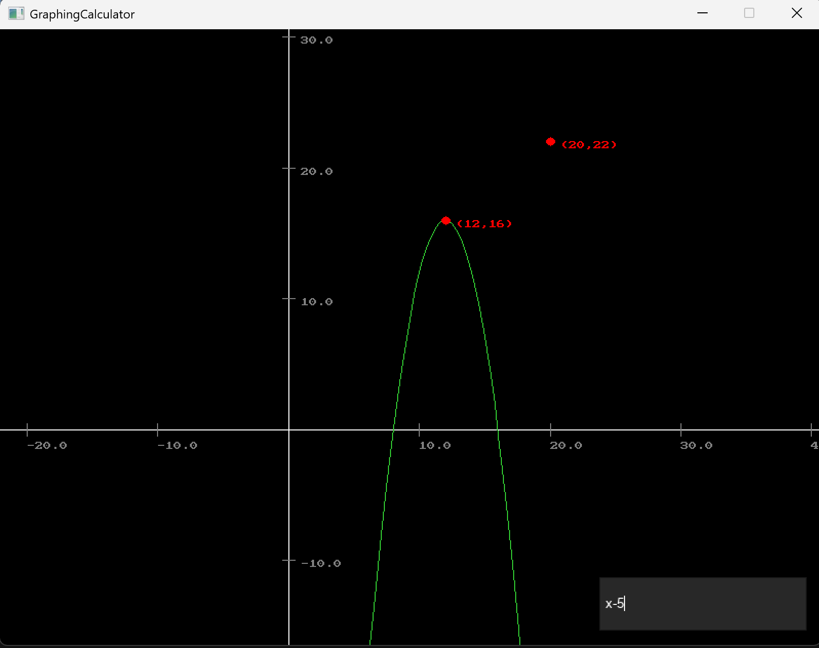
Overview
What is my program?
Why did I decide to build this program?
Key features:
Parsing any type of graph from text
Recalculating graph based on camera transform in world space
Displaying graphs relevant to camera transform on screen
25 classes

Slide 3
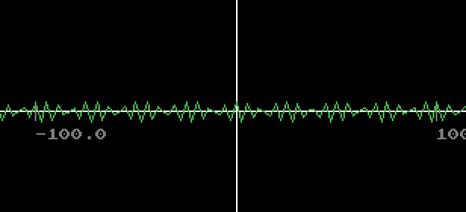
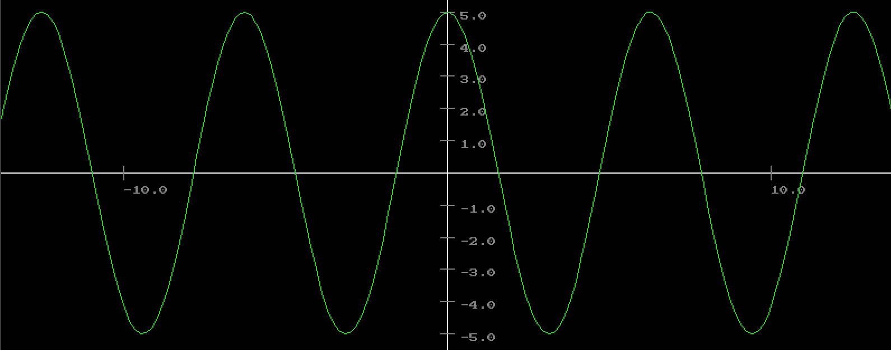
Code Design
How is the program challenging / special:
Parsing text
Strategy pattern
IOperation Interface
Seperatng functions
Token class
Rendering
Singleton pattern - Camera
Mediator pattern – Grid Lines
Boundary and other Functions
I have learned:
Difficulties of converting user input to functions
How to use classes to represent types of data
How to draw with a camera’s size and position, and structure for other objects

