Slide 1
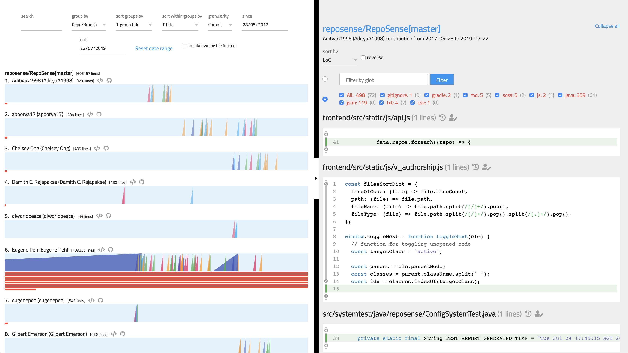
summary
tabs-pane
summary-picker
glob filter
summary-chart
summary-chart__ramp
summary-chart__ramp__slice
title
segment
file
summary-
chart__contrib

