Slide 1
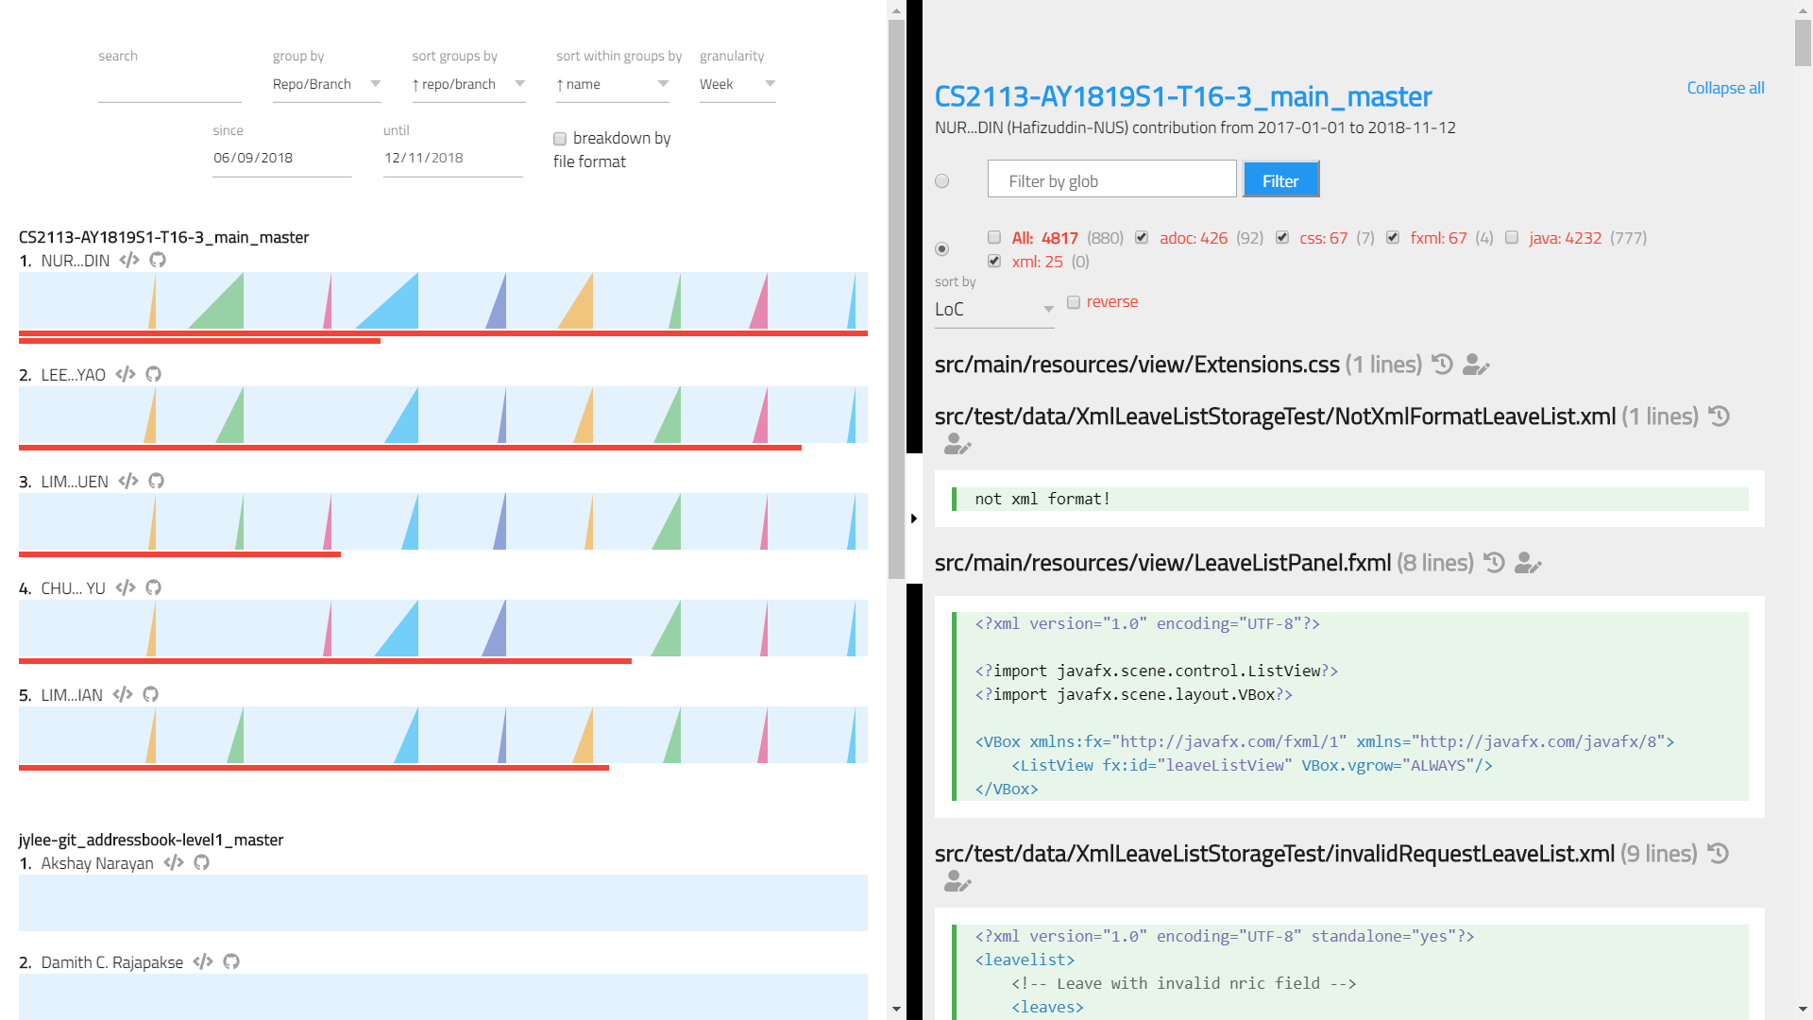
Chart Panel
Code Panel
Toolbar
Glob Filter
Ramps
Ramp Chart
History View
Blame View
Link to repository
View author’s committed codes
Contribution Bar

