Slide 1
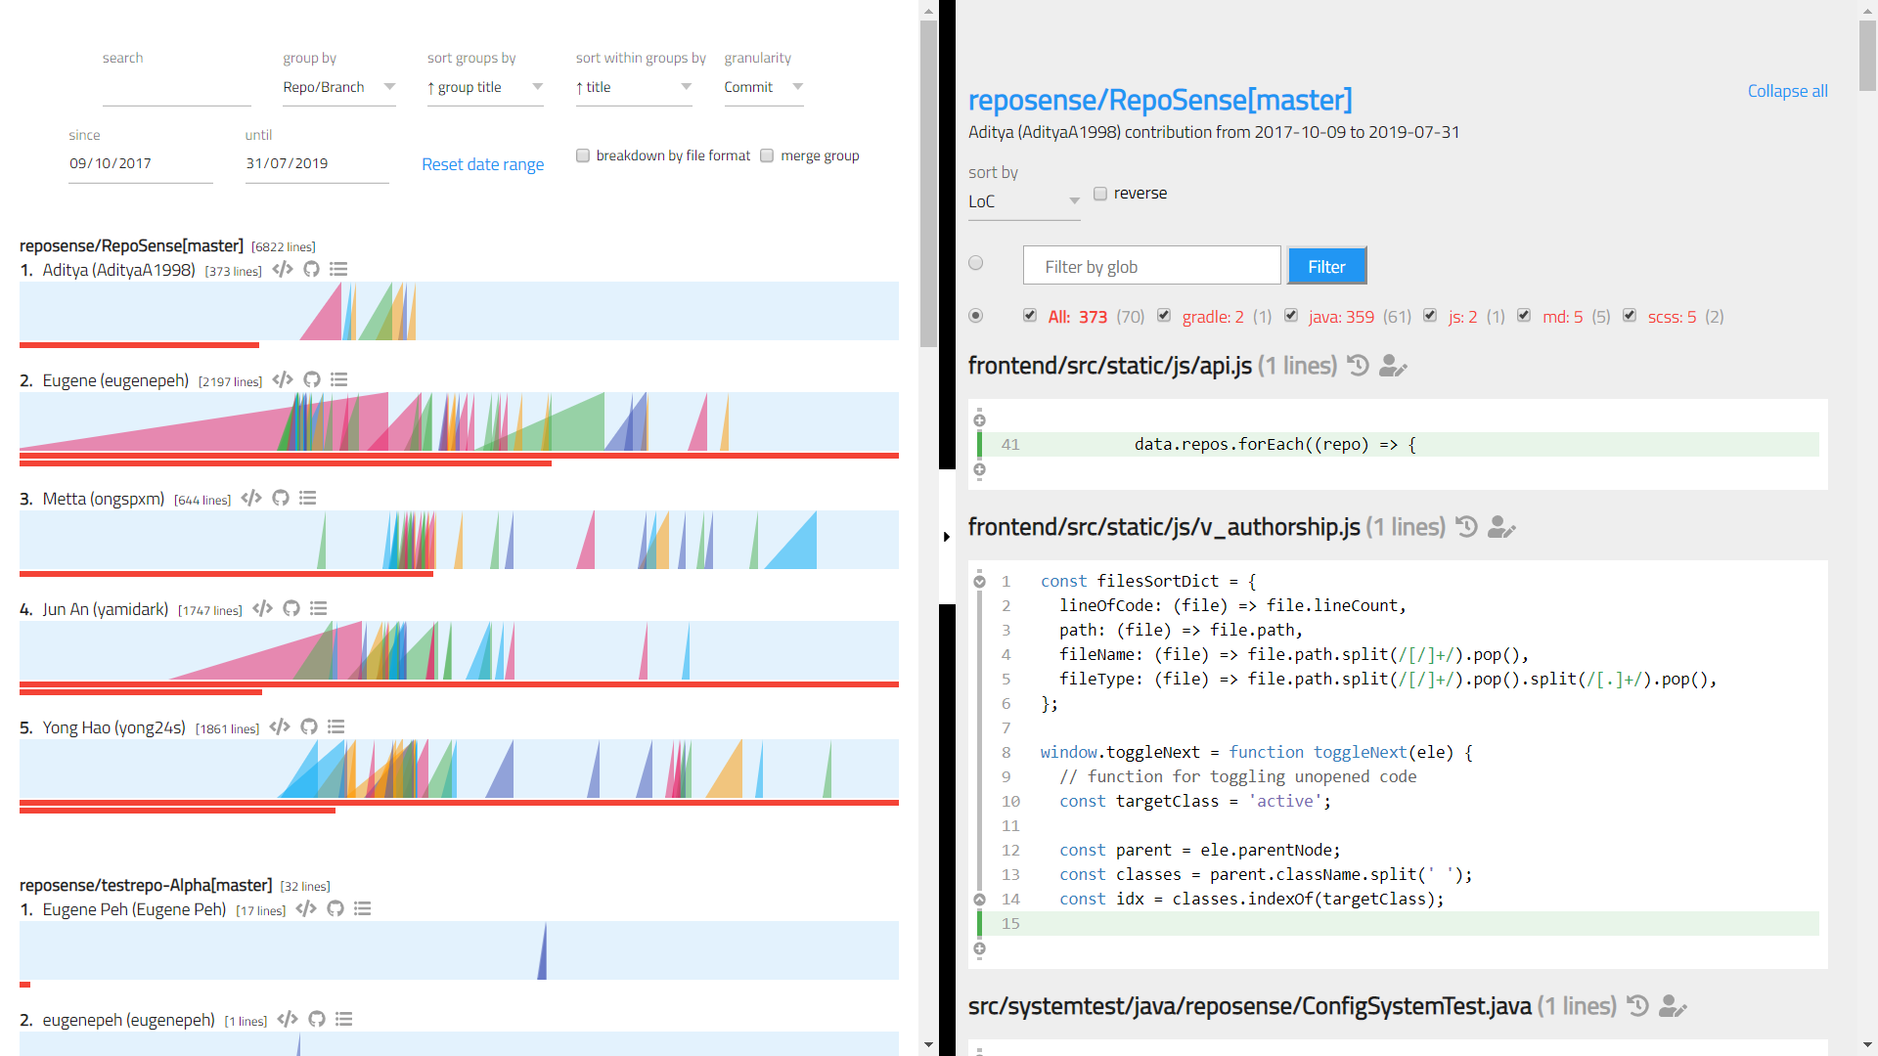
summary
tabs-pane
summary-picker
summary-chart
glob filter
summary-chart__ramp
title
summary-
chart__contrib
segment
file
summary-chart__ramp__slice

