Slide 1
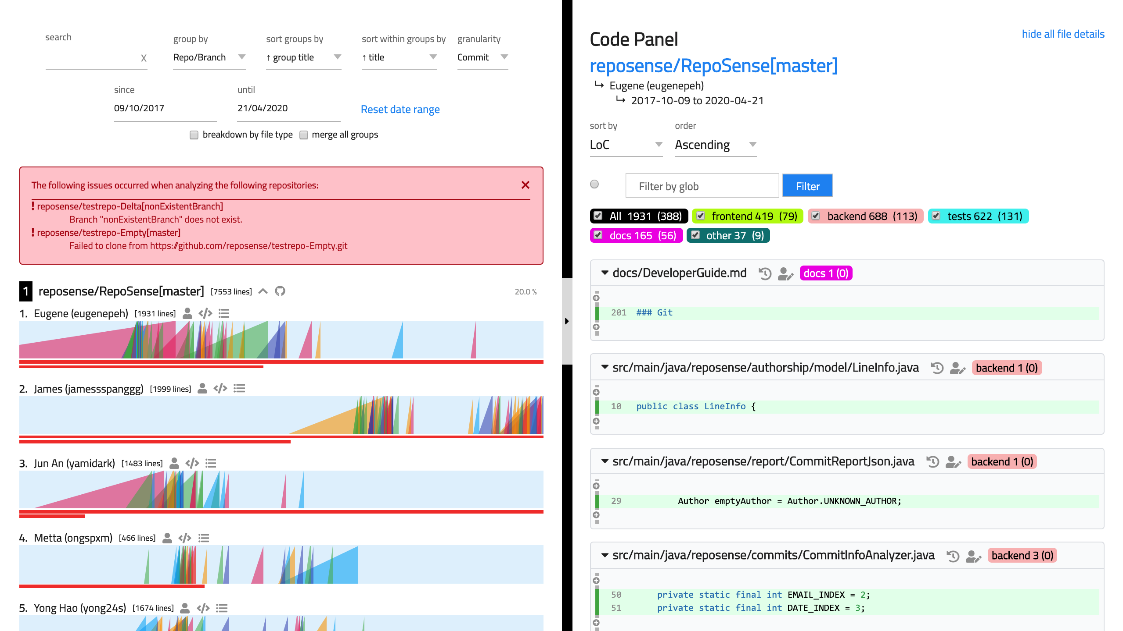
Chart Panel
Code Panel
Toolbar
Glob Filter
Merge group
Link to repository
View author’s committed codes
Ramp Chart
Link to author’s page
History View
Blame View
Link to commits panel
Contribution Bar
Ramps

