Slide 1
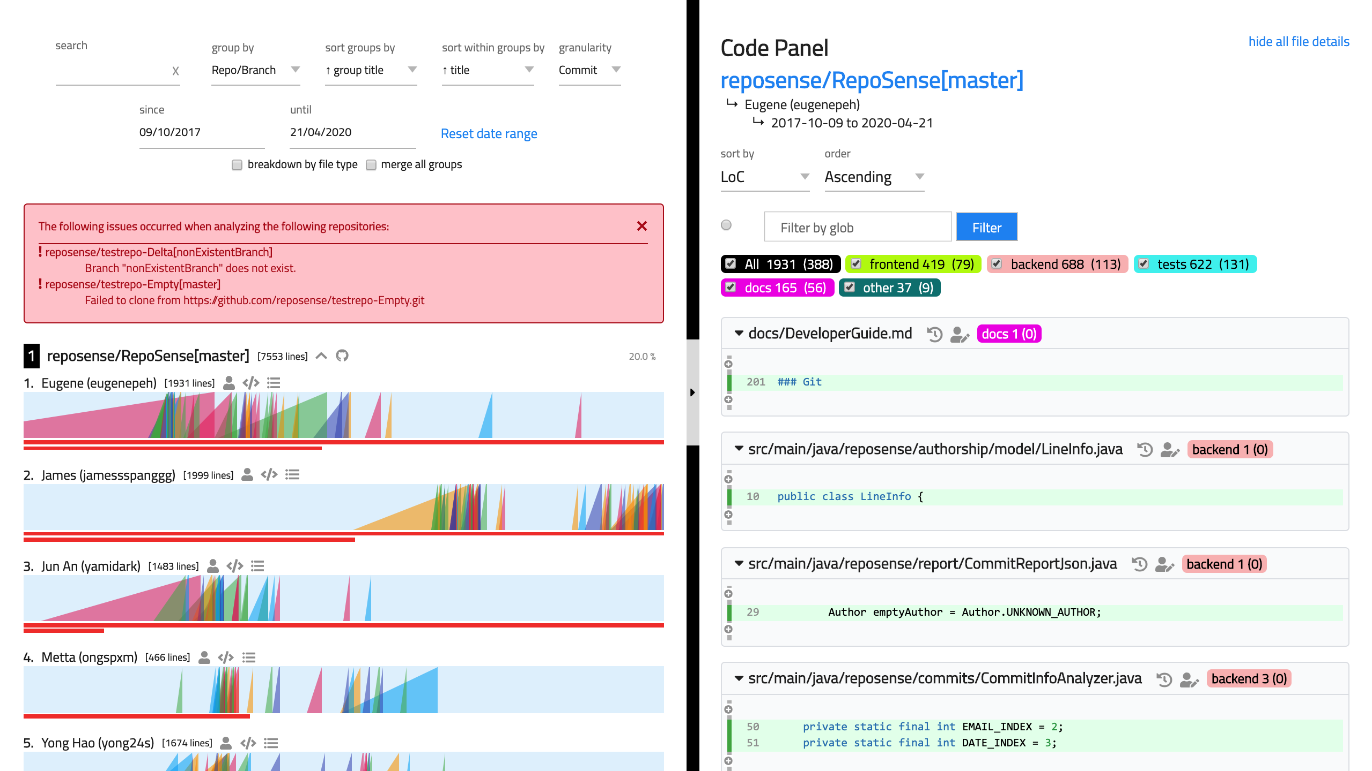
summary
tabs-pane
summary-picker
glob filter
title
summary-chart
file
summary-chart__ramp
summary-
chart__contrib
segment
summary-chart__ramp__slice

