Slide 1
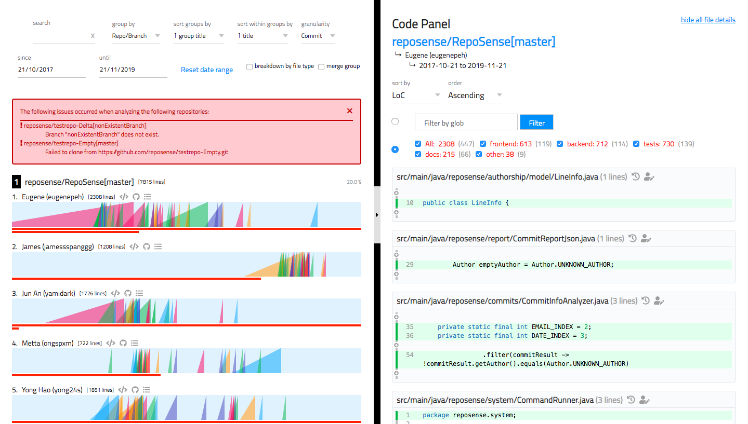
summary
tabs-pane
summary-picker
glob filter
title
summary-chart
summary-chart__ramp
file
summary-
chart__contrib
summary-chart__ramp__slice
segment

