Slide 1
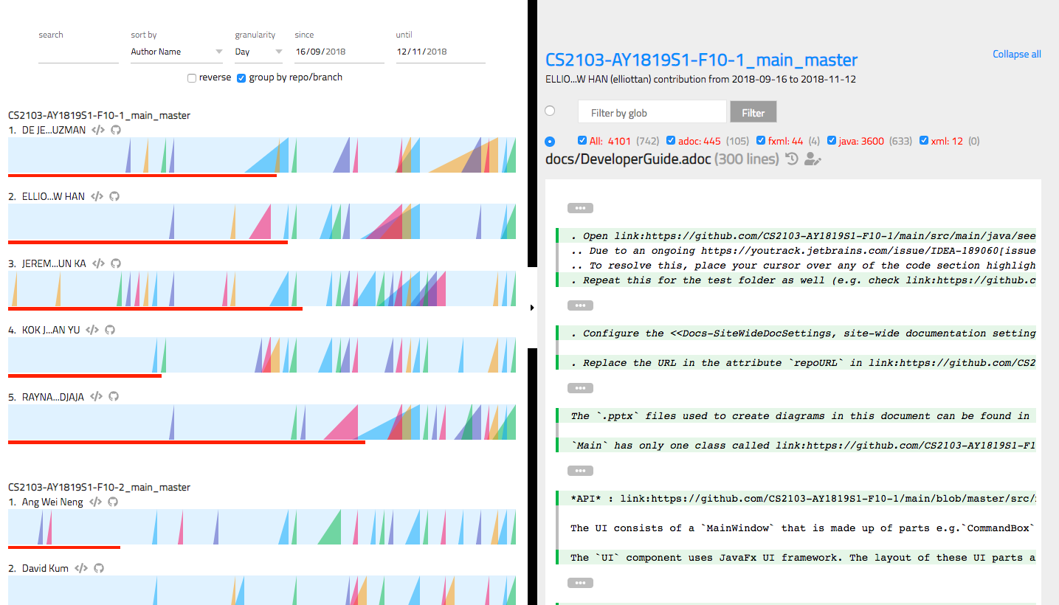
{ }
summary-picker
glob filter
{ }
summary-chart
title
summary-chart__contrib
summary-chart__ramp__slice
file
summary-chart__ramp

