Slide 1
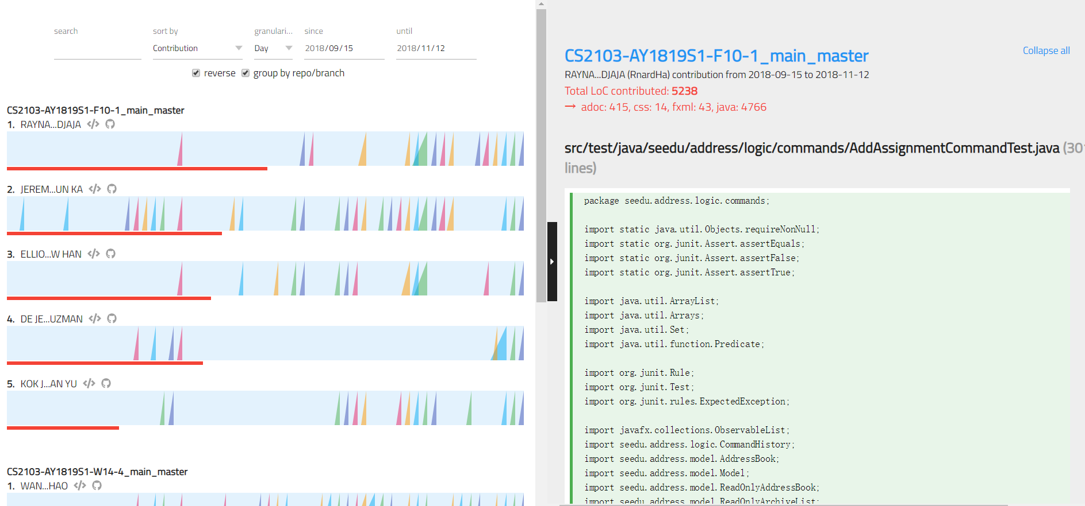
Chart Panel
Code Panel
Toolbar
Ramp Chart
Ramp
Contribution Bar

