Slide 1
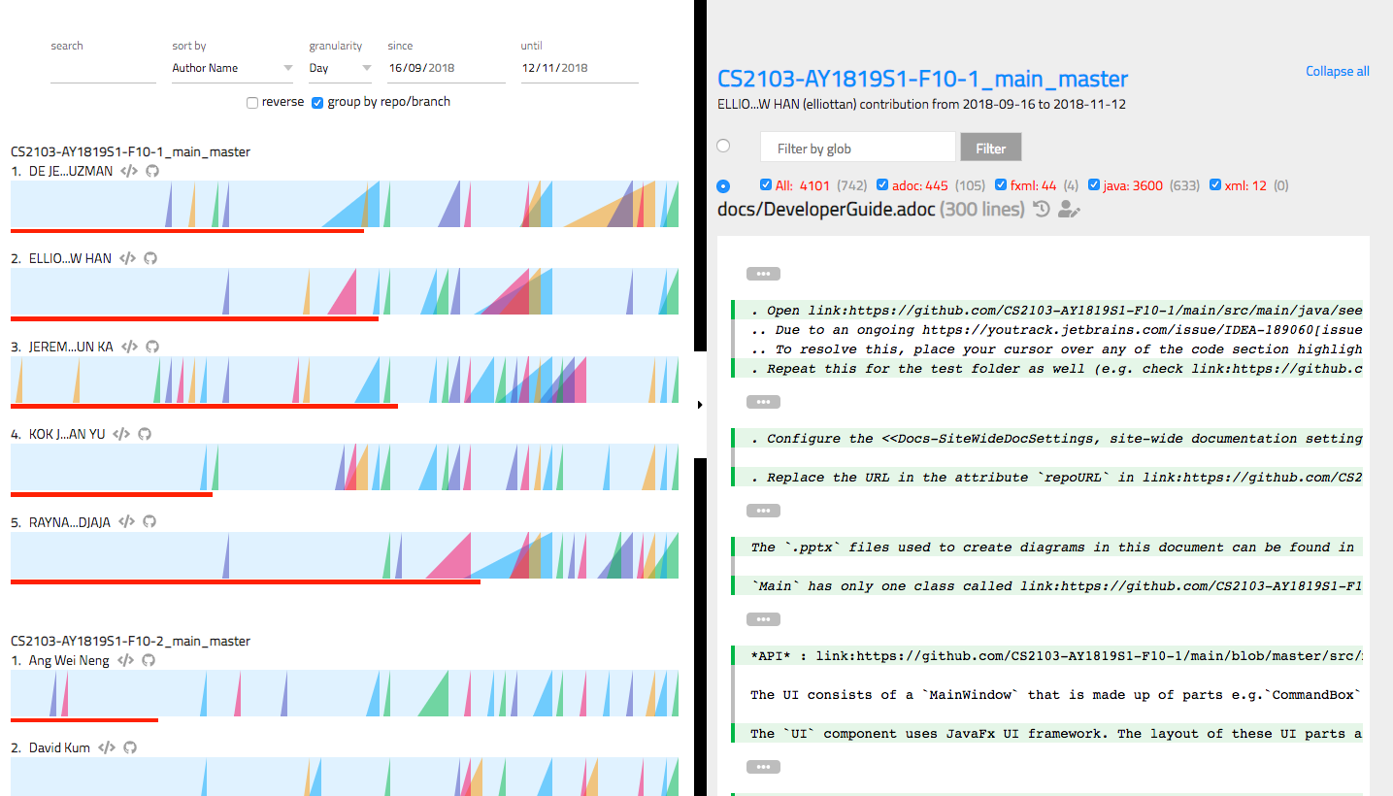
Chart Panel
Code Panel
Toolbar
Glob Filter
Repo Link
Blame View
History View
Ramp
Ramp Chart
Contribution Bar

