Slide 1
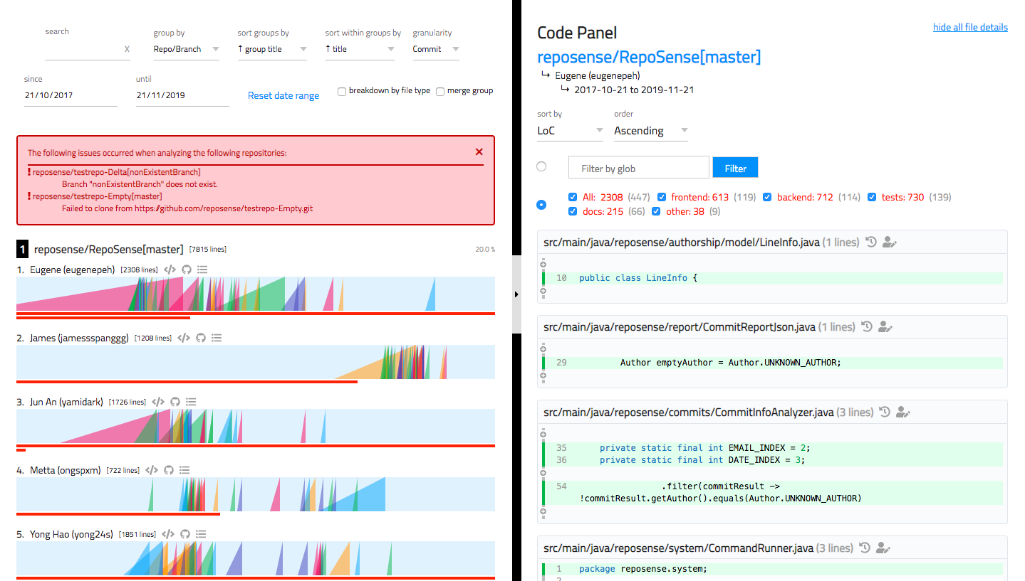
Chart Panel
Code Panel
Toolbar
Glob Filter
View author’s committed codes
History View
Ramp Chart
Blame View
Link to repository
Link to commits panel
Contribution Bar
Ramps

