Slide 1
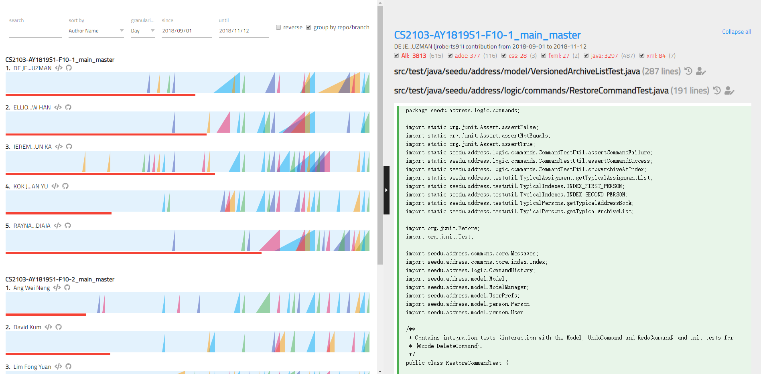
Chart Panel
Code Panel
History View
Toolbar
Blame View
Repo Link
Ramp Chart
Ramp
Contribution Bar

