Slide 1
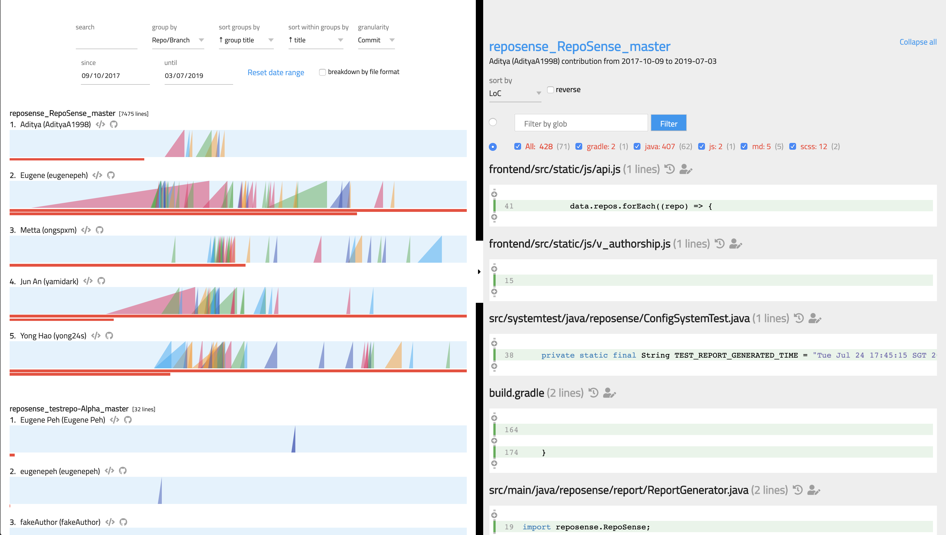
Chart Panel
Code Panel
Toolbar
Glob Filter
Ramp Chart
Link to repository
Blame View
View author’s committed codes
Ramps
History View
Contribution Bar

