Slide 1
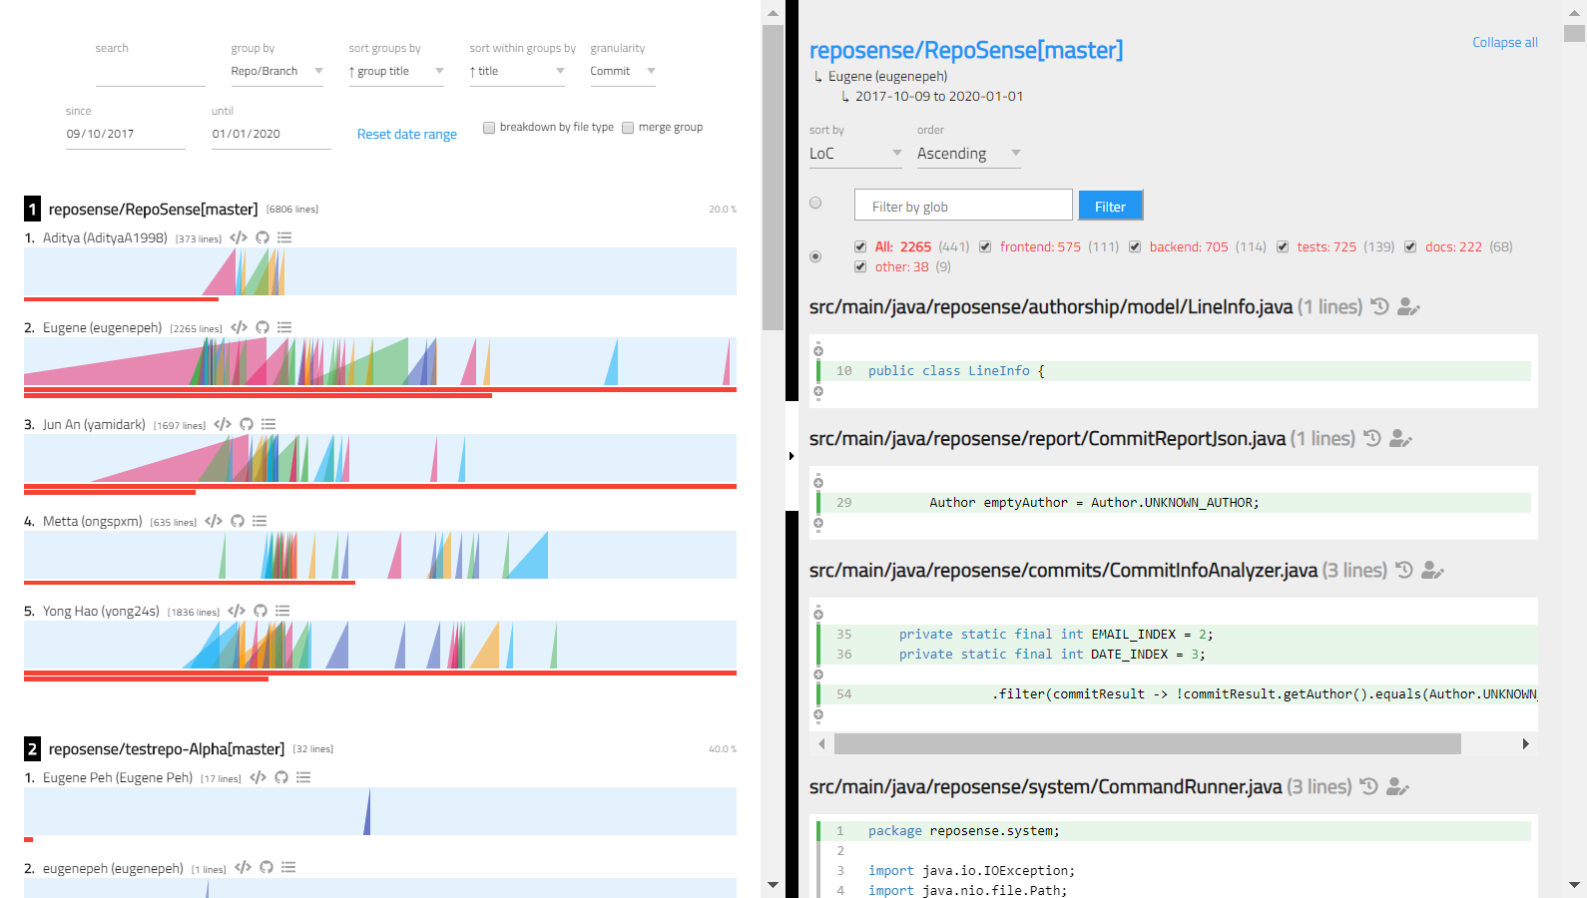
Chart Panel
Code Panel
Toolbar
Glob Filter
Ramp Chart
View author’s committed codes
History View
Blame View
Link to repository
Contribution Bar
Link to commits panel
Ramps

