Slide 1
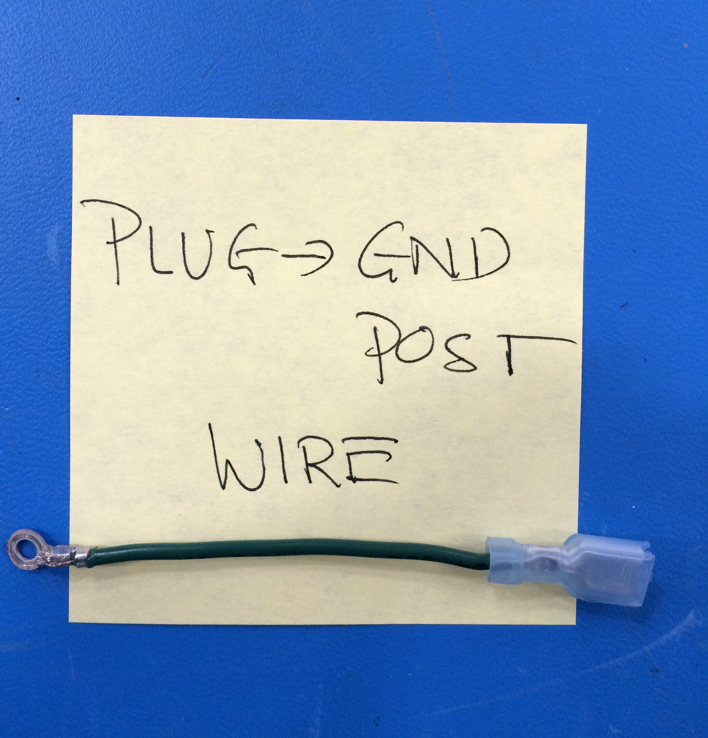
Mini - Daffodil
PLUG–TO–GND POST EXTENSION
N/A
200 mm
180 mm
N/A
Nozzle 5V
[EL-MS0143]
16 AWG - Green
[EL-WR0122]
[EL-MS0210]
Cut to length L = 80 mm

