Slide 1
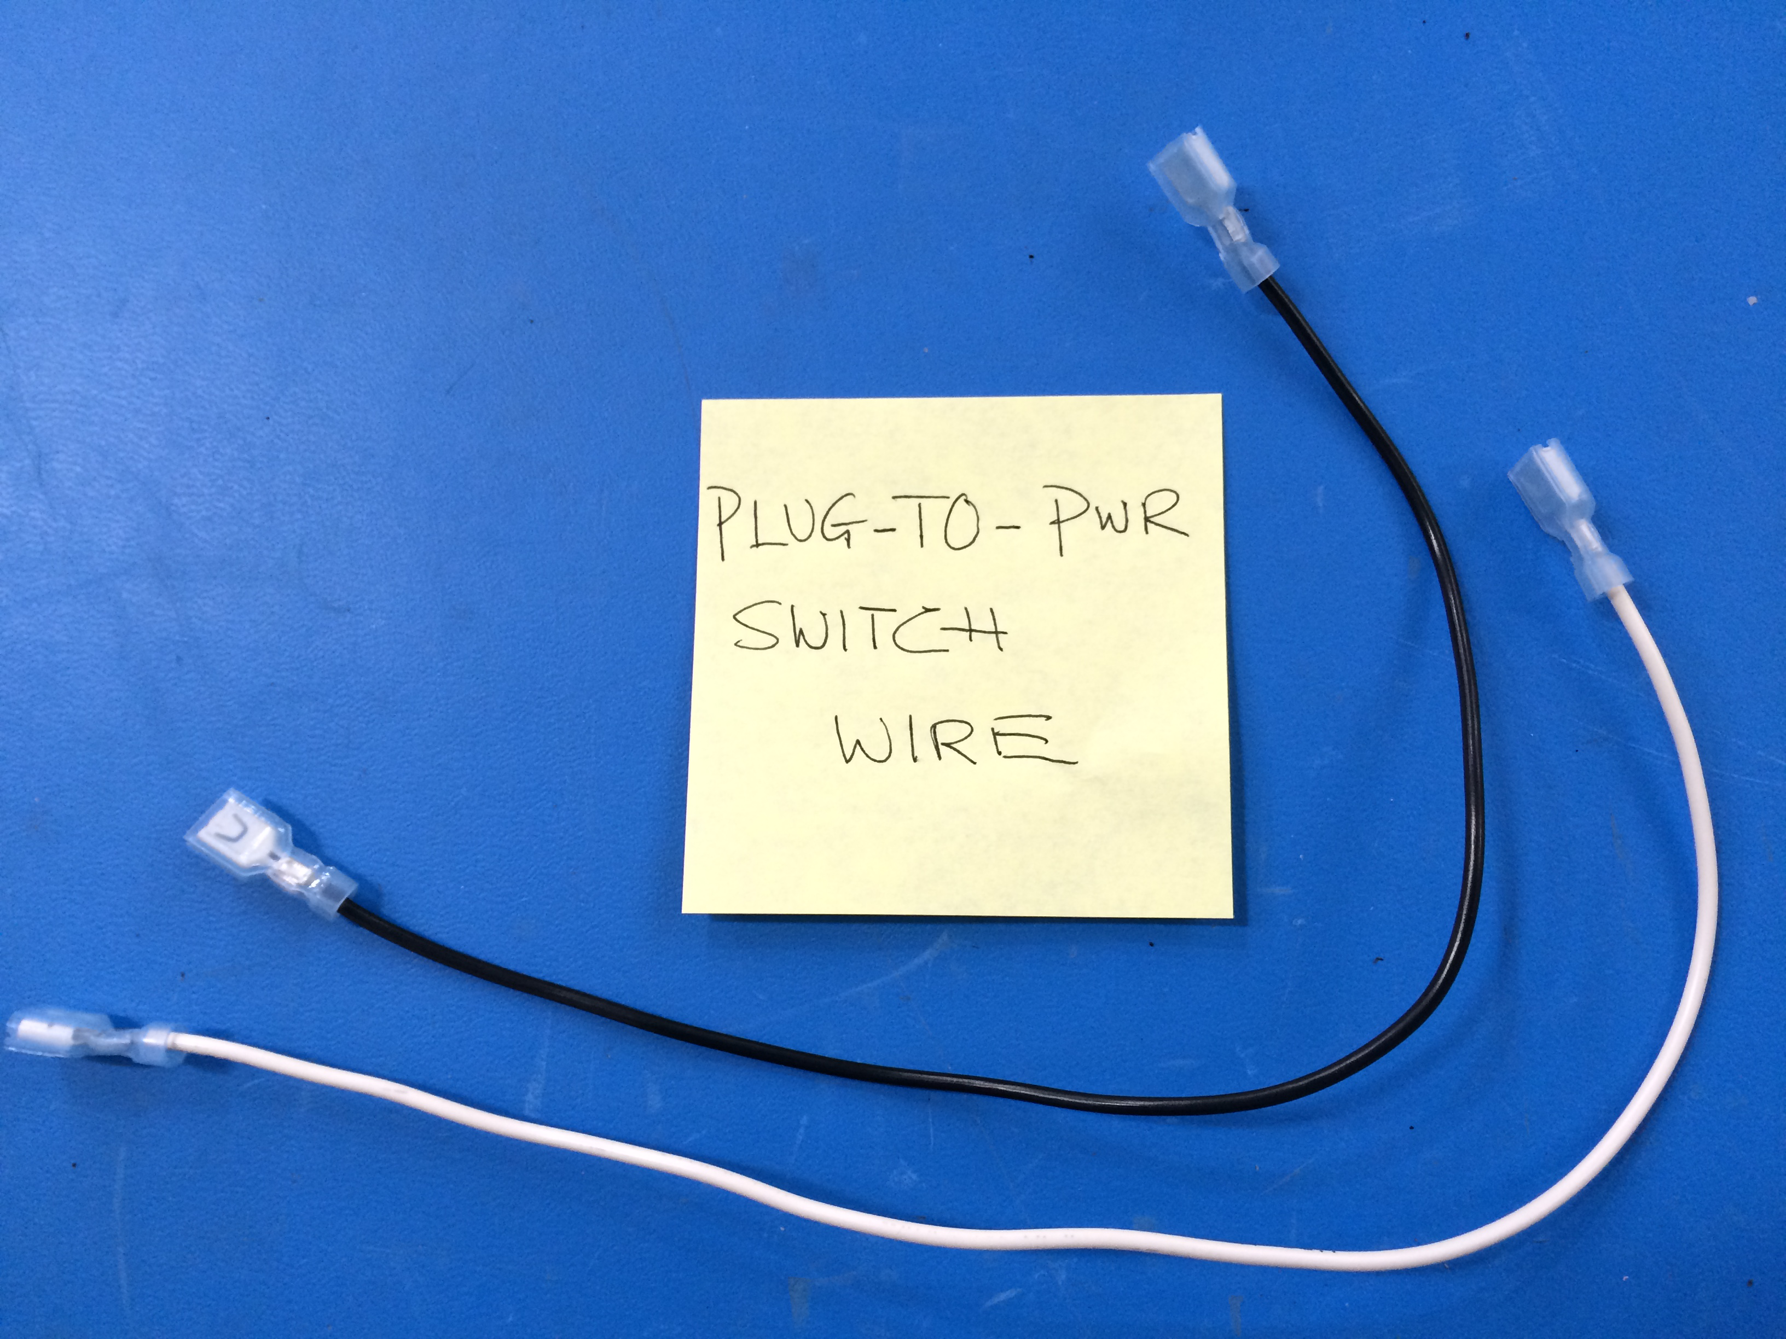
Mini – Daffodil
Plug-To-SW Extension
[EL-MS0143]
Cut to L = 610 mm
[EL-MS0143]
[EL-WR0121]
16AWG BLK
[EL-WR0123]
16AWG WHITE

