Slide 1
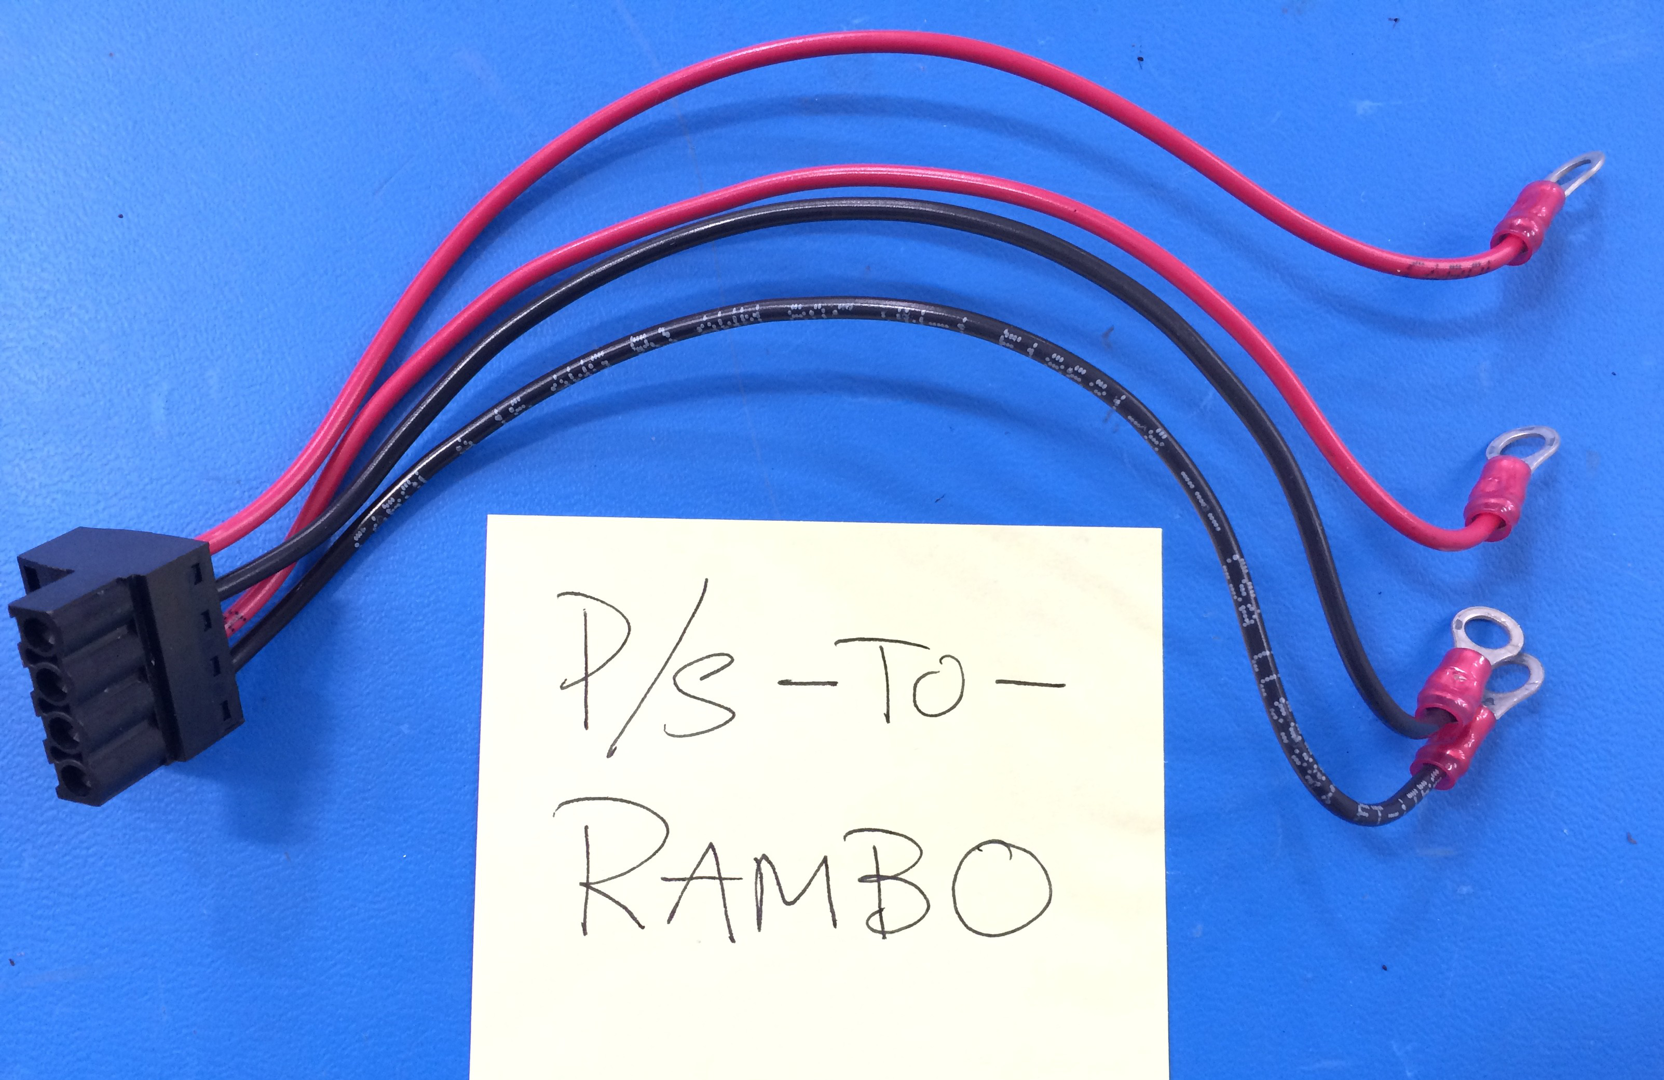
Mini - Daffodil
PS-To-RAMBO Extension
Cut to L = 200 mm
[EL-WR0106]
16AWG RED
[EL-WR0121]
16AWG BLK
[EL-MS0211]
[PC-CN0046]

