Slide 1
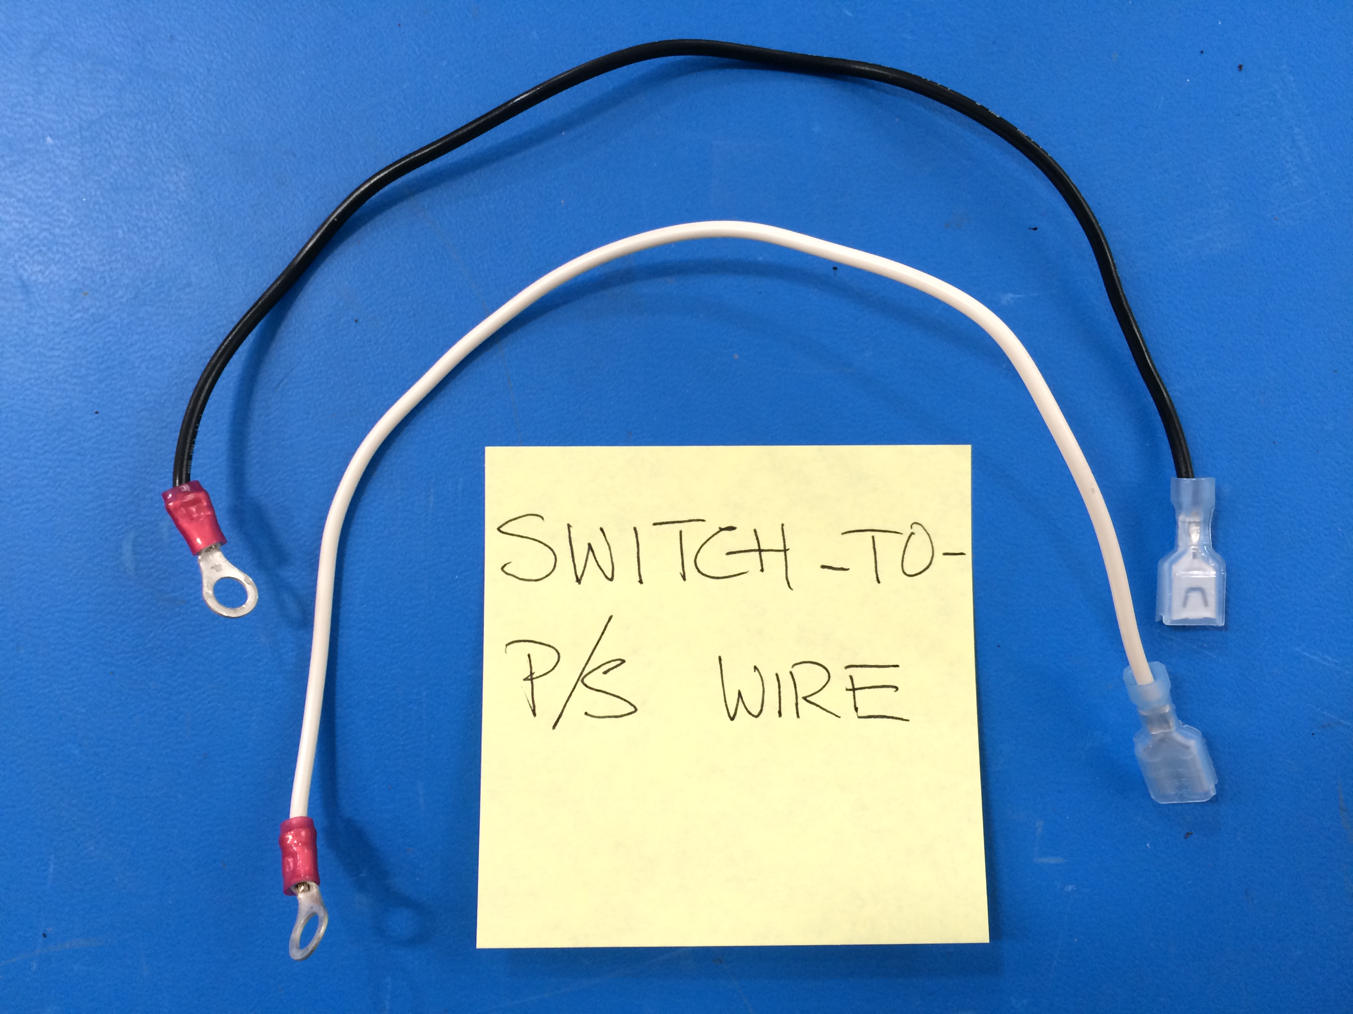
Mini – Daffodil
Switch-To-PS Extension
Cut to L = 260 mm
[EL-WR0121]
16AWG BLK
[EL-WR0123]
16AWG WHITE
[EL-WR0121]
16AWG BLK
[EL-MS0143]
[EL-MS0211]

