Slide 1
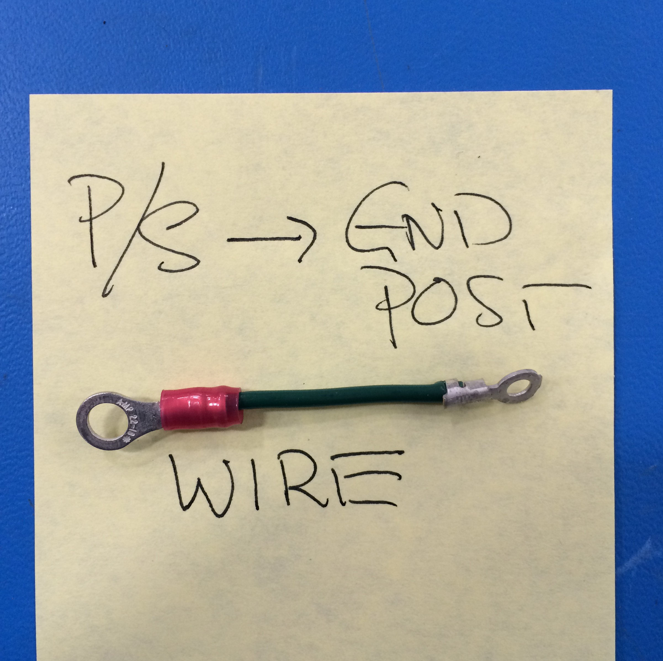
Mini - Daffodil
P/S–TO–GND POST EXTENSION
16 AWG - Green
[EL-WR0122]
[EL-MS0210]
[EL-MS0211]
Cut to length L = 50 mm

