Slide 1
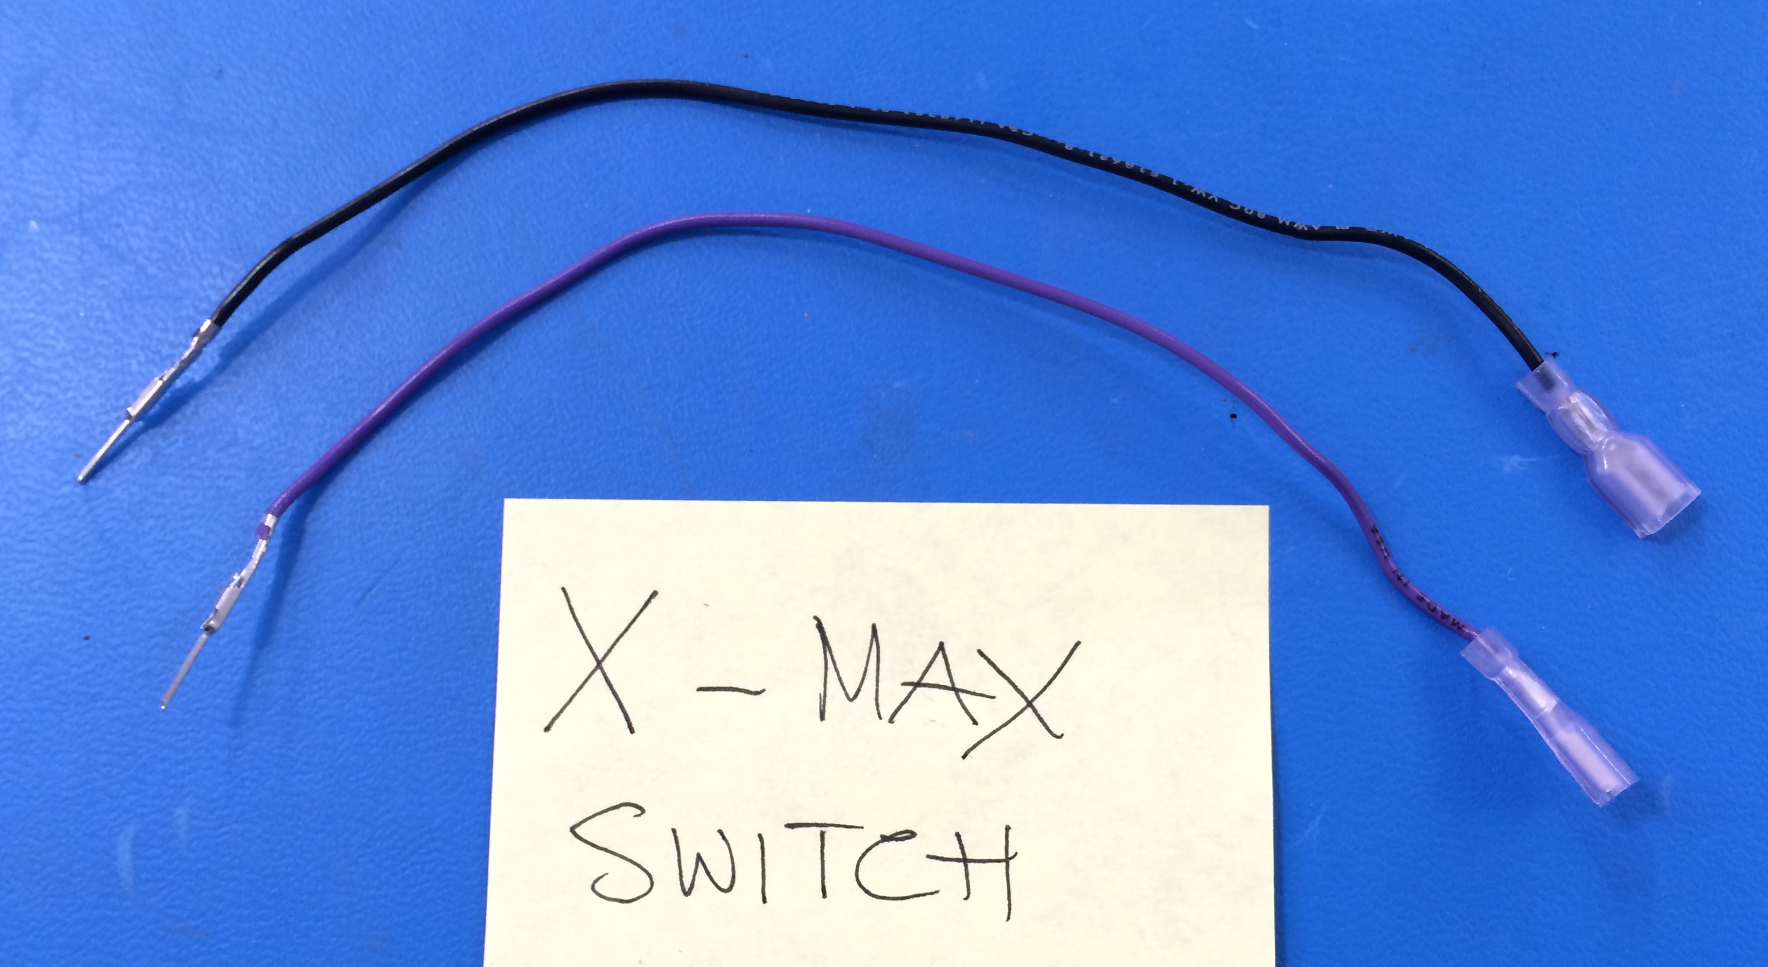
Mini - Daffodil
X-Max Switch Extension
[EL-WR0105]
24 AWG BLK
Cut to L = 160 mm
[EL-WR0120]
24 AWG PURPLE
[EL-MS0205]
[EL-MS0142]
[EL-WR0121]
16AWG BLK
[EL-WR0123]
16AWG WHITE

