Slide 1
Notebooks for python and R
Chris Baldassano
PSYC GR6130, Fall 2019

Slide 2
Jupyter Notebooks
Features for academic research:
Interactive code execution and visualization
Allows investigation of datasets
Can build and test an analysis pipeline piece-by-piece
Can intersperse code with text and equations
Can explain the purpose of the analysis for your future self or for sharing with others
Can use multiple languages, including python and R
Can share static or live versions easily online

Slide 3
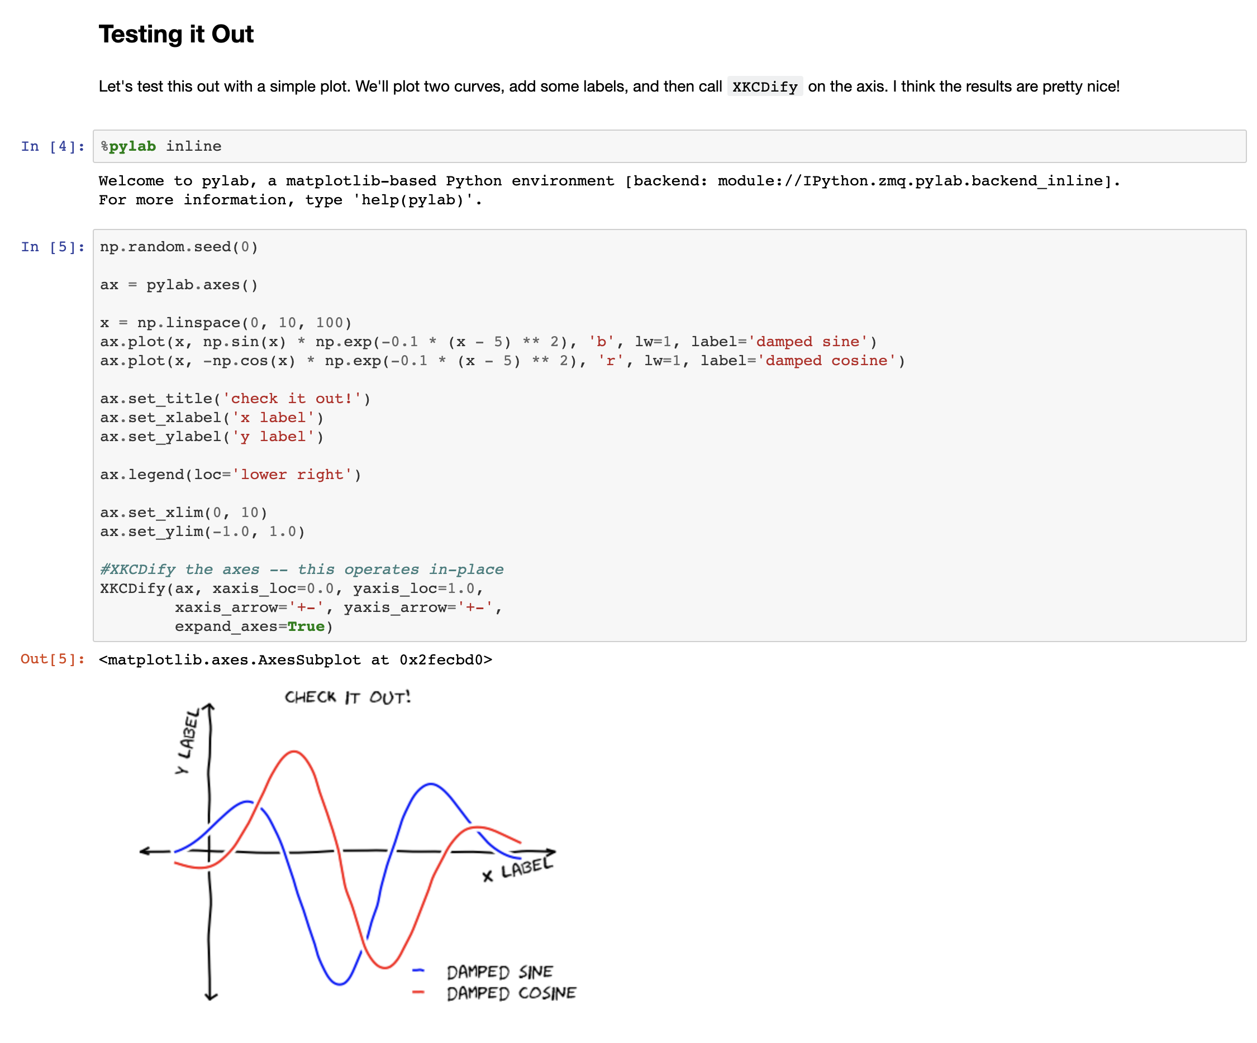

Slide 4
Live Demo

Slide 5
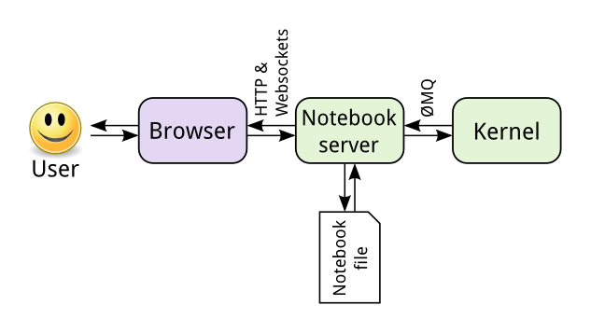
Jupyter architecture

Slide 6
Ipynb Files

Slide 7
Jupyterlab

Slide 8
Magic

Slide 9
Markdown
Allows plain text documents to be rendered with formatting
Design goal: remain as readable as possible (unlike HTML)
Not specific to Jupyter notebooks – this syntax will show up in multiple tools throughout the course

Slide 10
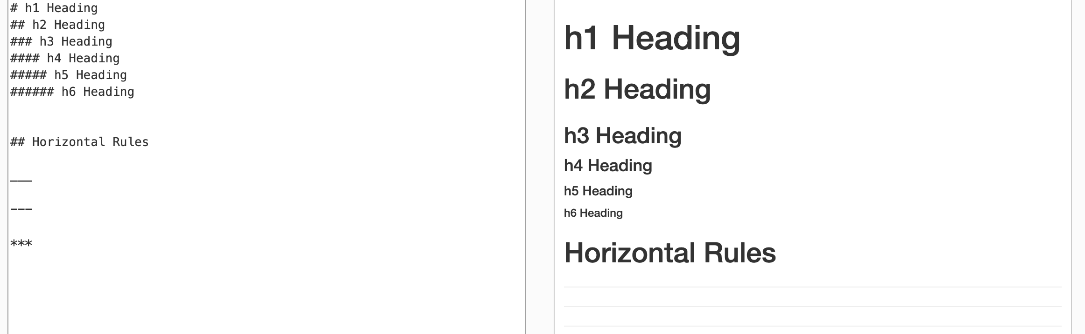
Markdown
Markdown
Rendered HTML

Slide 11
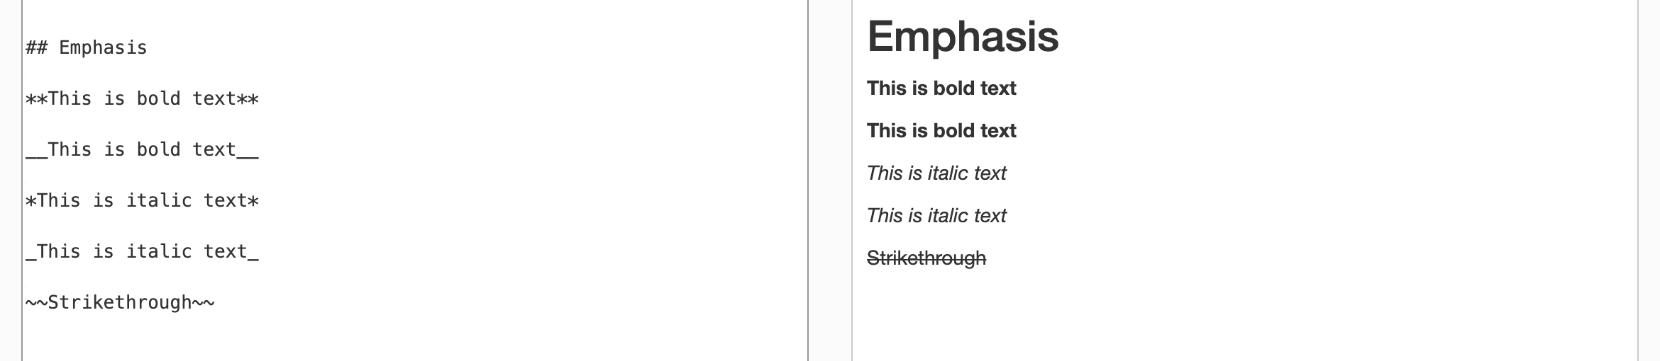
Markdown
Markdown
Rendered HTML

Slide 12
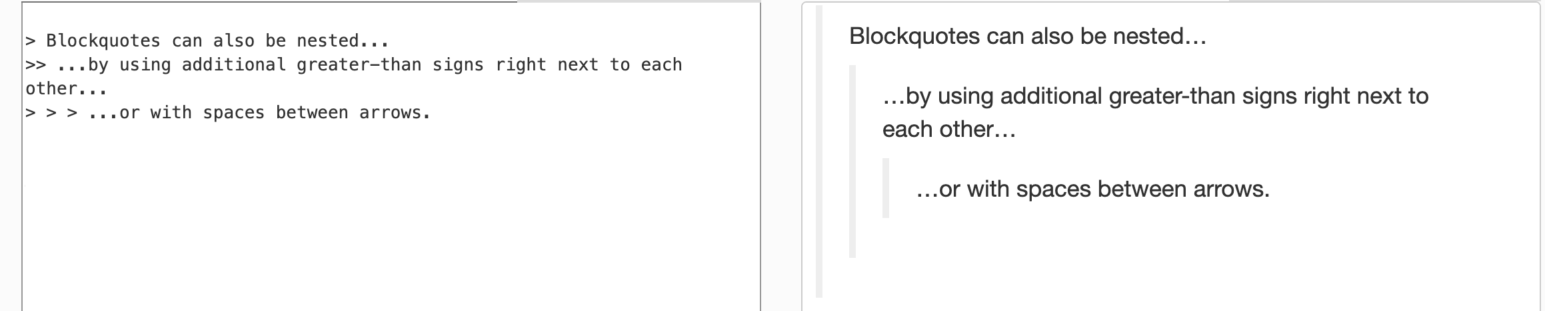
Markdown
Markdown
Rendered HTML

Slide 13
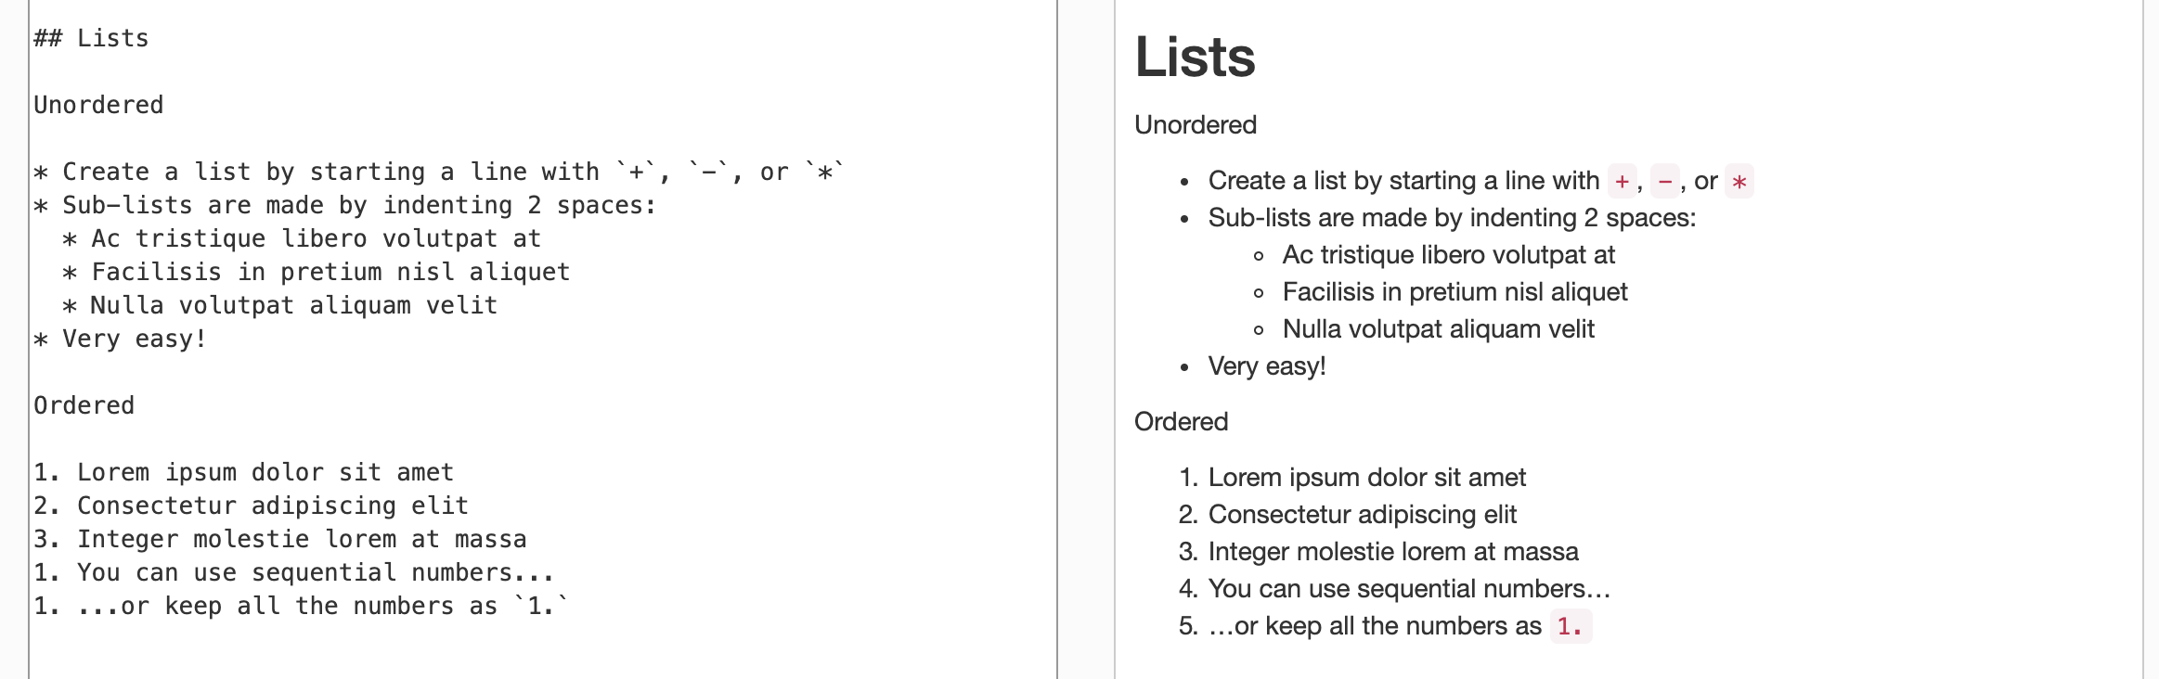
Markdown
Markdown
Rendered HTML

Slide 14
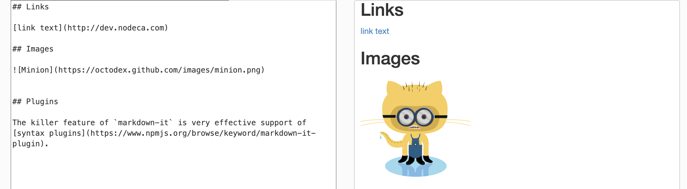
Markdown
Markdown
Rendered HTML

Slide 15
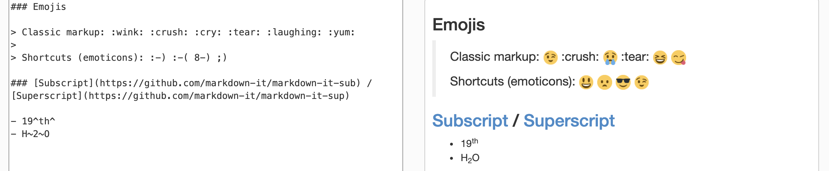
Markdown
Markdown
Rendered HTML

Slide 16
Sharing notebooks
Simply share ipynb files – requires python setup with all libraries
https://nbviewer.jupyter.org/ – renders any python notebook in a public repository as static HTML
Can also run nbviewer command locally to convert notebook to an HTML/pdf file
https://colab.research.google.com/ – opens any public notebook in an interactive environment! (12 hour time limit)
Can also open ipynb files in Google Drive
Can install libraries using “!pip” or !apt-get”
Free access to a GPU
CodeOcean – create an interactive shareable environment
More details later in the semester

