Slide 1
Reproducible Reports
Chris Baldassano
PSYC GR6130, Fall 2019

Slide 2
A simple Reproducible Pipeline
Analysis 1
Plot 1
Final report
Analysis 2
Plot 2
Data
Report text
Markdown file

Slide 3
Why Write a Report this way?
Markdown file contains all the code to perform the analyses and generate the plots in the paper
Clicking a single button turns data into a report, ensuring:
The exact code you used to produce the results is known
Results can be easily re-generated if data changes
https://youtu.be/s3JldKoA0zw

Slide 4
RMarkdown
Rmarkdown (.Rmd) files combine markdown text with R code
Easy to edit with Rstudio (or Rstudio.cloud), can “knit” into many different output formats (pdf, html…)
Plain-text format plays nicely with other tools, e.g. git
or others,
e.g. tex

Slide 5
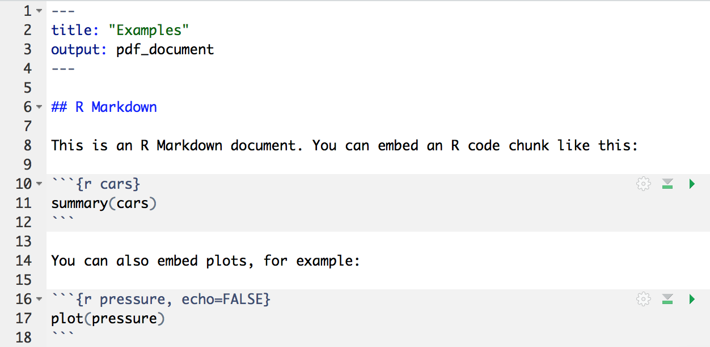
RMarkdown

Slide 6
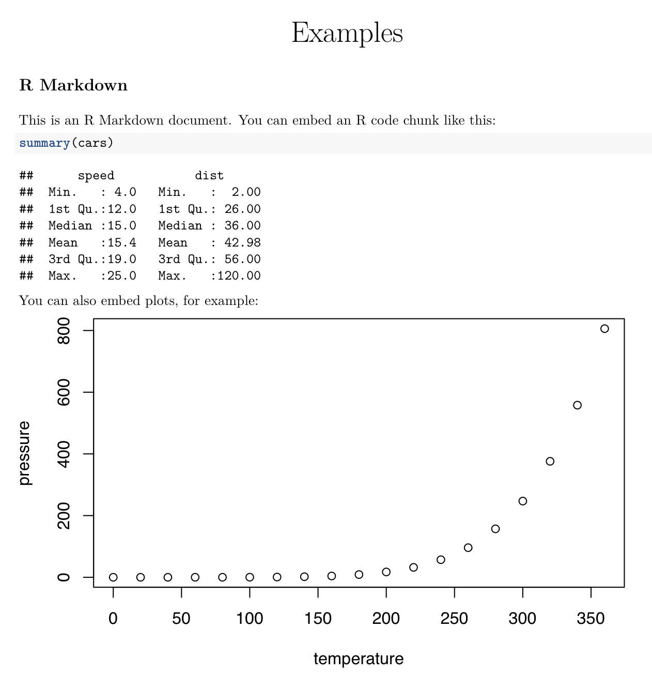
RMarkdown

Slide 7
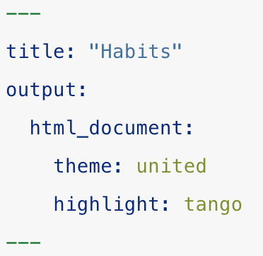
YAML Header
YAML = “YAML Ain’t Markup Language”
Specifies basic document metadata and output options
Note that indentation matters

Slide 8
YAML Header
YAML options:
Output file types (first one is default)
HTML
PDF
Word
Rich Text Format
Author, Date
Themes, highlighting, custom CSS
Global figure size options
…

Slide 9
Code chunk options
Code chunks start with a line with the format:
```{r chunk_name, option1=X, option2=Y}
The chunk_name is optional – it makes error messages more informative, and allows chunk dependencies (see next slide)
Common chunk options:
echo=FALSE – don’t show code in final document, but do show code outputs
include=FALSE – don’t show code or outputs in final document
eval=FALSE – disable chunk from running, but still show code in final document
tidy=TRUE – clean up code using tidy_source()
fig.height, fig.width – control figure output size

Slide 10
Code chunk Caching
By default, knitting will re-run every code chunk every time
Some code chunks might be slow (e.g. data loading or preprocessing), and aren’t frequently being changed
Set cache=TRUE in chunk options to only re-run when code changes
Problem: what if this code didn’t change, but something it depends on did change, so it needs to be re-run?
Can use dependson=‘prev_chunk_name’ chunk option
Use autodep to guess dependencies automatically: opts_chunk$set(cache=TRUE, autodep = TRUE)

Slide 11
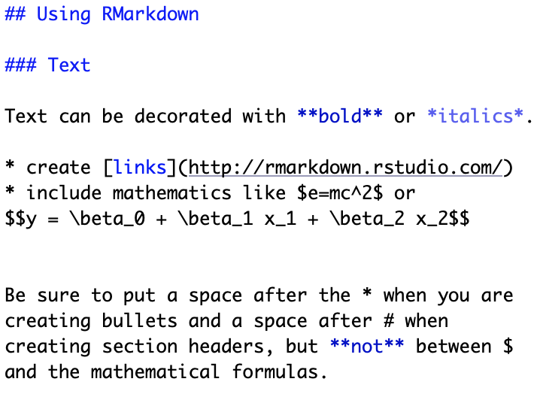
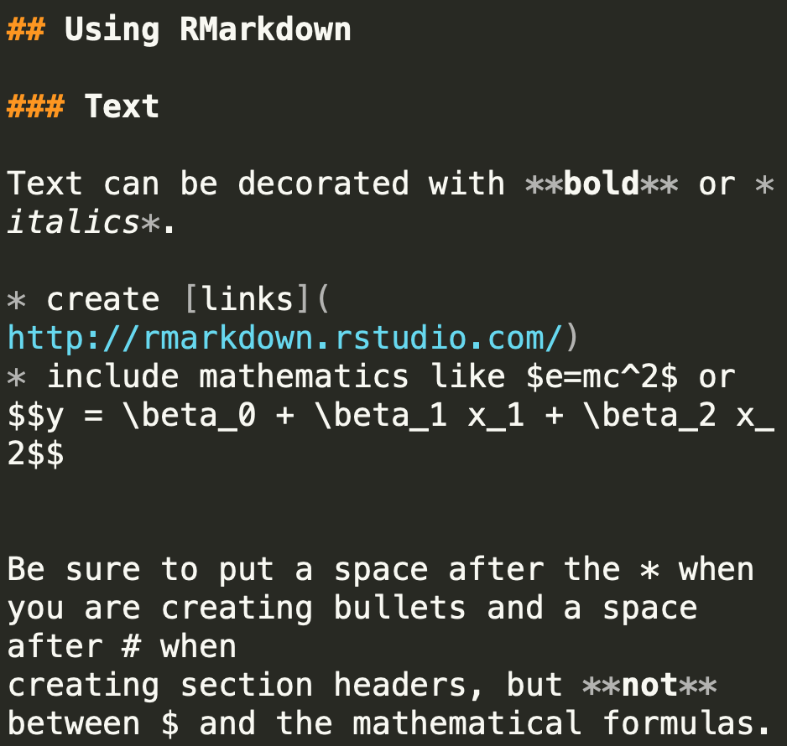
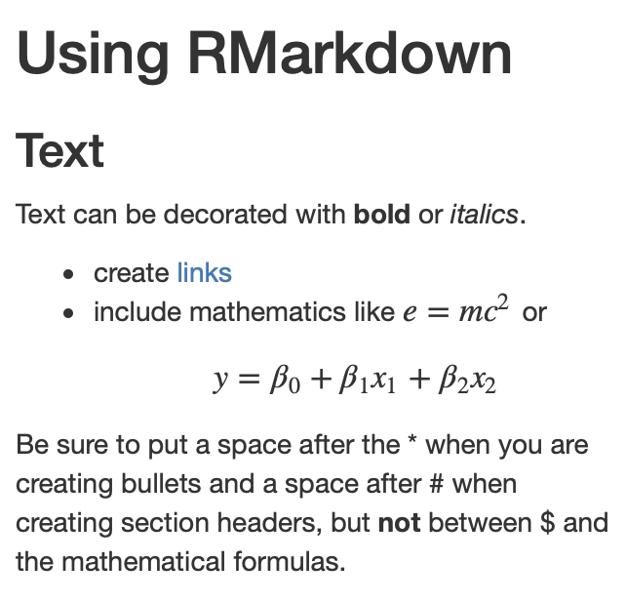
Source.Rmd
PostKnitr.md
Output.html

Slide 12
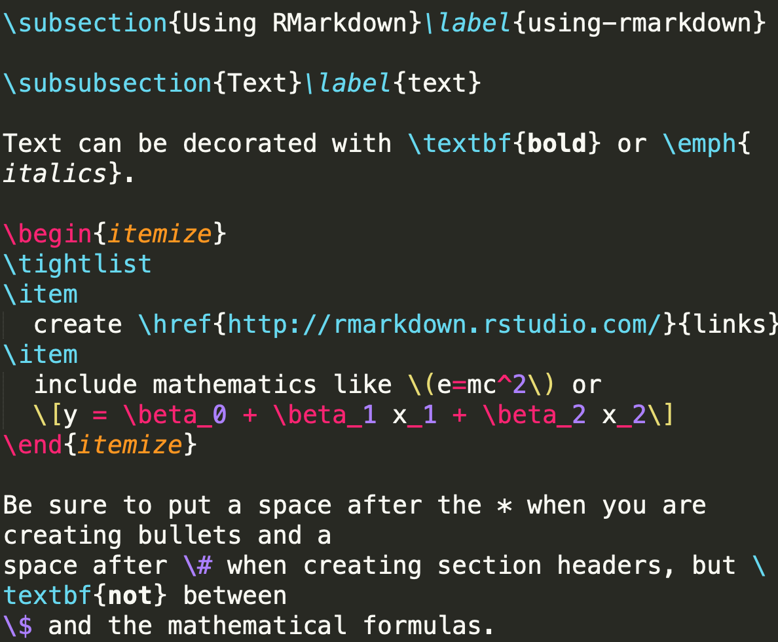
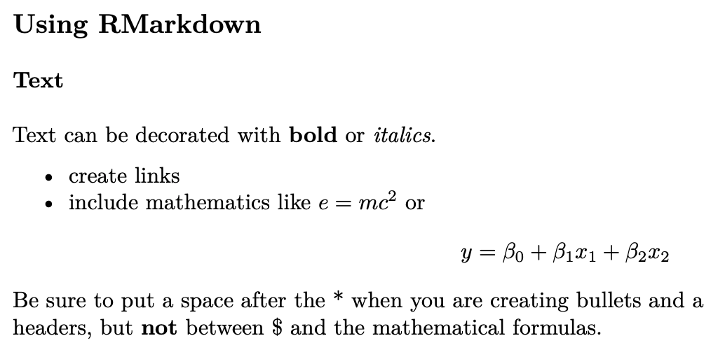
Source.Rmd
PostKnitr.tex
Output.pdf

Slide 13
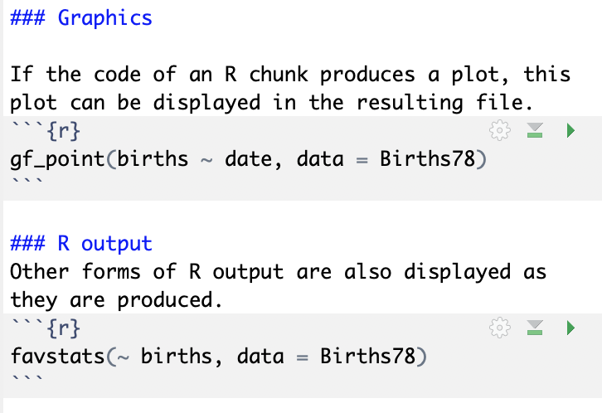
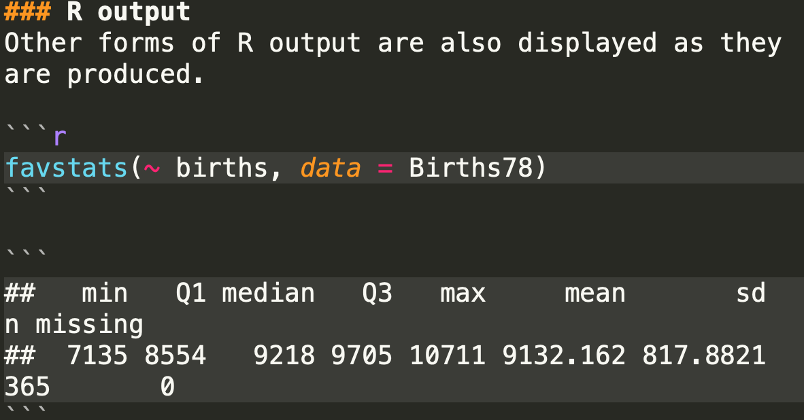
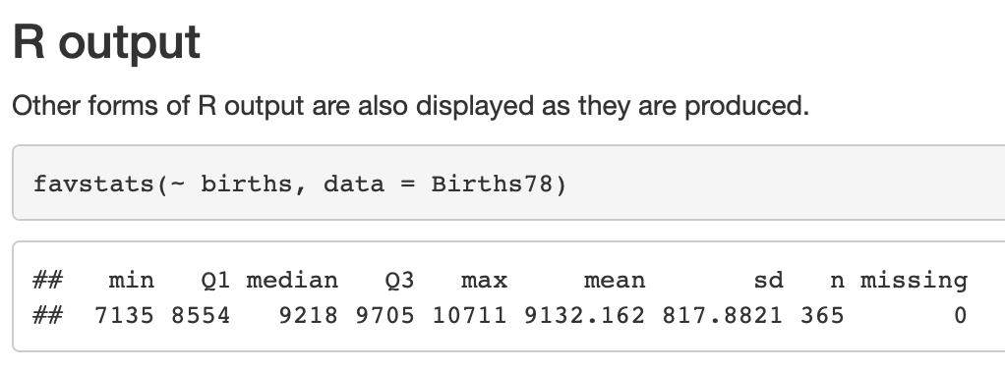
Source.Rmd
PostKnitr.md
Output.html

Slide 14
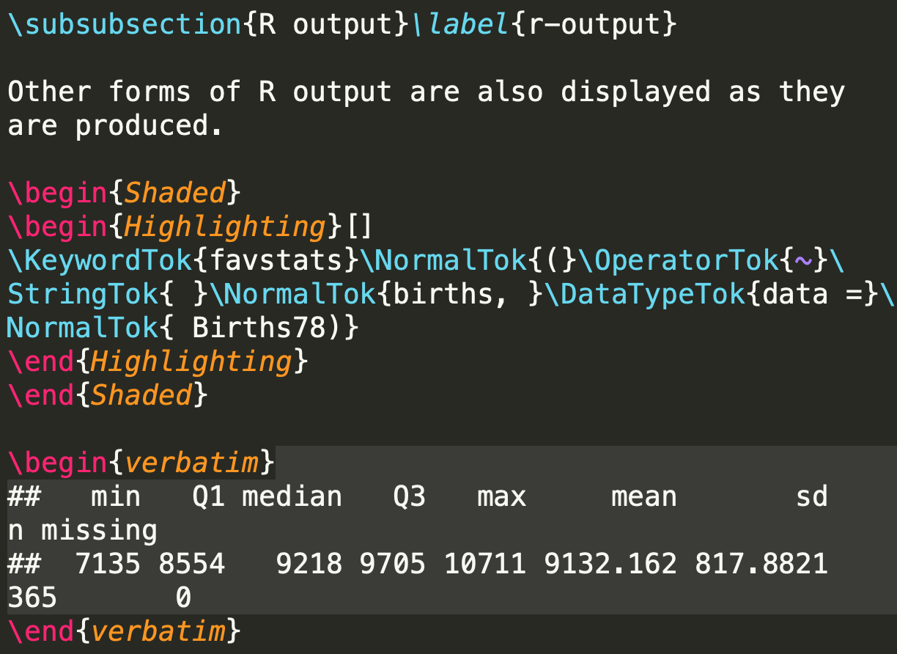
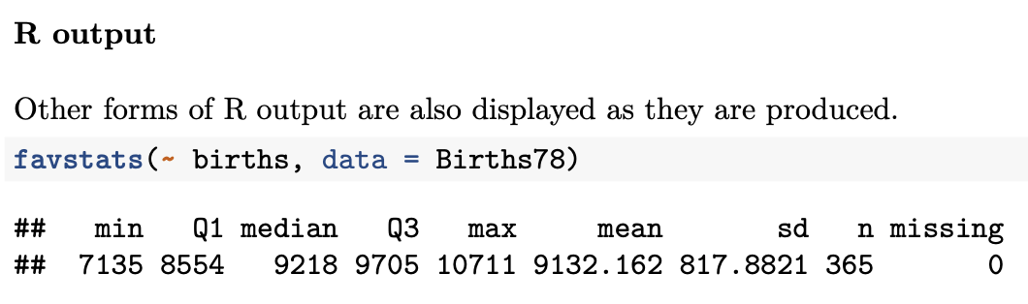
Source.Rmd
PostKnitr.tex
Output.pdf

Slide 15
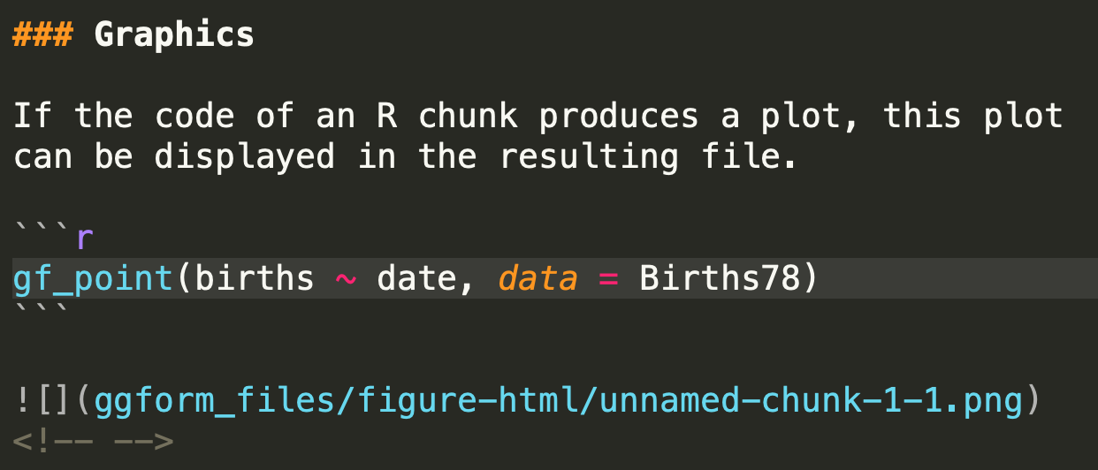
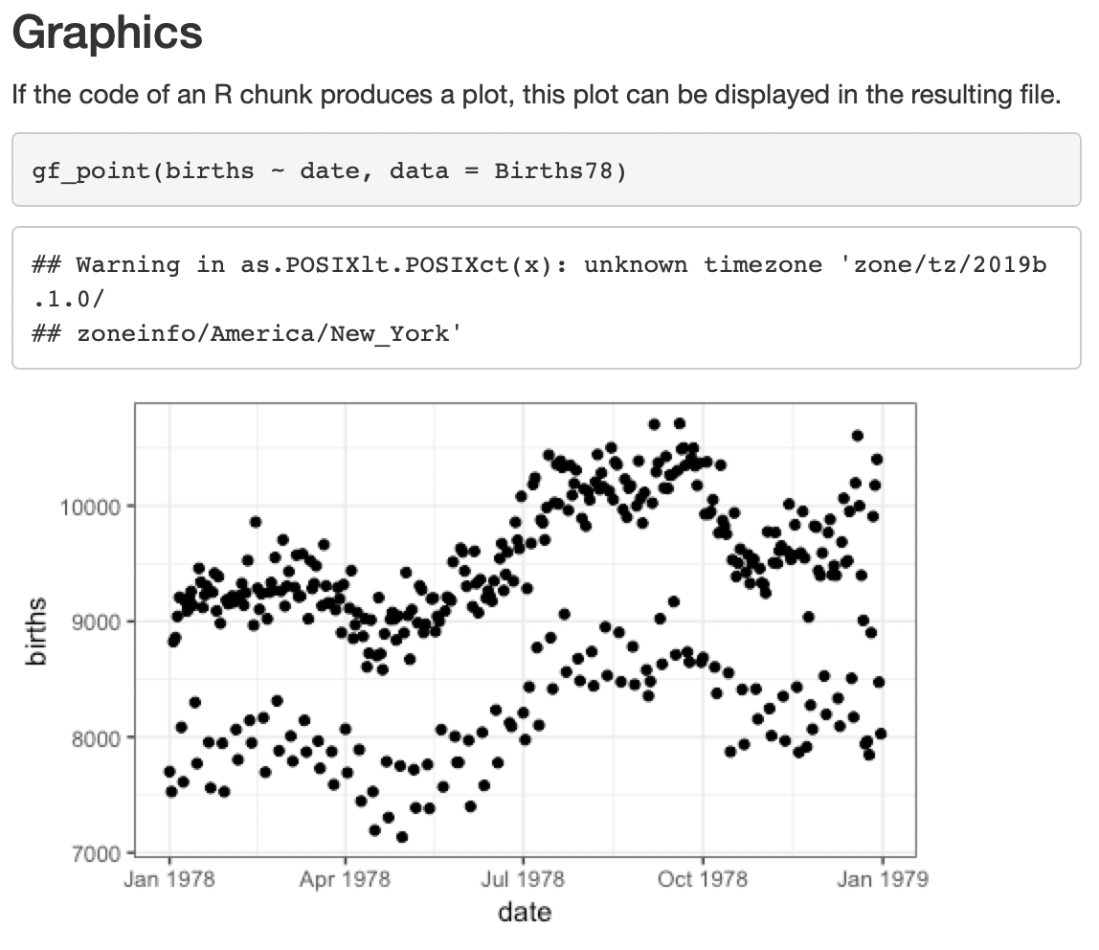
Source.Rmd
PostKnitr.md
Output.html

Slide 16
Self-contained HTML
Note that the default pandoc option is to create “self-contained” html files, in which the css, images, other media, etc. are embedded in the html file as base64-encoded strings
This means you can share the html file by itself without carting around a whole website file structure

Slide 17
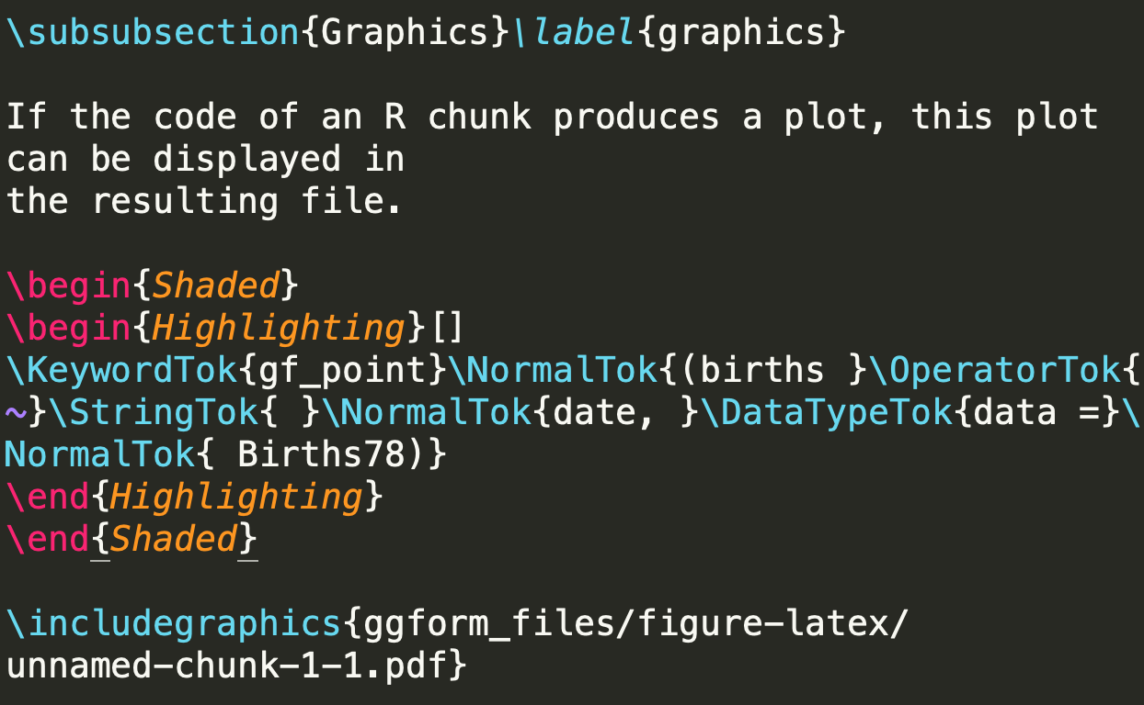
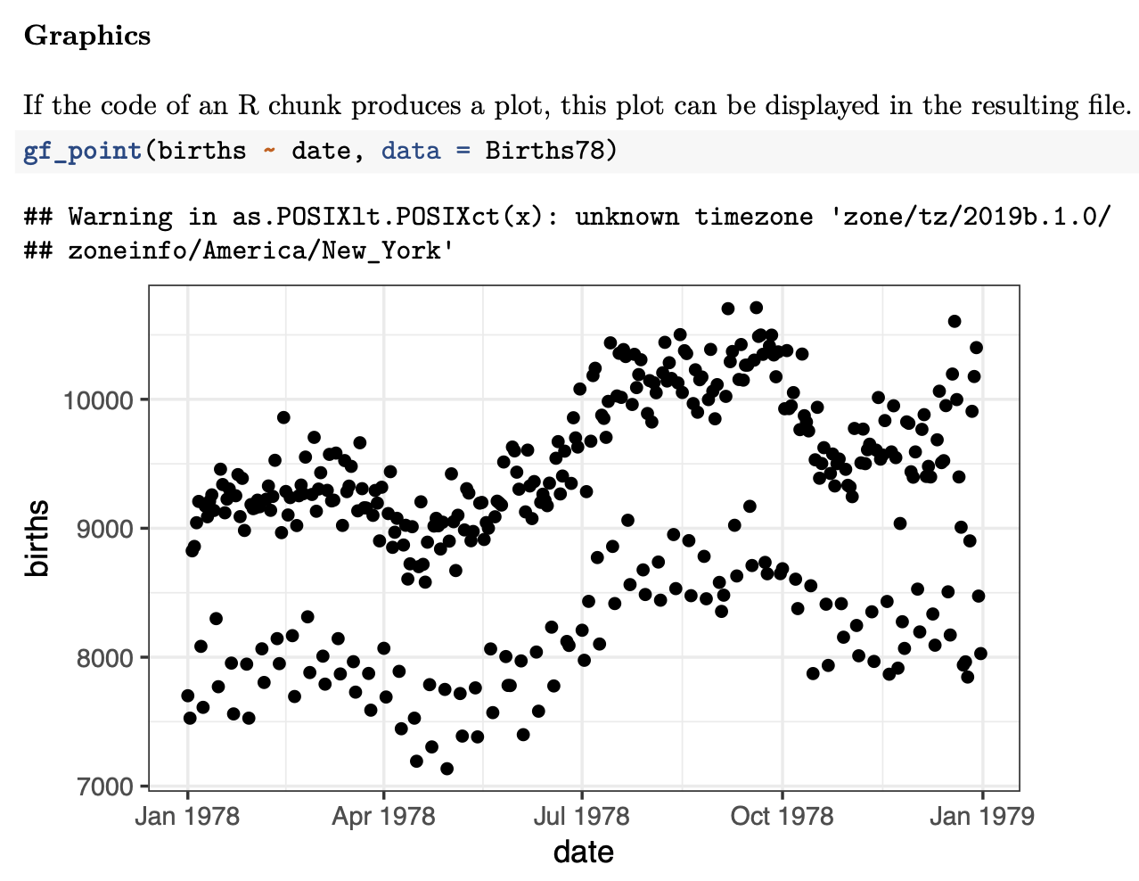
Source.Rmd
PostKnitr.tex
Output.pdf

Slide 18
Shiny APPS
Shiny is a simple framework for embedding interactive tables or plots into your report
Specify input widgets, and a function that updates plot
Requires a Shiny server running in the background, which gets input from widgets and runs the plotting function
RStudio can automatically set up a Shiny server for you locally
Can host shiny apps on shinyapps.io

Slide 19
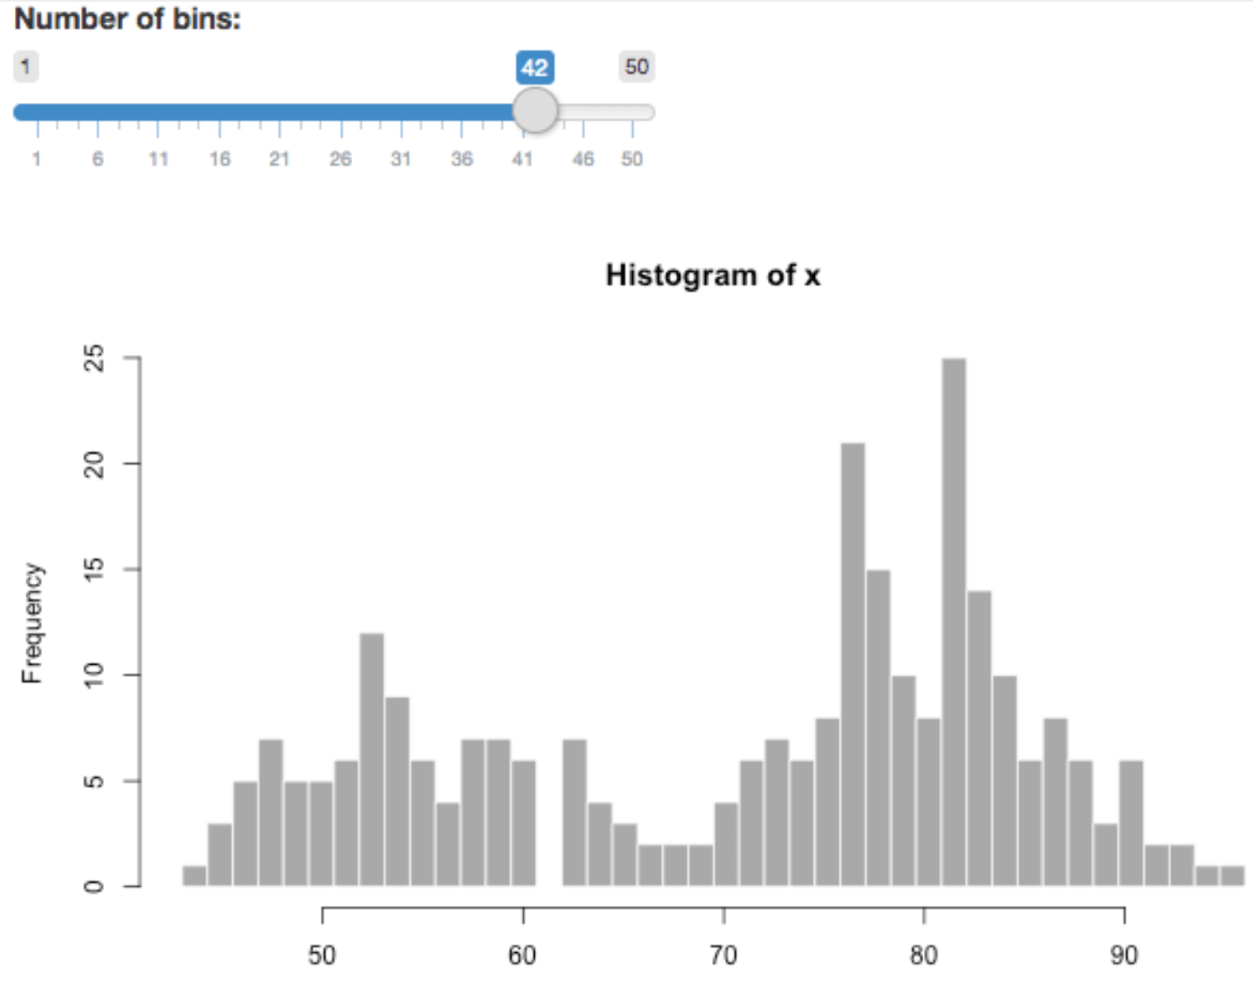
Shiny APPS

Slide 20
Shiny APPS
```{r, echo=FALSE}
sliderInput("bins",
"Number of bins:", 30, min = 1, max = 50)
renderPlot({
x = faithful[, 2] # Old Faithful Geyser data
bins = seq(min(x), max(x), length.out = input$bins + 1)
# draw the histogram with the specified number of bins
hist(x, breaks = bins, col = 'darkgray', border = 'white')
})
```

Slide 21
Python Markdown reports
As is often the case with python, there are a million different ways to do things:
pweave and knitpy: python markdown -> html/docx/pdf
stitch: python/R markdown -> html/docx/pdf
podoc, notedown, jupytext: markdown <-> notebook conversion
ipymd: edit markdown files in jupyter

Slide 22
Caveats with single-file reports
This approach of knitting/weaving a single markdown file doesn’t apply well to a complex project, which may require multiple pieces of software and long-running (or cluster-level) analyses
Next week: approaches for complex reproducible manuscripts
Also: reports/manuscripts are only reproducible if the data and software environment are exactly the same across computers – will be addressed next month

Slide 23
Lab 6
Copy assignment: https://classroom.github.com/a/9JVvLbIy
(I’ve changed some settings that will hopefully make this faster)
Git clone to your machine, and open squirrels.Rmd in RStudio.

