Slide 1
Preventing bugs with pluggable type checking
print(@Readonly Object x) {
List<@NonNull String> lst;
…
}
Michael D. Ernst
University of Washington
http://types.cs.washington.edu/jsr308

Slide 2
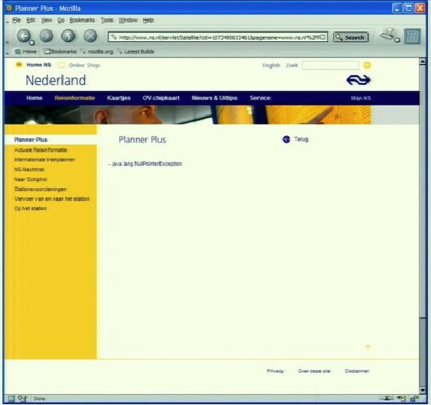
Motivation
java.lang.NullPointerException

Slide 3
Java’s type checking is too weak
Type checking prevents many bugs
int i = “hello”; // type error
Type checking doesn’t prevent enough bugs
System.console().readLine();
NullPointerException
Collections.emptyList().add(“One”);
UnsupportedOperationException
Notes:
Programmers wish to prevent these.

Slide 4
Some errors are silent
Date date = new Date(0); myMap.put(date, “Java Epoch”); date.setYear(70); myMap.put(date, “Linux Epoch”);
Corrupted map
dbStatement.executeQuery(userInput);
SQL injection attack
Initialization, data formatting, equality tests, …
Notes:
Also: UnsupportedOperationException, SQLException

Slide 5
Solution: Pluggable type systems
Design a type system to solve a specific problem
Write type qualifiers in code (or, type inference)
@Immutable Date date = new Date(0);
date.setTime(70); // compile-time error
Type checker warns about violations (bugs)
% javac -processor NullnessChecker MyFile.java
MyFile.java:149: dereference of possibly-null reference bb2
allVars = bb2.vars;
^

Slide 6
Benefits of pluggable types
Improve documentation
Find bugs in programs
Guarantee the absence of errors
Aid compilers, optimizers, and analysis tools
Reduce number of assertions and run-time checks
Possible negatives:
Must write the types (or use type inference)
False positives are possible (can be suppressed)

Slide 7
Sample checkers
Null dereferences
Mutation and side-effects
Equality tests
Locking
Security: encryption, tainting, access control
Aliasing
Strings: localization, regex syntax, ...
Typestate (e.g., open/closed files)
You can write your own!

Slide 8
Using checkers
Designed as compiler plug-ins (i.e., annotation processors)
Use familiar error messages
% javac –processor NullnessChecker MyFile.java
MyFile.java:9: incompatible types. nonNullVar = nullableValue; ^ found : @Nullable String required: @NonNull String

Slide 9
Demos available!
Catch me anytime today or tomorrow

Slide 10
Checkers are effective
Scales to > 200,000 LOC
Each checker found errors in each code base it ran on
Verified by a human and fixed

Slide 11
Comparison: other Nullness tools
 | Null pointer errors |  | False warnings | Annotations written
 | Found | Missed
Checker Framework | 8 | 0 | 4 | 35
FindBugs | 0 | 8 | 1 | 0
Jlint | 0 | 8 | 8 | 0
PMD | 0 | 8 | 0 | 0
Checking the Lookup program for file system searching (4KLOC)
Distributed with Daikon (>100KLOC verified by our checker)
False warnings are suppressed via an annotation or assertion

Slide 12
Checkers are featureful
Full type systems: inheritance, overriding, etc.
Generics (type polymorphism)
Also qualifier polymorphism
Flow-sensitive type qualifier inference
Qualifier defaults
Warning suppression

Slide 13
Checkers are usable
Integrated with toolchain
javac, Ant, Maven, Eclipse, Netbeans
Few false positives
Annotations are not too verbose
@NonNull: 1 per 75 lines
with program-wide defaults, 1 per 2000 liness
@Interned: 124 annotations in 220KLOC revealed 11 bugs
Possible to annotate part of program
Fewer annotations in new code
Inference tools: nullness, mutability

Slide 14
What a checker guarantees
The program satisfies the type property. There are:
no bugs (of particular varieties)
no wrong annotations
Caveat 1: only for code that is checked
Native methods
Reflection
Code compiled without the pluggable type checker
Suppressed warnings
Indicates what code a human should analyze
Checking part of a program is still useful
Caveat 2: The checker itself might contain an error

Slide 15
Annotating libraries
Each checker comes with JDK annotations
Typically, only for signatures, not bodies
Finds errors in clients, but not in the library itself
Inference tools for annotating new libraries

Slide 16
SQL injection attack
Server code bug: SQL query constructed using unfiltered user input
query = “SELECT * FROM users ”
+ “WHERE name=‘” + userInput + “’;”;
User inputs: a’ or ‘t’=‘t
Result:
query ⇒ SELECT * FROM users
WHERE name=‘a’ or ‘t’=‘t’;
Query returns information about all users

Slide 17
Taint checker
@TypeQualifier
@SubtypeOf(Unqualified.class)
@ImplicitFor(trees = {STRING_LITERAL})
public @interface Untainted { }
To use it:
Write @Untainted in your program
List getPosts(@Untainted String category) {…}
Compile your program
javac -processor BasicChecker -Aquals=Untainted MyProgram.java

Slide 18
Defining a type system
@TypeQualifier
public @interface NonNull { }

Slide 19
Defining a type system
Type qualifier hierarchy
Type introduction rules
Other type rules
@TypeQualifier
public @interface NonNull { }

Slide 20
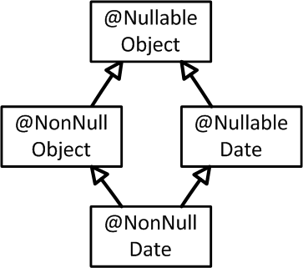
Defining a type system
Type qualifier hierarchy
Type introduction rules
Other type rules
@TypeQualifier
@SubtypeOf( Nullable.class )
public @interface NonNull { }

Slide 21
Defining a type system
Type qualifier hierarchy
Type introduction rules
Other type rules
@TypeQualifier
@SubtypeOf( Nullable.class )
@ImplicitFor(trees={ NEW_CLASS,
PLUS,
BOOLEAN_LITERAL, ... } )
public @interface NonNull { }
new Date()
“hello ” + getName()
Boolean.TRUE

Slide 22
Defining a type system
synchronized(expr) {
…
}
Type qualifier hierarchy
Type introduction rules
Other type rules
void visitSynchronized(SynchronizedTree node) {
ExpressionTree expr = node.getExpression();
AnnotatedTypeMirror type = getAnnotatedType(expr);
if (! type.hasAnnotation(NONNULL))
checker.report(Result.failure(...), expr);
}
Warn if expr may be null

Slide 23
Pluggable type-checking
Java 7 syntax for type annotations
Write in comments during transition to Java 7
Checker Framework for creating type checkers
Featureful, effective, easy to use, scalable
Prevent bugs at compile time
Create custom type-checkers
Learn more, or download the Checker Framework: http://types.cs.washington.edu/jsr308 (or, web search for “Checker Framework” or “JSR 308”)
Notes:
Catch me anytime for a demo.

